Slide 1

✨ GRADUATION PROJECT · 2025 – 2026
Plan Smart.
Study Better.
StudyNexus is an AI-powered, cross-platform study planner developed as a graduation project for the Department of Computer Science at the Islamic University of Lebanon.
🚀 AI Scheduling
💫 Behavior Analytics
🔥 Social Motivation
By Malak Yazbek

Slide 2

AGENDA
Presentation Overview
The Vision
The Experience
01
03
The problem students face, and the idea behind StudyNexus.
Features that keep students planning, focused, and connected.
The System
04
What's Ahead
02
Architecture, technology stack, and how the AI actually works.
Smarter evaluation, collaborative studying, and future plans.

Slide 3
THE PROBLEM
The Challenges of Modern Learning
Scattered Tools
No Real Feedback
01
03
Handwritten notes, disconnected apps, and separate planners.
Existing tools track completion, but provide little insight into learning effectiveness.
Manual Effort
04
The Need
02
Building and maintaining a schedule takes constant energy.
A centralized, intelligent platform that adapts to the student.

Slide 4

THE SOLUTION
Introducing StudyNexus
Flutter Mobile App
PHP Admin Portal
📱
🖥️
Students plan, track, and connect — day, week, and month.
Monitors AI-generated schedules and insights through an administrative dashboard.
Firebase Backbone
Gemini 2.5 Flash
🔥
✨
Firestore, Auth & Realtime DB keep everything in sync.
Builds schedules and generates coaching insights from real data.

Slide 5
THE VISION
Building a Smarter Future for Education
Student + AI + Supervisor
Governance By Design
01
03
A three-way relationship, not a black box.
Dual AI-supervision dashboards with permanent audit logs.
Grounded Personalization
04
Cost-Aware Performance
02
Every recommendation comes from real behavioural data.
Real-time sync that feels instant without driving up costs.

Slide 6
RELATED WORK
Meet Our Inspirations
Notion & Todoist
MyStudyLife & StudySmarter
📝
🎓
Flexible or reliable — but no academic structure or behaviour model.
Purpose-built for school, yet analytics stay purely descriptive.
Forest & Study Bunny
Motion & Reclaim.ai
🌲
📅
Great at sustaining focus, blind to what's actually being studied.
Automates time-blocking, but treats every task the same.

Slide 7
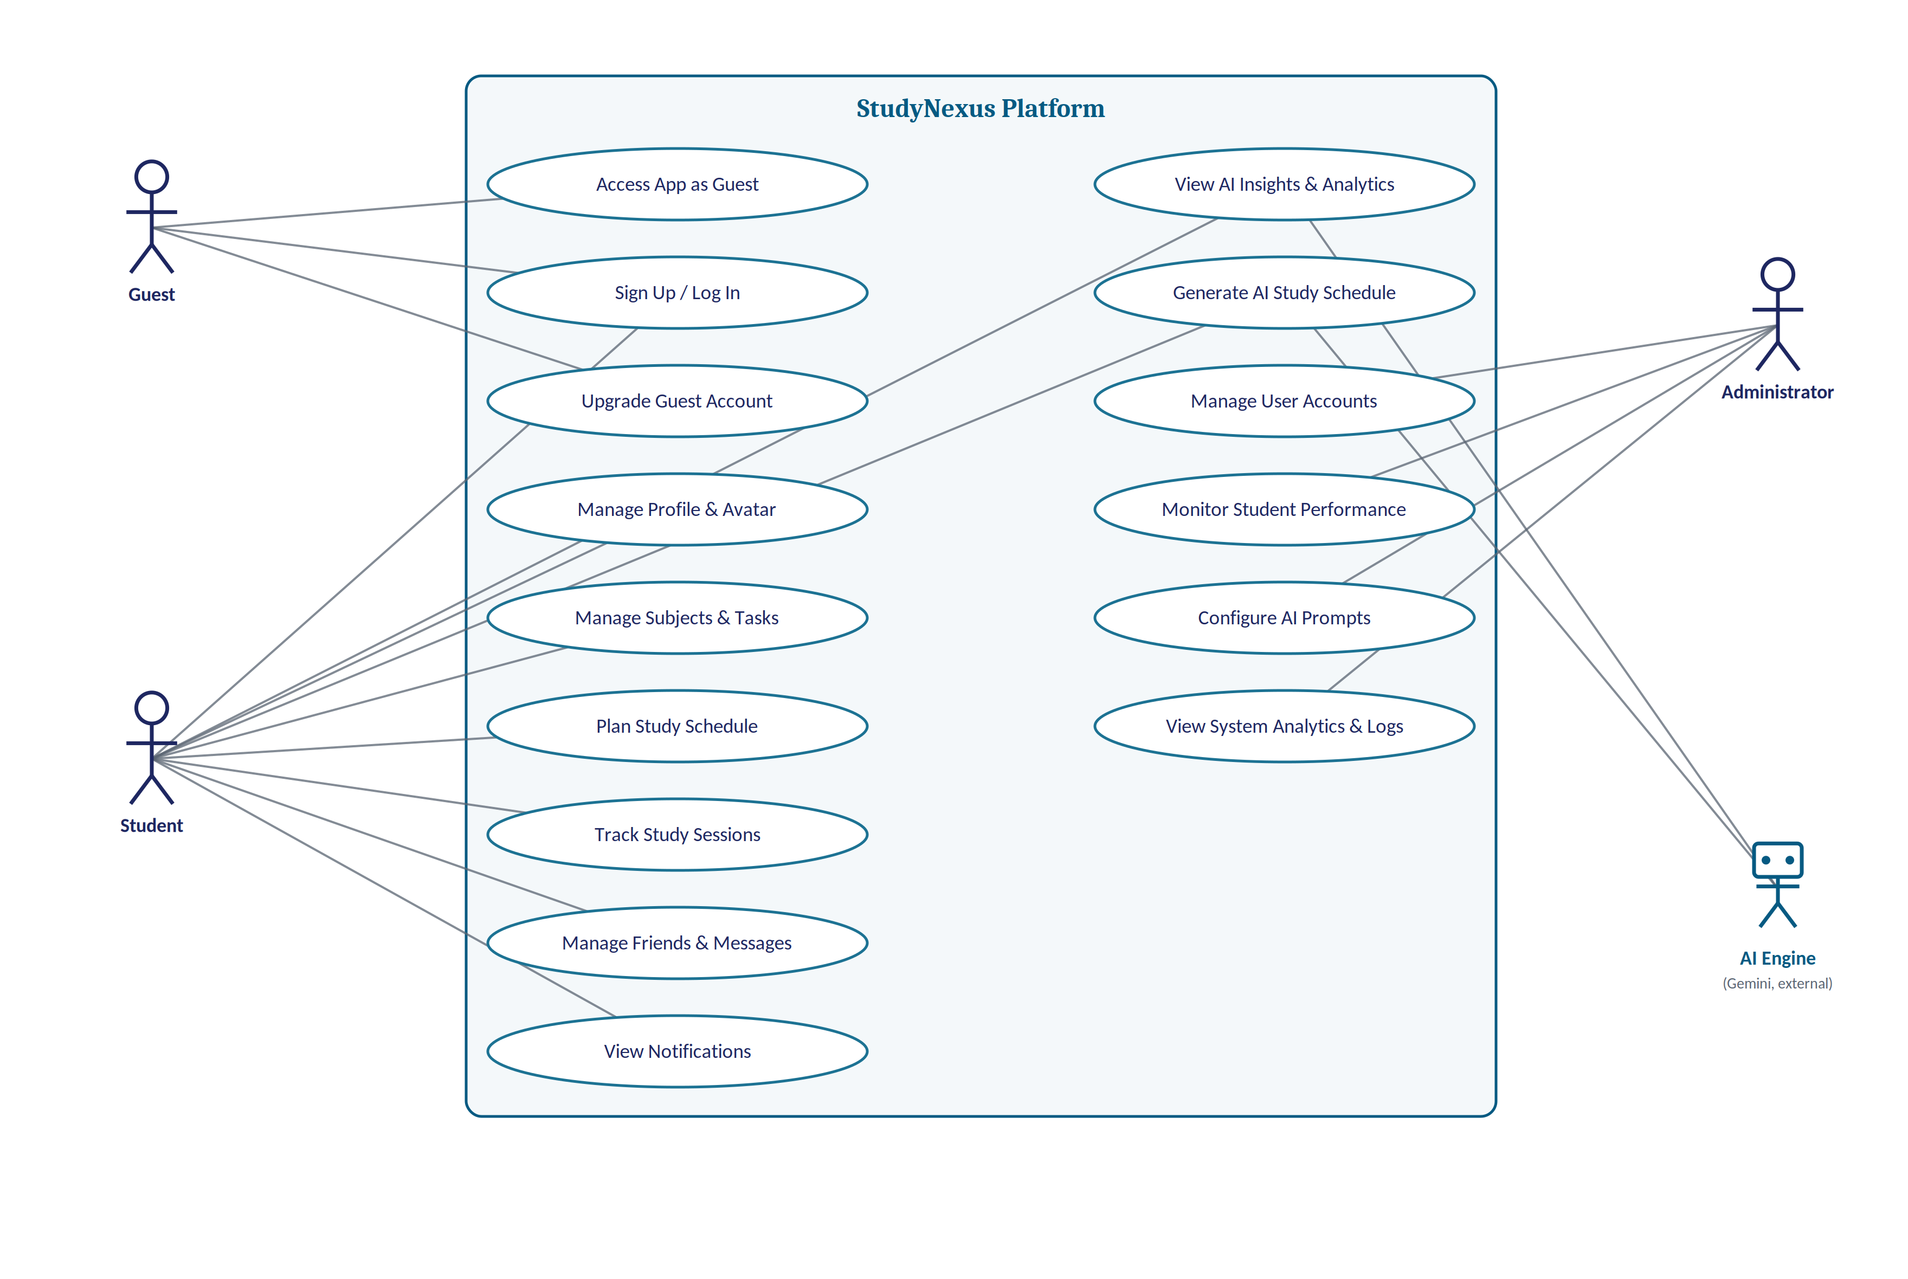
SYSTEM MODELING
Understanding the System
Use Case Diagram — how Student, Guest, and Administrator actors interact across StudyNexus

Slide 8
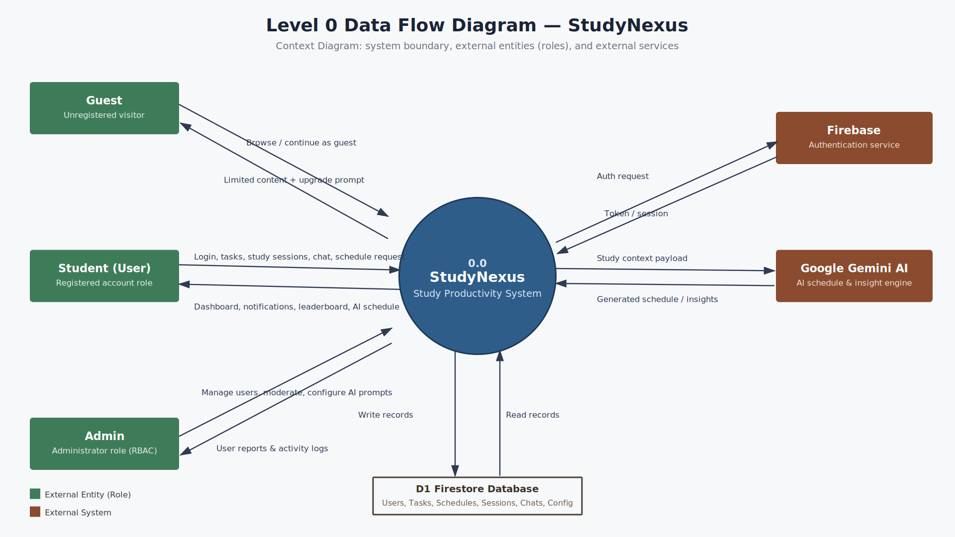
SYSTEM MODELING
How Data Flows Through StudyNexus
Data Flow Diagram — from authentication and planning to AI insight generation and admin control

Slide 9
THE STACK
The Technology Behind the Innovation
Flutter & Dart
PHP
🎯
🐘
Cross-platform mobile app for Android & iOS.
Admin logic, CSRF protection, Firestore REST integration.
Gemini 2.5 Flash
Firebase
🤖
☁️
AI scheduling & insights with strict JSON validation.
Firestore, Authentication & Realtime Database.

Slide 10
THE AI ENGINE
Intelligence That Adapts to Every Student
Real Constraints
Explainable by Design
01
03
Sleep protection, 30–90 minute blocks, and spaced repetition.
Deterministic scores pair with generative recommendations.
60 Days of Context
04
Cache-First
02
Behaviour analysed across 7-, 30-, and 60-day windows.
Insights regenerate only once 7+ days stale, saving cost and time.

Slide 11

UNDER THE HOOD
Designed to Scale
60
3x
18
Days of behavior analyzed per insight
Retry attempts with exponential backoff
AI response fields validated before storage
🟢 REAL-TIME FIRESTORE SYNC

Slide 12
PERFORMANCE ANALYTICS
Transforming Study Data into Actionable Insights
Nexus Analytics
Deep Learning Trends
01
03
Consistency heatmaps, subject intelligence, time-efficiency.
Best study times, and productivity across session length.
Streaks & Scores
04
Rule-Based Clarity
02
Focus, productivity, and efficiency from real session data.
Transparent, explainable messages — never a black box.

Slide 13
SOCIAL FEATURES
Connecting Students Beyond the Classroom
Smart Friend Discovery
Weekly Leaderboard
01
03
Weighted by mutual friends, major, and study level.
Ranked by weekly study minutes, refreshed every Monday.
Real-Time Messaging
04
Streaks & Avatars
02
Direct conversations between connected friends.
Motivation mechanics that reward consistency.

Slide 14
THE DAILY LOOP
From Planning to Productivity
Multi-View Planner
Pomodoro & Manual Timers
01
03
Day, Week & Month, manual or AI-generated.
Automatic break tracking built into every session.
Conflict-Free Scheduling
04
Reflect & Export
02
Overlap validation runs before every save.
Post-session feedback, plus polished PDF study plans.

Slide 15
WHAT'S NEXT
The Future of StudyNexus
AI Task Evaluation
Transparent Scoring
🧠
💬
NLP estimates task completion from a short student reflection rather than relying on self-reported guesses.
AI explains which objectives were met — and which weren't.
Collaborative Groups
Privacy-First Verification
👥
🔒
Shared sessions with peers for motivation & accountability.
Consent-based snapshots replace continuous video calls.

Slide 16

Plan Smart.
Study Better.
StudyNexus — Graduation Project by Malak Yazbek, supervised by Dr. Mokhaiber Dandash
Thank You
Islamic University of Lebanon · Dept. of Computer Science · 2025 – 2026

