Slide 1
DropCop
Drop a deal, Cop a deal
Team Members:
Pavandip Singh
Mohammed Alam
Justin Opraseuth

Slide 2
The real problem
Two part problem- rift between consumer and vendor
The communication between vendors and consumers lacks
Failure to target right audiences
Waste of money and time for both consumer and vendor

Slide 3
The two part problem
Local Vendors have extra merchandise
Local Vendors need better sales
Local Vendors don’t have access to market
People are searching for big discounts
People allocating too much time searching
People can’t afford things they want

Slide 4
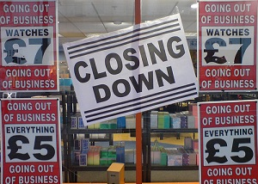

Why is this an Issue?
Shops are closing down due to low business income
This is because people buy from cheaper stores such as Walmart, Target…
People lose money in business, eventually could lose their homes etc...
People don’t have the time these days to go out and shop
A lot of people have begun shopping online at big stores that have cheap prices
Even the people who shop in store, don’t have time to look at different stores, they just go to brick and mortar stores to shop

Slide 5

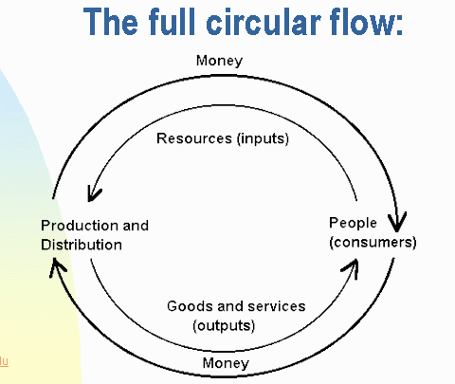
The Big WHAT IF and Did You Know?
What if we could find a way for local vendors to compete against big companies like walmart, target, best buy etc…?
Doesn’t everyone deserve a second chance?
What if we can stop bigger companies that are disrupting the economy?
Did you know that distributing money of local people to local markets stabilizes the economy?
Did you know that job growth rate is attributed to small business growth?
“Our findings highlight the important role of business startups and young businesses in U.S. job creation.”-John C. Haltiwanger, Ron S. Jarmin, Javier Miranda

Slide 6
Economic Stimulus
The founders of DropCop would like for American dollars to be spent locally
Vendors will be able to sleep easier with increased revenues
Increased sales will also generate increased taxes for local governments
Eventually jobs will be created

Slide 7

A similar scenario - Groupon
Groupon created a site where restaurants have gained massive exposure
Through the discounts offered, profitability at these establishments has increased
After a restaurant is featured on Groupon, its brand image is boosted
After Groupon debuted, they have since branched to include products and travel

Slide 8
Solution: What is DropCop?
“Drop a deal, Cop a deal” (Slogan)
Application to connect local vendors with online shoppers
Allows people to see what community deals they have available locally
Local Vendors post products and consumers post online deals

Slide 9

Why Choose Us?
As stated previously, the merchants on our site are all small businesses
When making a purchase, one will feel better about themselves
Share the wealth
The easy-to-navigate app allows for a pleasant purchase experience

Slide 10
WhatWhat is there to implement?
USE CASES
1. Buy products: allow Users to buy products with simple checkout process.
2. Submit online deals: Allow users and vendors to submit third party deals that are noteworthy for community benefit.

Slide 11
Requirements of Business Side
Technology
Users will need to have an iOS device to use the application
Improvement in the accuracy of network is required for everyone to have a smooth experience with the interface.
Integration between different smartphones to help make us sure that our application is running smooth with all its functionalities.
Economics
As prices rise for most items, more and more people will want to find cheaper products or cheaper deals on products. Vendors will most likely make deals to increase their sales with the laws of supply and demand.
Getting people cheaper substitutes will make the economy more stable.
Less money spent on items, means more purchasing power on other things giving people a better lifestyle.

Slide 12
Higher Purpose & Future Work
ultimate goal is increase sales for local markets
by developing a better communication method between the local vendor and customer
In the future we would like to implement other use cases such as creating polls
where consumers can make polls about something they’d be interested in and vendors who are selling such an item can communicate back by giving better deals when the quantity being sold is higher.
In the future, in-depth metrics will be gathered and provided to the vendor free of charge
This will help give them a better sense of their audience

Slide 13
POST IMPLEMENTATION REVIEW (PIR)
Created an app that will facilitate DropCop’s values
Delivered all requirements on-time
No Team arguments (agreed upon most things)
Meetings did not occur as scheduled
There was poor organization within the team
No prior experience in application development(learned everything from bottom up)
Requirements were set once, changes should be made along the way
Not much research was done into competitors
For the release, more focus on marketing should be made

Slide 14
Roles and Responsibility
Democratic Team Structure
Name | Role
Fred Strauss | Instructor and Project Manager
Pavandip Singh | Author for Documentation, Programmer, Reviewer, Tester
Mohammed Alam | Author for Documentation, Programmer, Reviewer, Tester
Justin Opraseuth | Author for Documentation, Programmer, Reviewer, Tester

Slide 15
Questions?

Slide 16
Demonstration

