Slide 1

Designing and Developing A Smart Dispatch and Trust-Verification Platform for On-Demand Skilled Technicians in Zambia
By
ARNOLD MALAMA
Student ID :2420996 · Diploma in Information Technology
Zambia University College of Technology
18 November 2026
Skilled People. Stronger Communities.
Notes:
Opening line: "Umodzi Connect is a low-data platform that helps consumers in Zambia find verified, available technicians nearby, and helps skilled technicians become visible beyond their personal networks."
Give your name, student number, programme and supervisor in one breath. About 15 seconds.
Likely question: "Why the name Umodzi?" — It means unity in the local languages: it unites consumers and technicians in one trusted space.

Slide 2
BACKGROUND AND INTRODUCTION
Consumers in Zambia find technicians mainly through word-of-mouth, Facebook and WhatsApp groups.
In the 18-respondent pilot, 72.7% of consumers used Facebook or WhatsApp groups (8 of 11).
Skills, location, availability and trustworthiness are scattered across informal channels.
Umodzi Connect puts verification, reviews, geolocation, AI-assisted classification and dispatch in one low-data platform.
Umodzi Connect · Arnold Malama · 2420996
2 / 16
Notes:
Frame the shift: informal discovery → structured discovery. Anchor on your own pilot figure, 8 of 11.
Say that the platform structures an existing market; it does not invent one.
Likely question: "Why not just use WhatsApp?" — No verification, no availability signal, no proximity matching, no accountability record.

Slide 3
PROBLEM STATEMENT
There is no central, trusted platform for finding an available local technician.
Consumers cannot verify a technician’s skill, availability, proximity or reliability.
Skilled technicians stay invisible outside a small personal network.
Repeated calls cause delay, cost and downtime — and social-media posts give no accountability.
Umodzi Connect · Arnold Malama · 2420996
3 / 16
Notes:
Deliver it as a chain: no platform → information asymmetry → repeated calls → lost time and lost income.
Do not quote national waiting-time statistics; your evidence is the pilot.
Likely question: "Is this an assumption?" — The pilot data and the literature review support it.

Slide 4
RESEARCH OBJECTIVES
SO1
A low-data mobile and web application for Zambian devices and connectivity.
SO2
Community-led vetting, rating and review for trust and accountability.
SO3
Geolocation matching by skill category and service area.
SO4
A multi-factor dispatch algorithm using skill, proximity, availability and trust.
Umodzi Connect · Arnold Malama · 2420996
4 / 16
Notes:
Read the aim once, then the four objectives. Keep to ~40 seconds.
"Multi-factor" in SO4 means the eligibility filter plus ordering by workload, completed jobs and rating — not a weighted score.
Likely question: "Do your objectives connect to your questions?" — SO1↔RQ1, SO2↔RQ2, SO3 and SO4↔RQ3, RQ4 informed the requirements.

Slide 5
RESEARCH QUESTIONS
RQ1
How can a mobile and web platform connect skilled technicians with consumers in Zambian cities?
RQ2
What verification and community-rating mechanisms improve trust and safety in informal service delivery?
RQ3
How can a multi-factor dispatch algorithm assign requests to suitable available technicians?
What requirements do technicians and consumers have on data usage, discovery, location, trust and language?
RQ4
Umodzi Connect · Arnold Malama · 2420996
5 / 16
Notes:
These four questions drive the defence; return to them at the end.
RQ4 is the requirements question — answer it with the pilot findings on data cost, discovery and language.
Likely question: "Which question does your dispatch answer?" — RQ3, informed by RQ4.

Slide 6
SCOPE OF RESEARCH
In scope
Out of scope
Kitwe and Ndola, Zambia
Households, SMEs, technicians and administrators
Eight technician categories: plumbing, electrical, automotive, HVAC, appliance, electronics, ICT, general
Profiles, verification, fault intake, classification, geolocation, dispatch, job tracking, reviews
Next.js PWA, Fastify API, PostgreSQL with PostGIS
Integrated payment gateways
Multi-stop routing
Full USSD support
Complete WhatsApp-based requests
Rural and national coverage
Claims about income or waiting-time impact , these need a controlled pilot and longitudinal study
Umodzi Connect · Arnold Malama · 2420996
6 / 16
Notes:
State the boundary confidently: a defence fails when you claim more than you built.
The pilot covered Ndola and one Kitwe respondent; generalisation is limited.
Likely question: "Why exclude payments?" — Trust and dispatch had to be validated first; payments add regulatory and settlement complexity.

Slide 7
SIGNIFICANCE OF THE STUDY
Practical
Cuts the time spent searching and lets consumers compare skills, location, availability and reviews.
Economic
Gives informal technicians digital visibility beyond personal networks — not a claim of higher income.
Academic
A Zambia-focused case study combining classification, geospatial matching, trust and dispatch.
Policy and industry
Evidence for digital inclusion, skills development and trade associations.
Umodzi Connect · Arnold Malama · 2420996
7 / 16
Notes:
Do not oversell: the economic claim is visibility, not income.
If asked about academic contribution, point to the combination of trust verification, geolocation and server-side dispatch in a low-data Zambian setting.

Slide 8
LITERATURE REVIEW
Source | Focus | Contribution
Grand View Research (2024) | On-demand home services | Platform home services are a growing model
Chigbu (2026) | Algorithmic management | Justifies workload-aware dispatch
OWASP (2023) | API Security Top 10 | Guides authorization and authentication
World Bank (2020a) | Zambia digital economy | Frames platforms as a development priority
Research gap
No Zambia-specific platform combines verification, community trust, low-data design and server-side dispatch for informal technicians.
Umodzi Connect · Arnold Malama · 2420996
8 / 16
Notes:
Move through the table quickly and land on the gap statement.
Every source is in your reference list — do not add any you have not read.
Likely question: "What do existing solutions lack?" — Verification, availability signals and accountability for informal local technicians.

Slide 9
CONCEPTUAL FRAMEWORK
Inputs
Classification
Dispatch engine
Outputs
Outcomes
Technician profile, skills, area, availability
Consumer fault, location, urgency
AI suggests a category
Customer confirms
Keyword fallback
Filter: category, area, verified, available
Order: workload, jobs, rating
Offer and response
Job status
Notifications and chat
Less search time
Better matching
Visibility and accountability
Umodzi Connect · Arnold Malama · 2420996
9 / 16
Notes:
Walk left to right: inputs come from the technician and consumer, the intelligence layer classifies, the dispatch engine chooses one technician at a time, and outputs are expected to lead to the outcomes.
Say clearly that outcomes are expected, not measured — that is what Chapter Five will report.
Likely question: "Where is the AI?" — In the intelligence layer: it only suggests a category, the customer confirms, and keyword fallback applies if the service is unavailable.

Slide 10
METHODOLOGY — RESEARCH
Approach
Data collection
Participants
Agile development in iterative sprints, guided by user feedback on each increment.
Questionnaire, interviews and observation in Ndola and Kitwe.
18 pilot respondents: 7 technicians, 11 consumers.
Agile cycle
Requirements
Design
Build
Test
Review
Umodzi Connect · Arnold Malama · 2420996
10 / 16
Notes:
Explain why Agile: requirements evolved with feedback, and the academic calendar required incremental delivery.
Say plainly that 18 respondents is a pilot: it produces requirements, not population estimates.
Likely question: "Why not Waterfall?" — Early assumptions would have been frozen before users could react to them.

Slide 11
METHODOLOGY — SOFTWARE
Requirements
Design
Tools
Functional
Registration and roles
Service requests
Dispatch and offers
Chat and notifications
Reviews and administration
Non-functional
Low data use
Security and privacy
Responsive on mobile
Client → API → database
PWA served by Next.js
Fastify REST + WebSocket
PostgreSQL with PostGIS
UML: use case, sequence, activity, class, state, ERD
Row-level security on all application tables
Next.js 15 · React 19
TypeScript · Fastify 5
PostgreSQL + PostGIS
JWT + argon2id
Gemini API
web-push (VAPID)
Netlify · Render · Supabase
VS Code · Git · GitHub
Umodzi Connect · Arnold Malama · 2420996
11 / 16
Notes:
This is the technical-methodology slide: requirements, design and the toolchain.
Be accurate: authentication is custom JWT with argon2id, not a third-party auth service; push is web-push/VAPID, not Firebase.
Likely question: "Why PostGIS?" — Geographic filtering and distance work belong in the database; it also keeps the API simple.

Slide 12
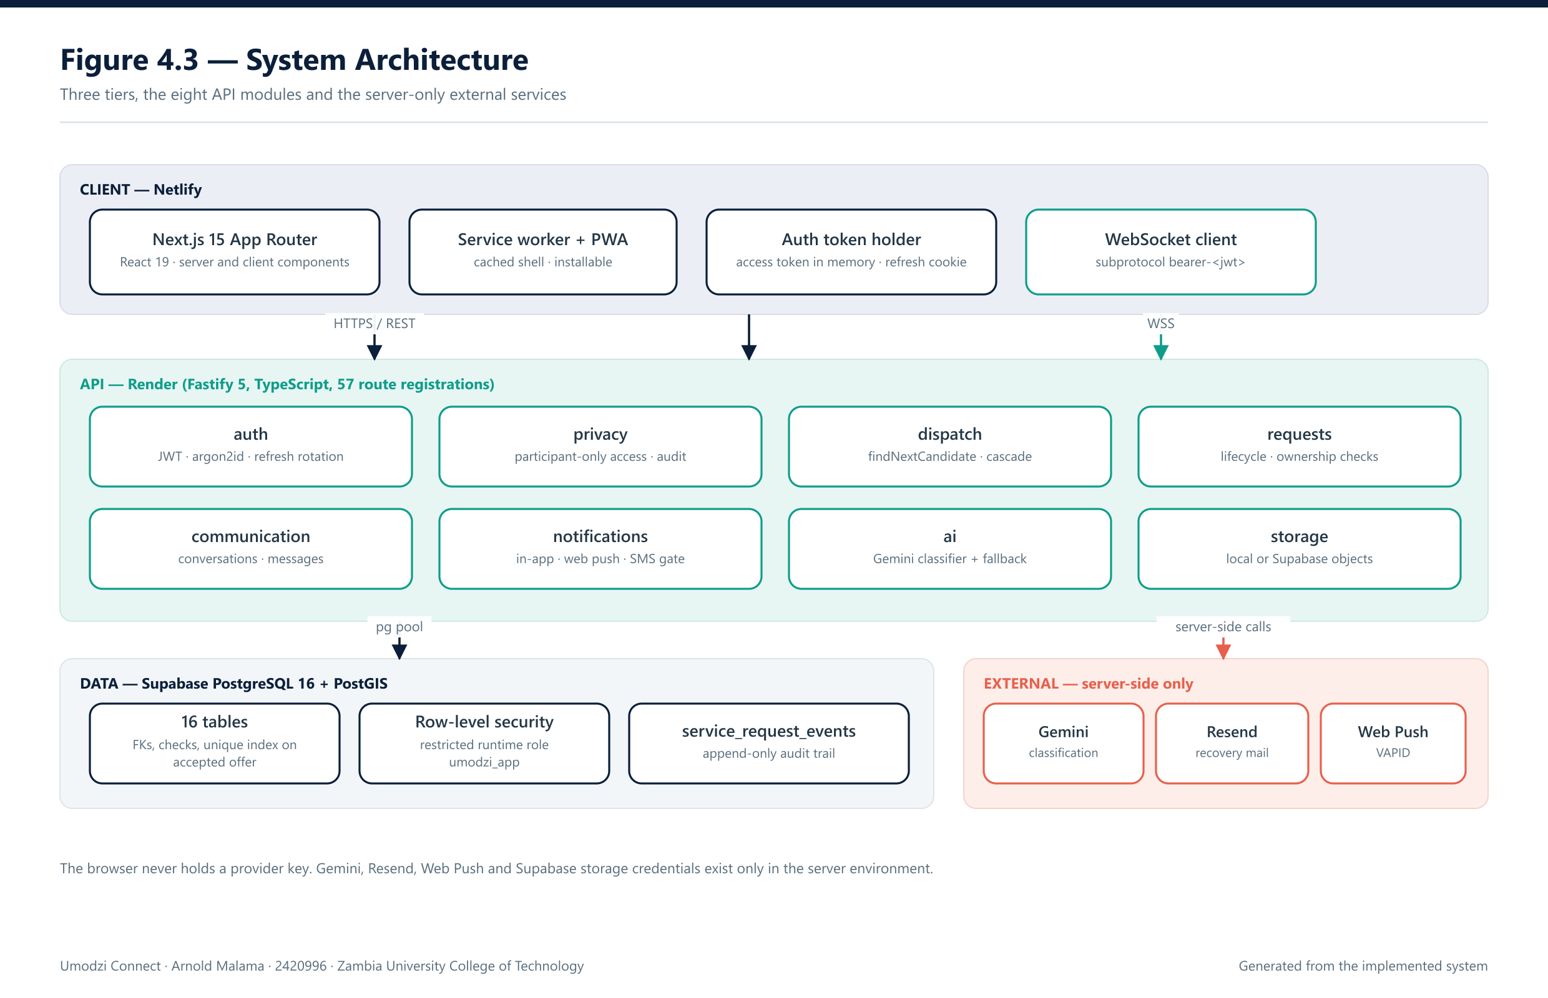
SYSTEM ARCHITECTURE
Umodzi Connect · Arnold Malama · 2420996
12 / 16
Notes:
Walk the three tiers top to bottom: the Netlify client never holds a provider key; the Render API exposes eight modules; Supabase PostgreSQL with PostGIS holds sixteen tables behind row-level security. Emphasise the red EXTERNAL band: Gemini, Resend and Web Push are server-side only, which is the answer to any credential-exposure question.

Slide 13
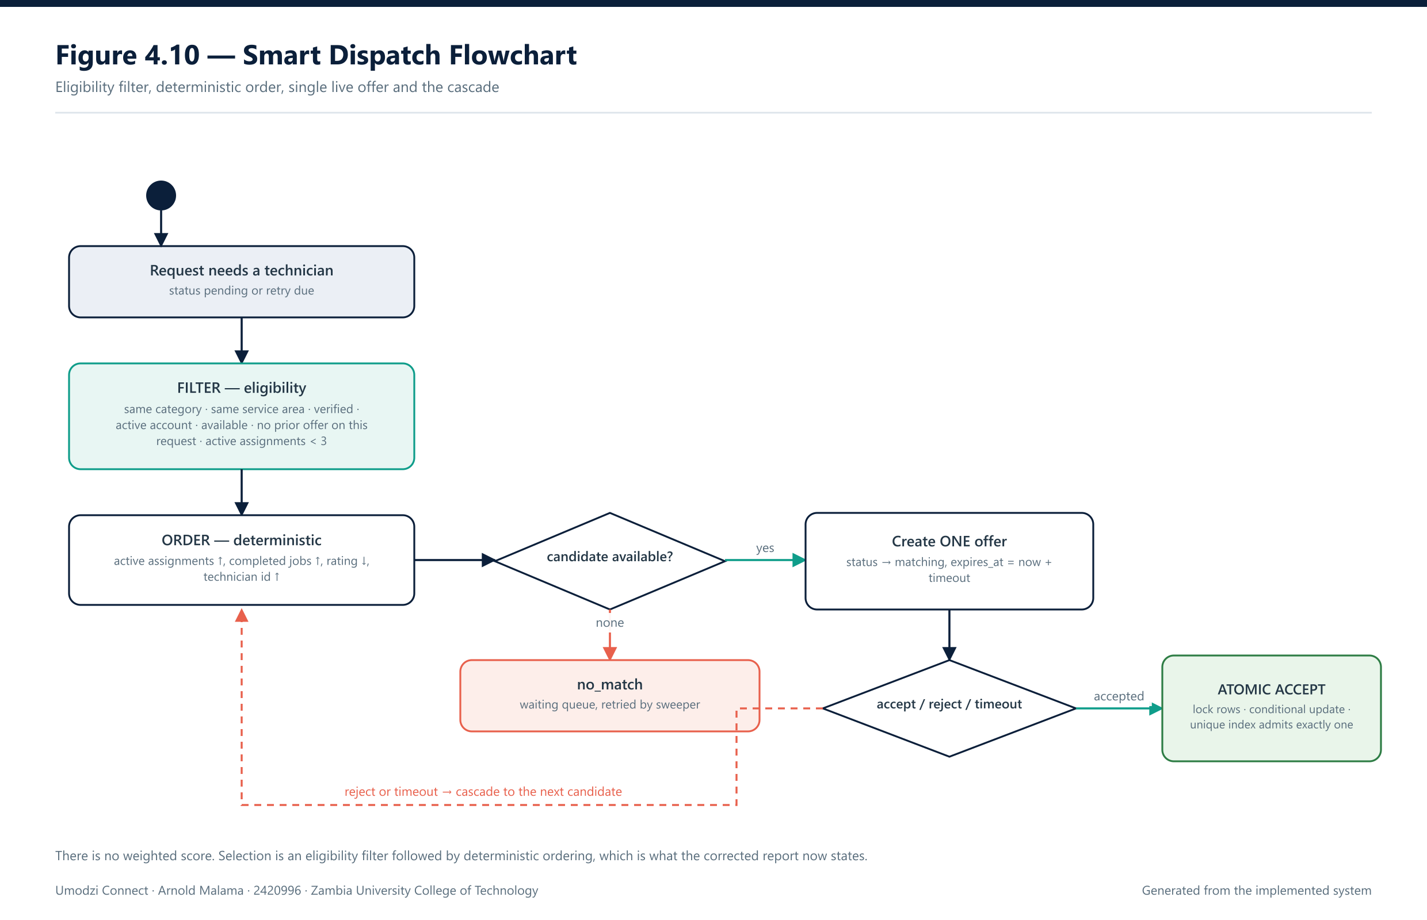
SMART DISPATCH FLOWCHART
Umodzi Connect · Arnold Malama · 2420996
13 / 16
Notes:
This is the core contribution. Stress that there is no weighted score: an eligibility filter narrows candidates, deterministic ordering picks one, exactly ONE live offer exists at a time, and accept is atomic under a unique index so two technicians can never both hold the same job. Reject or timeout cascades to the next candidate; exhaustion yields no_match and the retry queue.

Slide 14
FINDINGS
Specific objective | Result achieved | Discussion
SO1 Low-data application | Installable PWA on Next.js 15 with a cached app shell | Meets the connectivity objective; field data use not yet measured
SO2 Trust and accountability | Verification workflow, ratings and reviews implemented | Matches the trust signals ranked in the pilot
SO3 Geolocation matching | Service-area matching with PostGIS; map with opt-in GPS | Precise technician location withheld by design
SO4 Multi-factor dispatch | Server-side filter, workload-aware ordering, cascade and atomic accept | Algorithm implemented; match-rate and timing metrics outstanding
Functional pass rate, classification accuracy, dispatch timings, usability and security tests are not yet measured.
Umodzi Connect · Arnold Malama · 2420996
14 / 16
Notes:
Read the table row by row: objective, what was actually built, and what it means.
Be honest about the last box — those measurements are still outstanding and will be reported only when executed.
Likely question: "So what are your test results?" — Static gates and the production build pass; functional, accuracy, dispatch, usability and security measurements are pending against a controlled test database.

Slide 15
CONCLUSION
Umodzi Connect addresses fragmented technician discovery in urban Zambia.
The pilot supports the design assumptions: low data, trust signals and proximity all matter.
The platform delivers verified profiles, geolocation, classification and server-side dispatch.
It does not yet prove reduced waiting time, higher income or better service quality those need controlled evaluation.
Umodzi Connect · Arnold Malama · 2420996
15 / 16
Notes:
Return to the four research questions and answer each in one sentence.
Own the limitation: no controlled evaluation yet, therefore no causal claims.
Likely question: "Did you achieve your objectives?" — Objectives 1 to 3 are met by implemented features; objective 4 is implemented but its performance is not yet evaluated.

Slide 16
RECOMMENDATIONS
Complete functional, dispatch, usability and security testing.
Provision the classification key and evaluate accuracy on a labelled set.
Partner with trade bodies and colleges to strengthen verification.
Add mobile money, local-language support and USSD in future versions.
Run a controlled pilot in Kitwe and Ndola before any commercial claims.
Thank you — questions are welcome
Umodzi Connect · Skilled People. Stronger Communities.
Umodzi Connect · Arnold Malama · 2420996
16 / 16
Notes:
Finish on recommendations, then invite questions.
Prepare for: "What would you do with three more months?" — controlled pilot, labelled dataset, and fairness measurement across technicians.
Keep the closing slide on screen while answering questions.

