Slide 1
Assessing Knowledge, Attitude and Practices Among Students on E-Learning Platforms
Evans m.l.
219331A

Slide 2
Data Collection
Form of data collection: Questionnaire
Target population: Undergraduates in Sri Lanka
Target sample size: 100
Sampling method: Convenience Sampling (Non-Probabilistic)
Questionnaire was distributed among undergraduates by selected friends from all nine provinces in Sri Lanka
The expectation was to get participants from each province
Questionnaire was closed after receiving 100th response

Slide 3
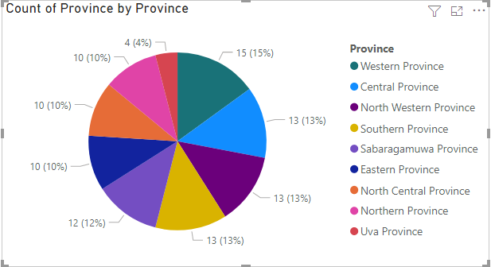
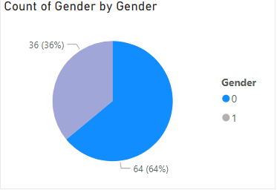
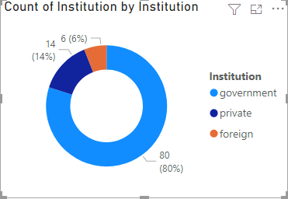
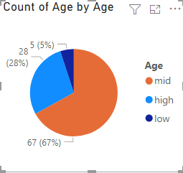
Data Collection
1 – Female
0 - Male
Mid – between 21 and 25
High – Elder than 26
Low – Younger than 20

Slide 4
Conclusions
Test1:
Null-Hypothesis: proportion of students in favour of e-learning is equal when their institute is in the same province and not
Alternative-Hypothesis: proportion of students in favour of e-learning is higher when their institute is not in the same province
Conclusion: Null-Hypothesis cannot be rejected (p=0.209 > 0.05)

Slide 5
Conclusions
Test2:
Null-Hypothesis: Knowledge on e-learning platforms independent from liking e-learning platforms
Alternative-Hypothesis: Knowledge on e-learning platforms correlated with liking e-learning platforms
Conclusion: There’s enough evidence to reject the null-hypothesis as p=0.048 ( < 0.05). Thus, with enough evidence we can claim that knowledge on e-learning platforms has a correlation with liking e-learning platforms.
This correlation is positive.

Slide 6
Conclusions
Test3:
Null-Hypothesis: Disliking e-learning platforms is not related to being a student of a government institution
Alternative-Hypothesis: Students of government institutions dislike e-learning platforms more
Conclusion: Since p=0.038 (< 0.05), null-hypothesis can be rejected with 95% confidence level. Null hypothesis can be rejected and it can be claimed that students of government institutions dislike e-learning platforms more

Slide 7
Method
Test1:
Dataset was separated to two on the basis whether province of the institution and residential province are different or not. E-learning preferred proportion was calculated for two datasets separately.
Performed proportion test in R for these statistics and found out that p=0.209 (single tailed test)
 | Preferred | Not preferred
Same province | 11 | 14
Different province | 42 | 33

Slide 8
Method
Test2:
Students were provided a question with three answers which was used to measure knowledge. Three answers are as below and each assigned a score to form the knowledge score (score is in brackets)
I learned through e-learning platforms for the first time during undergraduate studies and I didn’t know about e-learning platforms before that (10)
I have learned through e-learning platforms even before undergraduate studies (30)
I learned through e-learning platforms for the first time during undergraduate studies, but I knew about e-learning platforms before that (20)
Students were provided a set of options to select reasons to like e-learning platforms. The likes score formed by number of reasons selected.
Pearson Correlation test was performed in R to test correlation between the knowledge score and the likes score

Slide 9
Method
Test3:
Dislike score was computed based number of reasons selected for not liking e-learning platforms.
The data were divided to two parts on the basis of being government student or not.
Then a t test was conducted to test the difference of mean of two data portions.
P-value was equal to 0.038 and as it’s less than 0.05, null-hypothesis was rejected

Slide 10
Discussion
It might have been presumed that students who study in institutes in different provinces are more likely to prefer e-learning. But there’s no enough evidence to claim that as null-hypothesis could not be rejected in test1. Students definitely have other reasons as well.
The students who possess a good knowledge about e-learning platforms have more reasons to like e-learning platforms. There is enough evidence to claim this. Students can manage e-learning platforms easily when they have a good knowledge about it, thus there are more reasons to like it.
Students who are studying in government institutes have more reasons to dislike e-learning platforms. There’s enough evidence to claim this.

