Slide 1

Topic Modelling, Sentiment Polarity and Bitcoin Volatility
Do Bitcoin tweets help predict next-day price movement?
EDAB6808 Assignment 4
Mamello Malape (2023232750)
Reatile Seekoei (2021109463)

Slide 2
Two questions, two uses of text
1
2
Does sentiment add value to volatility forecasts?
Which themes dominate, and how do they change?
Topic modelling identifies recurring themes in the corpus and tracks how their share changes over the specified timestamps.
Tests whether estimated daily sentiment improves next-day volatility forecasts once market data and tweet volume are controlled for.
Purpose | Preparation | Sample
Topic modelling | Clean URLs, mentions and stop words. | 26,000 unique English texts
Sentiment | Retain negation, punctuation and emoji. | 40,083 scored tweets
The analysis is observational: associations are reported, not causal effects.
Notes:
Topic modelling summarises what is discussed; sentiment tests whether outlook adds predictive information.

Slide 3
One corpus, several different samples
4.69M
26,000
40,083
200
tweets retained after 109 exclusions
unique English tweets used to fit topics (2,000 per month)
tweets scored for sentiment (up to 200 per day)
usable forecasting days: 160 train, 40 test
Coverage gap: tweets exist on only 201 of 362 days (6 Mar 2025 – 2 Mar 2026). Some tweet text refers to 2021–2022 despite 2025–26 timestamps, so dates are treated with caution.
Notes:
Each sample answers a different question. Topic training, sentiment scoring and forecasting use different units.

Slide 4
NMF beat LDA, so nine NMF topics were used
LDA
NMF (selected)
Count vectors
TF–IDF
Coherence (higher is better)
-2.275
Coherence (higher is better)
-1.249
Keyword diversity
0.767
Keyword diversity
0.956
Largest topic
19.9%
Largest topic
42.1%
Nine topics balanced detail, coherence and stability across seeds (tested 5, 7, 9, 11 and 13).
Notes:
NMF has less negative coherence and more distinct keywords. Its lower balance reflects one broad trading topic.

Slide 5
Trading dominates the fitted topic sample
What this means
Trading, NFTs and crypto news make up 79.6% of the sample
Airdrop spam, faucets and bot alerts are a real share
Shares are for the balanced sample, not the full corpus
Notes:
Trading is 42%, NFTs/metaverse/meme coins 22%, general crypto news 15%. The rest are promotions and automated alerts.

Slide 6
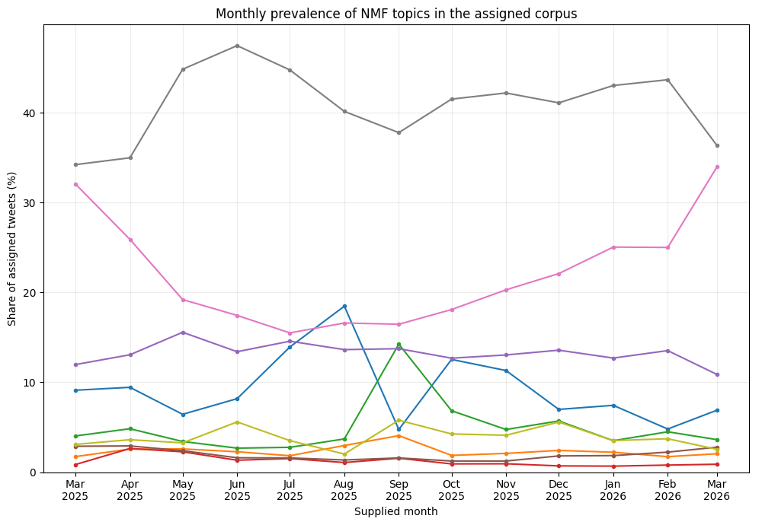
Topic mix shifted over the collection period
Trading
Largest theme throughout; strongest share around June 2025.
NFTs & meme coins
Falls from 32% (Mar) to 26% (Apr), declines into mid-2025, and recovers toward early 2026.
Airdrops & Cardano
Airdrops rise around July-August; Cardano alerts spike sharply in September.
Caution: data exist on only 201 of 362 days, and timestamps are unverified, so no historical-event explanations are offered.
Notes:
Patterns are read qualitatively. A higher share does not necessarily mean more tweets, and March 2025 is a partial month.

Slide 7
The sentiment model failed manual validation
Confusion matrix (rows = human, columns = model)
43%
Negative
Neutral
Positive
agreement with human labels (100 tweets)
Negative
2
4
5
Below the 46% baseline of always guessing the top label
Macro-F1 ≈ 0.38
Factual alerts misread as bullish or bearish
Neutral
2
15
26
Positive
1
19
26
Orange = correct. 26 of 43 neutral tweets were labelled positive; only 2 of 11 negative tweets were caught.
Notes:
CryptoBERT agreed with human labels on 43 of 100 tweets, below the 46% from always guessing the most common label.

Slide 8
Forecasting next-day movement, tested fairly
Input group | Variables | Purpose
Market | Signed return and absolute return | Market information control
Market + volume | Market inputs and log full tweet count | Activity control
Market + volume + sentiment | Add mean polarity and class shares | Incremental sentiment test
Each group is fitted with linear regression and random forest, and compared with three simple benchmarks (training mean, median, persistence).
Train: 160 days (6 Mar – 19 Nov 2025)
Test: 40 days
Notes:
Same 200 origins for every model. Chronological split, no random shuffling. Target is the absolute log return of the next day.

Slide 9
Simple regression wins; sentiment doesn't
1.134
Best MAE: market-only regression
1.594
Best RMSE: regression + volume
1.183
Training-mean benchmark MAE
Notes:
Market-only regression has the best MAE (1.134). Regression with volume has the best RMSE (1.594). Persistence is worst.

Slide 10
Sentiment's gain is small and not consistent
Random forest
Linear regression
+5.62%
+0.04%
−0.44%
−0.04%
MAE change
RMSE change
MAE change
RMSE change
Positive = lower error after adding sentiment (vs market + volume).
Correlation with next-day movement: log tweet volume −0.219 · mean polarity −0.019. Every model badly missed the largest price move.
Notes:
Forest MAE improves 5.6% but RMSE only 0.04%. Both regression models get slightly worse. Volume correlates more with next-day movement than sentiment.

Slide 11
Conclusions
Topics
Sentiment
Scope
NMF is a useful descriptive tool: trading talk, wider crypto projects, promotion and bot alerts.
Not a consistent forecasting gain. It helps one model on one error measure.
Results are associations, not causal or operational claims.
Market-based models remain the provisional benchmark.
Notes:
NMF is useful descriptively; sentiment is an experimental input only.

Slide 12
Limitations and next steps
Limitations
Next steps
Unreliable timestamps (2021–22 references)
No data on 161 of 362 days
Sampled, not census, data
43% sentiment accuracy, one reviewer
Only 40 test days, one split
Verify source timestamps
Expand manual review; improve sentiment
Use expanding-window testing
Try rolling standard deviation as target
Examine errors around large moves
Notes:
Recommendations are proposed extensions, not completed results.

