Slide 1
HONOURS IN BUSINESS ANALYTICS · EDAB6808
Bitcoin <-> Google Trends
Lead-Lag Relationships Between Bitcoin
and Internet Attention
Mamello Malape 2023232750 | Fumane Malangabe 2019611165
Period: 1 January 2025 to 31 December 2025
ASSESSOR: Dr H Combrink · Dr N Tamuka · V Oelofse
1 of 13

Slide 2
Introduction and Background
Investor behaviour has shifted toward online information-seeking, particularly retail investors (Barber & Odean, 2008).
Google Trends provides a real-time proxy for investor attention and public interest in assets (Da, Engelberg & Gao, 2011).
Spikes in search activity have been shown to precede trading volume and price movements (Bui & Nguyen, 2019).
Bitcoin represents a uniquely attention-driven market: retail-dominated, globally accessible, and highly sensitive to search trends.
This study investigates whether GSVI leads or lags Bitcoin market activity (returns, volume, and volatility).
INTRODUCTION
AND
BACKGROUND
Motivation
Study Period: 1 Jan 2025 – 31 Dec 2025 | 5 Bitcoin/crypto keywords | Data: Yahoo Finance + pytrends
2 of 13

Slide 3
Research Question and Hypotheses
Does internet attention, as measured by Google Trends, lead or lag Bitcoin market activity, and does it provide useful predictive information for Bitcoin returns, trading volume, and volatility?
Lead-Lag Relationship
Granger Causality
H0: No lead-lag relationship between Google Trends and Bitcoin
H1: A lead-lag relationship exists
H0: Google Trends does not Granger-cause Bitcoin returns or volume
H1: Google Trends Granger-causes Bitcoin returns or volume
Predictive Performance
Volatility Effects
H0: Google Trends variables do not improve prediction accuracy
H1: Google Trends variables improve prediction accuracy
H0: Attention variables are not significant in explaining volatility
H1: Attention variables significantly explain Bitcoin volatility
3 of 13

Slide 4
Data Collection and Keyword Selection
Keywords Used (Google Trends):
DATA
WAS COLLECTED FROM YAHOO FINANCE THROUGH AN API AND GOOGLE TRENDS
Buy Bitcoin
Direct transactional intent; signals active purchase interest
BTC
Ticker-based attention from technically informed investors
BTC price
Price-checking behaviour; linked to valuation curiosity
Ripple
Broader crypto market sentiment proxy
crypto
General cryptocurrency attention across all market participants
yfinance + pytrends
Source: Yahoo Finance (BTC-USD) + Google Trends via pytrends | Region: United States
4 of 13

Slide 5
Methodology
DATA TRANSFORMATION
STATIONARITY TESTING
Log returns from daily adjusted closing prices: time-additive and approximately normal.
Weekly aggregation: price as last value, returns as sum, volume as total.
Google Trends resampled to weekly means, forward-filled for sparse weeks.
ADF (H0: non-stationary) and KPSS (H0: stationary) applied together for mutual confirmation.
First differencing applied to price_w and Ripple, then re-confirmed.
Needed because non-stationary series produce spurious regressions.
CROSS-CORRELATION ANALYSIS
GRANGER CAUSALITY TEST
Correlates price_w, log_return_w and volume_w with all 5 keywords at lags -8 to +8 weeks.
Negative lag means attention leads; positive lag means attention follows.
Best lag is the one with the highest absolute correlation.
Tests whether past Trends values improve prediction of returns and volume.
Max lag 12 weeks; F-test p-value below 0.05 indicates significance.
Answers the core question: does attention predict market moves or react to them?
Justification: stationarity prevents spurious regressions; cross-correlation and Granger causality are the standard lead-lag tools in behavioural finance (Gujarati, 2003; Da et al., 2011; Aslanidis et al., 2022)
5 of 13

Slide 6
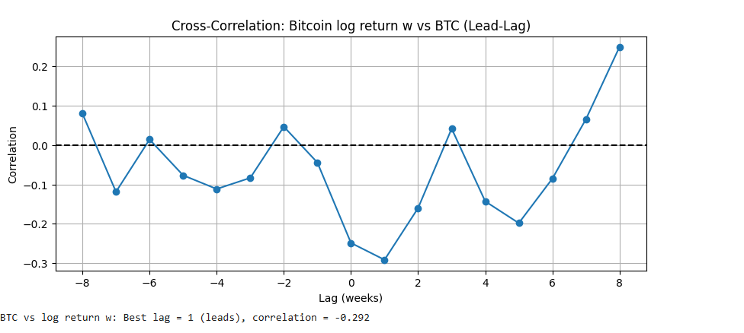
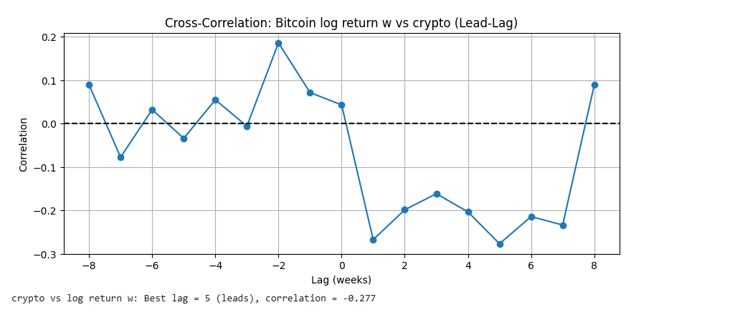
Findings: Statistical Methods (Cross-Correlation)
Returns are influenced quickly, with significant predictors at short lags (1-4 weeks).
Volume responds both immediately (1-2 weeks) and with longer delays (up to 7 weeks), especially to Ripple and general crypto sentiment.
Negative correlations: search spikes may slightly anticipate downward price corrections -retail attention peaks near market tops.
6 of 13

Slide 7
Granger Causality Findings
Bitcoin Variable | Trend Variable | Best Lag | Min p-value | Significance
log_return | Buy Bitcoin | 6 | 5.39e-02 | Not Significant
log_return | BTC | 1 | 3.92e-02 | Significant
log_return | BTC price | 1 | 3.02e-02 | Significant
log_return | Ripple | 1 | 5.82e-01 | Not Significant
log_return | crypto | 4 | 4.59e-02 | Significant
volume | Buy Bitcoin | 1 | 1.98e-03 | Significant
volume | BTC | 2 | 2.70e-08 | Significant
volume | BTC price | 2 | 1.77e-07 | Significant
volume | Ripple | 7 | 2.20e-02 | Significant
volume | crypto | 7 | 1.01e-03 | Significant
Returns show limited predictability from search trends
Only BTC, BTC price (lag 1) and crypto (lag 4) are significant
Buy Bitcoin is borderline insignificant (p =0.054)
Ripple shows no relationship with returns
Extremely low p-values for BTC and BTC price -very strong significance
Longer lag effects (lag 7) for crypto and Ripple
Indicates attention impacts trading activity more than returns
7 of 13

Slide 8
Machine Learning Model: LSTM
3.822%
2.913%
35.51%
71.43%
RMSE
MAE
R²
Direction
Root Mean
Squared Error
Mean Absolute
Error
Coefficient of
Determination
Directional
Accuracy
Interpretation of Results:
Metric | Value | What It Means
RMSE | 3.822% | Typical prediction error is 3.8% per week in return units
MAE | 2.913% | Average absolute miss is 2.9% -small relative to Bitcoin's weekly swings
R² | 35.51% | Model explains 35.5% of weekly return variability -reasonable for crypto forecasting
Direction | 71.43% | Correctly predicts up/down direction 71% of the time -most useful metric for trading
8 of 13

Slide 9
EGARCH Model Results
EGARCH
MODEL
Model Setup:
Dependent: log returns | Mean: Zero Mean | Volatility: EGARCH(1,1,1)
Fit Statistics:
Log-Likelihood = 82.67 | AIC = -159.35 | BIC = -153.61 -> Model fits well
omega:
−0.0642 -Baseline (unconditional) volatility level
alpha:
−0.6014 - ARCH effect: captures magnitude of past shocks on volatility (no gamma term estimated)
beta:
0.9996 -Very high persistence; volatility shocks cluster and last long
Volatility Analysis
EGARCH captures volatility clustering and near-permanent shock persistence - consistent with Bitcoin’s turbulent periods.
9 of 13

Slide 10
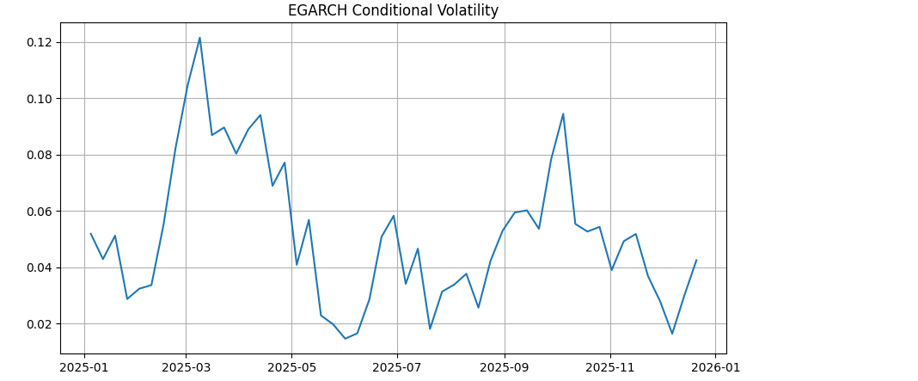
EGARCH: Conditional Volatility
Early 2025: Volatility spikes sharply, likely reflecting a period of market stress or major events.
Mid-2025: Volatility stabilises but remains moderate, suggesting steady but not extreme uncertainty.
Late 2025: Another surge is observed, indicating renewed market shocks or external influences.
End of 2025 -2026: Volatility declines significantly, pointing to calmer market conditions and reduced uncertainty.
Therefore: Volatility clearly changes over time and occurs in clusters, but there is no strong evidence that attention variables are the main drivers of these change
10 of 13

Slide 11
Key Insights
01 Attention Leads Returns
02 Volume is More Attention-Sensitive
03 LSTM Captures Directional Momentum
BTC and BTC price Granger-cause returns at lag 1 week; crypto at lag 4 weeks. Search picks up investor intent before it shows in prices.
All 5 keywords significantly predict volume - it reacts more broadly than returns do (Bui & Nguyen, 2019).
71.4% directional accuracy is practically meaningful -the model correctly calls market direction most weeks.
04 Volatility is Highly Persistent
05 Keyword Choice Matters
06 Supplement, Not Standalone
EGARCH beta = 0.9996 shows near-permanent persistence. Negative shocks amplify volatility more than positive ones.
BTC and BTC price outperform Buy Bitcoin and Ripple as predictors -more specific terms carry better signal.
R-squared of 35.5% shows attention explains only part of variance. It should be used alongside technical and macro indicators.
11 of 13

Slide 12
Evidence, Limitations and Recommendations
EVIDENCE SUPPORTING HYPOTHESES
LIMITATIONS
Cross-correlation: significant lags of 1-7 weeks between Trends and Bitcoin variables.
Granger causality: BTC, BTC price and crypto predict returns (p < 0.05); all 5 keywords predict volume.
LSTM reaches 71.43% directional accuracy; EGARCH beta = 0.9996 shows near-permanent persistence.
One-year window (2025) may miss full Bitcoin market cycles.
Trends indices are normalised 0-100 and not comparable across periods.
Only 52 weekly observations, which limits LSTM training and generalisability.
FOR INVESTORS AND TRADERS
FUTURE RESEARCH
Treat Trends as a supplementary signal, monitoring BTC and crypto at 1-3 week lags.
Prioritise volume signals: volume is predicted far more reliably than returns.
Validate the 71% directional accuracy before any live trading.
Extend to 2022-2025 and to other coins (Ethereum, Solana).
Add query sentiment and macro indicators (Fed rates, CPI).
Run a real-time paper trading simulation to test the signal in practice.
Conclusion: Google Trends carries predictive signal at 1-7 week lags, strongest for trading volume. It is a useful supplementary input alongside technical and macro analysis, not a standalone predictor.
12 of 13

Slide 13
HONOURS IN BUSINESS ANALYTICS · EDAB6808
Bitcoin <-> Google Trends
THANK YOU
Mamello Malape 2023232750 | Fumane Malangabe 2019611165
Lead-Lag Relationships Between Bitcoin and Internet Attention
13 of 13

