Slide 1
PEOPLE10 SOLUTIONS LAB · 3-DAY TAKE-HOME
Cloud-Native Data Platform on Azure
Unifying streaming and batch on a Databricks Lakehouse
Malappa
github.com/malappa2304/people10_usecase
ADLS Gen2
Databricks
Delta Lake
Synapse
Notes:
Be upfront — this is a take-home in 3 days, the manufacturing context is something I picked for realism, not a real engagement.

Slide 2





The problem the brief asks us to solve
Unify streaming + batch
One platform for both, not two pipelines.
Enable real-time insights
Sub-minute freshness for the business.
Support analytics
BI dashboards and ad-hoc SQL.
Prepare data for AI/ML
Offline + online feature stores.
Replace legacy ETL + silos
Unblock scalability, agility, and cost.
People10 Solutions Lab — Malappa
2 / 9
Notes:
This is the problem statement straight from the brief. Spend a moment on each — they're the five things every other slide answers.

Slide 3
Architecture — streaming + batch into one medallion
Real-time
⚡ Streaming
Power BI live tiles
Event Hubs (Kafka)
CNC telemetry
Bronze
Silver
Gold
Analytics
Synapse Serverless / Dedicated
📦 Batch
Delta
Delta
Delta
Auto Loader
SAP / MES files
Databricks Lakehouse on Delta Lake
AI / ML
Offline + online feature store
1
Both arrows → same Bronze. Unification at the storage layer.
2
Bronze → Silver → Gold on Delta Lake. ACID, time travel.
3
Three consumers — one per ask in the brief.
People10 Solutions Lab — Malappa
3 / 9
Notes:
I'd open the architecture diagram (docs/01_architecture_diagram.md) live during this slide. Stay on these three points; do not get pulled into a Delta-vs-Iceberg debate yet.

Slide 4
Why Delta Lake makes the medallion work
Concurrent streaming + batch writes on the same table (ACID)
IF ASKED
Time travel for replay and audit
Delta vs Iceberg?
Native Databricks + Unity Catalog. Synapse Serverless reads Delta directly — no metastore shim.
At 10× scale on a Trino-led stack I'd reconsider.
MERGE and apply_changes for idempotent SCD2
Open format — Synapse Serverless reads Delta natively
People10 Solutions Lab — Malappa
4 / 9
Notes:
If asked Delta vs Iceberg: native Databricks + Unity Catalog + Synapse Serverless reads it directly. At 10× scale on a Trino-led stack I'd reconsider.

Slide 5
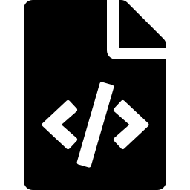
The PoC — one DLT pipeline, both arrows
poc/databricks/pipelines/unified_medallion_dlt.py
bronze_cnc_telemetry
streaming Kafka source · @dlt.table
1
bronze_sap_production_order
batch Auto Loader · same @dlt.table decorator
2
Three expectation tiers
expect_or_fail · expect_or_drop · expect
3
SCD2
via apply_changes
4
Gold materialised view
joins streaming-derived rollups with batch-derived dimensions
5
This single file is the answer to the brief's core question.
People10 Solutions Lab — Malappa
5 / 9
Notes:
This single file is the answer to the brief's core question. I'd open it live and walk the four blocks. Two minutes max.

Slide 6
Two-pattern processing — and why I kept both
Declarative — DLT
Imperative — PySpark + PipelineRun
Unified streaming + batch. Lineage, autoscaling, retries from the framework. Inline expectations and apply_changes.
SAP edge cases needing full PySpark control. PipelineRun chassis = lock + watermark + structured audit row.
DECISION RULE
Can this be expressed as @dlt.table + expects + apply_changes? If yes → DLT. If no → notebook.
People10 Solutions Lab — Malappa
6 / 9
Notes:
This is a deliberate choice for the PoC — shows pattern judgment, not just one default. In production I'd probably consolidate to DLT once the team has internalised the framework.

Slide 7
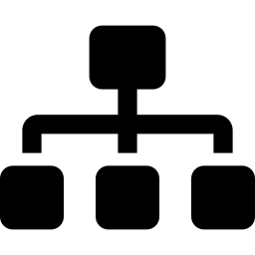

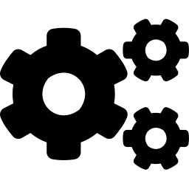
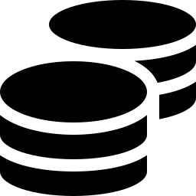
Production-readiness signals
Lineage
Security
Unity Catalog + Purview for AS9100-style audit trails.
Managed identities · CMK from Key Vault · Private Endpoints · RLS in Synapse.
CI/CD
Cost levers
GitHub Actions: ruff + pytest (cov ≥ 80%) + terraform validate + checkov + gitleaks.
ADLS lifecycle · Synapse pause schedule · Photon · spot workers · Serverless for ad-hoc.
People10 Solutions Lab — Malappa
7 / 9
Notes:
This slide is about signalling the production-shape thinking, not building everything. Specifically the OIDC federation, environment-promotion via merge requests, and pre-commit hooks are the things I'd dig into if asked.

Slide 8
Trade-offs · what I'd do next
1
Dual-pattern is a deliberate choice
DLT + imperative kept on purpose to show pattern judgment. In production I'd consolidate to DLT once the team has internalised the framework — keep PySpark only for genuine SAP edge cases.
2
Honest gaps
Cosmos online feature store (designed, not provisioned) · full networking module · real Synapse end-to-end run · Purview scan config. All listed in TODO.md with effort estimates.
3
Things I'm uncertain about
Whether 32 Event Hubs partitions is right at the cost we'd actually run at. Whether apply_changes plays well with the audit chassis. Whether to retire the imperative path entirely. Would genuinely like a panel opinion.
People10 Solutions Lab — Malappa
8 / 9
Notes:
I'd open the design-doc decision table and TODO.md live. The point of this slide is that I know what's not done and why — and that I have a view on what to discuss.

Slide 9
Questions?
I'd most welcome a question on why I kept both DLT and imperative notebooks — that's the part I'm most curious to get a second opinion on.
People10 Solutions Lab — Malappa
9 / 9
Notes:
After this slide, I stop talking and let the panel ask. Do not fill silence — the silence is the point.

