Slide 1
File Handling in C – A review

Slide 2
Introduction
Files are places where data can be stored permanently.
Some programs expect the same set of data to be fed as input every time it is run.
  Cumbersome.
  Better if the data are kept in a file, and the program reads from the file.
Programs generating large volumes of output.
  Difficult to view on the screen.
  Better to store them in a file for later viewing/ processing

Slide 3
Introduction
Data files
  When you use a file to store data for use by a program, that file usually consists of text (alphanumeric data) and is therefore called a text file.
  Can be created, updated, and processed by C programs
  Are used for permanent storage of large amounts of data
    Storage of data in variables and arrays is only temporary

Slide 4
Introduction
Data files can be created, updated, and processed by C programs
  Files are used for permanent storage of large amounts of data
  Storage of data in variables and arrays is only temporary

Slide 5
The Data Hierarchy
Bit - smallest data item
  Value of 0 or 1
Byte – 8 bits
  Used to store a character
    Decimal digits, letters, and special symbols
Field - group of characters conveying meaning
  Example: your name
Record – group of related fields
  Represented a struct or a class
  Example: In a payroll system, a record for a particular employee that contained his/her identification number, name, address, etc.
File – group of related records
  Example: payroll file
Database – group of related files

Slide 6
Files and Streams
C views each file as a sequence of bytes
  File ends with the end-of-file marker
Stream created when a file is opened
  Provide communication channel between files and programs
  Opening a file returns a pointer to a FILE structure

Slide 7
Files and Streams
C views each file as a sequence of bytes
  File ends with the end-of-file marker
    Or, file ends at a specified byte
Stream created when a file is opened
  Provide communication channel between files and programs
  Opening a file returns a pointer to a FILE structure (defined in <stdio.h>)
    Example file pointers:
    stdin - standard input (keyboard)
    stdout - standard output (screen)
    stderr - standard error (screen)
FILE structure
  File descriptor - Index into operating system array called the open file table
  File Control Block (FCB) - Found in every array element, system uses it to administer the file

Slide 8
Basic File Operations
Opening a file
Reading data from a file
Writing data to a file
Closing a file

Slide 9
Opening a File
A file must be “opened” before it can be used.
    FILE *fp;
  :
  fp = fopen (filename, mode);
  fp is declared as a pointer to the data type FILE.
  filename is a string - specifies the name of the file.
  fopen returns a pointer to the file which is used in all subsequent file operations.
  mode is a string which specifies the purpose of opening the file:
      “r” :: open the file for reading only
      “w” :: open the file for writing only
      “a” :: open the file for appending data to it

Slide 10
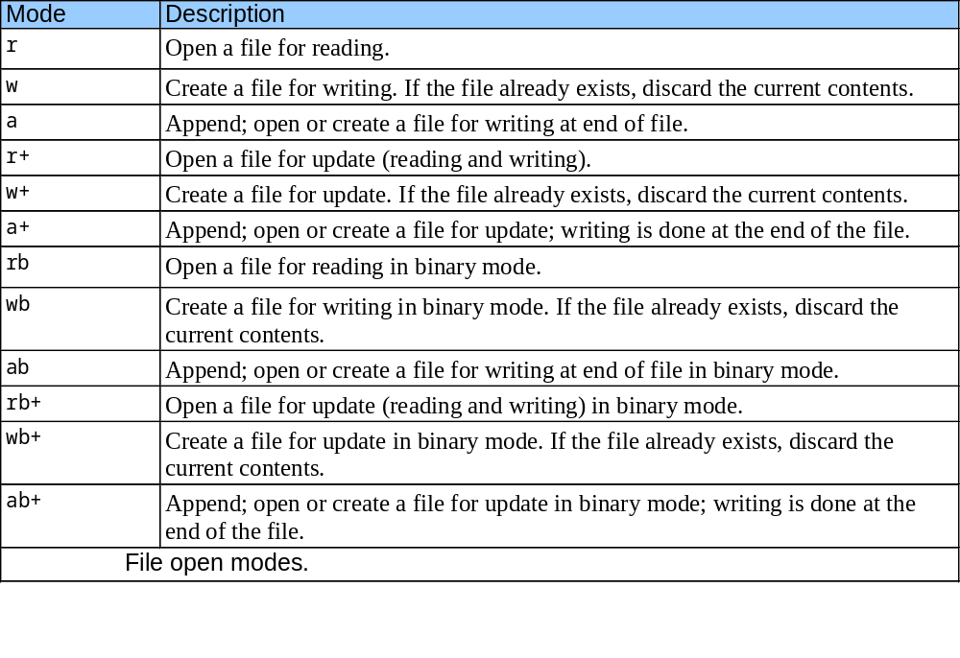
MODES

Slide 11
Contd.
Points to note:
  Several files may be opened at the same time.
  For the “w” and “a” modes, if the named file does not exist, it is automatically created.
  For the “w” mode, if the named file exists, its contents will be overwritten.

Slide 12
Examples
  FILE *in, *out ;
  in = fopen (“mydata.dat”, “r”) ;
  out = fopen (“result.dat”, “w”);
  FILE *empl ;
  char filename[25];
  scanf (“%s”, filename);
  empl = fopen (filename, “r”) ;

Slide 13
Closing a File
After all operations on a file have been completed, it must be closed.
  Ensures that all file data stored in memory buffers are properly written to the file.
General format: fclose (file_pointer) ;
    FILE *xyz ;
    xyz = fopen (“test.txt”, “w”) ;
    …….
    fclose (xyz) ;

Slide 14
Contd
  fclose( FILE pointer )
    Closes specified file
    Performed automatically when program ends
    Good practice to close files explicitly
    system resources are freed.
    Also, you might not find that all the information that you've written to the file has actually been written to disk until the file is closed.
  feof( FILE pointer )
    Returns true if end-of-file indicator (no more data to process) is set for the specified file

Slide 15
Files and Streams
Read/Write functions in standard library
  getc
    Reads one character from a file
    Takes a FILE pointer as an argument
    fgetc( stdin ) equivalent to getchar()
  putc
    Writes one character to a file
    Takes a FILE pointer and a character to write as an argument
    fputc( 'a', stdout ) equivalent to putchar( 'a' )
  scanf / fprintf
    File processing equivalents of scanf and printf

Slide 16
Files and Streams (II)
Read/Write functions in standard library
  fgetc - reads one character from a file
    Takes a FILE pointer as an argument
    fgetc( stdin ) is equivalent to getchar()
  fputc - writes one character to a file
    Takes a FILE pointer and a character to write as an argument
    fputc( 'a', stdout ) is equivalent to putchar( 'a' )
  fgets - read a line from a file
  fputs - write a line to a file
  fscanf / fprintf - file processing equivalents of scanf and printf

Slide 17
Read/Write Operations on Files
The simplest file input-output (I/O) function are getc and putc.
getc is used to read a character from a file and return it.
    char ch; FILE *fp;
    …..
    ch = getc (fp) ;
  getc will return an end-of-file marker EOF, when the end of the file has been reached.
putc is used to write a character to a file.
    char ch; FILE *fp;
    ……
    putc (ch, fp) ;

Slide 18
Example :: convert a text file to all UPPERCASE
main() {
FILE *in, *out ;
char c ;
in = fopen (“infile.dat”, “r”) ;
out = fopen (“outfile.dat”, “w”) ;
while ((c = getc (in)) != EOF)
putc (toupper (c), out);
fclose (in) ;
fclose (out) ;
}

Slide 19
Contd.
We can also use the file versions of scanf and printf, called fscanf and fprintf.
General format:
  fscanf (file_pointer, control_string, list) ;
  fprintf (file_pointer, control_string, list) ;
Examples:
    fscanf (fp, “%d %s %f”, &roll, dept_code, &cgpa) ;
    fprintf (out, “\nThe result is: %d”, xyz) ;

Slide 20
Contd.
fprintf
    Used to print to a file
    It is like printf, except first argument is a FILE pointer (pointer to the file you want to print in)

Slide 21

  Data read from beginning to end
  File position pointer - indicates number of next byte to be read/written
    Not really a pointer, but an integer value (specifies byte location)
    Also called byte offset
  rewind(myPtr) - repositions file position pointer to beginning of the file (byte 0)

Slide 22
Some Points
How to check EOF condition when using fscanf?
  Use the function feof
    if (feof (fp))
    printf (“\n Reached end of file”) ;
How to check successful open?
  For opening in “r” mode, the file must exist.
    if (fp == NULL)
    printf (“\n Unable to open file”) ;

Slide 23
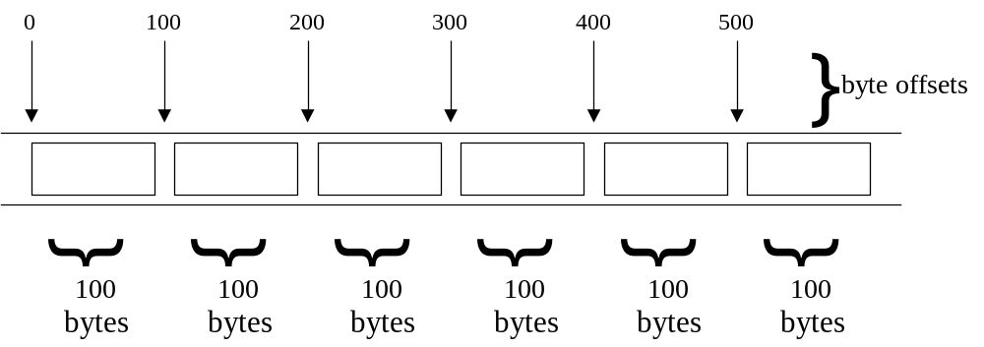
Random Access Files
Random access files
  Access individual records without searching through other records
  Instant access to records in a file
  Data can be inserted without destroying other data
  Data previously stored can be updated or deleted without overwriting.
Implemented using fixed length records
  Sequential files do not have fixed length records

Slide 24
Creating a Random Access File
Data
  Data unformatted (stored as "raw bytes") in random access files
    All data of the same type (ints, for example) use the same memory
    All records of the same type have a fixed length
    Data not human readable

Slide 25
Creating a Random Access File (II)
Unformatted I/O functions
  fwrite - Transfer bytes from a location in memory to a file
  fread - Transfer bytes from a file to a location in memory
  fwrite( &number, sizeof( int ), 1, myPtr );
    &number - Location to transfer bytes from
    sizeof( int ) - Number of bytes to transfer
    1 - For arrays, number of elements to transfer
      In this case, "one element" of an array is being transferred
    myPtr - File to transfer to or from
    fread similar

Slide 26
Creating a Random Access File
Writing structs
  fwrite( &myObject, sizeof (struct myStruct), 1, myPtr );
  sizeof - Returns size in bytes of object in parentheses
To write several array elements
  Pointer to array as first argument
  Number of elements to write as third argument

Slide 27
fread( ) and fwrite( )
size_t fread(void *buffer, size_t numbytes, size_t count, FILE *a_file);
size_t fwrite(void *buffer, size_t numbytes, size_t count, FILE *a_file);
  Buffer in fread is a pointer to a region of memory that will receive the data from the file. Buffer in fwrite() is a pointer to the information that will be written to the file.
  The second argument is the size of the element; it is in bytes. For example, if you have an array of characters, you would want to read it in one byte chunks, so numbytes is one. You can use the sizeof operator to get the size of the various datatypes; for example, if you have a variable, int x; you can get the size of x with sizeof(x);

Slide 28
Contd..
  The third argument is simply how many elements you want to read or write; for example, if you pass a 100 element array
  The final argument is simply the file pointer
  Size_t is an unsigned integer.
  fread() returns number of items read and fwrite() returns number of items written
  To check to ensure the end of file was reached, use the feof function, which accepts a FILE pointer and returns true if the end of the file has been reached.

Slide 29
/* a simple example of using fread and fwrite to read and write an array of structures
*/
#include <stdio.h>
#include <conio.h>
int main()
{
FILE *fp;
struct prod {
int cat_num;
float cost;
};
typedef struct prod product;
product a[3] = {{2,20.1},{4,40.1},{6,60.1}};
product k, *p = &k;

Slide 30
fp = fopen("c:\fread1.txt","w+");
// write the entire array into the file pointed to by fp
fwrite(a, sizeof(product), 3, fp);
// prepare for reading from the beginning of the file
rewind(fp);
// read from the file one product at a time
for (i=0; i<3; i++) {
fread(p, sizeof(product), 1, fp);
printf(" product %d, cat_num=%d, cost=%f\n", i,p->cat_num,p->cost);
}
getch();
}

Slide 31
Example: Merge two files
#include <stdio.h>
int main()
{ FILE *fileA, /* first input file */
*fileB, /* second input file */
*fileC; /* output file to be created */
int num1, /* number to be read from first file */
num2; /* number to be read from second file */
int f1, f2;
/* Open files for processing */
fileA = fopen("class1.txt","r");
fileB = fopen("class2.txt","r");
fileC = fopen("class.txt","w");

Slide 32
/* As long as there are numbers in both files, read and compare numbersone by one. Write the smaller number to the output file and read the next number in the file from which the smaller number is read. */ f1 = fscanf(fileA, "%d", &num1); f2 = fscanf(fileB, "%d", &num2); while ((f1!=EOF) && (f2!=EOF)){ if (num1 < num2){ fprintf(fileC,"%d\n", num1); f1 = fscanf(fileA, "%d", &num1);
} else if (num2 < num1) { fprintf(fileC,"%d\n", num2); f2 = fscanf(fileB, "%d", &num2);
} else { /* numbs are equal:read from both files */ fprintf(fileC,"%d\n", num1); f1 = fscanf(fileA, "%d", &num1); f2 = fscanf(fileB, "%d", &num2);
}
}

Slide 33
while (f1!=EOF){/* if reached end of second file, read the remaining numbers from first file and write to output file */ fprintf(fileC,"%d\n", num1); f1 = fscanf(fileA, "%d", &num1);
} while (f2!=EOF){ if reached the end of first file, read the remaining numbers from second file and write to output file */ fprintf(fileC,"%d\n", num2); f2 = fscanf(fileB, "%d", &num2);
}
/* close files */ fclose(fileA); fclose(fileB); fclose(fileC); return 0;
} /* end of main */

Slide 34
Writing Data Randomly to a Random Access File
fseek
  Sets file position pointer to a specific position
  fseek( myPtr, offset, symbolic_constant);
    myPtr - pointer to file
    offset - file position pointer (0 is first location)
    symbolic_constant - specifies where in file we are reading from
    SEEK_SET - seek starts at beginning of file
    SEEK_CUR - seek starts at current location in file
    SEEK_END - seek starts at end of file

Slide 35
Command Line Arguments
Command line arguments may be passed by specifying them under main( ).
int main(int argc, char *argv[ ]);
Argument
Count
Array of Strings
as command line
arguments including
the command itself.
Spring 2012
Programming and Data Structure

Slide 36
Example: Reading command line arguments
#include <stdio.h>
#include <string.h>
int main(int argc,char *argv[])
{
FILE *ifp,*ofp;
int i,c;
char src_file[100],dst_file[100];
if(argc!=3){
printf("Usage: ./a.out <src_file> <dst_file> \n");
exit(0);
}
else{
strcpy(src_file,argv[1]);
strcpy(dst_file,argv[2]);
}
Spring 2012
Programming and Data Structure

Slide 37
Example: Contd.
if((ifp=fopen(src_file,"r"))==NULL)
{
printf("File does not exist.\n");
exit(0);
}
if((ofp=fopen(dst_file,"w"))==NULL)
{
printf("File not created.\n");
exit(0);
}
while((c=getc(ifp))!=EOF){
putc(c,ofp);
}
fclose(ifp);
fclose(ofp);
}
./a.out s.dat d.dat
argc=3
./a.out
argv
s.dat
d.dat
Spring 2012
Programming and Data Structure

Slide 38
Getting numbers from strings
Once we've got a string with a number in it (either from a file or from the user typing) we can use atoi or atof to convert it to a number
The functions are part of stdlib.h
char numberstring[]= "3.14";
int i;
double pi;
pi= atof (numberstring);
i= atoi ("12");
Both of these functions return 0 if they have a problem
Spring 2012
Programming and Data Structure

Slide 39
Example: Averaging from Command Line
#include <stdio.h>
#include <stdlib.h>
int main(int argc,char *argv[])
{
float sum=0;
int i,num;
num=argc-1;
for(i=1;i<=num;i++)
sum+=atof(argv[i]);
printf("Average=%f \n",sum/(float) num);
}
$ ./a.out 45 239 123
Average=135.666667
Spring 2012
Programming and Data Structure

