Slide 1
Predicting Exchange Rates for USD vs EURO
14th November 2023
Malav Shah
MS in Data Science
Practical Data Science
Pace University

Slide 2
Agenda
Executive summary
Project plan recap
Data
Exploratory data analysis
Modeling methods
Findings
Recommendations and next steps

Slide 3
Executive summary
This summary outlines the development of a time series model for predicting USD vs. EURO exchange rates. The project's primary goal is to create an accurate forecasting tool, involving data collection, preprocessing, model selection, training, and validation. Feature engineering and optimization will enhance prediction accuracy, leading to a deployable model for real-time or batch processing. Continuous monitoring and risk management strategies are emphasized, recognizing the inherent risks in exchange rate forecasting. The project aims to empower stakeholders with reliable insights for improved financial decision-making in international trade and investments.

Slide 4
Project plan recap
Deliverable | Details | Due Date | Status
Data & EDA | Create final assignment deck skeleton and fill in the deck up to the end of the EDA section | 10/31/23 | Complete
Methods, Findings, and Recommendations | Fill in the Methods, Findings, and Recommendations sections of the deck | 11/14/23 | Complete
Final presentation | Send in final completed deck and present it | 12/5/23 | Not Started

Slide 5
Data

Slide 6
Data
Data Source:
The dataset was sourced from NASDAQ which is the American stock exchange based in New York.
Sample Size:
The dataset comprises 5311 observations, each representing the final closing price for the exchange rate.
Time Period:
The data spans from January 4, 2000 to December 31, 2020, capturing the closing exchange rates over a specified time frame.
The dataset also contains the data from the 2001-2003 and 2007-2009 recessions to study the behaviour of exchange rates during those period.

Slide 7
Exploratory Data Analysis

Slide 8
Clear and concise title that gets to the “so what” of the slide
What goes on this slide:
Data visualization and short summary of what it means (AKA the “so what”)
If/when applicable: provide a hyperlink to any appendix slide(s) that provide supplemental information for each slide
For ﬁnal class presentation:
This section should have 5 data visualizations: 1 data viz per slide that follows the above formats
The data vizes should relate to your model’s outcome variable and features as this deck should tell 1 cohesive story
If you want additional data viz slides (although not required), you can put them in the appendix
You do not need to have a diﬀerent type of data viz for each slide. The purpose of each data viz is to portray the “so what”, not to show us that you know how to make diﬀerent types of ﬁgures. So choose the type of data viz that appropriately portrays the “so what” clearly. Overly complicated data vizes do more harm than good - most of the time, simple charts get the job done, e.g., bar charts, scatter plots, line charts, etc. Refer to these class slides for guidance.

Slide 9
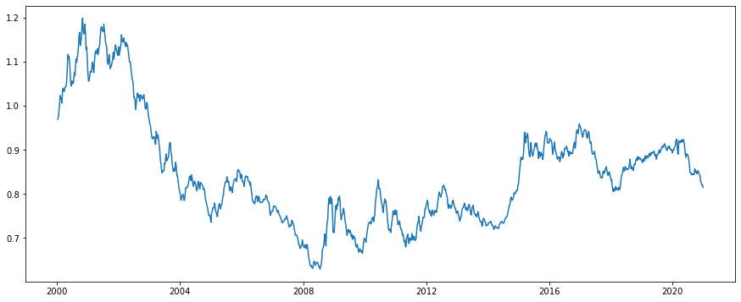
Plotting the time series data
The X-Axis denotes the time period here and the Y-Axis denotes the scaled exchange rate. We can observe the downfall of rates during the time period of 2001-2003 and 2007-2009. This signifies the time period to study the data during recession.
Exchange Rate
Time

Slide 10
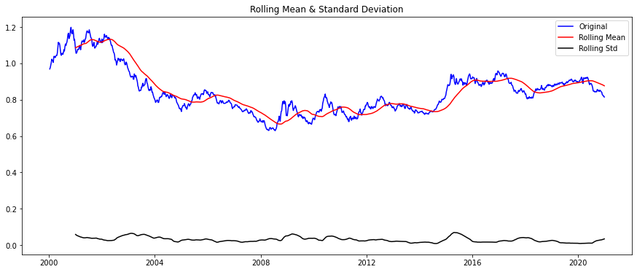
Checking the stationarity of Time Series
In simpler terms, this suggests that the time series data is not stationary. In other words, the data is showing patterns and changes over time that are not just due to random fluctuations. This information is important for understanding and analyzing the data because non-stationary data can be more challenging to work with and may require different analytical approaches.
For more detailed explanation you can click here.

Slide 11
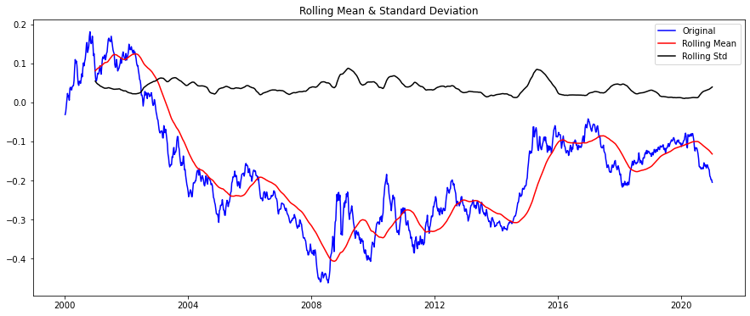
Making the Time Series Stationary
The first method used to make time series stationary is nonlinear log transformation. Instead of looking at the actual numbers, you look at their logarithms. It makes it easier to work with numbers. We can see the time series more stationary post that.

Slide 12
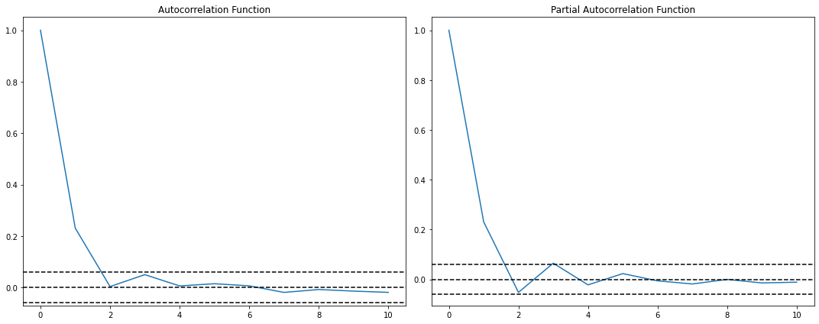
Plotting Correlation and Auto Correlation
Auto Correlation Function (ACF):
Visualize: A plot showing how each data point correlates with its past values.
Importance: Helps identify repeating patterns and cycles in the data.
Partial Auto Correlation Function (PACF):
Visualize: A plot indicating the direct relationship between data points while removing indirect influences.
Importance: Useful for uncovering the specific time lags that significantly impact the current observation.
Why Important:
Insightful Tools: ACF and PACF help analysts understand the temporal dependencies in time series data, guiding the selection of appropriate models for forecasting.

Slide 13
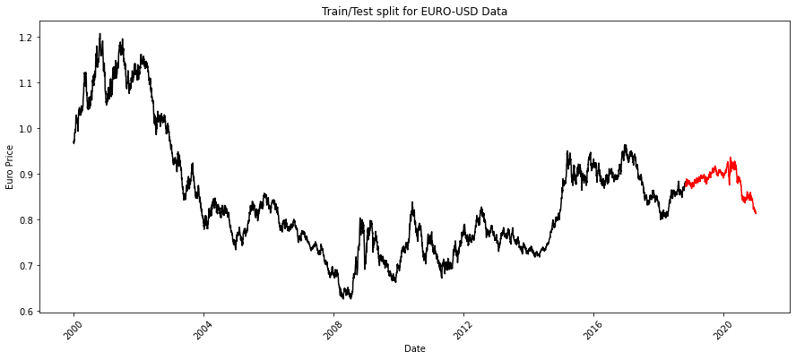
Visualizing the Train and Test Data
The time series in black shows the data used to train the model and the red part shows the data used to test the data for predicting values.

Slide 14
Machine Learning Modelling

Slide 15
Machine Learning Modelling
Model Selected: FBProphet
FBProphet is a forecasting tool created by Facebook for time series data, which is data collected over time. Imagine you have a set of data that shows how something changes over time, like the number of sales each day or the temperature each hour. FBProphet helps you make predictions about how that data will behave in the future.
Outcome Variable: Exchange Rate
The model is predicting exchange rate for EURO vs USD. The model needs to be very accurate with the predictions since the output would directly impact the financial analysts and investment portfolio managers.

Slide 16

Feature Importance
Features Selected: Date, Exchange Rate
Date: Time series data is ordered by time, and patterns often emerge over time. The "Date" feature allows the model to capture trends, seasonality, and any other time-dependent patterns in the data. Understanding how the exchange rate changes over time is essential for making accurate predictions.
Exchange Rate: Including "Exchange Rate" as a feature is, of course, essential because it represents the variable of interest. By analyzing how exchange rates change over time, the model can make informed predictions about future values based on historical patterns and trends.

Slide 17
Why FBProphet?
Components: FBProphet breaks down your time series data into three main components: trend, seasonality, and holidays.
Automatic Adjustment: FBProphet is designed to handle missing data points and outliers, adjusting for them to provide a more accurate forecast.
Customization: You can also tweak the parameters to customize the model based on your understanding of the data. For example, if you know that there's a yearly event affecting your sales, you can incorporate that knowledge into the model.
Uncertainty Estimates: FBProphet provides a range of possible values for future predictions, giving you an idea of how certain or uncertain the model is about its forecasts.
User-Friendly: It's designed to be easy to use even if you're not an expert in time series forecasting. You don't need to worry about a lot of complex math or coding.
So, in a nutshell, FBProphet is like a smart assistant for predicting future values in your time series data, considering trends, cycles, and special events. For a technical explanation of the model, you can click here.

Slide 18
Findings

Slide 19
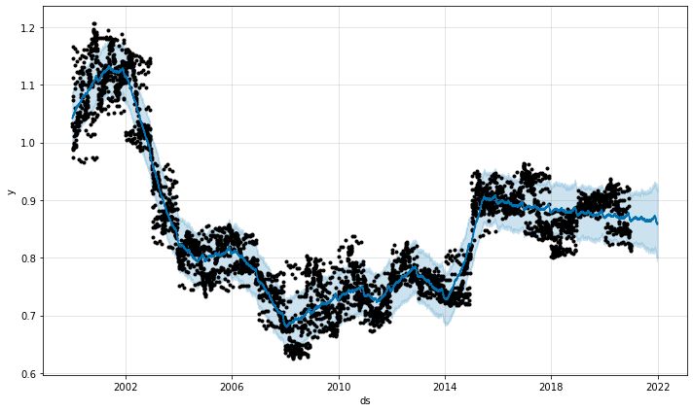
Model Findings and Outputs
The above graph indicates the predictions made by FB Prophet Model against the actual values. The values are very close the actual values and hence we can say that the model made very accurate predictions. This information is crucial for developing risk management strategies, including the use of hedging instruments.

Slide 20
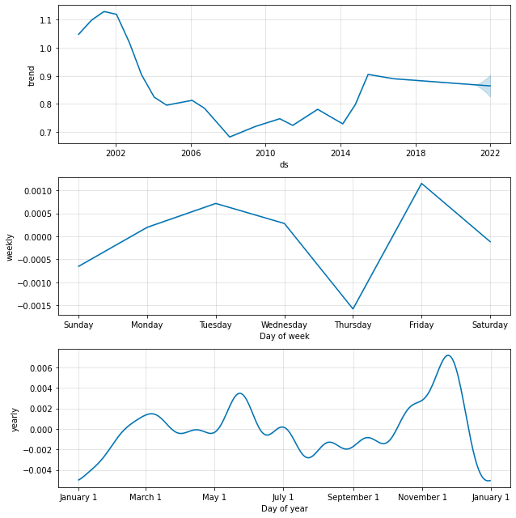
Plotting Trends and Seasonality
The prediction of trends and seasonality by time series models provides valuable information for financial analysts in several key areas:
Investment Decision-Making
Risk Management
Portfolio Allocation
Timing of Trades
Forecasting Future Performance
Understanding Seasonal Influences
Anticipating Economic Events

Slide 21
Recommendations and Future Work

Slide 22
Why is time series analysis important?
Time
Exchange Rates
Trends and Seasonality
Risk Management
Hedging Strategies
Portfolio Allocation
Market Timings
Understanding Seasonal Influences
Long Term Plannings
Exchange Rate Predictions
Investment Decision Making
Timing of Trades
Forecasting Future Performance
Data
Model Implementation (FBProphet)
Recommendations and Analysis

Slide 23
What next?
Incorporating External Factors:
Explore the integration of additional external factors, such as economic indicators, geopolitical events, and global market sentiment, into time series models. This could improve the models' ability to capture the complexities of the global financial landscape.
Implementation of Real-Time Dashboards:
Real-time dashboards that integrate exchange rate predictions with relevant market information, providing a comprehensive tool for analysts to monitor and make decisions in dynamic market conditions.

Slide 24
Appendix

Slide 25
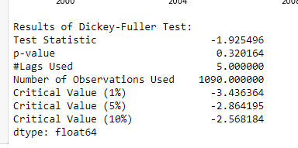
Checking the stationarity of Time Series
A stationary time series is a series where statistical properties are constant over the time and auto covariance is time independent. The two methods used below to check the stationarity are:
Plotting the moving variance and observing if it remains constant over time
Dickey-Fuller Test
The results indicate that the test statistic is significantly higher than the critical value, and the p-value is greater than 0.05.
In simpler terms, this suggests that the weekly time series data is not stationary. In other words, the data is showing patterns and changes over time that are not just due to random fluctuations. This information is important for understanding and analyzing the data because non-stationary data can be more challenging to work with and may require different analytical approaches.
For more detailed explanation you can check the hyperlink

Slide 26
Why FBProphet?
FBProphet, developed by Facebook, is a powerful time series forecasting model widely used for capturing trends and patterns in temporal data.
Model Architecture:
FBProphet employs an additive model that combines different components to capture the underlying patterns in time series data.
Trend Component:
The trend is modeled using a piecewise linear function, allowing the model to adapt to changes in the underlying trend over time. Automatic changepoint detection is used to identify significant shifts.
Seasonality Component:
Seasonal patterns are represented using a Fourier series expansion. FBProphet is flexible, accommodating both yearly and weekly seasonality patterns.

Slide 27
Why FBProphet?
Saturation and Uncertainty:
To limit the growth of the trend component, FBProphet introduces saturation minimum and maximum values. Additionally, the model employs Markov Chain Monte Carlo (MCMC) sampling to estimate the posterior distribution of parameters, providing uncertainty estimates for predicted values.
Fourier Series for Seasonality:
Seasonality is modeled using a Fourier series expansion, a mathematical approach that enables the representation of complex cyclic patterns through the combination of sine and cosine functions.
Hyperparameter Tuning:
Users have control over key hyperparameters such as seasonality strength, changepoint prior scale, allowing customization based on the characteristics of the specific time series being analyzed.
Bayesian Framework:
FBProphet is built on a Bayesian framework, incorporating uncertainty into the modeling process. This enhances the model's ability to provide uncertainty estimates and capture complex patterns.

Slide 28
THANK YOU

