Slide 1
Applied Machine Learning with scikit-learn
Comparing classifiers and regressors across two datasets
Tanay Malavia, Darpan Attri, Andres Ramos, Harika Yendapalli • CSCI 164 • Spring 2026 • github.com/malaviatanay/Applied-Machine-Learning-with-scikit-learn

Slide 2
Problem & Goals
• Build the full supervised-learning pipeline on two real datasets
• Apply three algorithms per dataset, tune them, compare results
• Benchmark against prior published work
• Deliverables: Jupyter notebooks, summary report, presentation

Slide 3
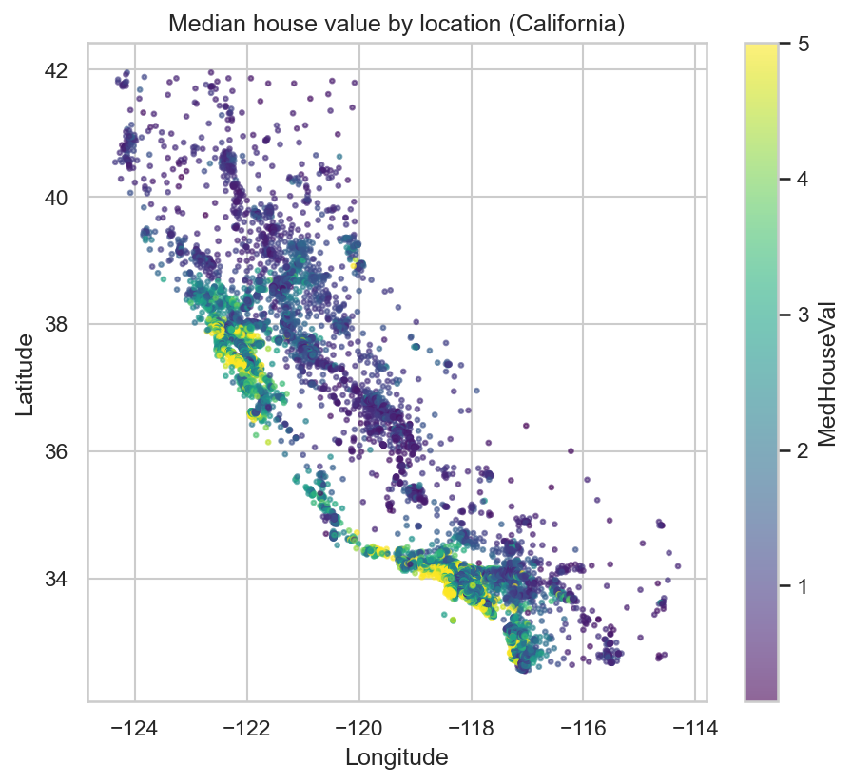
Datasets
Dataset | Task | Size | Target
Titanic | Classification | 891 rows, 11 features | Survived (0/1)
California Housing | Regression | 20,640 rows, 8 features | MedHouseVal ($100k)
• Why these: small, well-documented, strong prior-work benchmarks
• Cover both classification and regression

Slide 4
Preprocessing
Titanic
• Dropped PassengerId / Name / Ticket / Cabin
• Imputed Age (median), Embarked (mode)
• One-hot encoded Sex, Embarked
• Scaled numeric features
California Housing
• No missing values
• StandardScaler for linear / MLP models
Validation: 80/20 train-test split, 5-fold CV on training data

Slide 5
Models & Rationale
Dataset | Models
Titanic | Logistic Regression • k-NN • Decision Tree
California Housing | Linear Regression • Decision Tree • MLP
• Linear / Logistic → interpretable baseline
• k-NN / Decision Tree → non-parametric, capture local and non-linear structure
• MLP → flexible non-linear fit for continuous target
Tuning: GridSearchCV over C, k, max_depth, hidden_layer_sizes, alpha

Slide 6
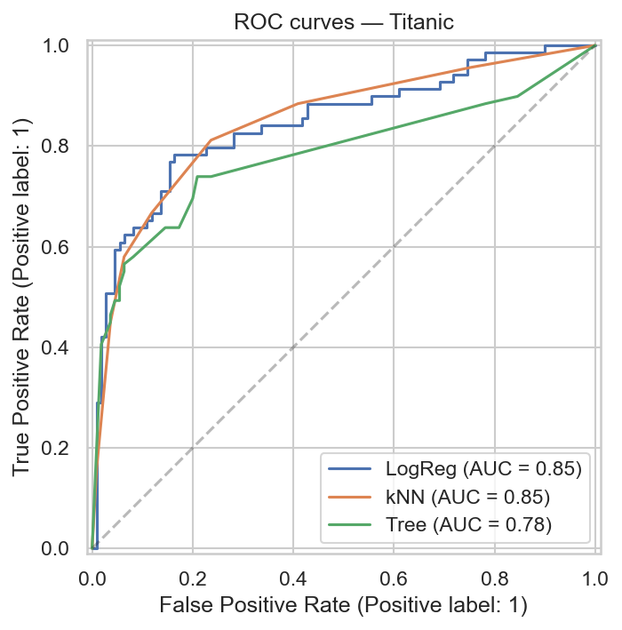
Results — Titanic (Classification)
Model | Accuracy | Precision | Recall | F1 | ROC-AUC
LogReg | 0.7933 | 0.7759 | 0.6522 | 0.7087 | 0.8472
k-NN (winner) | 0.7989 | 0.7797 | 0.6667 | 0.7188 | 0.8489
Tree | 0.7877 | 0.8163 | 0.5797 | 0.6780 | 0.7827
• k-NN wins overall — highest F1 and ROC-AUC
• Tree has best precision (0.82) but worst recall (0.58)
→ over-conservative decision boundary

Slide 7
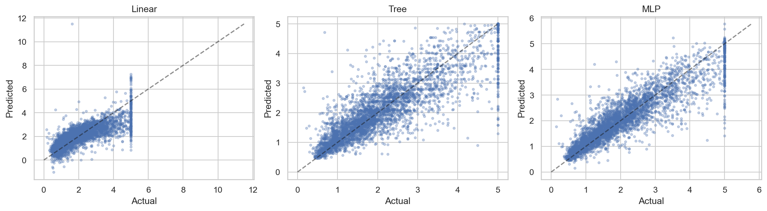
Results — California Housing (Regression)
Model | MAE | RMSE | R^2
Linear | 0.5332 | 0.7456 | 0.5758
Tree | 0.4041 | 0.5979 | 0.7272
MLP (winner) | 0.3448 | 0.5100 | 0.8015
• MLP wins — R^2 0.80, beats Linear by 24 points
• Linear underfits: income → value is non-linear
• Tree intermediate: axis-aligned greedy splits

Slide 8
Comparison to Prior Work
Titanic — Sehgal (Kaggle): reports 0.77–0.84 accuracy
→ Our 0.79 sits mid-band
→ Gap = feature engineering we omitted (titles, family size)
California Housing — Pace & Barry (1997): R^2 ≈ 0.65 (spatial autoregression)
→ Our MLP: 0.80, matching modern sklearn benchmarks
→ MLP captures the non-linear income-to-value curve

Slide 9
Lessons & Limitations
What worked
• Pipelines kept CV leakage-free
• GridSearchCV materially improved Tree and MLP
Limitations
• Titanic test set ~178 rows → 1–2 point gaps are noise
• CA target capped at $500k → residual spike at high end
• No ensemble methods (out of scope per rubric)
Next steps: feature engineering, gradient boosting, spatial features

Slide 10
Thanks — Questions?
github.com/malaviatanay/Applied-Machine-Learning-with-scikit-learn

