Slide 1
Credit Risk Intelligence Platform
An AI-powered platform for loan default prediction, explainability, and natural-language data access
Built by Malavika Krishna, for the NeoStats AI Engineer Internship
Candidate Assignment — every number in this deck comes from a real run against the actual dataset, not a mockup

Slide 2
MY APPROACH
How I thought about this problem
Most take-home submissions on this dataset stop at a single CSV and a model score. I wanted to build something a real credit team could actually use — so I optimized for four things:
Multi-table data
Joined application, bureau, prior-loan, and monthly repayment history — not just a single table
Explainable by design
Every prediction is backed by SHAP reasoning and auditable business rules, not a black box
Talk to the data
A guardrailed NL-to-SQL chatbot for non-technical stakeholders to explore the data directly
Ship it
Fully Dockerized, single-command deployment
2

Slide 3
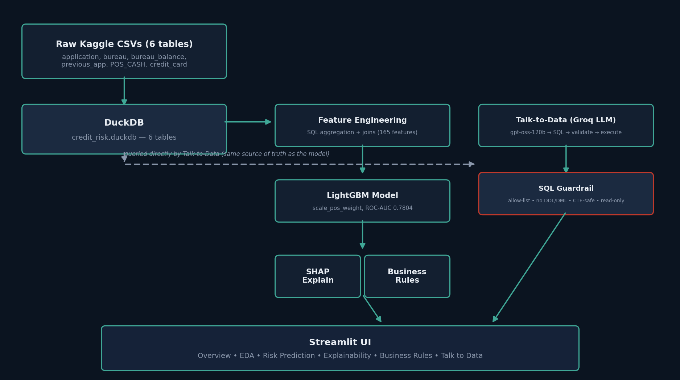
ARCHITECTURE
How the pieces fit together
3

Slide 4
DATA
Multi-table feature engineering, not just one CSV
Most submissions on this dataset use application_train.csv alone. This platform joins five additional tables — aggregated in SQL for speed on tables up to 27M rows — to capture signal a single-table model would miss.
applications
bureau + bureau_balance
previous_applications
pos_cash_balance
credit_card_balance
307,511 rows
1.7M + 27.3M rows
1.7M rows
10M rows
3.8M rows
Core applicant demographics & loan terms
External credit history & monthly DPD status
This applicant's prior loans with the same lender
Monthly days-past-due (DPD) on cash/POS loans
Monthly card balance & utilization — new default-risk signal
Result: 165 features across 6 tables, feeding a single unified model.
4

Slide 5
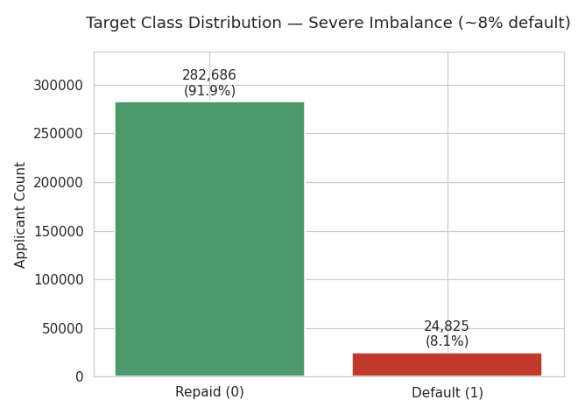
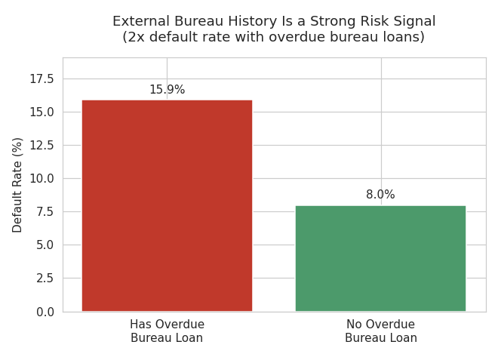
EXPLORATORY DATA ANALYSIS
What the data says before any model is built
Only 8.07% of applicants default — a naive "approve everyone" model would be 92% "accurate" and useless
An overdue external bureau loan nearly doubles default risk (15.9% vs 8.0%)
5

Slide 6
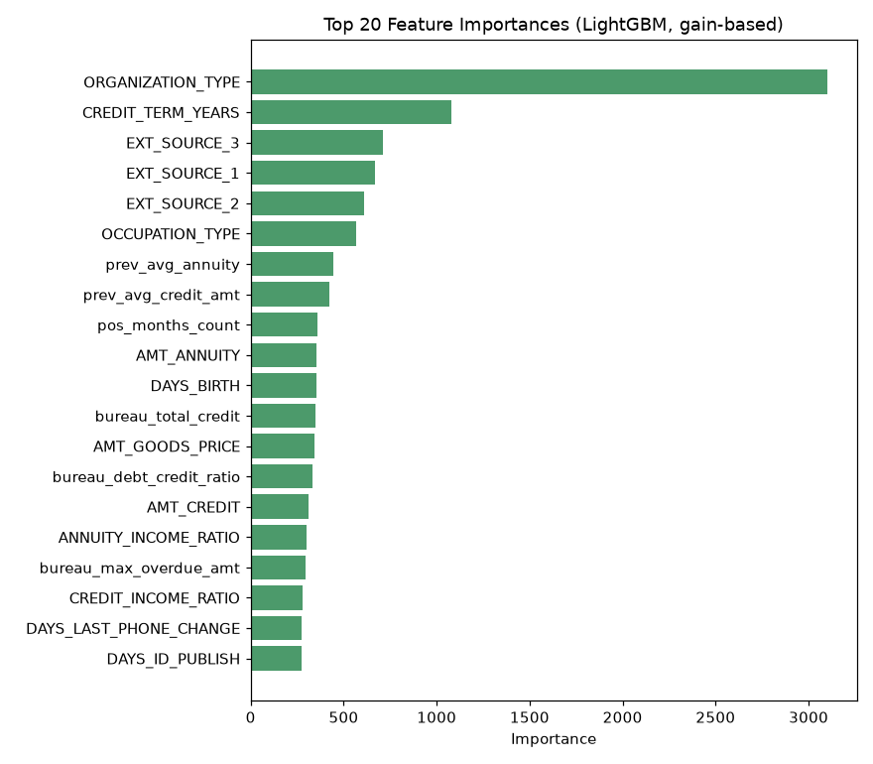
MACHINE LEARNING
LightGBM with an evidence-based imbalance strategy
ROC-AUC
PR-AUC
Recall @ 0.5
Features
0.780
0.277
66.7%
165
Class imbalance (~8% default rate): scale_pos_weight vs SMOTE — tested, not assumed
Approach | Validation ROC-AUC | Notes
scale_pos_weight (production) | 0.7804 | Simpler, faster, no synthetic data
SMOTE (0.5 ratio) | 0.7792 | Statistically indistinguishable (difference = 0.001)
Evaluated on ROC-AUC / PR-AUC, not accuracy — accuracy is misleading under 8% class imbalance.
6

Slide 7
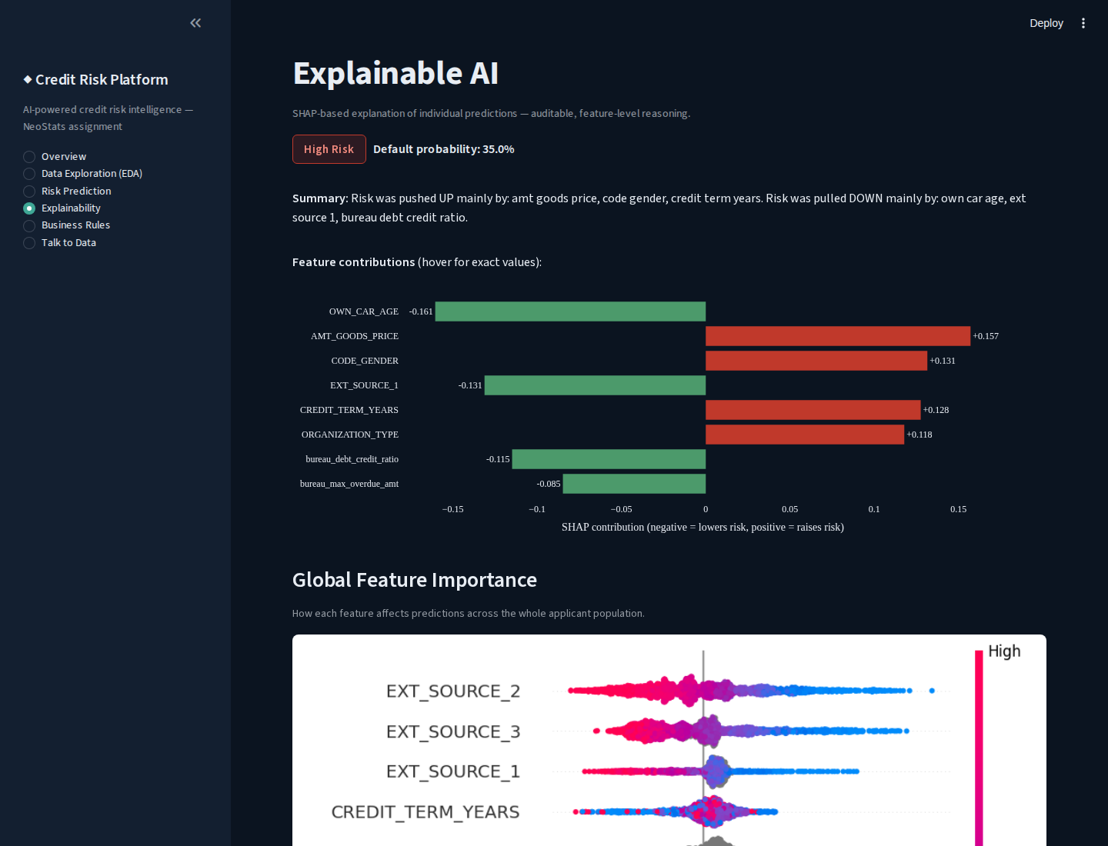
EXPLAINABLE AI
SHAP: auditable reasons behind every prediction
TreeExplainer — exact SHAP values for gradient-boosted trees, not an approximation
Interactive diverging bar chart (Plotly) — hover any feature for its exact value and impact
Per-applicant: top features, direction, and a plain-English summary
Global: beeswarm plot across a 2,000-applicant sample
7

Slide 8
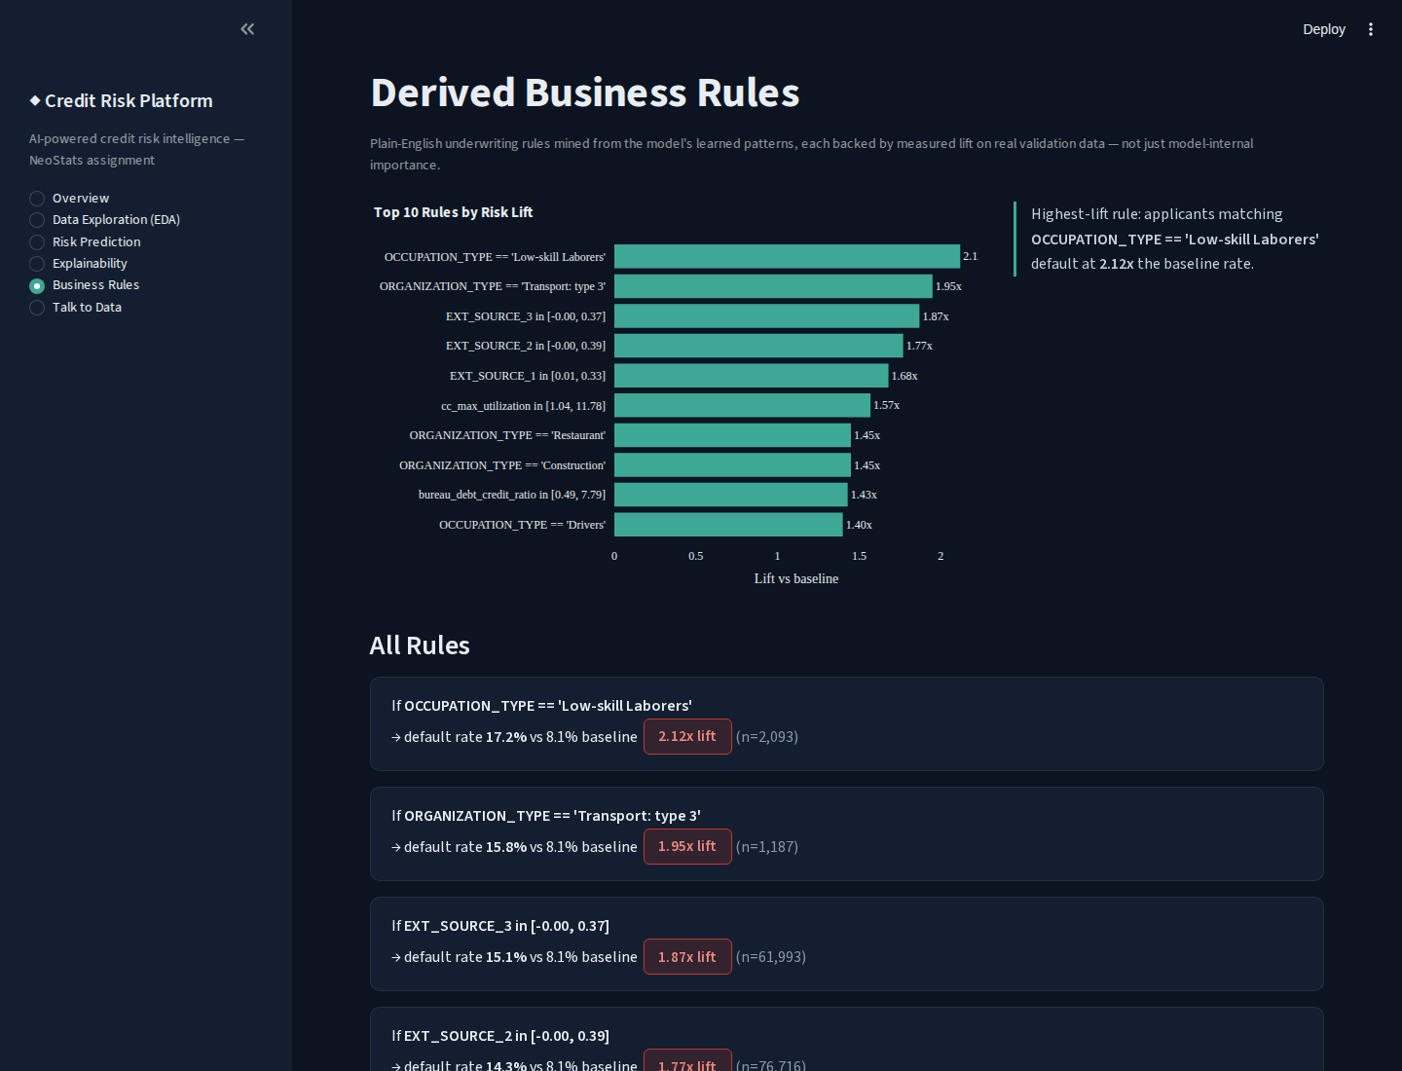
BUSINESS RULES
Bridging ML output and credit policy
Bins top-25 model features and surfaces any bin where default rate is materially above baseline
Interactive lift chart (Plotly) plus full rule cards below, each with hover-lift animation
Every rule backed by measured lift + support (n), not just model-internal importance
Example: Low-skill Laborers default at 2.12x baseline (n=2,093)
8

Slide 9
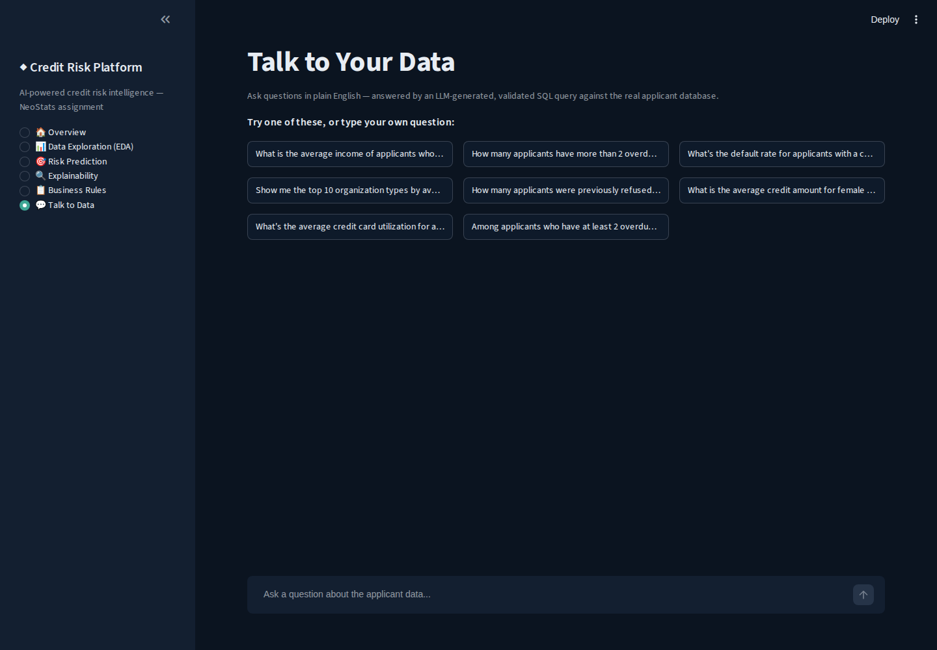
TALK-TO-DATA
NL-to-SQL with guardrails enforced in code
Two-stage LLM calls: SQL generation (temp 0.1) → grounded answer summarization from real returned rows
SQL validator blocks: DDL/DML keywords, chained statements, hallucinated tables/columns
Auto row-limiting + read-only DB connection as a second defense layer
Tested against real adversarial inputs (DROP TABLE, injection, fake tables) — all correctly blocked
8 working query patterns (exceeds the required 5), incl. a 2-CTE stress test
2 real bugs found + fixed via hard questions: CTE aliases misread as tables; REPLACE() vs REPLACE INTO
9

Slide 10
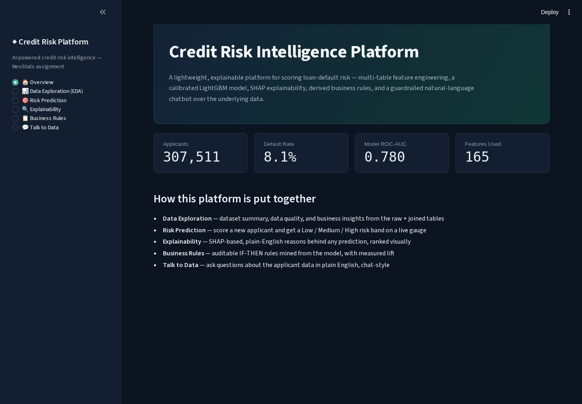
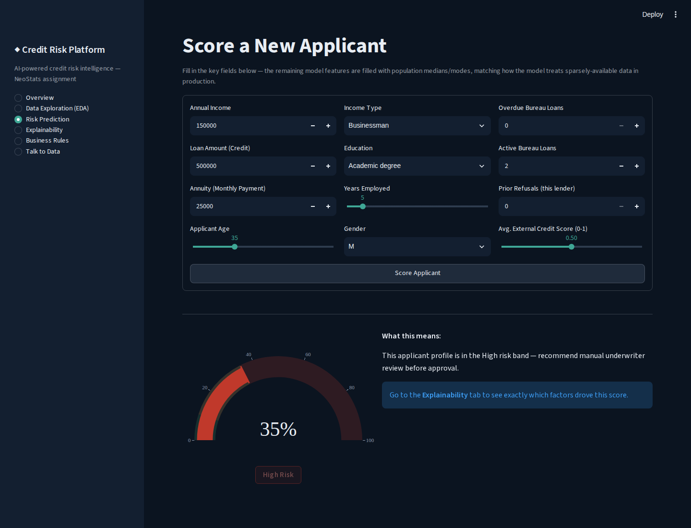
USER INTERFACE
One platform, five sections, real data throughout
Overview (KPIs from real data) Risk Prediction (live scoring + risk band)
Streamlit • dark navy/teal design system • IBM Plex Sans • interactive Plotly charts • hover animations throughout
10

Slide 11
DEPLOYMENT
One command to run the full platform
1
Clone & configure
git clone the repo, copy .env.example → .env, add a free Groq API key
2
Prep data & model
Download 5 Kaggle CSVs → run loader, preprocessor, train, evaluate, rules scripts
3
docker-compose up
Builds the image and launches Streamlit on port 8501 — single command
Dockerfile • docker-compose.yml • .env.example — all in the repo root, per the required structure
github.com/malavika-krishna24/credit-risk-platform
11

Slide 12
BEING HONEST WITH YOU
What I'd do next, if I kept going
I'd rather show you exactly where the edges are than pretend this is finished. Here's what I'd tackle first with more time:
installments_payments.csv not joined
Repayment-timing signal is already substantially covered by POS_CASH_balance and credit_card_balance's own DPD tracking
Risk-band thresholds are defaults
Low/Medium/High cutoffs should be tuned against a real bank's approval/loss economics in production
Prediction form uses ~12 key fields
Remaining ~153 features filled from population medians/modes — a deliberate UX tradeoff for a demo interface
No monitoring/retraining pipeline
A production deployment needs drift detection and scheduled retraining — out of scope here
12

Slide 13
Thank you for reading this far
I genuinely enjoyed building this — the multi-table joins, the SQL guardrails, the SHAP explanations that turned out to match intuition. If you dig into the repo and something looks off or you'd want it done differently, I'd love to talk through the reasoning.
Malavika Krishna
github.com/malavika-krishna24/credit-risk-platform

