Slide 1


Deep Learning-Based Diabetes Prediction
PROJECT BY
MALAVIKA RAJANALA
SRI CHETAN VALLABHANENI
VIKAS NIMMAGADDA

Slide 2
Table of contents
1. Deep Learning-Based Diabetes Prediction
2. Contents: Problem Definition & Data
4. Methodology & Results
5. Evaluation & Future Work
6. Hypotheses
7. Neural Network Architecture
8. Model Performance
9. Feature Importance
10. Future Work Recommendations

Slide 3
Deep Learning-Based Diabetes Prediction
1
1
2
Accuracy
Precision (Class 0)
3
4
73.38%
0.78
5
6
7
Recall (Class 0)
Precision (Class 1)
8
0.81
0.63
9
10

Slide 4
Contents
1
Problem Definition
2
Early detection of diabetes is crucial for effective management and treatment.
Develop a deep learning model to predict diabetes risk based on health indicators.
3
4
5
Data
6
7
Source: Pima Indians Diabetes Database (Kaggle).
768 instances, 8 features, 1 target variable.
Features: Pregnancies, Glucose, Blood Pressure, Skin Thickness, Insulin, BMI, Diabetes Pedigree Function, Age.
Target: Diabetes Outcome (0 or 1).
8
9
10

Slide 5
Methodology
1
2
Data Preparation
Data Processing
Used the Pima Indians Diabetes dataset (768 samples, 8 features).
Features include health indicators like Glucose, BMI, and Age.
Target: Diabetes Outcome (0 = Non-Diabetic, 1 = Diabetic)
Splitted into train (80%) and test (20%) sets.
Scaled features using StandardScaler.
3
4
5
6
Training & Evulation
Model Design
Optimizer: Adam (learning rate 0.001).
Loss: Binary Crossentropy.
Trained for 100 epochs, batch size: 32.
Metrics: Accuracy, Precision, Recall, F1score. Analyzed training history and feature importance.
7
Built a Neural Network (MLP) in TensorFlow / Keras:
3 hidden layers with 64, 32, and 16 neurons (ReLU activation).
Dropout layers to reduce overfitting.
Output: 1 neuron (sigmoid activation).
8
9
10

Slide 6
Result
1
The model achieved a test accuracy of 73.38%, showing good ability to correctly identify non-diabetic cases with 78% precision and 81% recall. However, its performance in predicting diabetic cases was less accurate, with a precision of 63% and a recall of 60%, indicating room for improvement. Key factors like glucose levels and BMI stood out as the most significant predictors of diabetes, which is consistent with medical understanding. Although the model narrowly missed the 75% accuracy goal, it demonstrates potential as a useful screening tool. Some overfitting was noticed during training, suggesting the need for further adjustments to improve its generalization.
2
3
4
5
6
7
8
9
10

Slide 7
Evaluation & Future Work
1
2
Evaluation: The model achieved a test accuracy of 73.38%, showing promising results. Identified non-diabetic cases with good accuracy, but diabetic cases were less accurately predicted. Glucose and BMI were confirmed as top predictors, aligning with medical knowledge.
3
4
5
6
Future Work: Experiment with more complex neural network architectures to potentially improve accuracy. Implement k-fold cross-validation for robust performance estimation and validation. Explore ensemble methods like combining MLP with Random Forests for enhanced predictive power. Incorporate additional relevant features such as family history and diet information for a more comprehensive model. Develop a user-friendly web or mobile application for easy access to the diabetes prediction tool.
7
8
9
10

Slide 8
Hypotheses
1
2
3
Hypothesis 1: A deep neural network can achieve at least 75% accuracy in predicting diabetes risk.
This accuracy threshold is crucial for the model to be considered reliable for early detection.
4
5
6
Hypothesis 2: Glucose levels and BMI will be the most significant predictors.
These two features are commonly associated with diabetes risk in medical literature and are expected to have a strong impact on the prediction model.
7
8
9
10

Slide 9
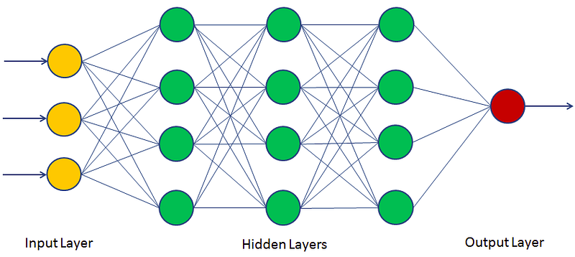
Neural Network Architecture
1
2
3
4
5
6
7
8
9
10

Slide 10
Model Performance
1
1
2
3
Test Accuracy
Precision & Recall
4
73.38%
0.78
5
Precision (Class 0): 0.78, Recall (Class 0): 0.81
Precision (Class 1): 0.63, Recall (Class 1): 0.60
Precision measures the model's ability to correctly identify true positives, while recall measures the model's ability to capture all actual positives.
The model's accuracy in predicting diabetes risk on test data.
6
7
Top Predictors
Performance Evaluation
8
0.63
8
0.81
9
Glucose and BMI identified as significant predictors.
Glucose levels and BMI play a crucial role in predicting diabetes risk.
The model shows promise but falls slightly short of the 75% accuracy target.
Effective in identifying non-diabetic cases but less accurate for diabetic cases.
10

Slide 11
Feature Importance
1
1
2
3
Glucose Level
BMI (Body Mass Index)
4
High glucose levels have a significant impact on diabetes risk.
Glucose is a key indicator in predicting the likelihood of developing diabetes.
High glucose levels have a significant impact on diabetes risk.
Glucose is a key indicator in predicting the likelihood of developing diabetes.
5
6
Blood Pressure
Age & Insulin Levels
7
High blood pressure is a common comorbidity of diabetes.
Monitoring blood pressure is essential in diabetes management.
Age is an important factor in diabetes prediction.
Risk of diabetes tends to increase with age due to various physiological changes.
Insulin levels are closely linked to diabetes risk.
Abnormal insulin levels can indicate insulin resistance, a precursor to diabetes.
8
9
9
10

Slide 12
Future Work Recommendations
1
1
2
3
Explore Transfer Learning
Enhanced data Augmentation Techniques
4
Investigate the potential of leveraging pre-trained models for diabetes prediction tasks.
Transfer learning can help improve model performance by utilizing knowledge from related domains.
5
Implement advanced data augmentation methods to increase the diversity and size of the training dataset.
Augmented data can lead to more robust models and better generalization to unseen instances.
6
7
Integrate Time-Series Analysis
Deploy Explainable AI techniques
8
Incorporate temporal aspects into the model to capture trends and patterns over time.
Time-series analysis can provide valuable insights into the progression of diabetes risk factors.
Utilize interpretable models to enhance transparency and trust in the prediction results.
Explainable AI methods can help clinicians understand the model's decisions and improve patient care.
9
10

Slide 13
THANK YOU…..

