Slide 1

Factor-based Portfolio Construction: Optimizing Risk-Adjusted Return
DATA690: Financial Data Science
A Multi-Factor Approach to Portfolio Management
By Malav Patel

Slide 2
Table of Contents
01
02
03
Introduction
Motivation
Research & Analysis
04
05
06
Findings
Insights
Concusion

Slide 3

Introduction
01

Slide 4
Competitors
Developed by
Type
Model
Reason
It's rooted in academic research, particularly the work of Eugene Fama and Kenneth French.
Factor-based investing is an approach that aims to capture specific drivers of returns across asset classes.
We focus on the Fama-French Three-Factor Model, which includes:
This approach allows for a more nuanced understanding of portfolio risk and return drivers.

Slide 5

Factors
Market Factor (MKT)
Size Factor (SMB)
Value Factor (HML)
Excess return of the market over the risk-free rate
Return difference between small and big stocks
Return difference between high and low price-to-book ratio stocks

Slide 6

Motivation
02

Slide 7

Traditional portfolio theory often relies on simplistic assumption about risk and return
Motivation
Factor-based investing offers potential for improved risk-adjusted returns by:
It allows investors to tailor their portfolios to specific factor exposures based on their views or risk preferences.
Capturing specific return drivers
Providing a more granular view of risk exposures
The approach can lead to better diversification by considering not just asset classes, but underlying return drivers.

Slide 8

Research & Analysis
03

Slide 9
Research Methodology
Data collection
Factor Calculation
Model Implementaion
Selected 10 diverse stocks:
AAPL, NVDA, GOOGL, AMZN, TSLA, BRK-B, JNJ, JPM, V, PG
Time period: 2010-2023
Market (MKT): Excess return of
S&P 500 over risk-free rate
Size (SMB): Return difference between small and big stocks based on market cap
Value (HML): Return difference between high and low book-to-market stocks
Used linear regression to estimate factor loadings for each stock
Calculated expected returns based on factor exposures

Slide 10
Initial Portfolio Optimization
Apple
Tesla
Objective
Maximize Sharpe Ratio (risk-adjusted return)
17.83%
19.67%
Initial Constraints
Only budget constraint
(weights sum to 1)
18.82%
26.98%
Visa
Nvidia
Weights distribution
Results showed heavy distribution in few stocks
Result
This concentration, while theoretically optimal, poses practical issues in terms of diversification and risk management.

Slide 11
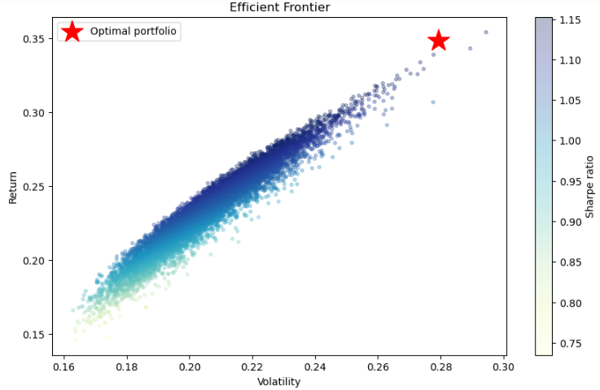
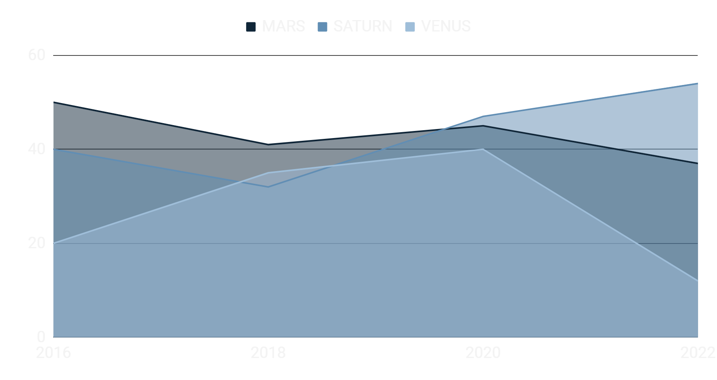
Efficient Frontier without constraints
The portfolio is quite concentrated, with about 80% allocated to just four stocks. This lack of diversification could be a concern in practice.
The expected annual return of 34.86% is very high, which suggests our model might be overly optimistic. This could be due to using historical data during a period of strong market performance.
The volatility of 27.93% is also quite high, reflecting the aggressive nature of this portfolio.
The Sharpe ratio of 1.1765 is good, indicating a favorable risk-adjusted return.
If you want to modify this graph, click on it, follow the link, change the data and replace it

Slide 12
Enhanced Portfolio Optimization
Added practical constraints to improve real-world applicability:
Maximum industry weight
Maximum stock weight
20%
40%
Constraints
Turnover limit
Transaction cost
0.1%
20%
These constraints aim to balance theoretical optimality with practical considerations of diversification and trading costs.

Slide 13
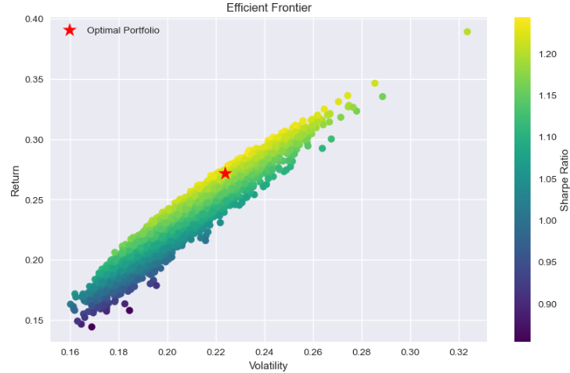
Efficient Frontier with constraints
Our optimized portfolio lies on the efficient frontier, indicating it offers the best possible expected return for its level of risk.
The position of our portfolio suggests a good balance between risk and return, it lies in the upper middle part of the portfolio concentrations because of the constraints.
If you want to modify this graph, click on it, follow the link, change the data and replace it

Slide 14
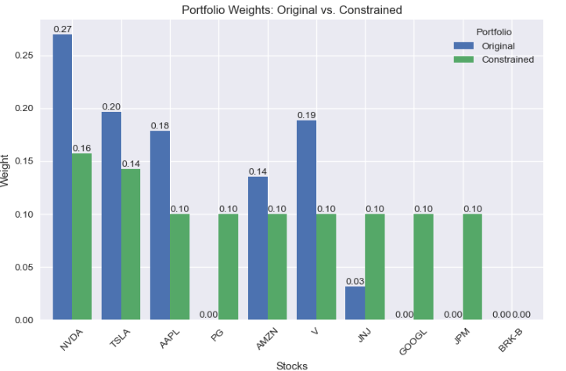
Portfolio Weight Comparison
The constraints significantly altered the portfolio composition:
More evenly distributed weights across stocks
Reduced concentration risk
Increased diversification across industries
While potentially reducing theoretical performance, these changes make the portfolio more robust and implementable in practice.
If you want to modify this graph, click on it, follow the link, change the data and replace it

Slide 15

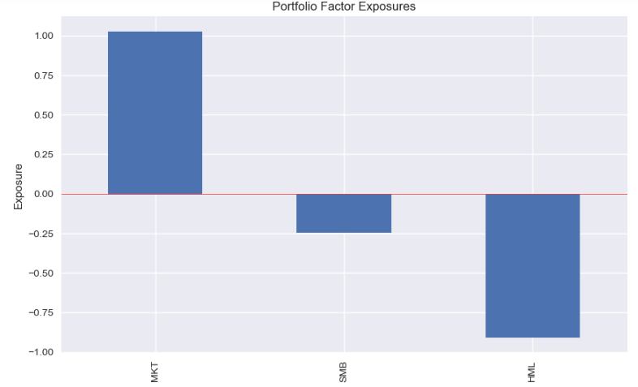
Our portfolio shows significant factor exposures:
- Strong positive exposure to the market factor (beta close to 1)
- Slight negative exposure to the size factor (tilt towards larger companies)
- Strong negative exposure to the value factor (significant growth tilt).
These exposures reflect the characteristics of our selected stocks, which include many large-cap, growth-oriented technology companies.
Factor Analysis
Factor exposures chart

Slide 16
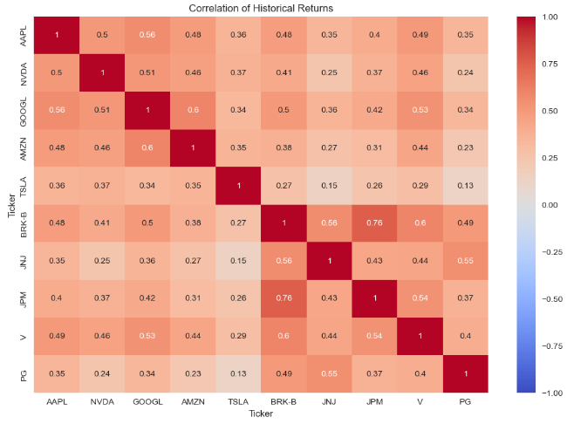
Historical Return Analysis
The correlation heatmap reveals:
Generally positive correlations between stocks, ranging from 0.13 to 0.8
Higher correlations between certain sectors (e.g., tech stocks)
Lower correlations for some stocks (e.g., TSLA), offering diversification benefits
These correlations is crucial for effective diversification and risk management.
If you want to modify this graph, click on it, follow the link, change the data and replace it

Slide 17
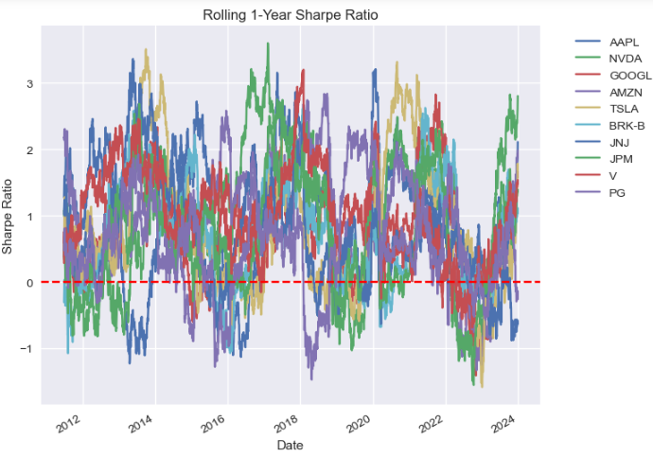
Rolling Performance
The rolling Sharpe ratio plot shows:
Significant variation in risk-adjusted performance over time
Periods of exceptional performance for some stocks (e.g., NVDA, TSLA)
A general decline in Sharpe ratios around 2023, likely due to market conditions
This dynamic nature of performance underscores the importance of regular portfolio rebalancing and ongoing factor analysis.
If you want to modify this graph, click on it, follow the link, change the data and replace it

Slide 18

Findings
04

Slide 19
Portfolio Performance Metrics
34.86%
27.93%
27.20%
22.38%
Expected Annual return before constraints
Expected Annual volatility before constraints
Expected Annual return after constraints
Expected Annual volatility after constraints
The constrained portfolio shows lower expected return and volatility, with only a slight decrease in Sharpe ratio, indicating improved risk-adjusted performance stability.

Slide 20

Key findings
Improved diversification through constraints, reducing concentration risk.
Maintained strong risk-adjusted performance despite more conservative allocation.
Persistent factor exposures, particularly a growth tilt and slight large-cap bias.
Importance of balancing theoretical optimization with practical constraints.
Dynamic nature of factor performances, necessitating ongoing monitoring and rebalancing.

Slide 21

Insights
05

Slide 22

Insights
Constraints are crucial in translating theoretical models to practical portfolio management
Factor exposures provide a more nuanced understanding of portfolio risk and return drivers
There's a clear trade-off between maximizing theoretical performance and ensuring real-world applicability
Regular rebalancing is essential due to the dynamic nature of factor performances
Factor-based approach allows for more targeted risk management and return enhancement

Slide 23

Conclusion
06

Slide 24

Conclusion
Factor-based portfolio construction offers a sophisticated approach to optimizing risk-adjusted returns
Balancing theoretical optimization with practical constraints is crucial for real-world implementation
Regular monitoring and rebalancing are necessary due to the dynamic nature of factor performances
While challenges remain, factor investing represents a powerful tool for portfolio managers seeking to enhance returns and manage risk more effectively

Slide 25

Future Work
Incorporate additional factors (e.g., momentum, quality)
Explore machine learning techniques for factor identification and weighting
Investigate the impact of different economic conditions on factor performance

Slide 26

Morgan Housal
“The idea that a few things account for most results is not just true for companies in your investment portfolio. It’s also an important part of your own behaviour as an investor.”
Author of the International Bestseller
‘The Psychology of Money’

Slide 27

Thanks
Does anyone have any questions?
malavp1@umbc.edu

