Slide 1
SecureHealth
An AWS-based secure patient records portal with role-based access control, encrypted storage and verifiable integrity
Malav Mehta · Robert Ruiz Villalta · Zawad Hossain · Cinderella Akash Gill
MCSC-6002-RNA · Professor Timothy Wong · Humber Polytechnic · August 2026
Notes:
Malav opens. We built a working secure patient records system on AWS, not a design exercise. Everything you see today is deployed and live in ca-central-1.

Slide 2
THE PROBLEM
Small clinics hold the most sensitive data with the weakest defences
US$7.42M
42%
+26%
Average cost of a healthcare
data breach — highest of any
industry (IBM, 2025)
of Canadian organizations had a
data breach in the past year,
up from 29% in 2022 (CIRA, 2025)
average yearly growth in known
Canadian ransomware incidents,
2021–2024 (Cyber Centre, 2026)
Why it matters beyond the cost
Health data cannot be reissued like a credit card — it keeps its value to attackers indefinitely
PHIPA and PIPEDA require access controls and audit trails: weak protection is a compliance failure, not only a technical one
Record integrity is patient safety — an undetected change to an allergy or dosage causes direct physical harm
Notes:
Healthcare is the most expensive breach target in the world, and Canadian numbers are climbing. But the point we care about most is the third one: integrity is a patient safety issue, not just a privacy issue.

Slide 3
WHAT WE BUILT
A clinic portal where every control is enforced on the server
The system
Three roles, enforced in the API
Register, search, view and update patient records
Serverless AWS stack, deployed and running in ca-central-1
Next.js dashboard, API Gateway, Lambda, DynamoDB, KMS, Cognito
Entire stack defined as infrastructure as code
Admin
Full record access, plus the audit log
Doctor
Full clinical access: create, read, update
Receptionist
Demographics only — clinical fields redacted, writes refused
The interface hides what a role cannot do. The API refuses it. Only the second one is a security control.
Notes:
Robert takes this slide. Emphasise the bottom line — hiding a button is presentation, refusing the request is enforcement. We test both.

Slide 4
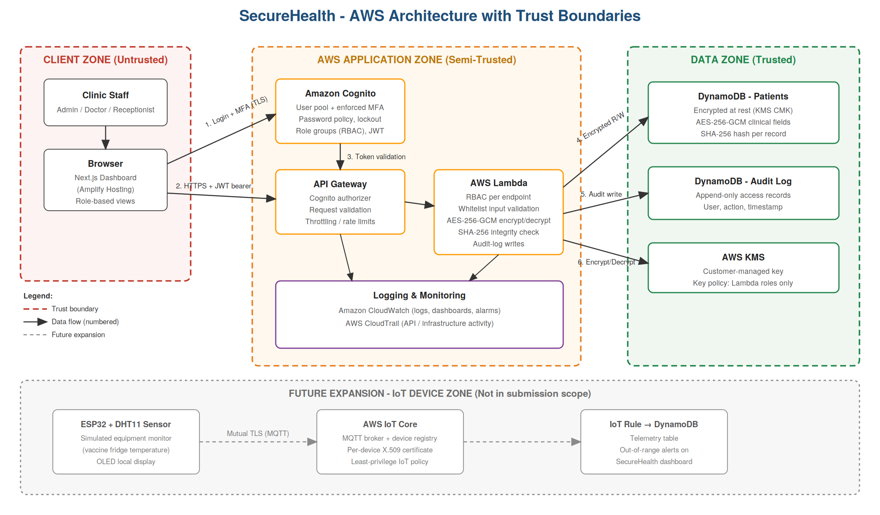
ARCHITECTURE
Three trust zones, and every crossing is checked
Client zone is untrusted · Application zone authenticates, authorises and validates · Data zone is reachable only from Lambda roles scoped to one table and one key
Notes:
Malav. Walk the numbered flows: 1 login with MFA, 2 API call with a bearer token, 3 token validation, 4-7 encrypted reads and writes through KMS. Note the IoT zone is greyed out - designed, not built.

Slide 5
SECURITY IMPLEMENTATION
Six controls, chained so none can be skipped
Authentication & MFA
Role-based access control
1
2
Cognito user pool, TOTP enforced, 12-character policy, admin-only provisioning
Deny-by-default matrix; identity read only from validated token claims
Input validation
Encryption AES-256-GCM
3
4
Server-side whitelist; unknown fields rejected; strict per-field patterns
KMS customer-managed key; per-record encryption context; TLS in transit
SHA-256 integrity
Logging & monitoring
5
6
Hash over plaintext, verified on every read; tampering returns 409
Append-only audit trail, CloudWatch metrics, six alarms, CloudTrail
The requirement was four. Every request runs the same pipeline: identity → authorise → validate → act → audit.
Notes:
Zawad. The project asked for four controls; we implemented all six. The pipeline order matters - authorisation happens before validation, so a role that cannot act never reaches the parsing code.

Slide 6
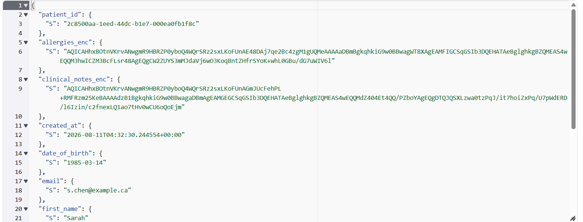
HOW TWO CONTROLS WORK
Encryption you can see, integrity you can prove
Encryption
Integrity
Clinical fields are encrypted through AWS KMS before they reach the database. The plaintext key never enters the function's memory.
A SHA-256 hash is taken over the decrypted record and re-checked on every read — so tampering is caught whether an attacker edits a clear field or swaps an encrypted blob.
Record read from DynamoDB
Hash recomputed over plaintext
Mismatch → 409, record withheld
Alert written to the audit log
What is actually stored: ciphertext, never the note. A blob copied onto another patient's record fails to decrypt.
Restore the original value and it verifies again.
Notes:
Malav. The key design decision: we hash the plaintext, not the ciphertext. That catches both a console edit of a name and a swapped encrypted blob. Hashing ciphertext would only catch the second.

Slide 7
THREAT MODELLING
STRIDE applied at every boundary, before any code was written
S
Spoofing
Forged token, stolen credentials
MFA + gateway token validation
T
Tampering
Injection; record altered in the database
Whitelist validation; SHA-256 verification
R
Repudiation
User denies an access or change
Append-only audit trail with identity
I
Info disclosure
PHI from a stolen table; role over-reach
KMS encryption; server-side redaction
D
Denial of service
Flooding; oversized payloads
Gateway throttling; 10 KB body cap
E
Elevation
Low-privilege role reaching write endpoints
Deny-by-default RBAC, audited
15 threats modelled in OWASP Threat Dragon · 12 mitigated · 3 accepted and documented as residual risk
Notes:
Zawad. We modelled threats before implementing, so mitigations drove the design rather than being retrofitted. Three threats remain open and we say so - MFA fatigue, audit immutability, per-identity rate limiting.

Slide 8
TESTING
145 passing tests, each mapped to a threat
145
6/6
0
0
automated tests, all passing
STRIDE categories covered
Bandit findings in 428 lines
high-risk ZAP findings
Attack scenarios run against the deployed system
Unauthenticated request
SQL and XSS payloads in every field
401 — blocked at the gateway
400 — rejected, never reflected back
Mass assignment of is_admin
Receptionist creates a record
400 — unknown field refused
403 — denied and audited
Record altered directly in DynamoDB
Doctor requests the audit log
409 — integrity failure, record withheld
403 — Admin only
The suite also caught a real defect: one endpoint written before response handling was centralised was missing a security header. Manual checks had missed it.
Notes:
Cinderella. All 145 pass, unit and integration. Every test carries a STRIDE marker so the suite maps directly to the threat model. The last line matters: automated testing found something manual checking had not.

Slide 9
LIVE DEMONSTRATION
The system, running
1
2
3
4
5
Sign in with MFA
Doctor view vs Receptionist view
Blocked attack attempts
Tamper, detect, restore
Audit log and dashboard
Notes:
Malav drives the demo, Robert narrates. Order: login with MFA, doctor sees clinical notes, receptionist sees REDACTED, receptionist create returns 403, tamper a record in DynamoDB and read it back for the 409, restore it, then the audit log and CloudWatch alarms. Backup video ready if the network fails.

Slide 10
DEMONSTRATION WALKTHROUGH
What the demo shows
Authentication
Password alone is refused; a TOTP code is required every time
Role separation
The same record shows clinical notes to a Doctor and [REDACTED] to a Receptionist
Server-side enforcement
A Receptionist calling the API directly still gets 403 — the hidden button was never the control
Encryption at rest
The DynamoDB console shows ciphertext where the clinical note should be
Tamper detection
A record edited in the console returns 409 and is withheld; restoring it makes the record valid again
Accountability
Every action above — including each denial — appears in the audit log
Notes:
Robert. This is the map of what the audience just watched, in case the demo runs long or something needs to be skipped.

Slide 11
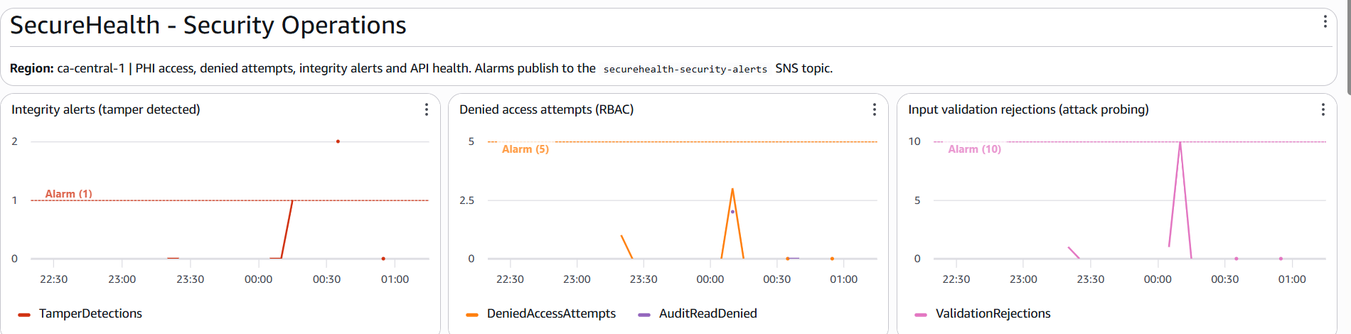
MONITORING
Security is watched, not assumed
From log line to alarm
What we alarm on
1
Handler prints a structured security event
Record tampering
1 event
2
CloudWatch metric filter parses it
Repeated access denials
5 in 5 min
Input attack probing
10 in 5 min
3
Custom metric feeds the dashboard
API server errors
5 in 5 min
4
Alarm publishes to an SNS topic
Gateway throttling
20 in 10 min
Function errors
3 in 5 min
Metrics are derived from logs, so monitoring adds no latency to a user's request.
Tampering alarms on a single event. Denials and rejections happen in normal use — they only matter in volume.
Notes:
Zawad. Explain the asymmetric thresholds - one integrity failure means data has already been altered, so there is no tolerance band. Denials are expected in normal operation.

Slide 12
CHALLENGES
What went wrong, and what it taught us
1
Least privilege blocked our own code
2
Hidden account-level state
The first authenticated request failed with 502. The Lambda role could write to the audit table but not use the KMS key protecting it. Data permissions and key permissions are separate grants.
Deployment failed until an account-wide API Gateway logging role was created — a prerequisite that does not exist in a fresh AWS account. Infrastructure as code covers what it declares, not what it assumes.
3
Configuration drift
4
Credential shortcuts under deadline
A CORS fix applied by hand was silently reverted when an archive was unpacked over the working copy. A change that lives only in a working copy will eventually be overwritten.
Early work used root credentials because it was fastest. Moving to a scoped IAM user took five minutes and had been deferred for hours.
Notes:
Cinderella. These were genuine obstacles on the day, not hypotheticals. The first one is our favourite - the encryption control was working exactly as designed, it just had not been told our own code was authorised.

Slide 13
LIMITATIONS & FUTURE WORK
Where the guarantees end
Known limitations
Designed future expansion: IoT
Patient search uses a table scan; production would use a secondary index
CORS is permissive for the demo; production pins the origin
Audit immutability rests on application design and IAM, not cryptography
Rate limiting is per method, not per identity
Frontend CSP allows unsafe-inline in development mode
Connected equipment monitoring — an ESP32 with a temperature sensor watching a vaccine refrigerator — designed but deliberately not built, so effort stayed on the assessed controls.
Adds a fourth trust zone: a physical device can be stolen and cloned
Per-device X.509 certificates with mutual TLS to AWS IoT Core
New STRIDE threats: device spoofing and telemetry tampering
Knowing exactly where a system's guarantees end is itself a security property.
Notes:
Zawad covers the IoT column, Cinderella the limitations. Be ready for a question on why we did not build the IoT piece - the honest answer is scope control, and the controls being assessed were the priority.

Slide 14
What we set out to prove
The controls are real, not decorative
Least-privilege IAM refused our own code until it was properly authorised
Encryption enforcing itself is stronger evidence than a passing test
The integrity check withheld a record altered in the database, then served it again once restored
Deterministic verification, not a one-way failure state
Automated tests found a defect that manual checking had missed
Which is exactly why they were written
Six controls · 15 threats modelled · 145 tests passing · deployed and running
Notes:
Malav closes. The strongest evidence was not that the controls worked when we tested them - it was how they behaved when things went wrong.

Slide 15
THANK YOU
Questions
Team contributions
Ask us about
Malav Mehta
Why we hash plaintext rather than ciphertext
Why encryption is delegated to KMS
How the per-record encryption context defeats blob swapping
What we would fix first with another week
Architecture, backend security, threat model
Robert Ruiz Villalta
Frontend, authentication flow, diagrams
Zawad Hossain
Logging, monitoring, IoT design
Cinderella Akash Gill
Testing, security scans, documentation
github.com/malavmehta7101/securehealth
Notes:
All four members field questions. If asked what we would fix first: a global secondary index for search, then per-identity rate limiting, then S3 Object Lock for the audit trail.

