Slide 1


Programming 01
Maxime Lavigne B. Eng, M.Sc, PhD Candidate
PPHS616 - Principles and Practice of Public Health Surveillance
McGill University
January 20, 2020

Slide 2
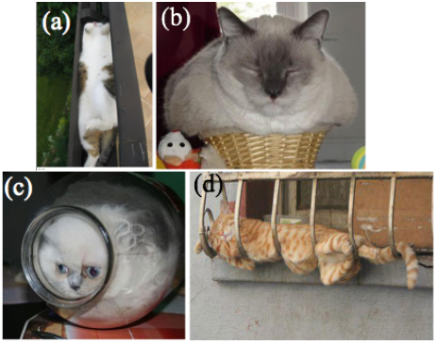
Effective Communicators are better Scientists
Modern science is collaborative and iterative
Built on the works of others
Increasingly interdisciplinary
Often repurposed in unexpected ways
In Scientific Communication
Limit Ambiguity
Completeness, transparency
Reproducibility / Falsifiability
Persuasive communication
Perceived correctness
Fardin, M.A., 2014. On the rheology of cats. Rheology Bulletin, 83(2), pp.16-17. 2017 IG Nobel Winner in Physics
Notes:
Rheology or the study of flow. (Are Cats liquid or solid?)
Completeness in the sense of no “magic happens”. Proof and argument need to be complete.

Slide 3
Canadian Chronic Disease Surveillance System (CCDSS)
Diabetes Mellitus – Case Definition
“One or more hospitalizations or two or more physician claims within two years “
ICD Codes 9 (250*) 10 (E1(0|1|2|3|4)*) Ages 1+
Confident you could replicate their numbers?
health-infobase.canada.ca/ccdss/data-tool/
Notes:
(wait for answer at the end)
What could go wrong?

Slide 4
Canadian Chronic Disease Surveillance System (CCDSS)
“One or more hospitalizations or two or more physician claims within two years “
Indicators Based on this Case Definition
What is a year (Same date two years later? What about leap year, is year 365, 365.25, depends on year?)
What if a physician makes two claims for one visit? (same day)
Do you count services given before the cut off age? Or can’t they have DM before 1?
Indicators Based on this Case Definition
When does a year start/end?
Will you round the number, how to match their rounding? (What if probabilistic strategy)
What about confidence intervals? May be modified for suppression.
What if age-standardized? What population, from which counts, rounded before/after/not at all?
Do you use a “burn-in” period for unstable early years.
Notes:
This is the difference between a definition and a specification.
You can imagine how, for example, this could have many consequences in complex environment like self-driving cars.

Slide 5
Pseudocode for DM
with events as diagnoses where
icd like “250*” or between “E10” to “E14”
and date >= dob + interval ‘1 year’
(
select distinct patient, min date from events where hospitalization
) UNION (
select distinct patient, date of second
from events as first join events as second on
same id and
second between first + interval ‘1 day’ and interval ‘2 year’
)
Notes:
Interval 1 year add 1 to the year.

Slide 6
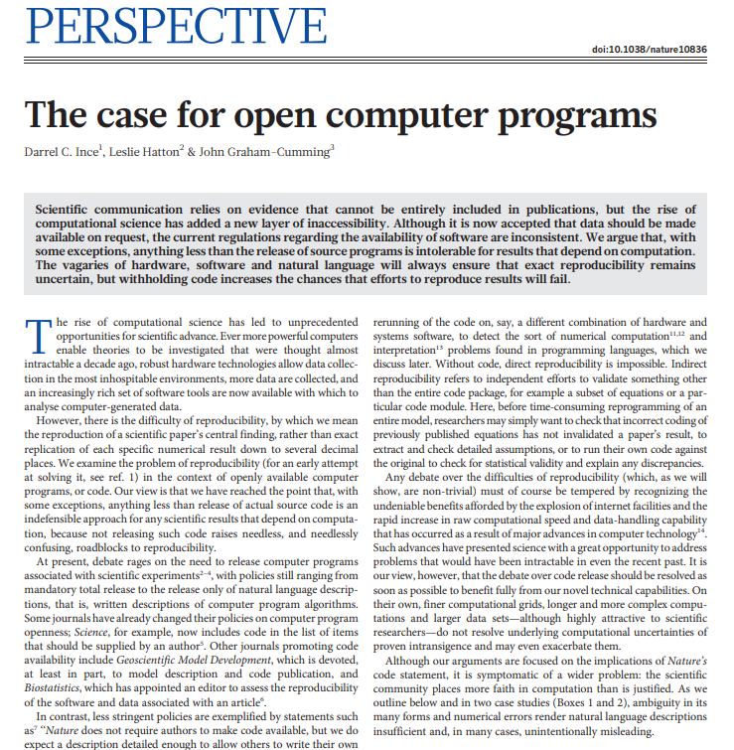
Ince, D.C., Hatton, L. and Graham-Cumming, J., 2012. The case for open computer programs. Nature, 482(7386), p.485.
Notes:
So, how did you find it?

Slide 7
The case for open computer programs
The failure of code descriptions
Ambiguity in scientific publications
(natural vs formal, designed vs not, mathematic)
Writing specific requires skills “peripherical to their work”
Matches multiple implementations, is incomplete, or unspecified
No guarantee of absence of error
Programming error
Numerical Properties of Sc. Software (rounding, power v mult, machine eps)
Run-time differences (concurrency, deterministic randomness, …)
Many of these will be hidden in soft. packages
Library/runtime versions
Notes:
Why would there be no guarantee of absence of error? : (proving a negative) : logical proof in specific scenario.

Slide 8
The case for open computer programs
Challenges are no excuses for closed code
Are imperfect solutions sufficient?
Proposed Solutions
Full source code allowing reproduction
Partial code and description of packages used
Marginal source (API, tests)
No source
Intellectual Property Rights, Logistic, Packaging
Notes:
Would you feel comfortable sharing your code?
(Pause)
What if a major part of your code gets copied in another person’s paper?
What if someone discovers a major bug which affects your conclusions?
Why would there be no guarantee of absence of error? : (proving a negative) : logical proof in specific scenario.

Slide 9
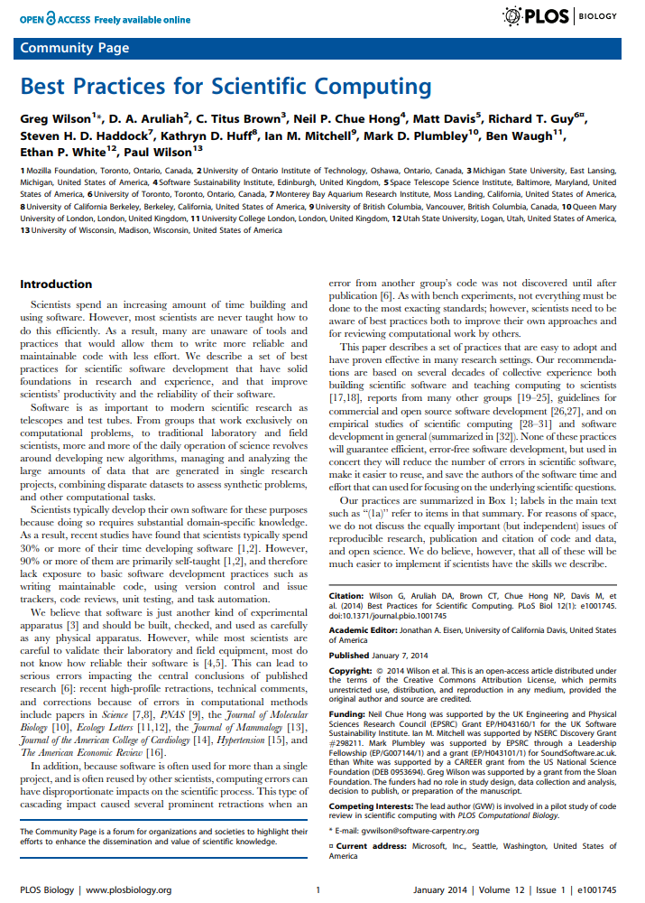
Wilson, G., Aruliah, D.A., Brown, C.T., Hong, N.P.C., Davis, M., Guy, R.T., Haddock, S.H., Huff, K.D., Mitchell, I.M., Plumbley, M.D. and Waugh, B., 2014. Best practices for scientific computing. PLoS biology, 12(1), p.e1001745.
Notes:
So, how did you find it? (Did it ring true?)
One of the difficulties with this sort of knowledge is that it is very experiential. This is along the line of getting burned on the stove. You can be careful after being told, or end up learning the hard way.

Slide 10
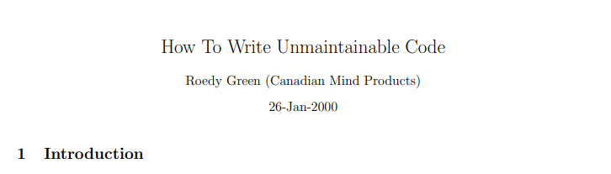
Best Practices for Scientific Computing
Write programs for people, not computers.
A program should not require its readers to hold more than a handful of facts in memory at once.
Make names consistent, distinctive, and meaningful.
Make code style and formatting consistent.
In other words, manage expectations and familiarity
But what if you want to subvert expectations?
Green, R., 2001. How to write unmaintainable code. Java Developers' Journal, 2(6).
Notes:
To Ensure a Job for Life maybe?

Slide 11
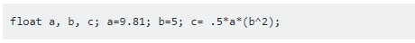

Code example 1
Code example 2
Community Wiki, Stack Overflow, “What is self-documenting code […]”

Slide 12
Best Practices for Scientific Computing
Let the computer do the work.
Make the computer repeat tasks.
Save recent commands in a file for re-use.
Use a build tool to automate workflows.

Slide 13
Best Practices for Scientific Computing
Make incremental changes.
Work in small steps with frequent feedback and course correction.
Use a version control system.
Put everything that has been created manually in version control.
Don't repeat yourself (or others).
Every piece of data must have a single authoritative representation in the system.
Modularize code rather than copying and pasting.
Re-use code instead of rewriting it.

Slide 14
Best Practices for Scientific Computing
Document design and purpose, not mechanics.
Document interfaces and reasons, not implementations.
Refactor code in preference to explaining how it works.
Embed the documentation for a piece of software in that software.
Collaborate.
Use pre-merge code reviews.
Use pair programming when bringing someone new up to speed and when tackling particularly tricky problems.
Use an issue tracking tool.

Slide 15
Good enough practices? (a 2017 Update)
Data management:
saving both raw and intermediate forms, documenting all steps, creating tidy data amenable to analysis.
Software:
writing, organizing, and sharing scripts and programs used in an analysis.
Collaboration:
making it easy for existing and new collaborators to understand and contribute to a project.
Project organization:
organizing the digital artifacts of a project to ease discovery and understanding.
Tracking changes:
recording how various components of your project change over time.
Manuscripts:
writing manuscripts in a way that leaves an audit trail and minimizes manual merging of conflicts.
Wilson, G., Bryan, J., Cranston, K., Kitzes, J., Nederbragt, L. and Teal, T.K., 2017. Good enough practices in scientific computing. PLoS computational biology, 13(6), p.e1005510.
Notes:
Given the high level nature of the recommendations, the authors went back in 2017 with a new compendium of concrete high importance recommendations.

Slide 16
Concept Review

Slide 17
Concept Review
The R Interpreter Program
The R Studio editing environment
The GIT CLI Program
The Github Desktop App
Notes:
Show the REPL

Slide 18
Algorithms
Finite sequence of well-defined instructions typically used to solve a problem or perform a computation.
Describe the expected behaviour of a thermostat in words
Algorithms are subject to evaluation by many criteria: compactness, speed, time complexity, space complexity, readability …

Slide 19
desired_temperature <- default or last set
while power_is_on do:
temperature <- measure_temperature
if temperature < desired_temperature:
increase heat
else if temperature > desired_temperature:
decrease heat / increase cooling
else
do nothing
Notes:
No legitimate temperature check

Slide 20
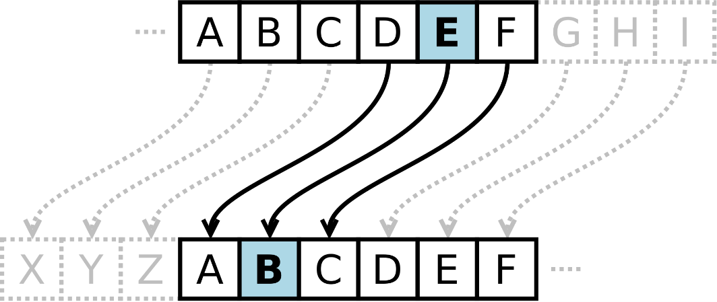
Caesar Cipher (ROT 13)
One of the earliest known cipher used to encrypt messages for insecure medium of communication.
Describe its behaviour in words
Matt Crypto Wikimedia

Slide 21
Caesar Cipher (ROT 13)
Pseudocode:
For letter in message:
(letter + 13) modulo 26
In R:
for (letter in msg_as_int) {
(letter + 13) %% 26
}
Or:
(msg_as_int + 13) %% 26
Matt Crypto Wikimedia
Full Version: intToUtf8((((utf8ToInt("helloworld") - 97) + 13) %% 26) + 97)

Slide 22
Data Types
Basic types
character: ”a", "swc"
numeric: 2.0, 15.5
integer: 2
logical: TRUE, FALSE
complex: 1 + 4i
Other Types
Factors Categorical Data Structure (ex. Marital Status)
Vector 1 indexed series of element of similar type, indexes or logical
Array N dimension series of elements [row, column, …]
List Mixed-Type data structure, support tag per element (“a” = 5)
Data frame List containing elements of equal length
Notes:
Remember every basic type is a vector

Slide 23
Questions from the exercises?

Slide 24
Let’s read some code!

Slide 25
What have we learned?
As science relies more on computers and algorithms, communication skills now include programming skills.
Don’t code for machine, code for people.
Don’t wait to get burn, leverage good practices now
PPHS616 is the ideal moment to spend the time to learn R.
Managing, cleaning, reading data is the first step of every project.
We will be the one reading your code, your main priority should be that I understand what it does.
The learning the lingo will help you search for the answer.
Notes:
Spend the time to learn R now, instead of when at work or later in your study.
- Invest now, because you might not be able to do later.

Slide 26

Thank you

