Slide 1
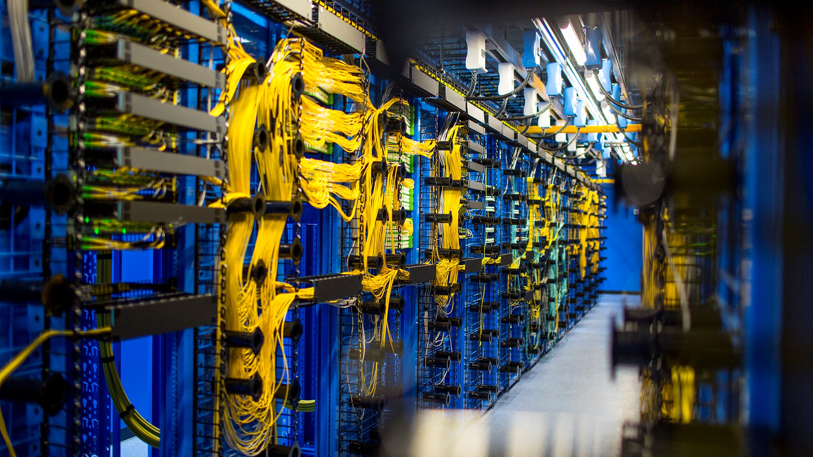

Azure Networking
Richard Cheney
Cloud Solution Architect
@RichCheneyAzure

Slide 2
Virtual Networks

Slide 3
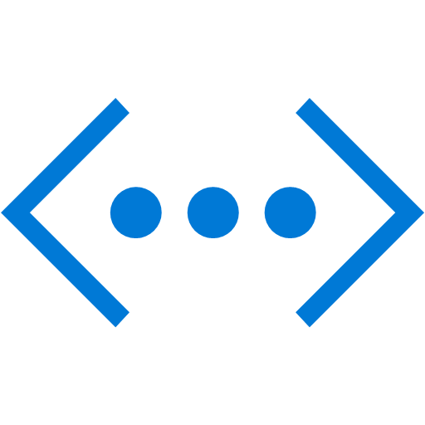
Azure networking is built around the concept of Virtual Networks (vNets).
Name: Prod

Slide 4
Azure networking is built around the concept of Virtual Networks (vNets).
Name: Prod
A vNet is simply a logical, isolated network within the Azure fabric.

Slide 5
vNets are (by default) completely isolated from each other.
Name: Prod
Name: Test
Name: Dev

Slide 6
A vNet must be configured with at least one IP address space.
Name: Prod
IP address space: 10.0.0.0/16

Slide 7
A vNet must be configured with at least one IP address space.
Name: Prod
IP address space: 10.0.0.0/16, 192.168.1.0/24
It is possible for a vNet to have more than one address space assigned to it.

Slide 8
We then configure one or more subnets inside the vNet.
Name: Prod
IP address space: 10.0.0.0/16
10.0.0.0/24
10.0.1.0/24

Slide 9
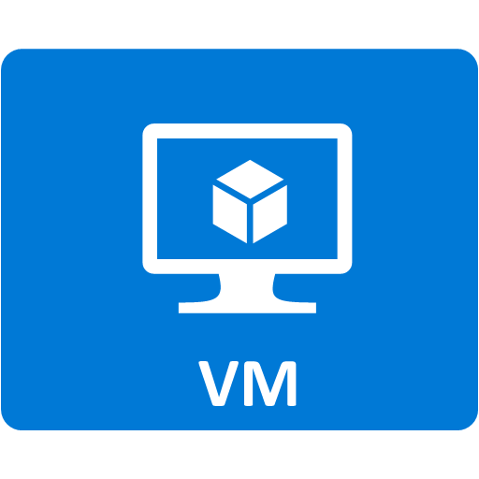
Virtual machines are deployed into a subnet.
Name: Prod
IP address space: 10.0.0.0/16
10.0.0.0/24
10.0.1.0/24

Slide 10

VMs have outbound Internet connectivity by default.
Name: Prod
IP address space: 10.0.0.0/16
10.0.0.0/24
10.0.1.0/24

Slide 11

Technically, it is the Network Interface that connects a VM to a subnet.
10.0.0.0/24

Slide 12

Private IP addresses (i.e. taken from the subnet range) can be allocated either dynamically or statically.
10.0.0.0/24
With dynamic assignment, addresses are automatically allocated by the DHCP server when the VM starts and may not remain the same when the VM reboots.

Slide 13
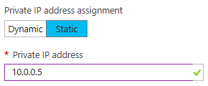
Private IP addresses (i.e. taken from the subnet range) can be allocated either dynamically or statically.
10.0.0.0/24
Static assignment means that you can manually specify the address and it will be set as a reservation by DHCP.

Slide 14
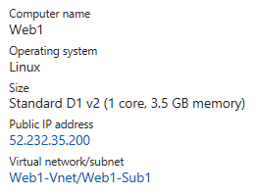
A VM can also have a Public IP assigned to it – by doing so, the VM will be accessible from the Internet.
10.0.0.0/24
Web1

Slide 15
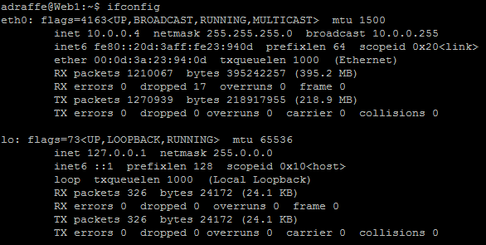
But…when I look at the interfaces on my VM, I don’t see my public IP?!
10.0.0.0/24
Web1

Slide 16
This is because the public IP actually exists as a NAT (Network Address Translation) entry on the Azure fabric that gets mapped to the VM.
Public IP: 52.232.35.200
NAT
Web1

Slide 17
Public IP addresses are available in two “SKUs” – Basic or Standard.
Public IP (Basic)
Public IP (Standard)
Web1
Web2

Slide 18
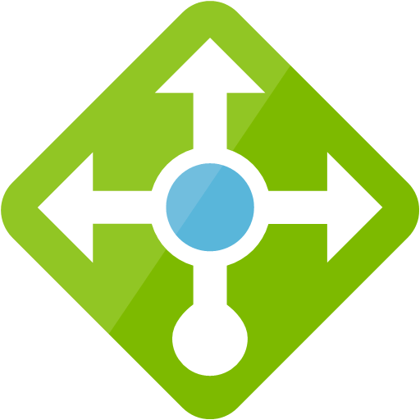
The main difference with Standard Public IP addresses are that they are zone redundant.
Web1
Web2
Web3
Availability Zone 1
Availability Zone 2
Availability Zone 3

Slide 19

Caution: If attaching a “Standard SKU” public IP to a VM interface, you must apply a Network Security Group, otherwise you won’t be able to reach that VM.
Web1

Slide 20
By default, VMs in different subnets within a vNet can route to each other directly.
Name: vNet1
IP address space: 10.0.0.0/16
10.0.0.0/24
10.0.1.0/24

Slide 21
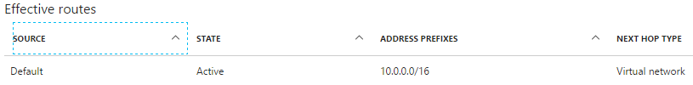
A system route is installed to allow traffic within the vNet. System routes are also installed for vNet peerings, VM to Internet connectivity, VPN gateway connectivity, etc.
Name: vNet1
IP address space: 10.0.0.0/16
10.0.0.0/24
10.0.1.0/24
System Route

Slide 22
A system route is installed to allow traffic within the vNet. System routes are also installed for vNet peerings, VM to Internet connectivity, VPN gateway connectivity, etc.
Name: vNet1
IP address space: 10.0.0.0/16
System routes can be overridden! More on this later.
10.0.0.0/24
10.0.1.0/24
System Route

Slide 23

VMs in different vNets cannot communicate, unless you configure this specifically (e.g. vNet peering or other method).
Name: Prod
Name: Test

Slide 24
Connecting Virtual Networks Together

Slide 25
At some point, you’ll want to allow connectivity between different virtual networks.
Name: Prod
Name: Test
There are two main ways to achieve that:
VPN Gateways or Virtual Network Peering.

Slide 26
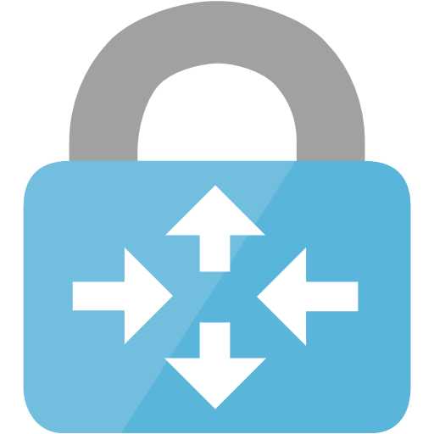
Option 1: VPN Gateways
VPN gateways are appliances that can be used to connect two vNets together, or between on-premises networks and Azure.
Name: Prod
Name: Test

Slide 27
Option 1: VPN Gateways
Name: Prod
Name: Test
To connect two vNets together,
you must create a VPN gateway in each vNet.

Slide 28
Option 1: VPN Gateways
Name: Prod
Name: Test
GatewaySubnet
GatewaySubnet
VPN gateways always connect to a special subnet, called GatewaySubnet (this name is mandatory).

Slide 29
Option 1: VPN Gateways
Once the gateways have been created,
the next step is to create a connection between them.
Name: Prod
Name: Test
IPSec Tunnel
GatewaySubnet
GatewaySubnet

Slide 30
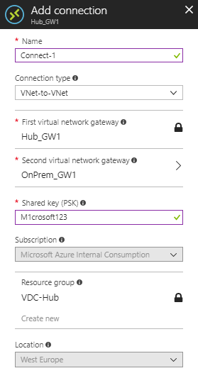
Option 1: VPN Gateways
To create a connection, simply specify the two VPN gateways and configure a shared key.
You need to do this from both sides, i.e. create a connection from each VPN gateway to the other one.

Slide 31
Option 1: VPN Gateways
Although this is hidden from the user, VPN gateways consist of two instances in an active / standby configuration.
Name: Prod
Name: Test
A
A
S
S
GatewaySubnet
GatewaySubnet

Slide 32
Option 1: VPN Gateways
Failure of a gateway will result in the standby taking over
(worst case 1.5 mins failover time).
Name: Prod
Name: Test
A
A
S
GatewaySubnet
GatewaySubnet

Slide 33
Option 1: VPN Gateways
It’s also possible to create VPN gateways in an active / active configuration, which will use a full mesh of IPSec tunnels.
Name: Prod
Name: Test
A
A
A
A
GatewaySubnet
GatewaySubnet
New-AzureRmVirtualNetworkGateway -EnableActiveActiveFeature

Slide 34
Option 1: VPN Gateways
One of the issues with using VPN gateways to connect vNets is that you are limited to the bandwidth of the gateway (e.g. 650Mbps for VpnGw1).
Name: Prod
Name: Test
IPSec Tunnel
VpnGw1
VpnGw1
650Mbps

Slide 35
Option 2: vNet Peering
One of the issues in using VPN gateways to connect vNets is that you are limited to the bandwidth of the gateway (e.g. 650Mbps for VpnGw1).
A better way to connect virtual networks together is by using vNet Peering.

Slide 36
vNet Peering uses the Microsoft backbone network to connect the vNets together – no gateways required!
Option 2: vNet Peering
Name: Prod
Name: Test
vNet Peering

Slide 37
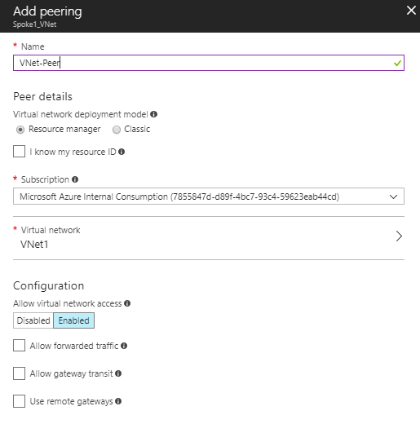
Setting up vNet Peering is easy – just specify the vNet you want to connect to.
Option 2: vNet Peering

Slide 38
What are these options for? These cover more advanced scenarios, such as sharing gateways, hub and spoke networks, etc – we’ll come back to these later!
Option 2: vNet Peering

Slide 39
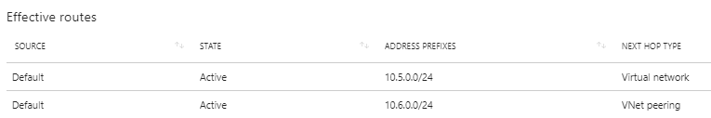
Once a vNet peering connection has been created, routes are automatically added to each vNet to point to the other.
Option 2: vNet Peering
Name: Prod
Name: Test
vNet Peering
Subnet1: 10.5.0.0/24
Subnet1: 10.6.0.0/24
You can find this by selecting ‘Effective Routes’ under the NIC connected to a VM inside the vNet.

Slide 40
You can peer two vNets that reside in different subscriptions…
Option 2: vNet Peering
Name: Prod
Name: Test
vNet Peering
Subnet1: 10.5.0.0/24
Subnet1: 10.6.0.0/24
Subscription A
Subscription B

Slide 41
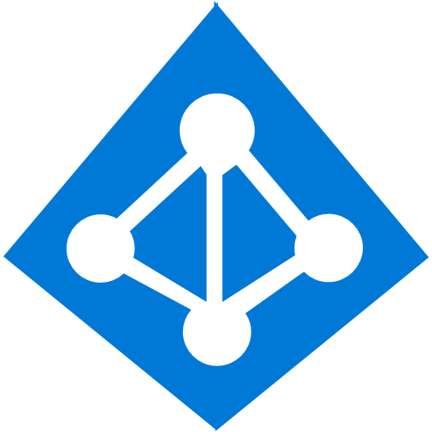
…but only if they are associated to the same Azure AD tenant.
Option 2: vNet Peering
Name: Prod
Name: Test
vNet Peering
Subnet1: 10.5.0.0/24
Subnet1: 10.6.0.0/24
Subscription A
Subscription B
Azure AD Tenant 1

Slide 42
vNet Peerings are non-transitive – this means that vNet Prod cannot communicate with vNet Dev through vNet Test.
Option 2: vNet Peering
Name: Prod
Name: Test
Name: Dev
Peering
Peering

Slide 43
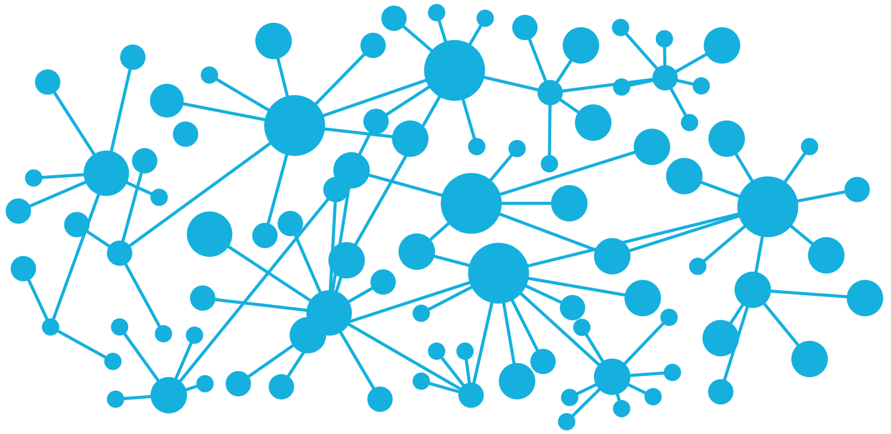
Routing in Azure

Slide 44
Routing in Azure…is just like routing anywhere else.
You still have destination prefixes, next hops, etc.

Slide 45
Azure configures System Routes when required – for example, for routing between subnets / vNets, routing to the Internet, etc.
Internet
Name: Prod
Name: Test
vNet Peering
Type | Destination | Next Hop Type
System | vNet_Prod | vNet Peering
System | 0.0.0.0 | Internet

Slide 46
You can’t delete System Routes, but you can override them, using User Defined Routes (UDRs).
Internet
Name: Prod
Name: Test
vNet Peering
Type | Destination | Next Hop Type
System | vNet_Prod | vNet Peering
System | 0.0.0.0 | Internet

Slide 47

We have a Network Virtual Appliance (e.g. firewall) in the ‘Hub’ vNet, which we want to act as the enforcement point for Internet traffic.
Internet
Network Virtual Appliance (10.104.1.1)
vNet: Hub
vNet Peering
vNet Peering
vNet: Spoke1
vNet: Spoke2

Slide 48
The problem is, system routing means Internet traffic from the Spoke vNets goes directly out from the vNet (not via the NVA).
Internet
Network Virtual Appliance (10.104.1.1)
vNet: Hub
vNet Peering
vNet Peering
Type | Destination | Next Hop Type
System | vNet_Hub | vNet Peering
System | 0.0.0.0 | Internet
vNet: Spoke1
vNet: Spoke2

Slide 49
We configure a User Defined Route to point to the Internet via the virtual appliance.
Internet
Network Virtual Appliance (10.104.1.1)
vNet: Hub
vNet Peering
vNet Peering
Type | Destination | Next Hop Type | Next Hop
System | vNet_Hub | vNet Peering
User Defined | 0.0.0.0 | Virtual Appliance | 10.104.1.1
vNet: Spoke1
vNet: Spoke2

Slide 50
To configure UDRs, we first create a Route Table.
Type | Destination | Next Hop Type | Next Hop

Slide 51
We then create routes.
Type | Destination | Next Hop Type | Next Hop
User Defined | 10.1.0.0/16 | Virtual Appliance | 10.104.1.1
User Defined | 10.2.0.0/16 | Virtual Appliance | 10.104.1.1

Slide 52
Finally, we associate the route table with a subnet.
Type | Destination | Next Hop Type | Next Hop
User Defined | 10.1.0.0/16 | Virtual Appliance | 10.104.1.1
User Defined | 10.2.0.0/16 | Virtual Appliance | 10.104.1.1
Subnet1: 10.0.0.0/24

Slide 53
What about dynamic routing? Is that supported?

Slide 54
BGP is supported on VPN Gateways*.
Azure vNet
On-Premises DC
IPSec Tunnel
BGP
VpnGw1
* Not on ‘Basic’ SKU or on ‘policy-based’ gateways

Slide 55
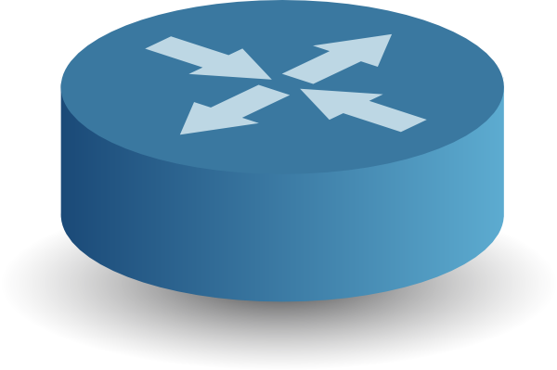
Advertising 0.0.0.0 to Azure forces all traffic via the VPN gateway.
Azure vNet
On-Premises DC
IPSec Tunnel
BGP
VpnGw1
Advertise 0.0.0.0
Internet

Slide 56
Advertising 0.0.0.0 to Azure forces all traffic via the VPN gateway.
Azure vNet
On-Premises DC
IPSec Tunnel
BGP
VpnGw1
Advertise 0.0.0.0
Internet

Slide 57
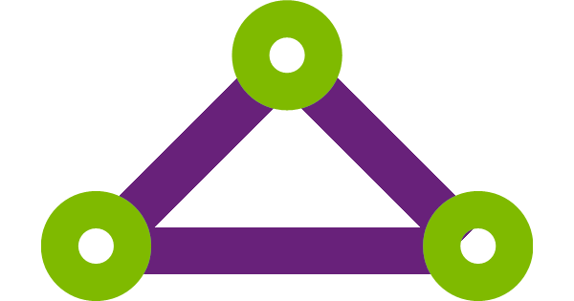
Connecting to On-Premises Data Centres Using ExpressRoute

Slide 58


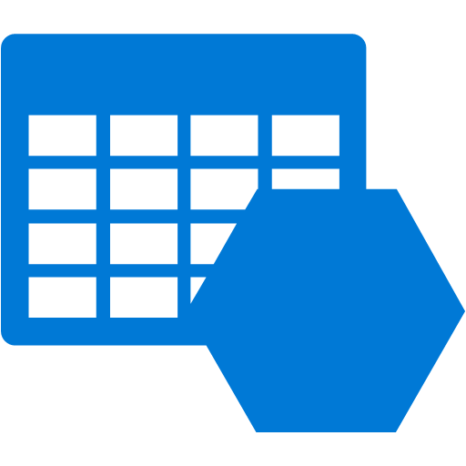

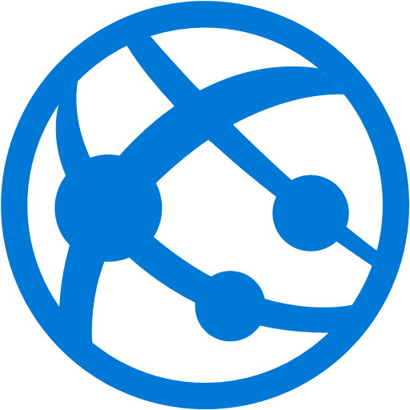
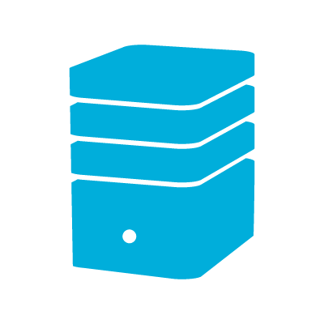
ExpressRoute extends On-Premises networks into the Microsoft Cloud using a dedicated connection.
Partner Edge
Primary Connection
Microsoft Edge
Secondary Connection
Customer Premises

Slide 59
Why ExpressRoute?
Predictable performance & latency
High throughput
Built-in redundancy

Slide 60
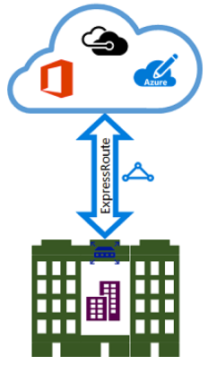
Three ER Connectivity Models
1. Co-located Cloud Exchange.
Virtual cross connect to MS cloud through provider’s Ethernet exchange.

Slide 61
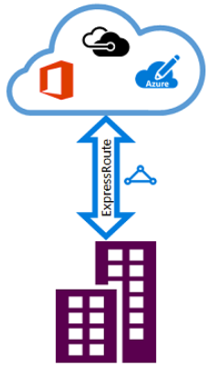
Three ER Connectivity Models
2. Point-to-point Ethernet.
Connect on-premises datacenters/offices to the Microsoft cloud through point-to-point Ethernet links.

Slide 62
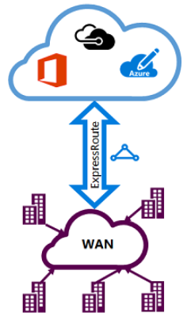
Three ER Connectivity Models
3. IPVPN (Any-to-Any).
Integrate your WAN with the Microsoft cloud using any-to-any connectivity typically MPLS VPN.

Slide 63
Two Peering Types
1. Private Peering
Connect to Azure services deployed within a virtual network.
Partner Edge
Microsoft Edge
Customer Premises
Private Peering

Slide 64
Two Peering Types
2. Microsoft Peering
Connect to Azure PaaS services (storage, SQL, Web Apps, etc)
and SaaS services (O365, etc).
Partner Edge
Microsoft Edge
Customer Premises
Microsoft Peering

Slide 65
Important! Connecting to Office 365 via ExpressRoute Microsoft peering requires approval.
Partner Edge
Microsoft Edge
Customer Premises
Microsoft Peering

Slide 66
Each peering type requires a separate set of BGP peer sessions.
Microsoft BGP Peering
Partner Edge
Microsoft Edge
Customer Premises
Private BGP Peering

Slide 67
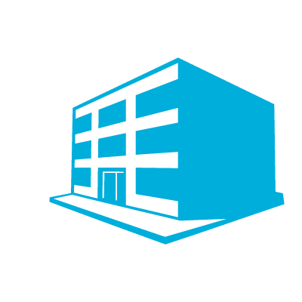
An ExpressRoute connection allows access to other regions within the same ‘geo-political area’.
North Europe
West Europe
Azure
ExpressRoute

Slide 68
The ExpressRoute ‘Premium’ add-on enables connectivity across geo-political boundaries.
North Europe
West Europe
Azure
Central US
ExpressRoute

Slide 69
The ‘Premium’ add-on also gives you increased route limits (10,000).
West Europe
Azure
ExpressRoute
10,000 routes

Slide 70
ExpressRoute uses a gateway that resides in the GatewaySubnet (similar to VPN gateways).
Customer Premises
ExpressRoute Gateway
GatewaySubnet

Slide 71
ExpressRoute has two types of billing: Metered and Unmetered.

Slide 72
With Metered billing, you pay for outbound data transfers (per GB).
Customer Premises
Azure
$$$

Slide 73
Unmetered billing gives you unlimited outbound data transfer (but of course is more expensive in the first place).
Customer Premises
Azure
Unlimited

Slide 74
Let’s imagine a scenario where our Azure VMs need to communicate with public Azure services (e.g. Azure Storage or Azure SQL).
Microsoft BGP Peering
Private BGP Peering
Customer Premises

Slide 75
In most circumstances, traffic will be kept on the Microsoft network (i.e. it won’t traverse the ExpressRoute circuit).
Microsoft BGP Peering
Private BGP Peering
Customer Premises

Slide 76
However, some customers might choose to advertise a default route to Azure via the private peering (to force all traffic via on-premises).
0.0.0.0/0
Customer Premises

Slide 77
In that case, all traffic between your vNet and Azure public services will hairpin via on-premises.
0.0.0.0/0
Customer Premises

Slide 78
In scenarios with multiple ER circuits, asymmetric routing can occur.
Virtual Network
Virtual Network
West Europe
North Europe
Microsoft Network
ExpressRoute
ExpressRoute
Amsterdam Office
London Office

Slide 79
Use AS Path Prepend to help with path preference.
West Europe Routing Table
Range | AS Path | From
10.1.0.0/16 | 64496 | Amsterdam
10.1.0.0/16 | 64496 64496 | London
10.2.0.0/16 | 64496 64496 | Amsterdam
10.2.0.0/16 | 64496 | London
Virtual Network
Virtual Network
West Europe
North Europe
Microsoft Network
ExpressRoute
ExpressRoute
Amsterdam Office
Range | AS Path
10.1.0.0/16 | 64496
10.2.0.0/16 | 64496 64496
Range | AS Path
10.1.0.0/16 | 64496 64496
10.2.0.0/16 | 64496
London Office

Slide 80
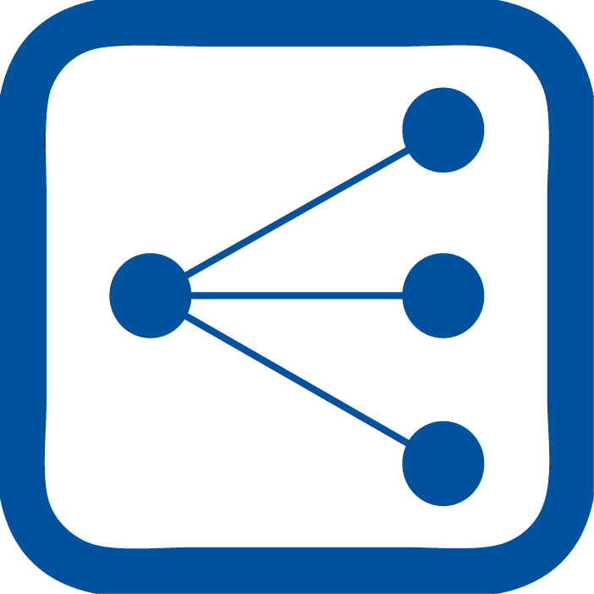
Load Balancing in Azure

Slide 81
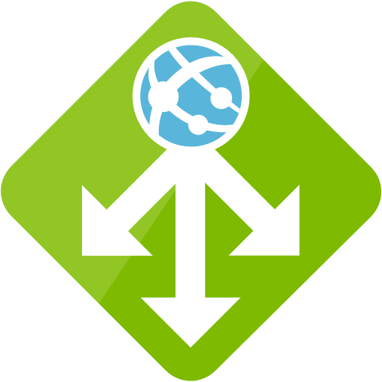

Azure has a few different types of load balancer available.

Slide 82
First, let’s look at the basic / standard load balancer.

Slide 83
The Azure load balancer offers basic L4 load balancing.
10.0.0.1
10.0.0.2
Internet
Public IP
10.0.0.3

Slide 84
Load balancers can operate in ‘public’ mode (i.e. with a public IP address)
10.0.0.1
10.0.0.2
Internet
Public IP
10.0.0.3

Slide 85
Load balancers can also operate in ‘internal’ mode (i.e. private IP).
10.0.0.1
Private IP
10.0.0.2
10.0.0.3

Slide 86
The ‘Standard SKU’ load balancer adds support for zone redundancy.
Availability Zone 1
LB Standard
Availability Zone 2
Availability Zone 3

Slide 87
Azure Application Gateway is a fully featured application delivery controller working at layer 7.
Web Application Firewall
HTTP load balancing
Cookie based session affinity
SSL offload
Multi-site routing
URL based content routing
Advanced diagnostics
Azure Web App support

Slide 88
Traffic manager is a DNS based global load balancing service.
webapp.trafficmanager.net
webapp-northeurope.azurewebsites.net
North Europe Region
webapp-westeurope.azurewebsites.net
West Europe Region
webapp-centralus.azurewebsites.net
Central US Region

Slide 89
Traffic manager can also work with non-Azure based end points.
webapp.trafficmanager.net
webapp-onprem.contoso.com
On Premises
webapp-westeurope.azurewebsites.net
West Europe Region
webapp-centralus.azurewebsites.net
Central US Region

Slide 90
Traffic Manager has four routing methods.
webapp.trafficmanager.net
webapp-northeurope.azurewebsites.net
North Europe Region
webapp-westeurope.azurewebsites.net
West Europe Region
webapp-centralus.azurewebsites.net
Central US Region

Slide 91
1. Priority Routing
Use a primary endpoint for traffic; failover when primary is unavailable.
End Point | Priority
North Europe | 1
West Europe | 2
Central US | 3
webapp.trafficmanager.net
webapp-northeurope.azurewebsites.net
North Europe Region
webapp-westeurope.azurewebsites.net
West Europe Region
webapp-centralus.azurewebsites.net
Central US Region

Slide 92
2. Weighted Routing
Distribute traffic according to weights.
End Point | Priority
North Europe | 50
West Europe | 40
Central US | 10
webapp.trafficmanager.net
webapp-northeurope.azurewebsites.net
North Europe Region
webapp-westeurope.azurewebsites.net
West Europe Region
webapp-centralus.azurewebsites.net
Central US Region

Slide 93
3. Performance Routing
Direct users to the ‘closest’ end point, based on latency.
End Point | Priority | Latency
North Europe | 50 | 30ms
West Europe | 40 | 50ms
Central US | 10 | 110ms
webapp.trafficmanager.net
webapp-northeurope.azurewebsites.net
North Europe Region
webapp-westeurope.azurewebsites.net
West Europe Region
webapp-centralus.azurewebsites.net
Central US Region

Slide 94
4. Geographic Routing
Direct users based on the geographic location the DNS query came from.
End Point | Assigned Geo
North Europe | UK / Ireland
West Europe | Germany
Central US | US
webapp.trafficmanager.net
webapp-northeurope.azurewebsites.net
North Europe Region
webapp-westeurope.azurewebsites.net
West Europe Region
webapp-centralus.azurewebsites.net
Central US Region

Slide 95
Network Security Groups

Slide 96
Network Security Groups (NSGs) lock down access to a subnet or VM.
Name: Prod
IP address space: 10.0.0.0/16
10.0.0.0/24
10.0.1.0/24

Slide 97
An NSG is essentially a list of access control rules, permitting or denying traffic based on various criteria.
Source IP | Dest IP | Protocol | Port | Action
10.1.1.2 | 30.1.1.5 | TCP | 22 | Allow
10.1.1.2 | * | TCP | 80 | Allow
10.1.1.2 | 30.1.1.6 | TCP | 443 | Allow
* | * | * | * | Deny

Slide 98
The NSG can be applied either at the VM (NIC) level, or at the subnet level.
Name: Prod
IP address space: 10.0.0.0/16
10.0.0.0/24
10.0.1.0/24

Slide 99
NSGs contain a number of default rules.
Inbound
Name | Priority | Source IP | Destination IP
AllowvNetInBound | 65000 | VirtualNetwork | VirtualNetwork
AllowAzureLoadBalancerInBound | 65001 | AzureLoadBalancer | *
DenyAllInBound | 65500 | * | *
Outbound
Name | Priority | Source IP | Destination IP
AllowvNetOutbound | 65000 | VirtualNetwork | VirtualNetwork
AllowInternetOutBound | 65001 | * | Internet
DenyAllInBound | 65500 | * | *

Slide 100

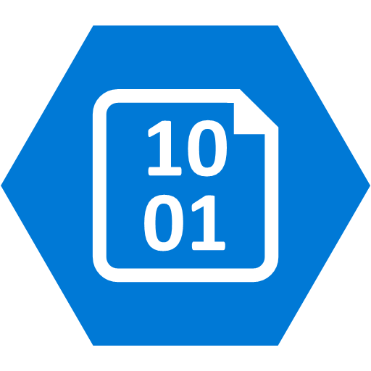
NSGs only work if a resource is connected to a vNet – they do not work for other resources (e.g. PaaS services).

Slide 101
Advanced Network Topologies

Slide 102
How do we build multiple vNet topologies in Azure?
Name: Spoke1
Name: Hub
Name: Spoke2

Slide 103
Let’s say we use vNet peering to create connections between the hub and both spoke vNets.
Name: Spoke1
Name: Hub
vNet Peering
vNet Peering
Name: Spoke2

Slide 104
We might expect Spoke1 VMs to be able to talk to Spoke2 VMs, but this doesn’t work.
Name: Spoke1
Name: Hub
vNet Peering
vNet Peering
Name: Spoke2

Slide 105
Name: Spoke1
This is because vNet peerings are non-transitive –
we can’t talk from vNet A to C, through B.
Name: Hub
vNet Peering
vNet Peering
Name: Spoke2

Slide 106
Using a site-2-site VPN with BGP will allow spoke to spoke communication through the hub.
Name: Spoke1
GatewaySubnet
Name: Hub
VPN
BGP
GatewaySubnet
BGP
VPN
Name: Spoke2
GatewaySubnet

Slide 107
Alternatively, a full mesh of vNet peerings will work.
Name: Spoke1
Name: Hub
vNet Peering
vNet Peering
vNet Peering
Name: Spoke2

Slide 108
Name: Spoke1
Name: Hub
vNet Peering
ExpressRoute / VPN
vNet Peering
Name: Spoke2
It’s possible to use a gateway in a ‘remote’ vNet (e.g. to share an ExpressRoute / VPN connection among spoke vNets).

