Slide 1
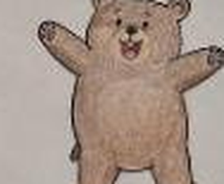
A CLAY SHELTER STORY
GRIZZLY
Grizzly is a cheerful young bear, curious, brave and full of love for nature. This is the story of the little clay house that was designed and built just for him.
By Arooj Fatima
GRIZZLY SHELTER / ARCHITECTURAL STUDIO
01 / 08

Slide 2
MATERIAL & AESTHETIC
COLOURS, TEXTURE & NATURE
The whole house is built with non air-dry clay, shaped by hand and used in different shades.
BROWN
the walls and the bear's face
GREEN
the base and the plants
BLUE
the window
YELLOW
the honey on the roof
WHITE
the stones and the path
BLACK
the eyes and the nose
GRIZZLY SHELTER / ARCHITECTURAL STUDIO
02 / 08

Slide 3

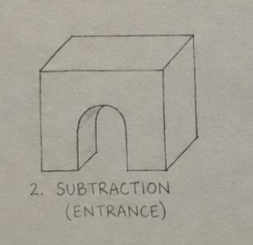
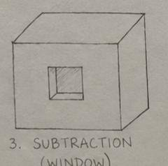
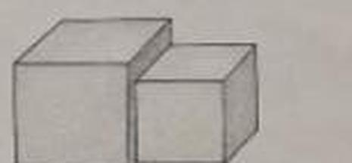
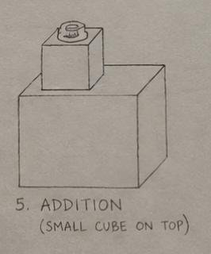
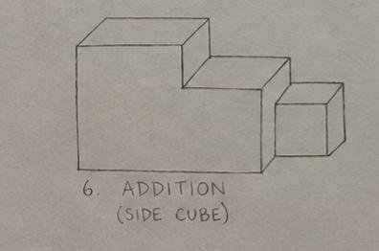
THE PROCESS
FROM SKETCH TO SHELTER
First, the plan in sketches, step by step.
01 BASE CUBE
02 SUBTRACTION (ENTRANCE)
03 SUBTRACTION (WINDOW)
The plain cube every step starts from.
The arched entrance is cut into the cube.
A square window is cut into the wall.
04 COMBINED FORM
05 ADDITION (SMALL CUBE ON TOP)
06 ADDITION (SIDE CUBE)
The two volumes join into one form.
A small cube is added on top.
A side cube extends the shelter.
GRIZZLY SHELTER / ARCHITECTURAL STUDIO
03 / 08

Slide 4
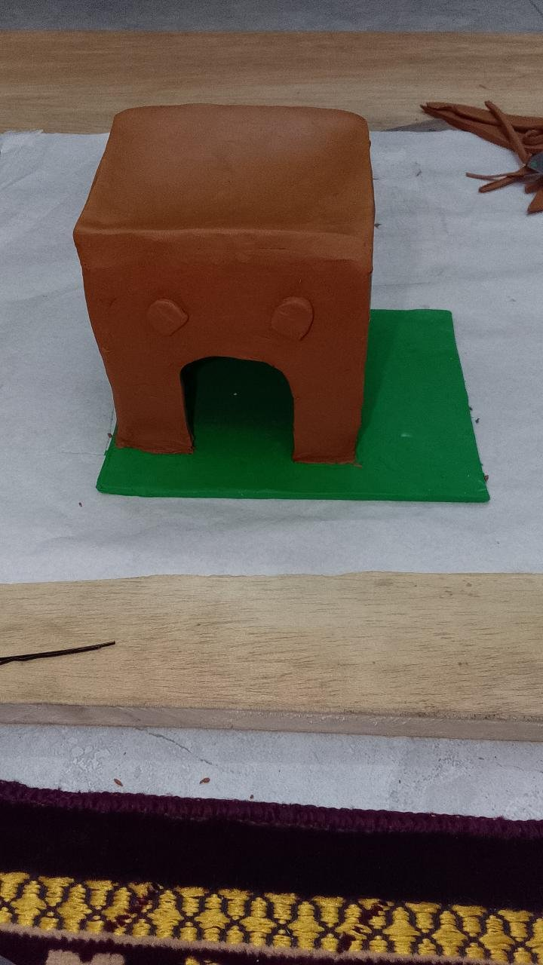
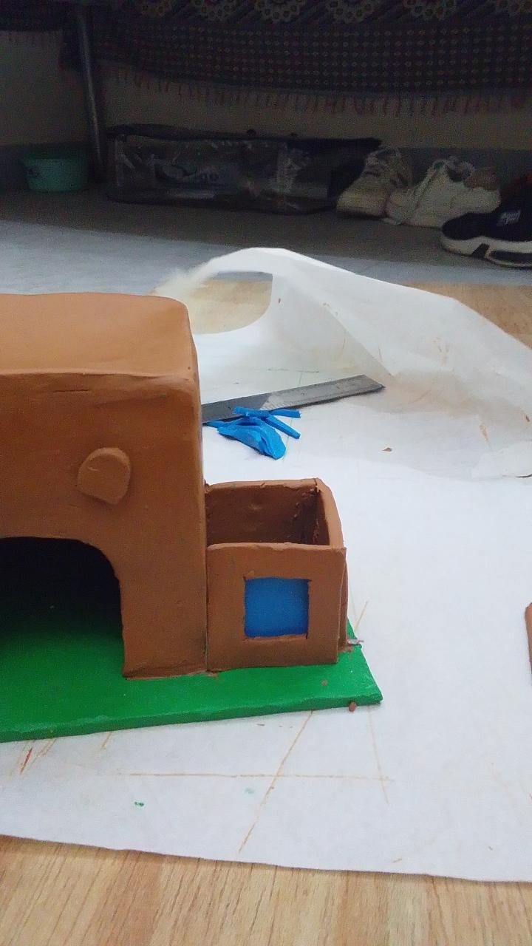
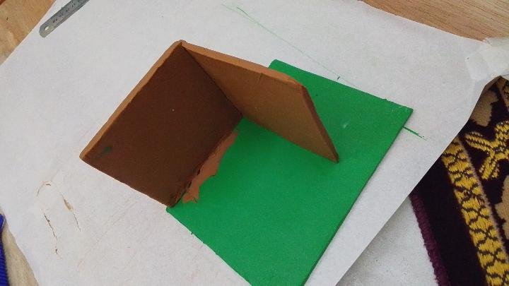
THE PROCESS
BUILDING IT IN CLAY
Then, the shelter is built by hand, one stage at a time.
01 RAISING THE WALLS
02 THE MAIN CUBE
03 SIDE CUBE & WINDOW
Flat clay slabs are joined on the green base.
The cube takes shape, with its arched entrance.
The attached room and blue window are added.
GRIZZLY SHELTER / ARCHITECTURAL STUDIO
04 / 08

Slide 5
THE CHARACTER
GRIZZLY'S QUALITIES
• Caring
• Loving
• Friendly
• Adventurous
• Impatient
• Naturist
• Brave
• Protective
• Enthusiastic
• Loyal
• Curious
• Foody
GRIZZLY SHELTER / ARCHITECTURAL STUDIO
05 / 08

Slide 6
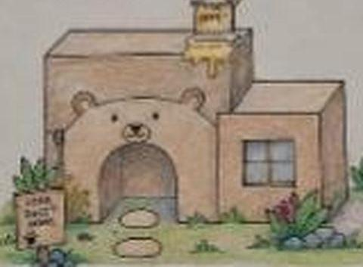
ARCHITECTURAL FEATURES
LITTLE DETAILS, BIG PERSONALITY
CURIOSITY
The window, in bright blue colour.
NATURIST
The green base and the plants.
BRAVE
The strong cubic structure.
FOODY
The honey pot on the roof.
ATTENTION SEEKER
The bear face entrance.
FRIENDLY
The open, welcoming entrance.
GRIZZLY SHELTER / ARCHITECTURAL STUDIO
06 / 08

Slide 7
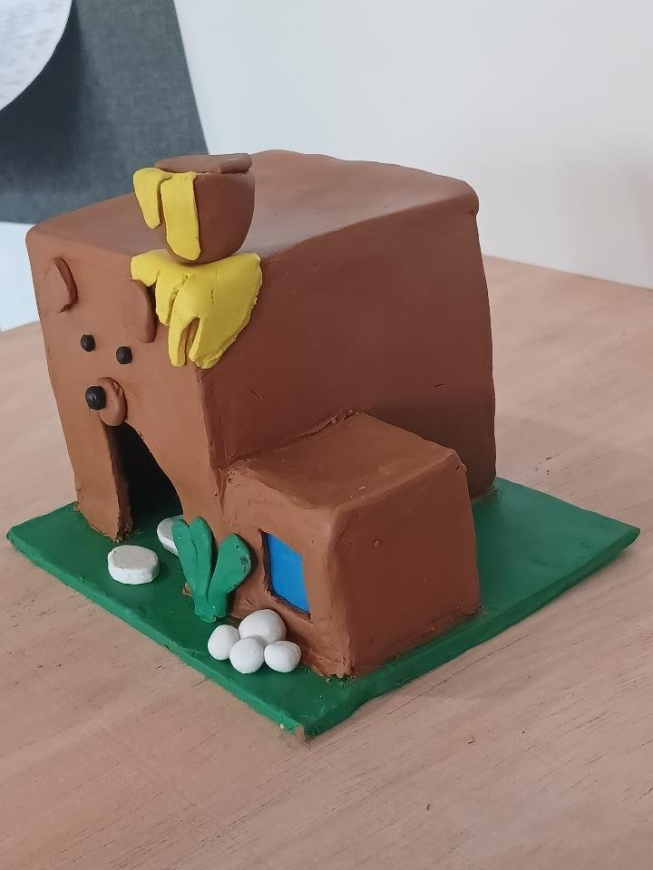
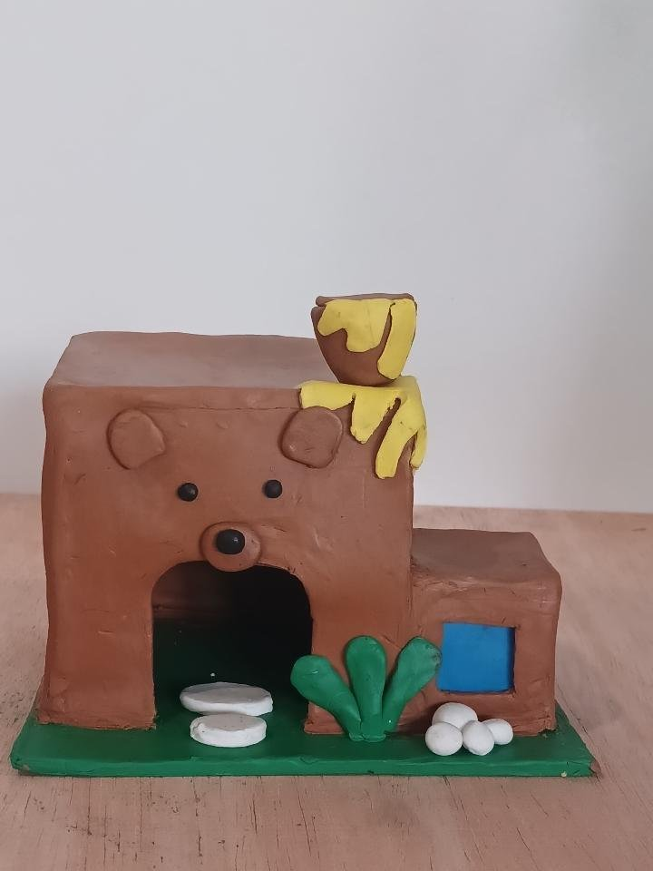
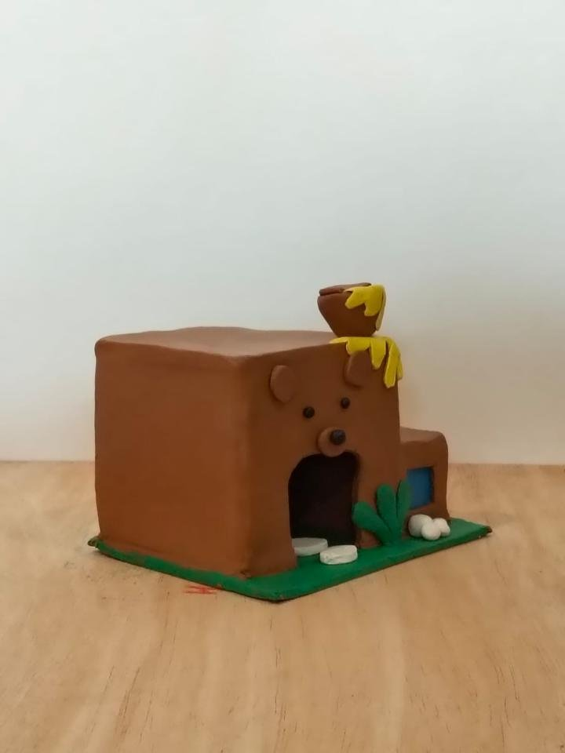
FINAL PRESENTATION
MY FINAL GRIZZLY SHELTER
One model, viewed from different angles.
ANGLE VIEW
FRONT VIEW
SIDE VIEW
A shelter where architecture meets imagination.
GRIZZLY SHELTER / ARCHITECTURAL STUDIO
07 / 08

Slide 8
THE END
THANK YOU
And so Grizzly got a home as brave, warm and full of love as he is, built by hand, one cube at a time.
Presentation by Arooj Fatima
GRIZZLY SHELTER / ARCHITECTURAL STUDIO
08 / 08

