Slide 1
This file is a simple PowerPoint template for creating Vectrex game manuals.
The template can easily be edited, modified and new elements can be added. Remove this first page and save the final result in *.pdf format.
This file was developed by Prof. Dr. Peer Johannsen as part of the “Retro-Programming” and “Advanced C Programming” class at Pforzheim University, Germany.
It can freely be used, but at one’s own risk and for non-commercial purposes only. Please respect the copyright and credit the origin of this file.
Feedback, suggestions and bug-reports are welcome and can be sent to:
peer.johannsen@pforzheim-university.de

Slide 2
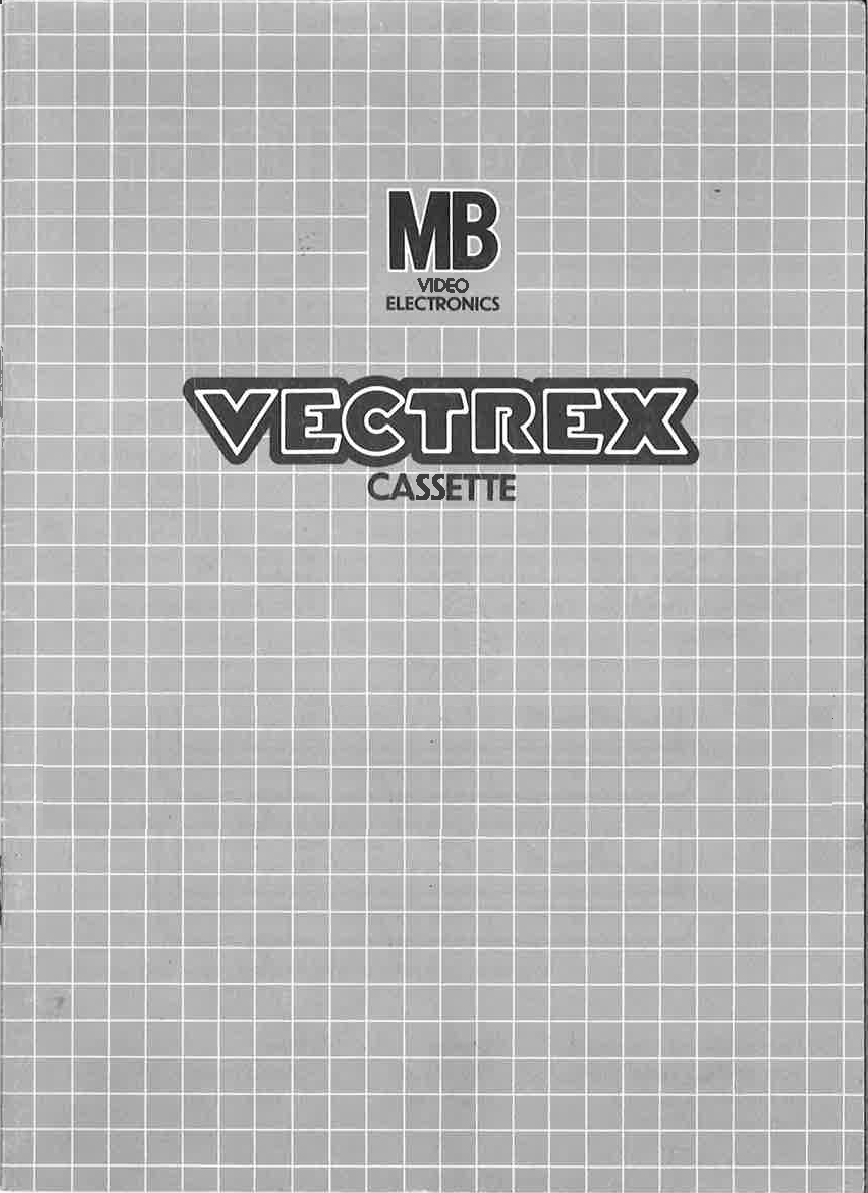
MY GAME

Slide 3
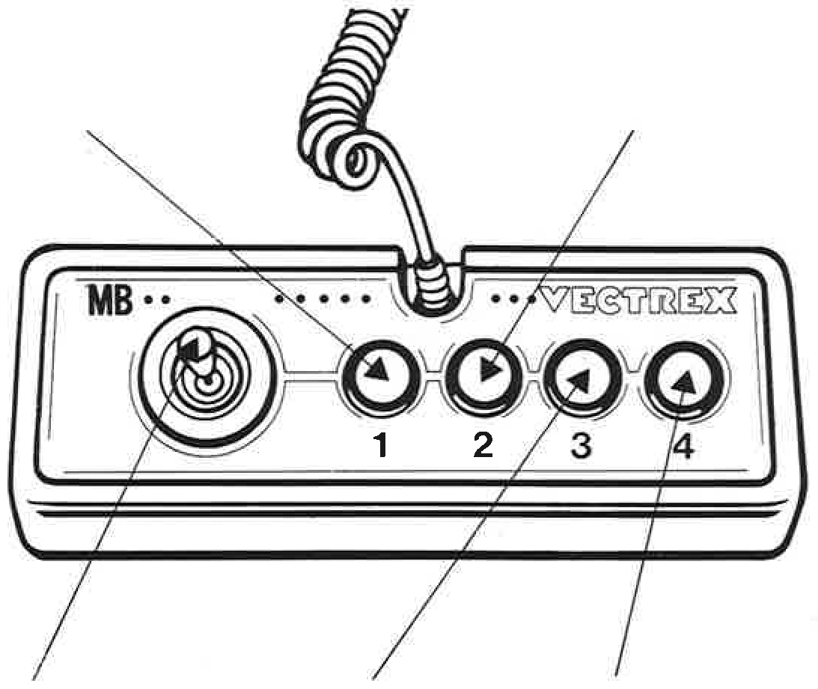
MY GAME
GAME CONTROLS
MY GAME is designed to be played with the built-in control panel only. The functions of the controls are:
Button 1
Short description of what button 1 does
Button 2
Short description of what button 2 does
Joystick
Short description of what the joystick is used for
Button 3
Short description of what button 3 does
Button 4
Short description of what button 4 does

Slide 4
HOW TO PLAY
PLAYER SELECTION
Description of how many players can play this game and of how the number of players is selected in the game menu.
OPTION SELECTION
Description of the available game options and of how these options are selected in the game menu.
GAME PLAY
Detailed description of what the game is about and of how the game is played.
WHATEVER ELSE IS IMPORTANT
Description of whatever else is important in the game. Scores, lives, bonus points, etc.

Slide 5
SCORING
Points are awarded for achieving the following:
You will earn extra points for…
HIGH SCORE MEMORY
As long as your machine is on, with the game cartridge in place, the highest score is retained. To see this score, press the Reset button. When the machine is turned off and the cartridge removed, the score is lost.
RESTARTING THE GAME
To restart a completed game with the same number of players and the same game option, press any of the four buttons once the game is over. If you wish to restart the game before it is completed, or change the number of players or the game option, press the Reset button.

Slide 6
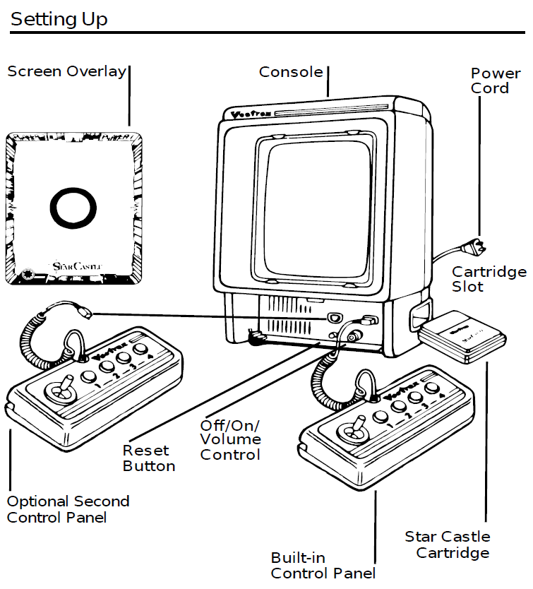
SETTING UP
CREDITS
This game was developed by Firstname Lastname and programmed in C and / or MC6809 assembly language.

Slide 7
