Slide 1

(An Autonomous Institute affiliated to Savitribai Phule Pune University)
(NBA and NAAC accredited, ISO 9001:2015 certified)
Problem Title: Skin Cancer Detection Using CNN
Group Members:
Pratham Raka (22010590)
Saiprasad Mane (22010642)
Roshan Gugale (22010602)
Yash Mutha (22011175)
Guide name: Prof. Yashwant Ingle

Slide 2
Overview
Introduction
Need & Objectives
Literature Review and Novelty
Methodology
Tools &Technologies used
Results
Project`s Practical Impact
Conclusion & Future Work
References

Slide 3
Introduction
Critical Importance of Early Detection: Skin cancer, a perilous disease, demands early identification to curb mortality rates linked to insufficient awareness.
Varied Risks and Advanced Techniques: Diverse skin cancer types, particularly pigmented lesions, necessitate advanced image detection techniques for accurate classification.
HAM10000 Dataset Utilization: Our model, leveraging the HAM10000 dataset, achieves enhanced precision through augmentation methods.
Outstanding CNN Model Results: The proposed CNN-based system attains an impressive 97.92% validation accuracy, contributing to early disease identification and empowering medical practitioners in treatment decisions.

Slide 4
Need for such system
Global Skin Cancer Rise: With increasing global skin cancer rates, there's a critical need for efficient detection methods.
Limitations of Traditional Methods: Visual examinations are subjective, time-consuming, and error-prone, especially given the shortage of dermatologists.
CNNs as a Solution: Convolutional Neural Networks (CNNs) offer an objective and automated approach, overcoming traditional method limitations.
Improving Patient Outcomes: Implementing CNN-based detection aligns with the broader goal of enhancing accuracy, efficiency, and scalability in the face of rising global health challenges.

Slide 5
Literature Review
Paper Title | Methodology | Result
Skin Cancer Detection using Deep Learning DOI: 10.1109/CCIP57447.2022.10058685 | CNN, Image Processing | Achieved accuracy of 88%
Skin cancer classification using Convolutional neural networks DOI: 10.1109/Confluence51648.2021.9377155 | CNN, Machine Vision | Training accuracy: 83.11%, Testing accuracy: 83.04 %
Skin cancer diagnosis based on deep transfer learning and sparrow search algorithm DOI: 10.1109/iv51561.2020.00130 | SpaSA, U-Net, U-Net, Attention U-Net, V-net, and Swin U-Net | 85:87% by the MobileNetV2
Deep Learning in Skin Lesion Analysis Towards Cancer Detection DOI: 10.1109/IV51561.2020.00130 | Desnet201, Adam Optimizer | ROC AUC value in %: 93.8,97,99.3,98.1 96.9,99.9,99.8

Slide 6

Novelty & Research gap
Outperforming Existing Models
Significant Dataset Size
Lightweight model and Architecture
Data-Centric Approach

Slide 7
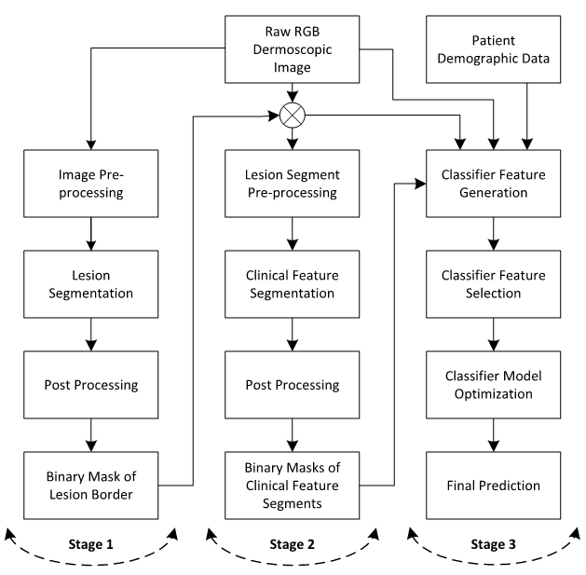
Methodology
Data Collection and Preprocessing: Used Skin Cancer MNIST and HAM10000 datasets from kaggle.com. Applied preprocessing for data quality and model readiness.
Model Architecture Design: Researched and selected an optimal CNN architecture aligned with project objectives and dataset characteristics.
Model Training: Trained the selected CNN model with the dataset, iteratively adjusting hyper-parameters for improved performance.
Model Evaluation and Optimization: Evaluated the model on the test set, optimizing for desired metrics like accuracy, precision, recall, and F1-score.
Fig. Structural Diagram

Slide 8
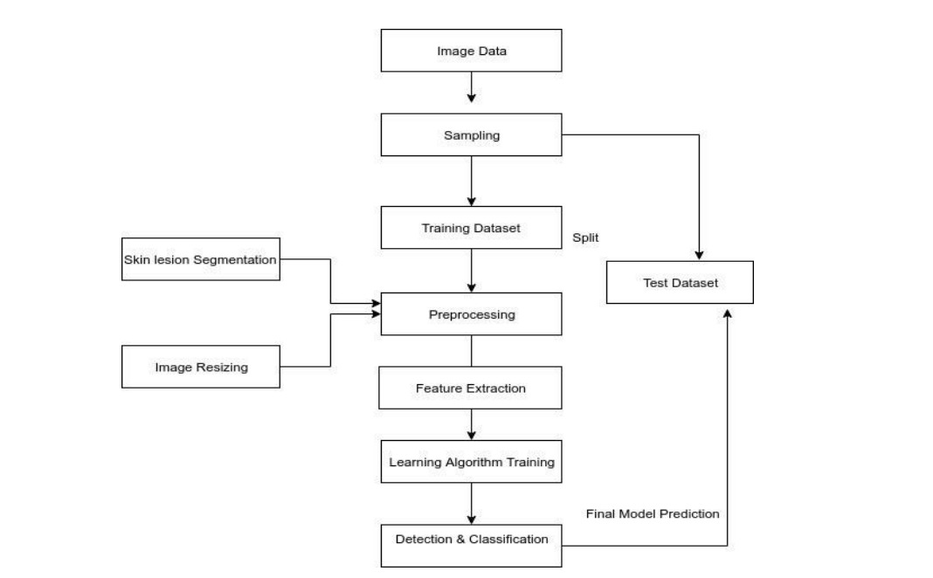
Methodology
User Interface Design and Development: Designed an intuitive, user-friendly interface for the skin cancer classification application.
System Integration: Integrated the CNN model with the interface using TensorFlow or pickle libraries for real-time classification.
Testing and Validation: Conducted thorough testing to identify and address bugs, ensuring the robustness and reliability of the entire system.
Fig. Flowchart Diagram

Slide 9
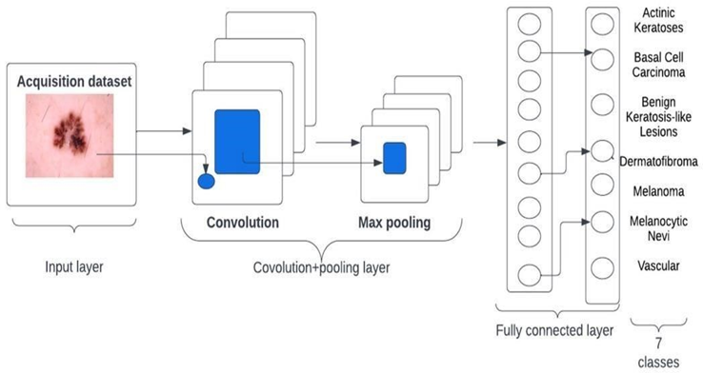
CNN Architecture
Let:
i. X: Input image data (n x m matrix),
ii. Y: Image label denoting skin cancer type,
iii. θ: Model parameters (weights, biases).

Slide 10
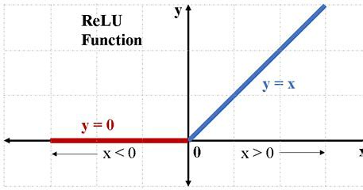
Mathematical Model
• Convolutional Layers: Apply filters, produce feature maps.
H[l] = ReLU(Convolution(H[l-1], θ[l], padding, stride))
• Pooling Layers: Reduce spatial dimensions.
H'[l] = Pooling(H[l], S[p], D[p])
• Fully Connected Layers: Transform features, softmax for predictions.
Z = Softmax(FC(H'[L'], θ[F]))
• Loss Function: Categorical cross-entropy.
Loss = -1/N * Σ(Y * log(Z))

Slide 11
Tools & Technologies to be used
Programming Language: Python, HTML, CSS, JavaScript, Kotlin
Deep Learning Technologies: CNN, TensorFlow
Machine Learning Libraries: Pandas, NumPy, Keras, Scikit-learn, Matplotlib, OpenCV
Model Deployment: HTML, CSS, JavaScript, Moongose ( for web based ) & Kotlin (for app-based)
Development Environment: Jupyter Notebooks, Kaggle

Slide 12
Modules Split-Up
Saiprasad Mane: Website Design and App, Integrating model in website and app
Pratham Raka: Designing and developing CNN model
Roshan Gugale and Yash Mutha: Data acquisition, Data Pre-processing, Data Augmentation, Basic EDA, Research & Documentation
We are following Agile methodology in the project management, taking sprint in every week. Also we regularly follow up with our guide and mentor.

Slide 13
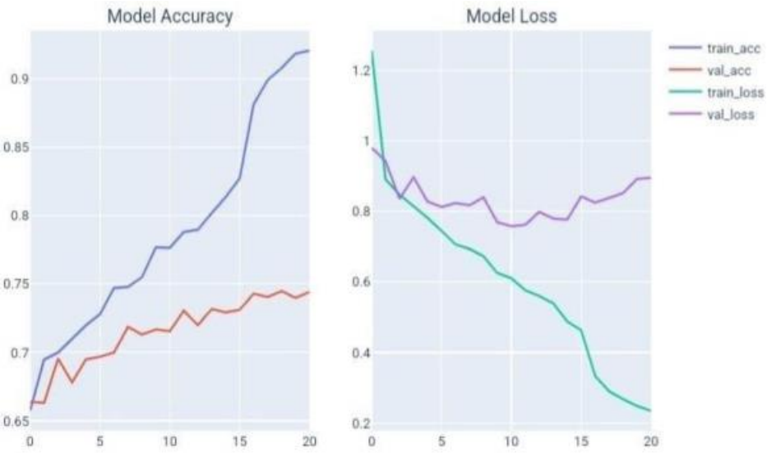
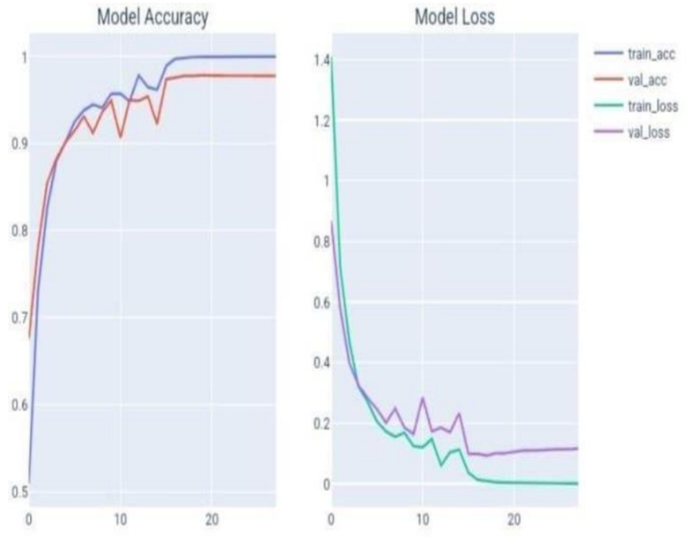
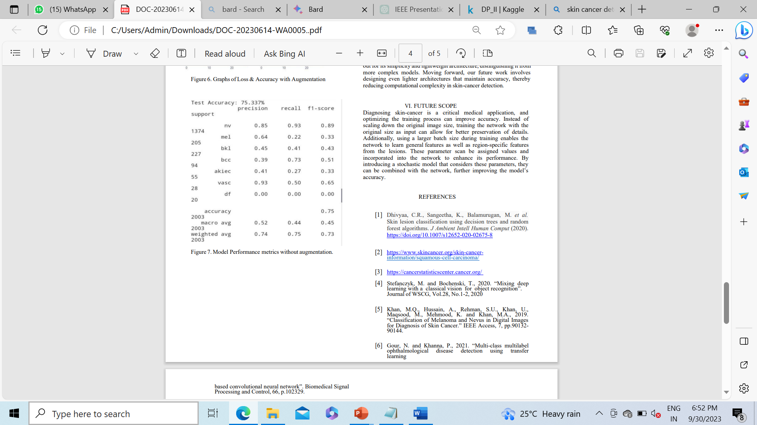
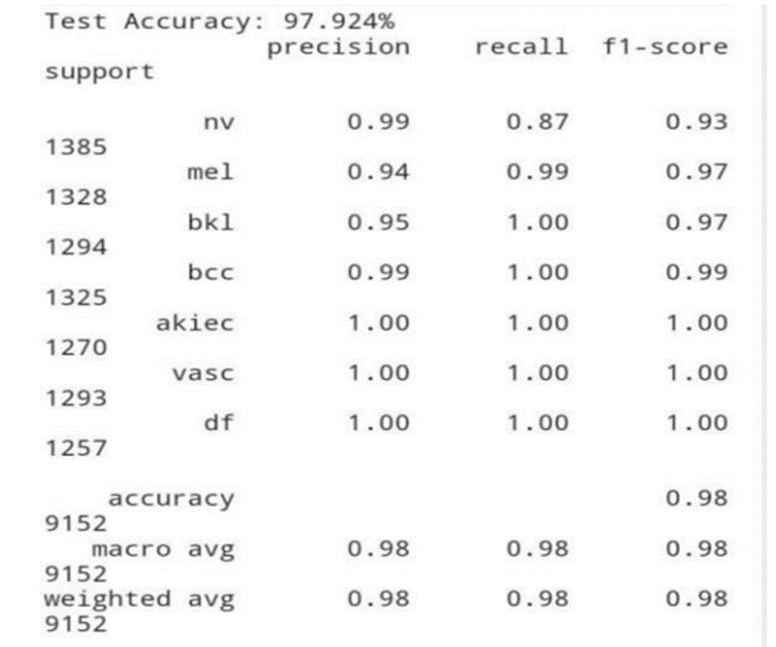
Results
Model performance without using Data Augmentation
Model Performance metrics without Data augmentation.

Slide 14
Transforming Healthcare: Our Project's Practical Impact
Early Detection for Improved Treatment: Enable early and accurate diagnosis of skin cancer, contributing to improved treatment outcomes and potentially saving lives.
Reduced Healthcare Burden: Try to alleviate the strain on healthcare systems by providing a cost-effective and efficient tool for skin cancer diagnosis, facilitating timely interventions.
Accessible Healthcare: Increase accessibility to skin cancer diagnosis, especially in remote or underserved areas, promoting wider healthcare inclusivity and awareness.

Slide 15
Conclusion
In this project, we utilized a dataset with seven skin cancer types, employing augmentation for size expansion. Our goal was to propose a skin cancer classification method using deep learning and neural networks. To address overfitting, we incorporated regularization, achieving an impressive 97.92% accuracy. The model outperformed many existing methods in accuracy, precision, recall, sensitivity, and specificity, standing out for its simplicity and lightweight design. Future work aims to develop even lighter architectures while maintaining accuracy for efficient skin cancer detection.

Slide 16
Intended Future Work
Mobile App & Website Development: Continue to develop app and website for this system by adding more features. Improve user experience also.
Continuous Improvement: Establish a feedback loop, collaborate with healthcare providers, and research capabilities to enhance model accuracy and expand utility.
Search for larger dataset: Stay in touch with hospitals to access their datasets. Integrate this recent real time dataset with ours to improve model`s performance.
Use of Nvidia Server: Train our large datasets on Nvidia servers available at our college to reduce computational cost and time for training.
Lightweight model: To develop even lighter architectures while maintaining accuracy for efficient skin cancer detection.

Slide 17
References
Stefanczyk, M. and Bochenski, T., 2020. “Mixing deep learning with a classical vision for object recognition”. Journal of WSCG, Vol.28, No.1-2, 2020
Gour, N. and Khanna, P., 2021. “Multi-class multilabel ophthalmological disease detection using transfer learning based convolutional neural network”. Biomedical Signal Processing and Control, 66, p.102329.
Junayed, M.S., Sakib, A.N.M., Anjum, N., Islam, M.B. and Jeny, A.A., 2020, December. EczemaNet. “A Deep CNN-based Eczema Diseases Classification”. In 2020 IEEE 4th International Conference on Image Processing, Applications and Systems (IPAS) (pp. 174-179). IEEE.
Nahata, H. and Singh, S.P., 2020. “Deep learning solutions for skin cancer detection and diagnosis.” In Machine Learning with Health Care Perspective (pp. 159-182). Springer, Cham.
J. Vineeth, S. Hemanth, C. V. Rao, N. Pavankumar, H. Jayanna and C. Janardhan, "Skin cancer detection using deep learning," 2022 Fourth International Conference on Cognitive Computing and Information Processing (CCIP), Bengaluru, India, 2022, pp. 1-6, doi: 10.1109/CCIP57447.2022.10058685.
R. R. Subramanian, D. Achuth, P. S. Kumar, K. Naveen kumar Reddy, S. Amara and A. S. Chowdary, "Skin cancer classification using Convolutional neural networks," 2021 11th International Conference on Cloud Computing, Data Science & Engineering (Confluence), Noida, India, 2021, pp. 13-19, doi: 10.1109/Confluence51648.2021.9377155.
A. K. Waweru, K. Ahmed, Y. Miao and P. Kawan, "Deep Learning in Skin Lesion Analysis Towards Cancer Detection," 2020 24th International Conference Information Visualisation (IV), Melbourne, Australia, 2020, pp. 740-745, doi: 10.1109/IV51561.2020.00130.

Slide 18
THANK YOU !

