Slide 1
Pre-operative Physiotherapy Intervention in Gynaecological Surgery Patients
Client: Sherin Jarvis
Royal Hospital for Women
Team: S. Lujic, P. Brown & M. Villar

Slide 2
Overview of the talk
Rationale
Aim of the study
Objectives
Data analysis
  SQ, HQ, PTT
  Critique, remedies
  Summary
The Consulting Process

Slide 3
Rationale
11% lifetime risk for pelvic floor surgery before the age of 80
30% re-operation rate
25% of all PFS patients suffered from worse mental health.

Slide 4
Aim of the study
To determine whether physiotherapy (pelvic floor muscle exercises) has any beneficial effects on patients undergoing pro-lapse and/or incontinence corrective surgery.

Slide 5
Objectives
To produce statistical analysis of data on three response variables, namely:
  Symptoms Questionnaire
  Health Questionnaire
  Paper Towel Test
To report significant intra- and inter-group differences (treatment vs. control)

Slide 6
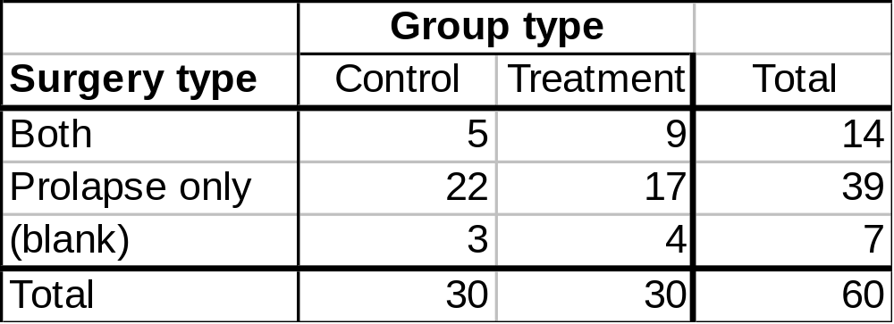
Data
60 patients – 30 treatment, 30 control
Surgery type – prolapse, incontinence, both
Outcome measures – symptoms, quality of life, area of leakage

Slide 7
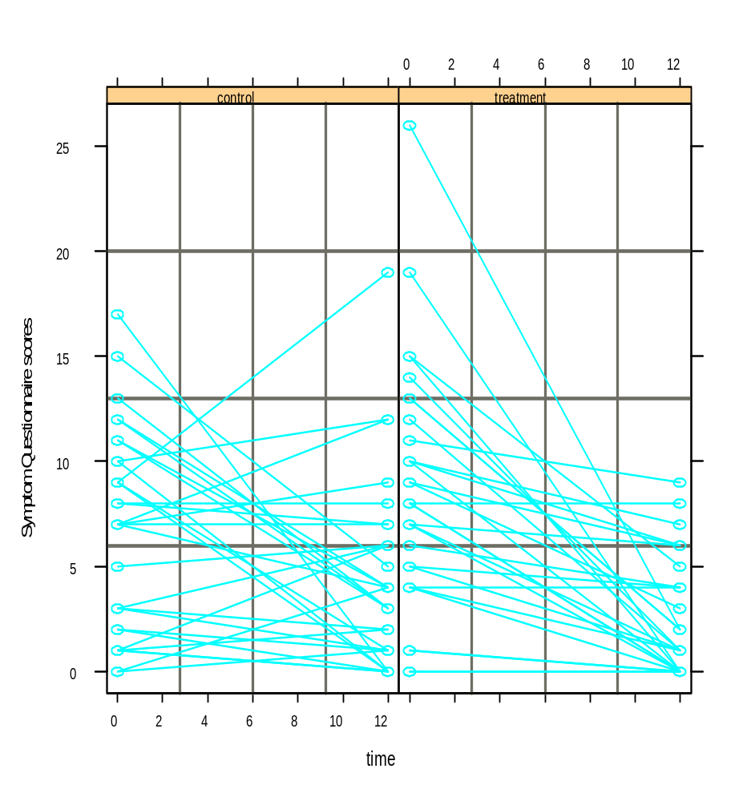
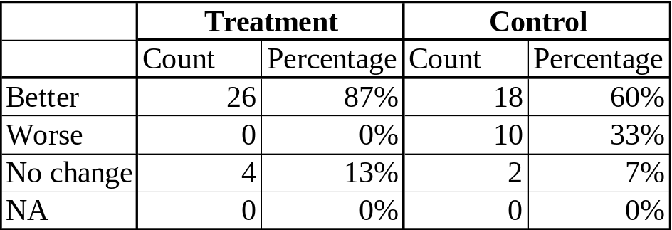
Symptoms Questionnaire - EDA
SQ Scores for treatment and control groups

Slide 8
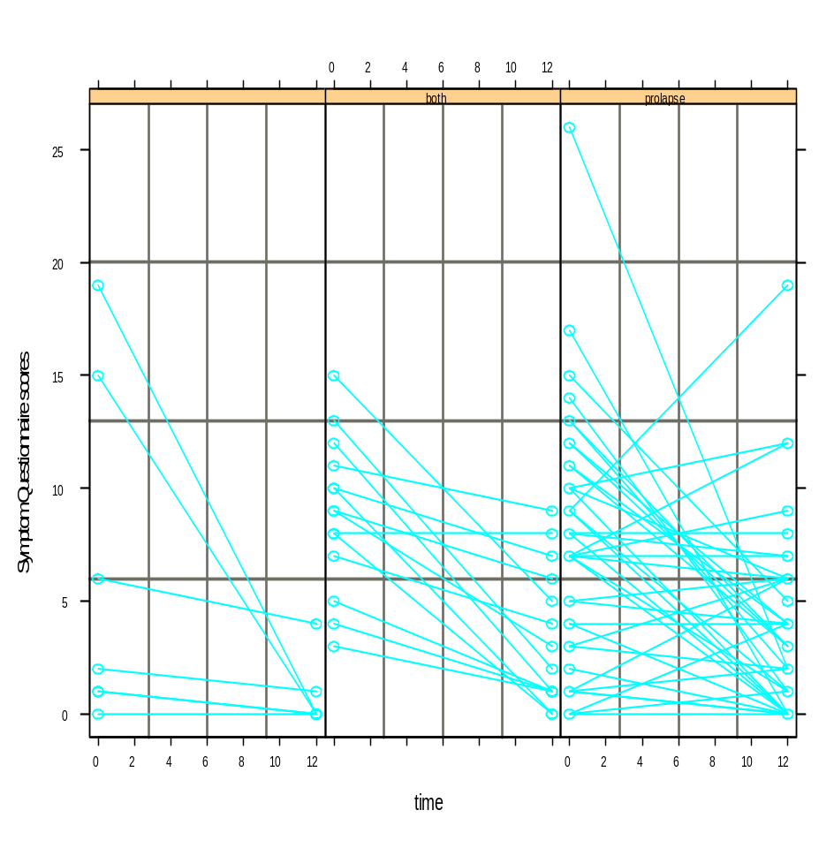
Symptoms Questionnaire Scores
SQ Scores by surgery type

Slide 9
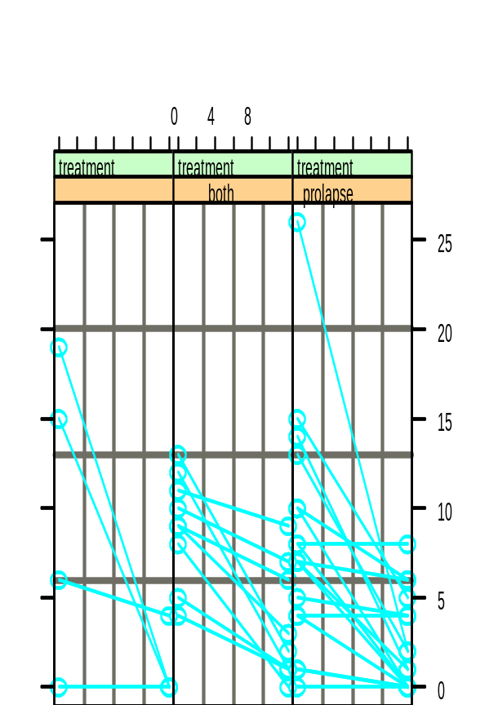
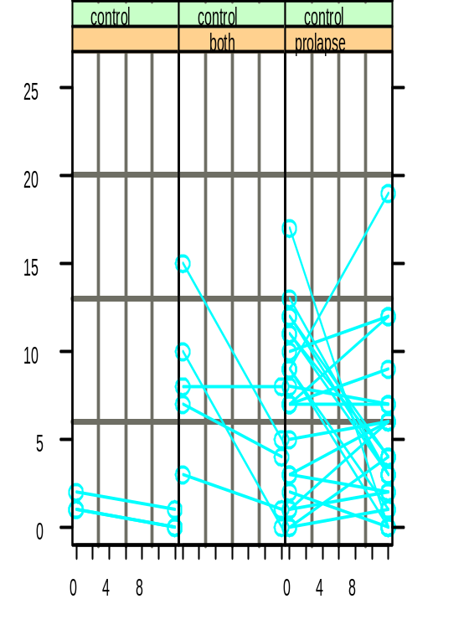
Symptoms Questionnaire Scores
SQ Scores by group and surgery type

Slide 10
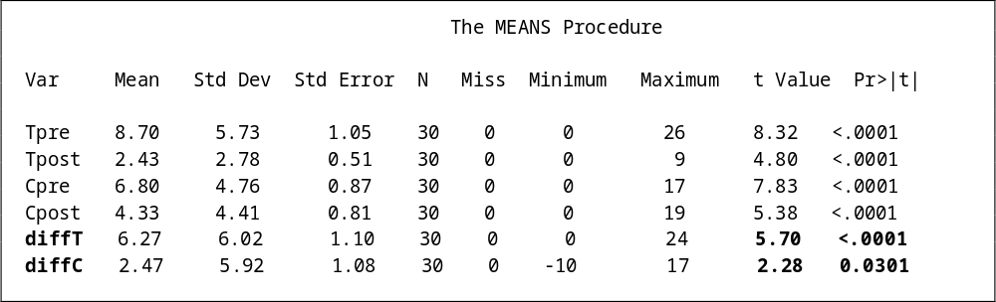
Symptoms – Summary Statistics

Slide 11
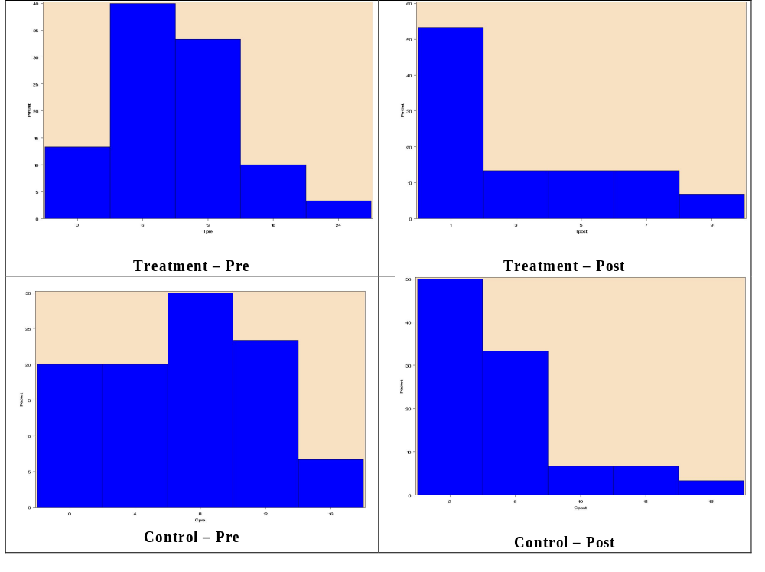
Symptoms – Histograms

Slide 12
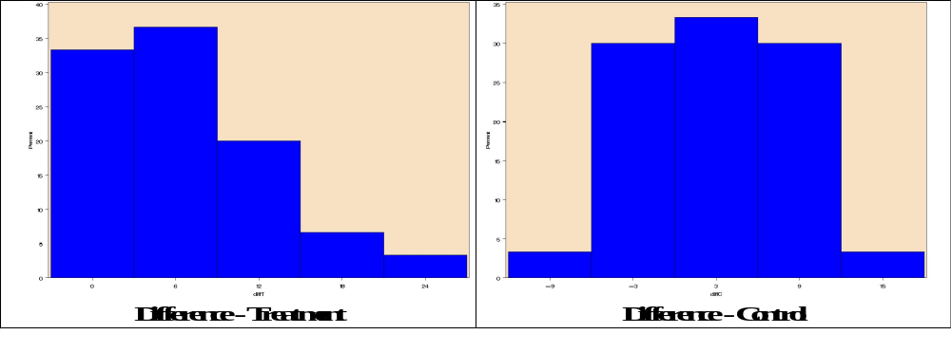
Symptoms – Histograms

Slide 13
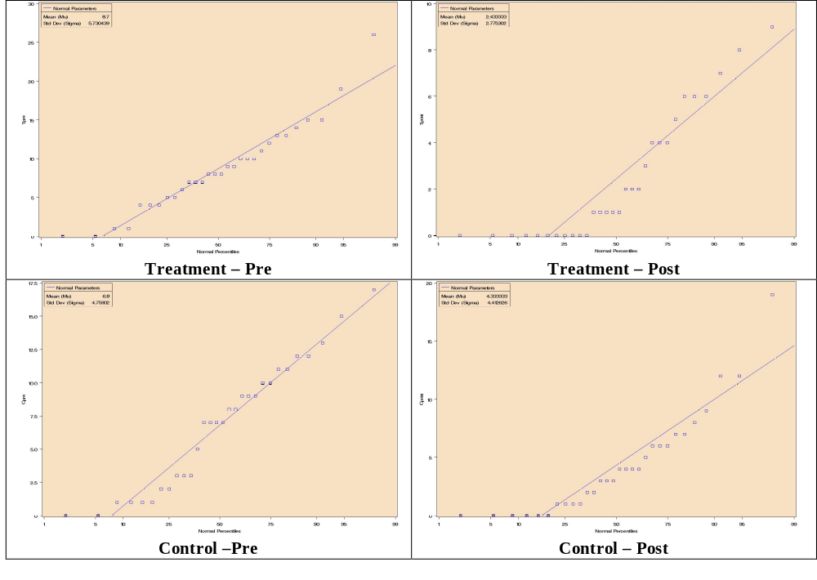
Symptoms – Probability Plots

Slide 14
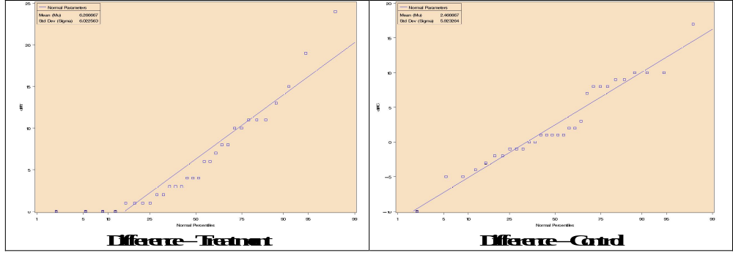
Symptoms – Probability Plots

Slide 15
Symptoms Questionnaire - Analysis
Testing baseline differences between treatment and control groups
Testing intra-group differences (before and after operation)
Testing inter-group differences (treatment vs. control)
Results Summary

Slide 16
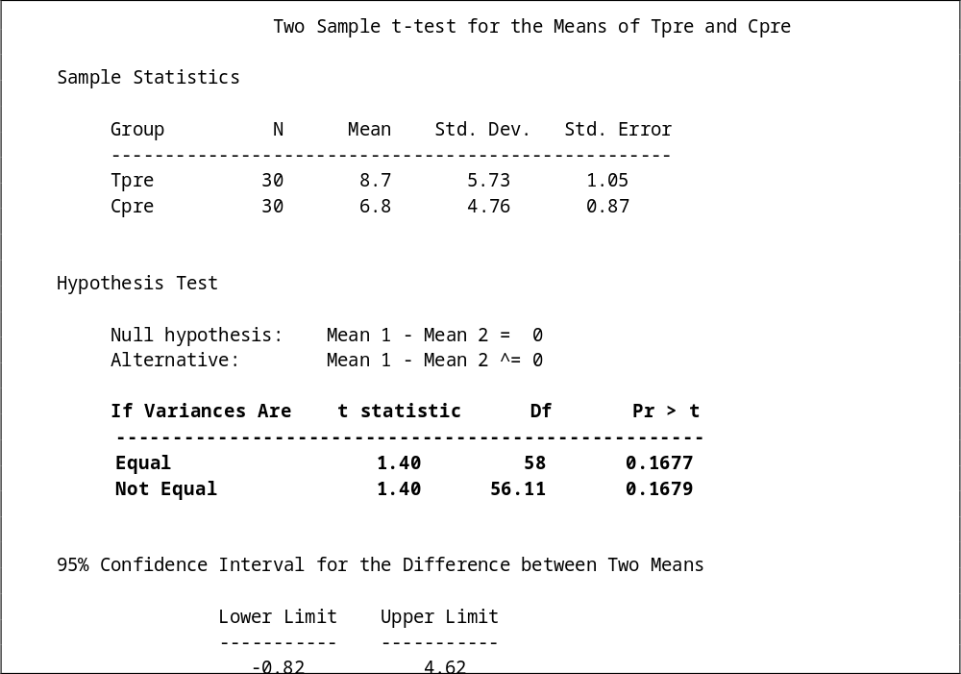
Symptoms Questionnaire – Testing baseline or pre-intervention differences

Slide 17
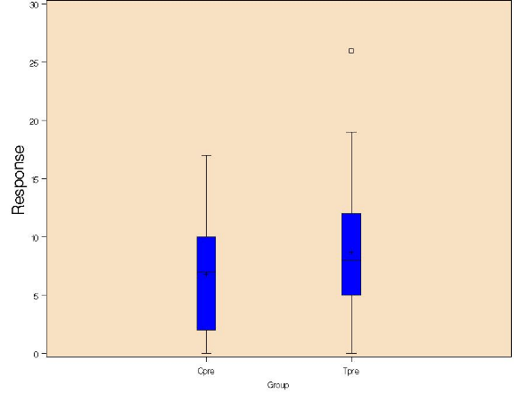
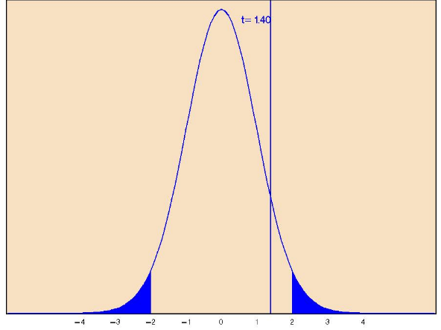
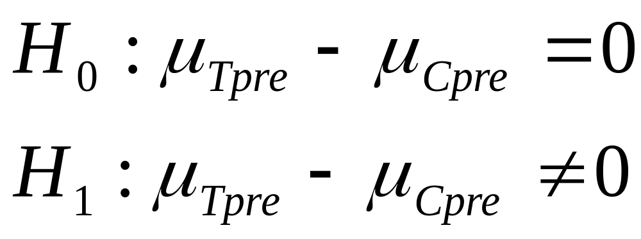
Symptoms Questionnaire – Testing baseline or pre-intervention differences

Slide 18
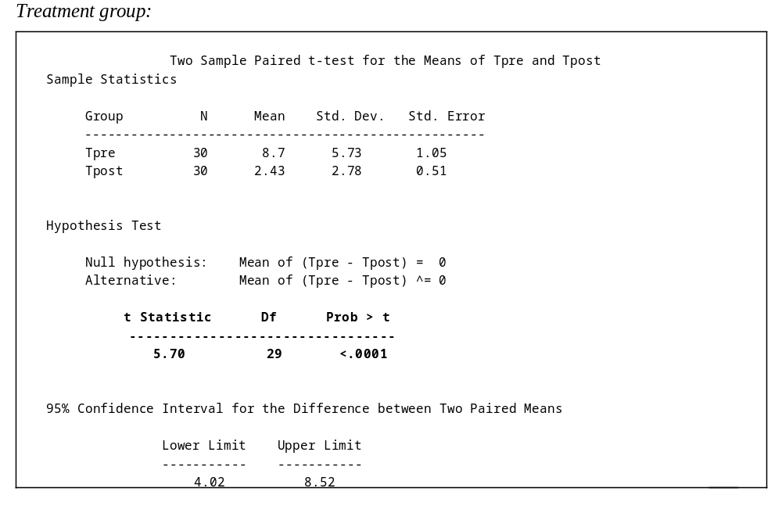
Symptoms Questionnaire – Testing intra-group differences (pre vs. post)

Slide 19
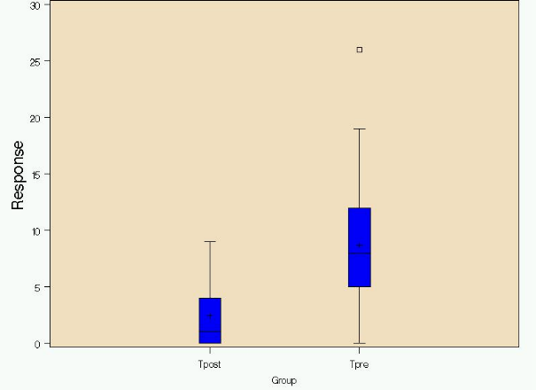
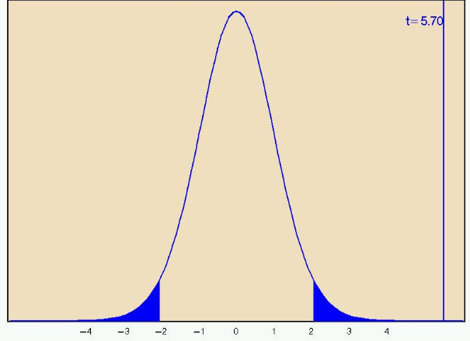
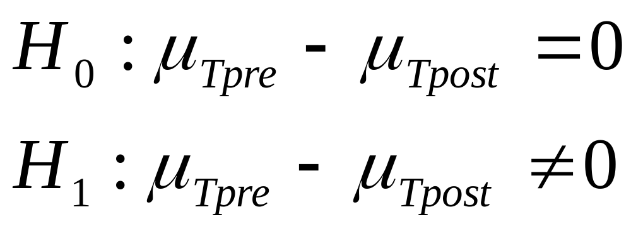
Symptoms Questionnaire – Testing intra-group differences (Treatment)

Slide 20
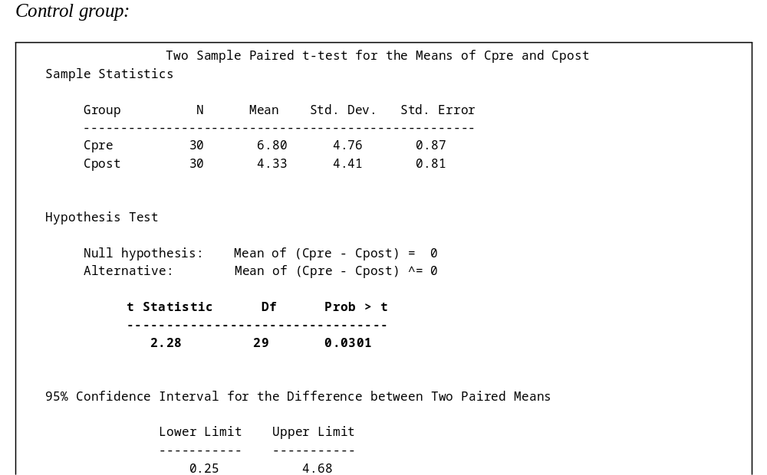
Symptoms Questionnaire – Testing intra-group differences (pre vs. post)

Slide 21
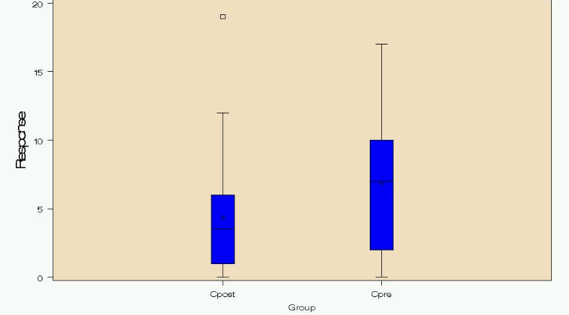
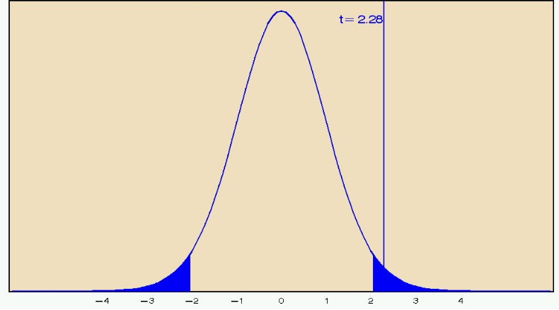
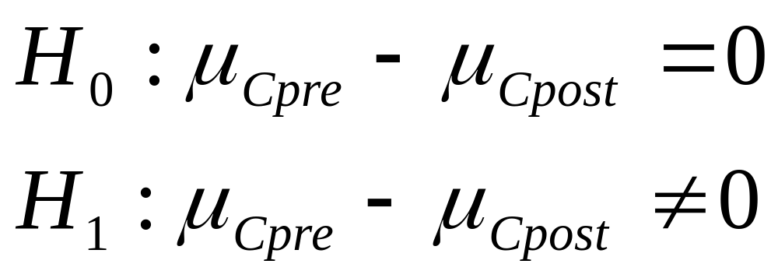
Symptoms Questionnaire – Testing intra-group differences (Control)

Slide 22
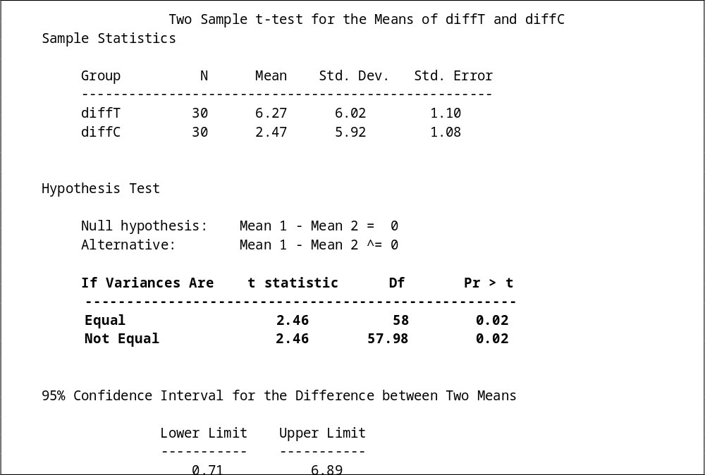
Symptoms - Testing inter-group differences (treatment vs. control)

Slide 23
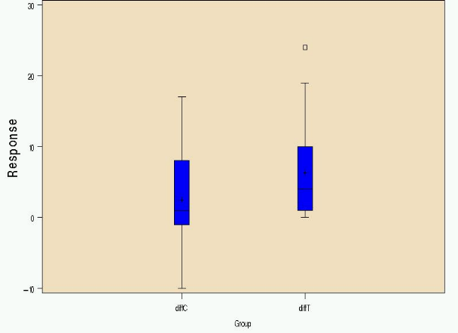
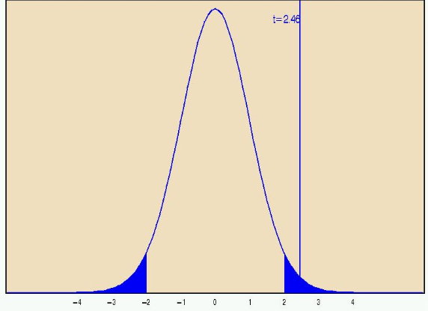
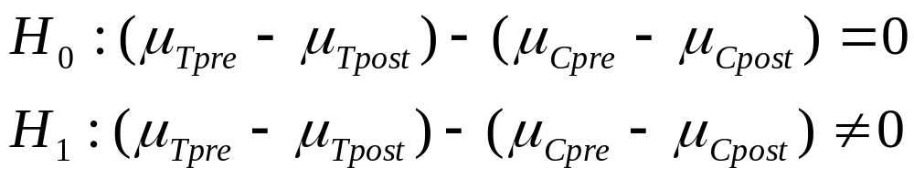
Symptoms - Testing inter-group differences (treatment vs. control)

Slide 24
Symptoms Questionnaire– Results Summary
Baseline differences – insignificant → neither group more morbid prior to any intervention, thus randomisation effective
Intra-group differences – significant for both treatment and control groups → mean scores different before and after operation
Inter-group differences – significant → mean scores different between the two groups

Slide 25
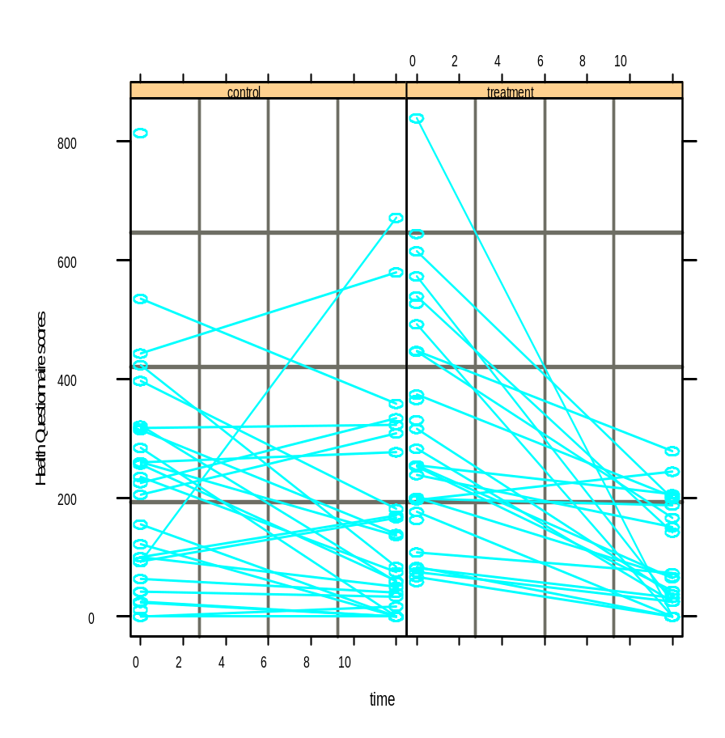
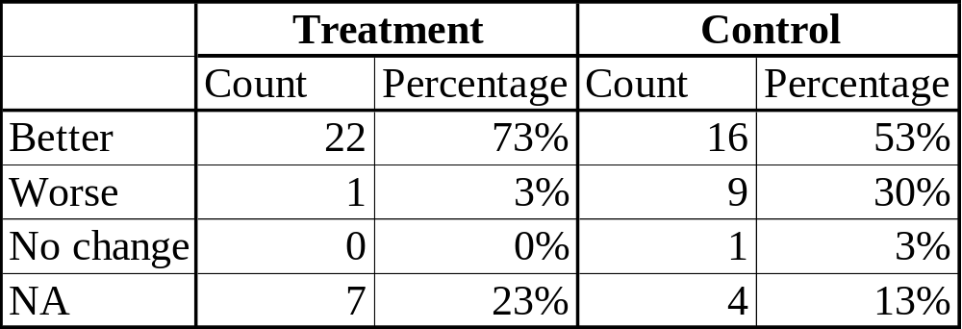
Health Questionnaire - EDA
HQ Scores for treatment and control groups

Slide 26
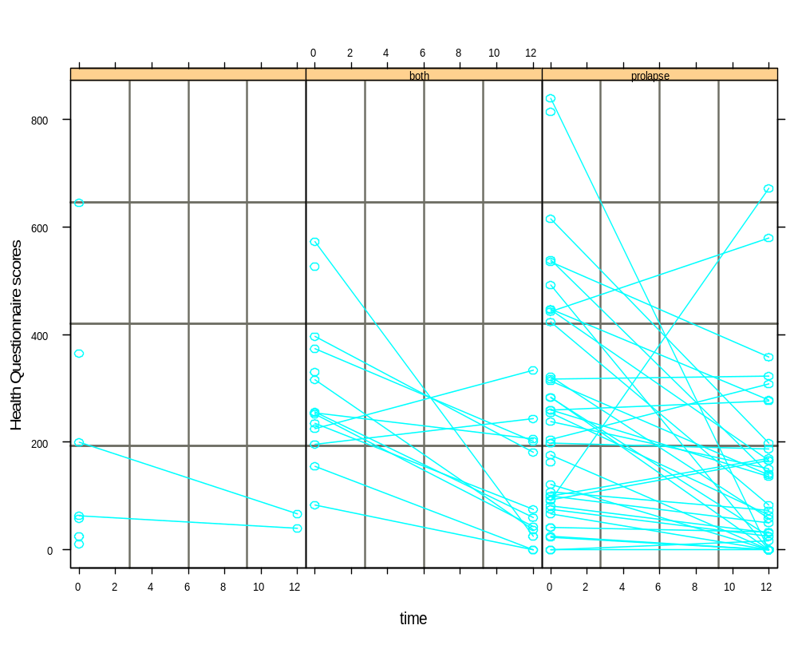
Health Questionnaire Scores
HQ Scores by surgery type

Slide 27
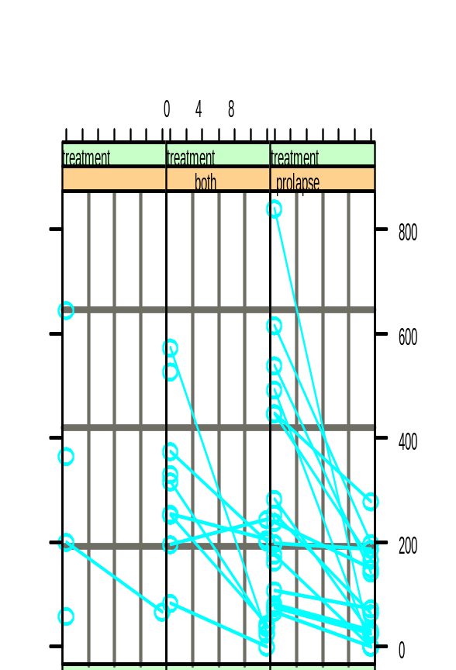
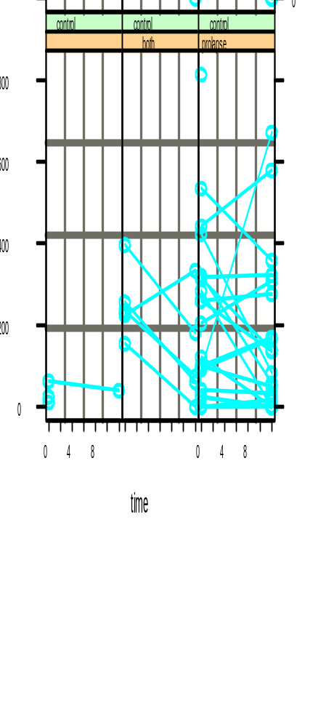
Health Questionnaire Scores
HQ Scores by group and surgery type

Slide 28
Health Questionnaire– Results Summary
Baseline differences – significant → treatment group performing worse prior to intervention, thus randomisation not effective
Intra-group differences – significant only for treatment group → equal mean scores for control group before and after operation
Inter-group differences – significant → mean scores different between the two groups (?)

Slide 29
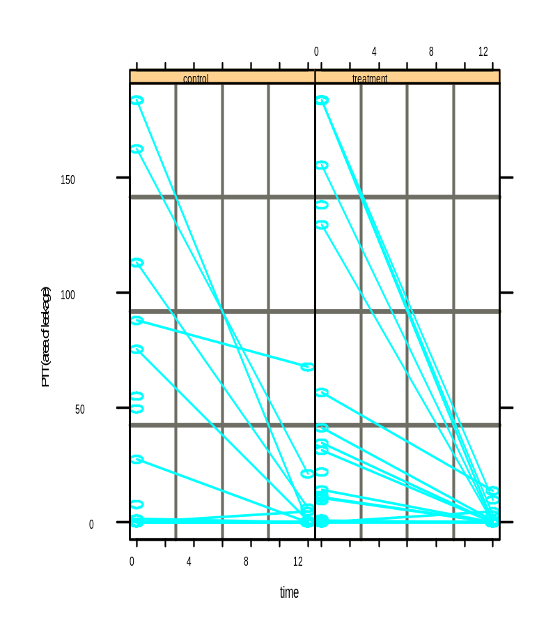
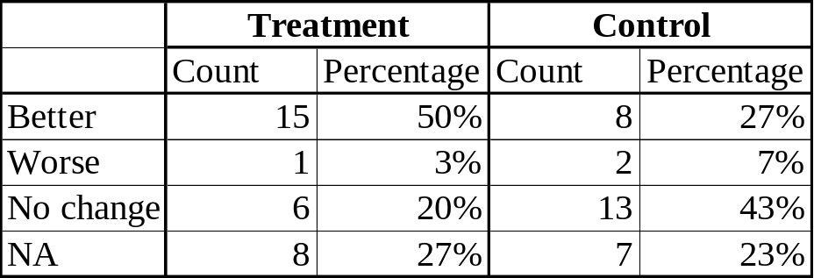
Paper Towel Test - EDA
PTT area of leakage for treatment and control groups

Slide 30
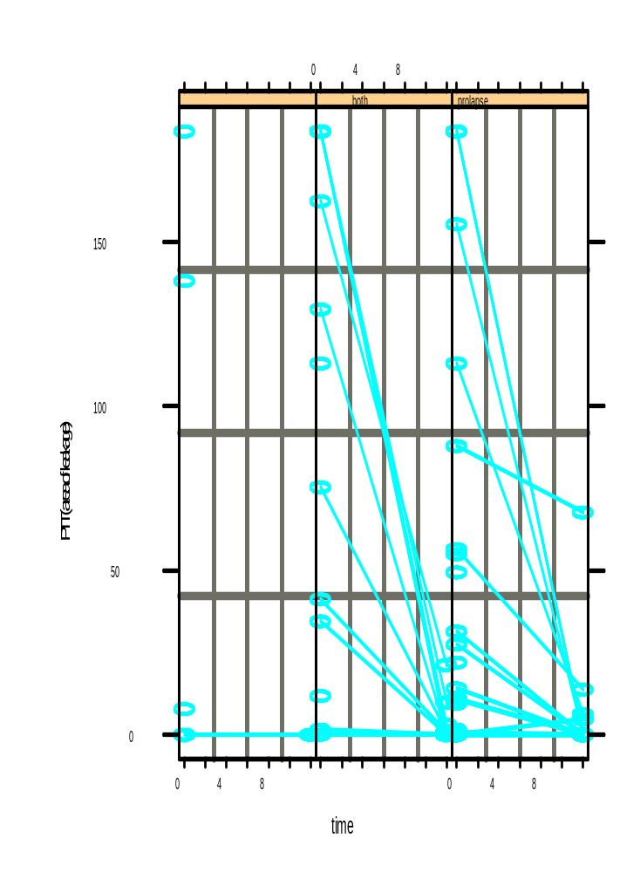
Paper Towel Test Scores
PTT area of leakage by surgery type

Slide 31
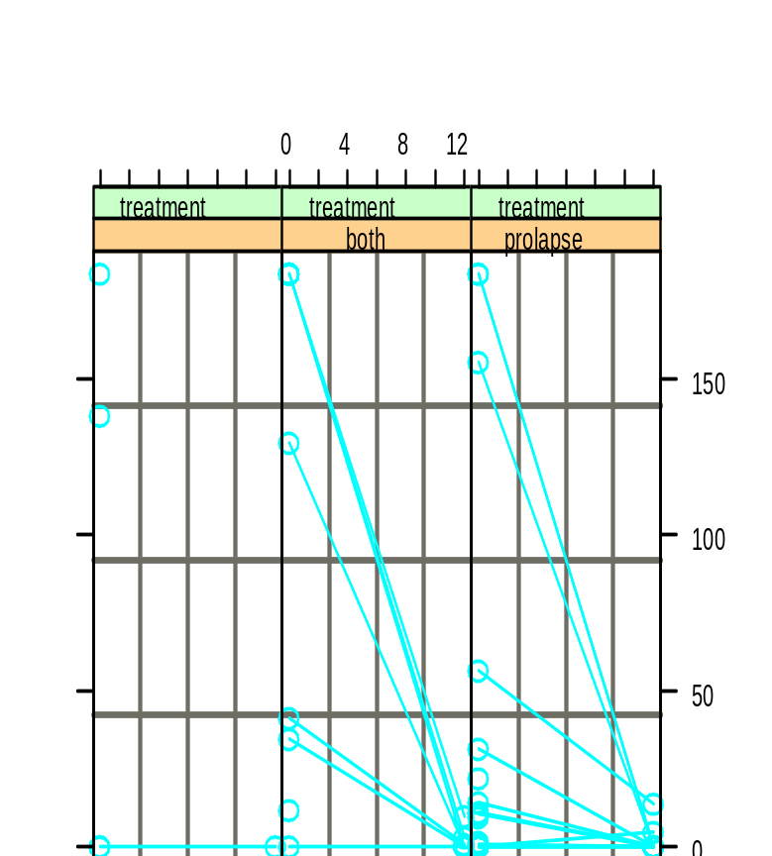
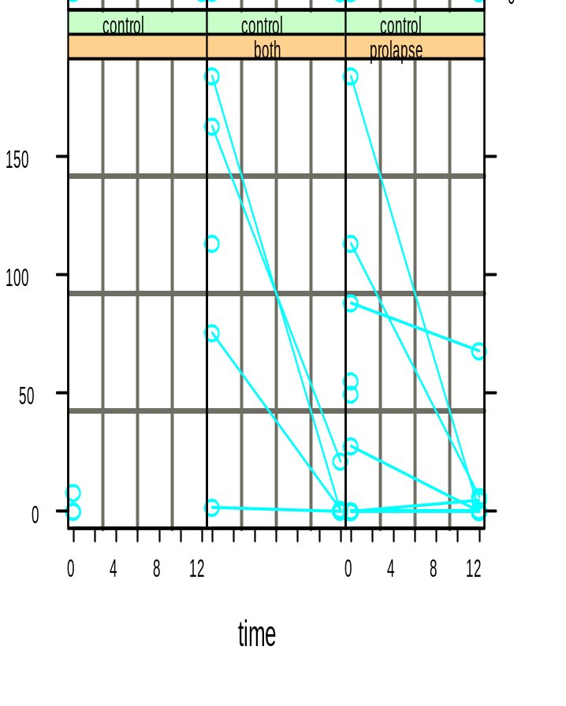
Paper Towel Test Scores
PTT area of leakage by group and surgery type

Slide 32
Paper Towel Test – Results Summary
Baseline differences – insignificant → neither group performing wetter prior to intervention, thus randomisation effective
Intra-group differences – significant for both groups → different mean scores for control and treatment groups pre and post operation
Inter-group differences – insignificant → mean area of leakage the same between the two groups

Slide 33
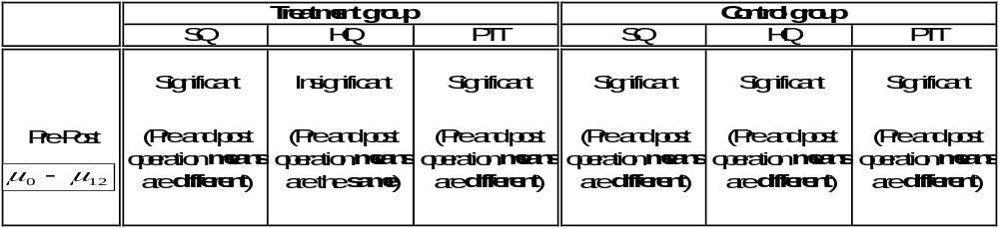
Summary

Slide 34
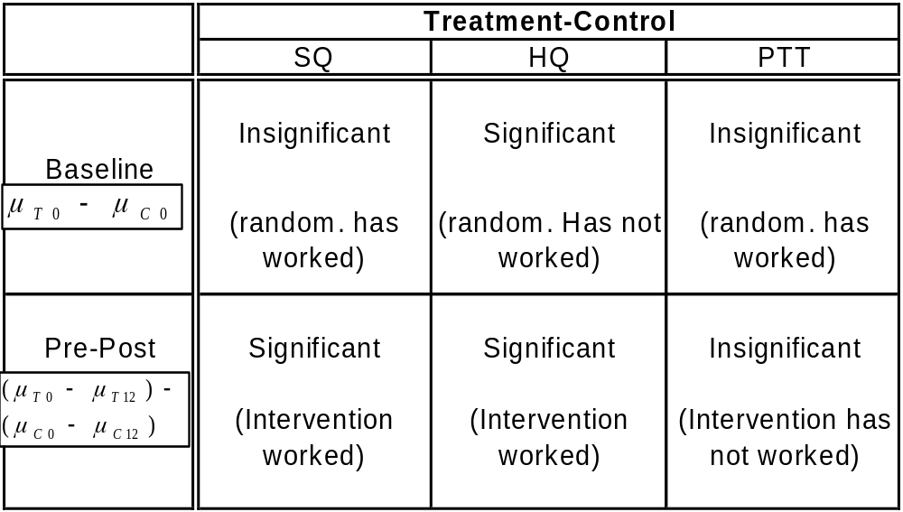
Summary

Slide 35
Critique
Evidence of non-normal distributions (particularly for PTT) – crucial assumption of parametric t-test violated.
In PTT, initial zero values or ‘dry’ cases problematic → almost all non-wet patients reported no significant improvement.
Right-censored data for PTT, upper limit of 183.8 cm² area of leakage recorded for 7 women

Slide 36
Remedies / Suggestions
Nonparametric methods → do not require restrictive normality assumption
Conditional PTT analysis → removal of ‘problematic’ zeros, considering only wet cases
Use categorical variable instead of continuous for PTT area of leakage

Slide 37
The Consulting Process
Overview
Initial Briefing
Clarification Meetings
Approach to Analysis
Hiccups
Analysis
Conclusions
Future Recommendations

Slide 38
Initial Briefing
RHW Objectives
  Is there evidence to support the intervention strategy under investigation from a clinical viewpoint, and
  From a patient well being viewpoint.
Initial inspection of data
  Extensive
  What was relevant?
  How to approach
Identify Issues requiring clarification

Slide 39
Clarification Meetings
Refine Objectives
Resolve the variables to be used
Study the data
  Quality
  Extent
  Distribution
  Does it measure what we want?
Allocate and Prioritise tasks

Slide 40
SCOPE
Agreed Measures
  Paper towel Tests (Area only)
  Health Questionnaire(King’s Hospital)
  Symptom questionnaire(King’s)
Additional measures if time permitted
  Qualitative Bladder diary and associated
  Personal data such as age, BMI etc

Slide 41
Follow Up Meetings
Confirmed scope (tentatively)
Request additional information
  Type of operation (I, P and I/P)
  Consulting doctor
  Information on test procedures
  Information on questionnaires

Slide 42
Approach to Analysis
Characteristics
  Non-normal data
  Paired observations
  Small sample size
  Potential for many confounders
  Matching of Controls to Treatment
Parametric and Nonparametric
  Contrast T & C before operation (ANOVA)
  Contrast pre-op and 12 weeks after op(paired-t)
Model Regression… accounting for Type-op, treatment or not for each measure

Slide 43
Problems encountered in Analysis
Baseline issues
  Some measures no change likely due initial
  How to interpret changes (revert to zero?)
Distribution of operation types
  Few incontinence only!
  Most data prolapse related
Data Presentation
  Trellis graphs not straightforward
  Data measurement constraints
Isolating treatment effects(eg healing time similar to timeframe for measuring physiotherapy intervention)

Slide 44
SUMMARY
PTT
Health Questionnaire
Symptom Questionnaire

Slide 45
Recommendations
What was learnt
  Translation of objectives to stats. not easy
  Analysis of source data not straightforward
  Preparation and manipulation of data not straightforward
  Visualisation aids very helpful
  Coordination an issue

Slide 46
If we had More Time
  Review T & C allocation
  Refine objective measures and data collection
    Operation type
    Specificity of tests
    Review treatment breakdown to isolate better tests and include some like Bladder diary
  Check questionnaire scaling and validity
  Break down the scope if possible

