Slide 1
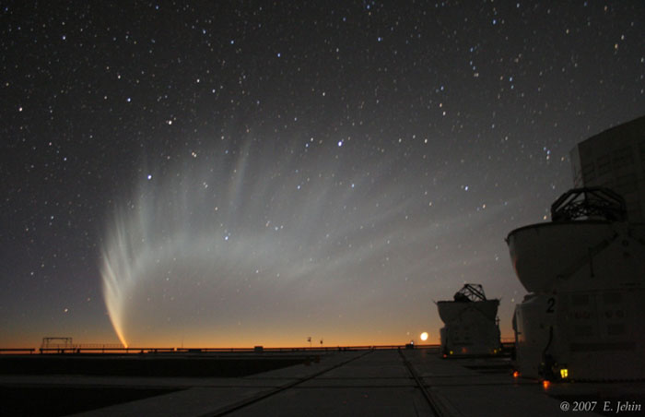
Comets and the Solar System
Practical Astronomy: 16 September 2014
Tonight's Topics
Planets over the next few months
Three good comets are visible NOW!
Comet Siding Springs passes close to Mars
Total Lunar Eclipse of 8 October

Slide 2
Planetary Highlights
Mercury highest in evening sky for the year
Conjunctions of Mercury & Mars
Jupiter becoming visible again in the morning
Last chance to see Saturn
Uranus and Neptune now visible in the evening sky
A roundup of the planets visible each month is published in CASMAG, and is also available from the RASNZ web site.

Slide 3
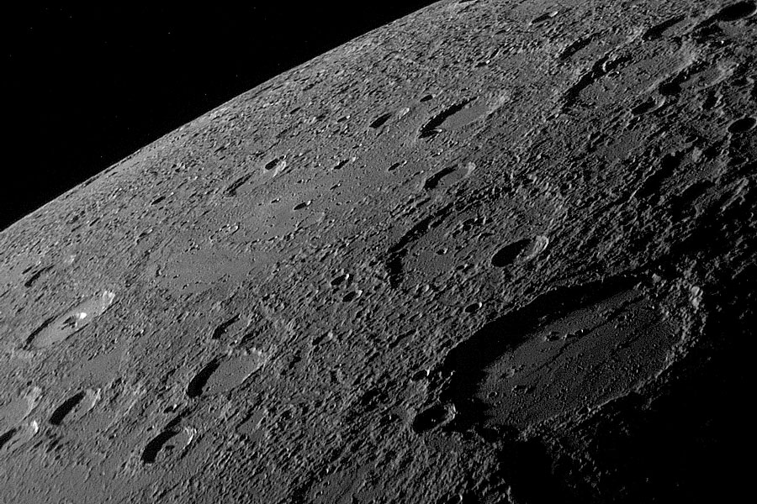
Mercury
Near maximum evening elongation NOW
Max on 22nd September
About 15-18 degrees up at 7pm
Phases like Venus
Very small disk (6 arcsrc) but the phase is visible if the atmosphere is steady enough
Conjunction with Spica 20 & 21 Sept

Slide 4
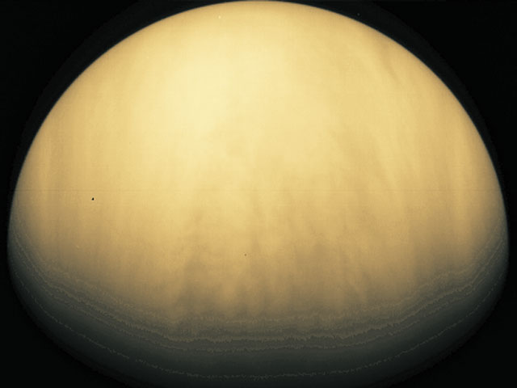
Venus
Far side of the sun, too close to see
Moving into evening sky from January
Best in July next year
Visible in daytime from December
Trailing sun by 10 degrees in December
Stand in shade and use binos
Small (10”), full phase.

Slide 5
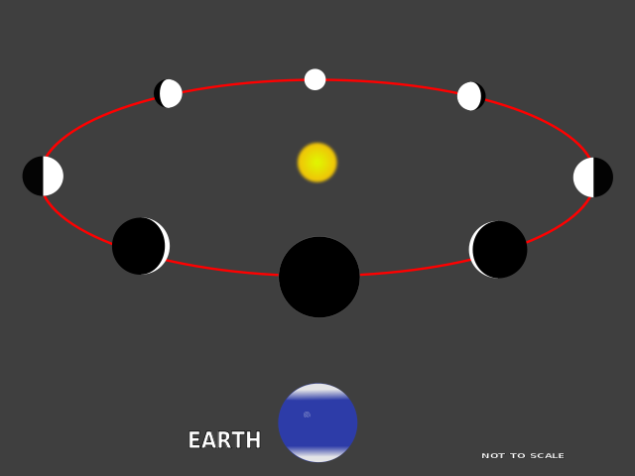

Slide 6
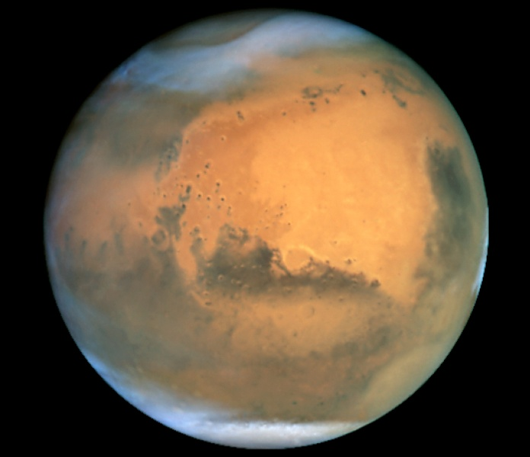
Mars
Visible early evening
Falling behind earth & getting smaller
Good again 2016 (even better!)
Showing phase now
Conjunction with Antares “Rival of Mars” - 29th
Comet Siding Springs passes on 19th October

Slide 7
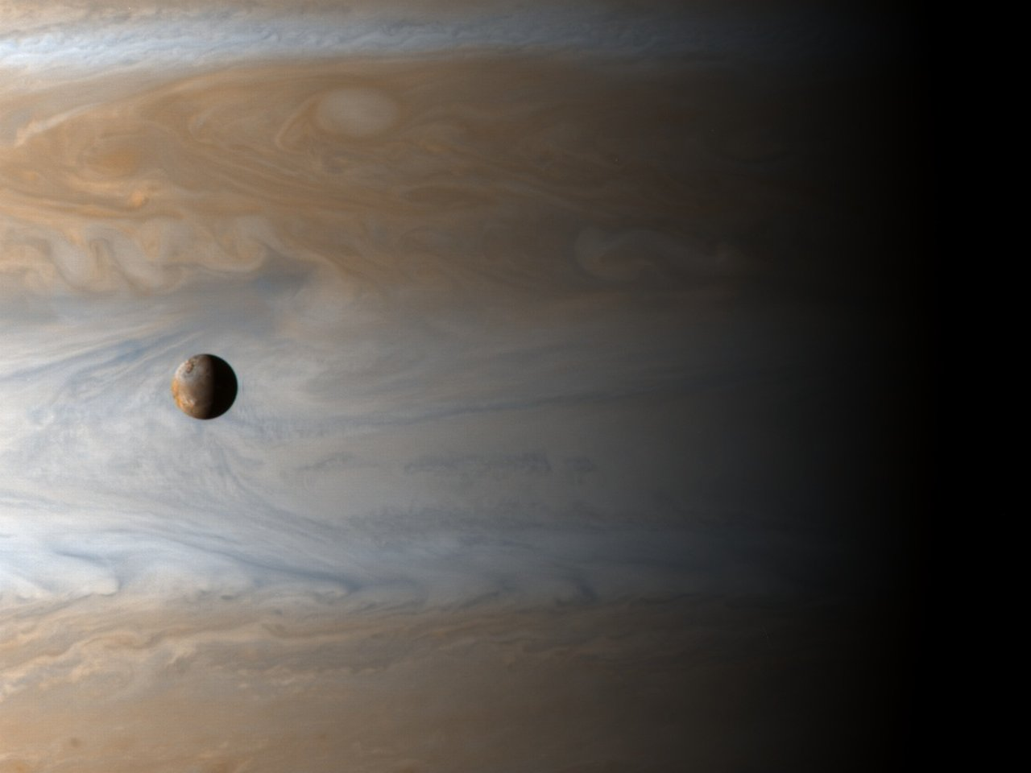
Jupiter
Low in morning sky
Higher in morning sky November/December
Late evening sky from February
Mutual eclipses of Moons!
Callisto’s shadow on Ganymede, 1 November
Europa occults Callisto, 11 November
Many more eclipses and occultations through summer

Slide 8
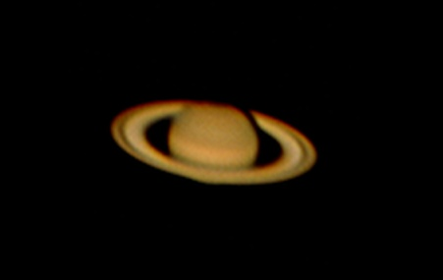
Saturn - Uranus - Neptune
Last chance to see Saturn
- Shadow visible on rings
Uranus in Pisces late evening
- Bright (mag 6) - binos - tiny disk - 4 arcsec
Neptune in Aquarius all evening
- Mag 7.7 - binos - 2.4 arcsec

Slide 9
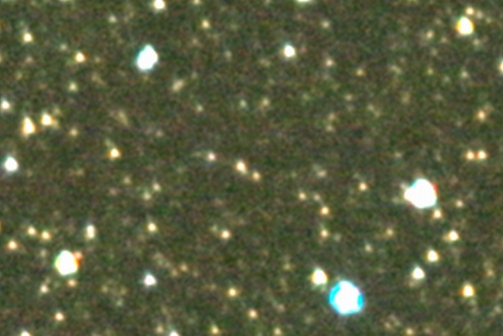
Pluto
Need 12” scope or 300mm f/5.6 lens and image stacking!

Slide 10
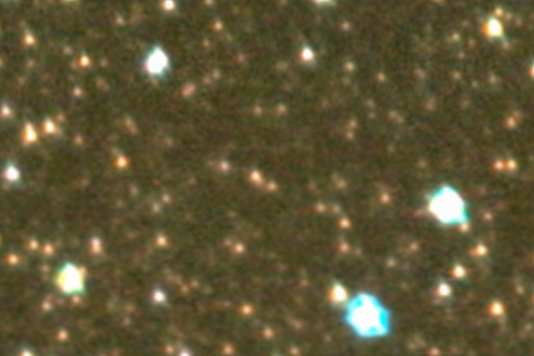
Pluto
Need 12” scope or 300mm f/5.6 lens and image stacking!

Slide 11
Comets are visible this month
C/2013 V5 (Oukaimeden) -binos, evening
C/2012 K1 (PanSTARRS) - binos, morning
C/2013 A1 (Siding Spring) - scope, evening
- Passes Mars on 19th of October
C/2012 X1 (LINEAR) - Very faint, big scope

Slide 12
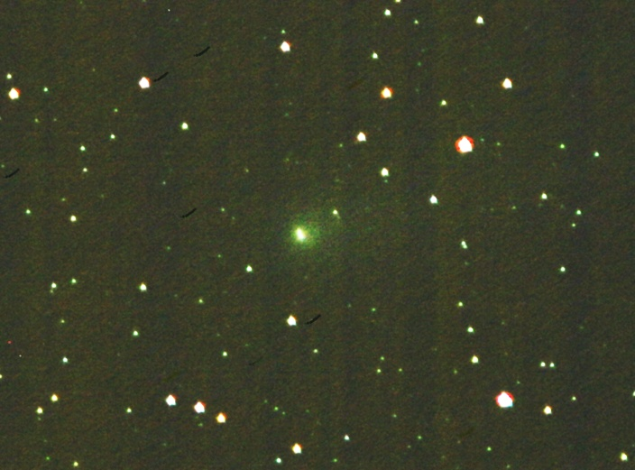
Comet C/2012 X1 Linear
24/7/2014

Slide 13
C/2013 V5 (Oukaimeden)
Brightest NOW, Mag 6 - binos
Moving to evening sky from 20th
Best before 26th when new moon is in sky
Gets higher but dimmers as moon gets brighter
Still good until early October with moon

Slide 14
C/2012 K1 (PanSTARRS)
Morning only for now, Mag 7 - binos
Getting higher
Brightest mid October, Mag 6
New moon leaves morning sky from 22nd Sep
Moon back in morning from 7th Oct
Visible all night late October, Mag 7

Slide 15
C/2013 A1 (Siding Spring)
Max brightness now, around mag 8-9
Faint in 4” scope
High in evening sky
Moving Pavo to tail of Scorpius this month
Passes within 130,000km of Mars on 19th October
Sets before we see closest approach

Slide 16
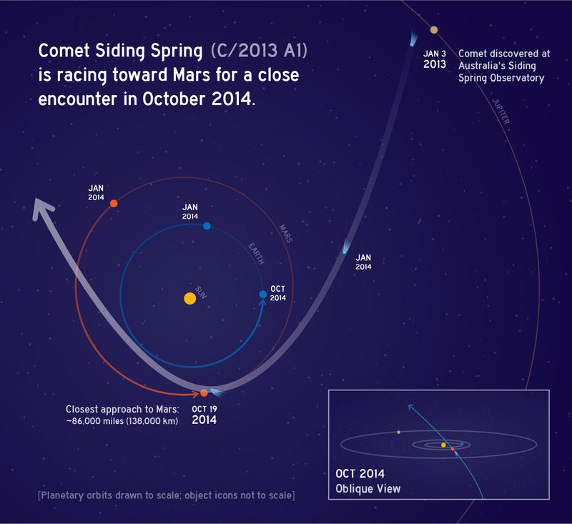

Slide 17
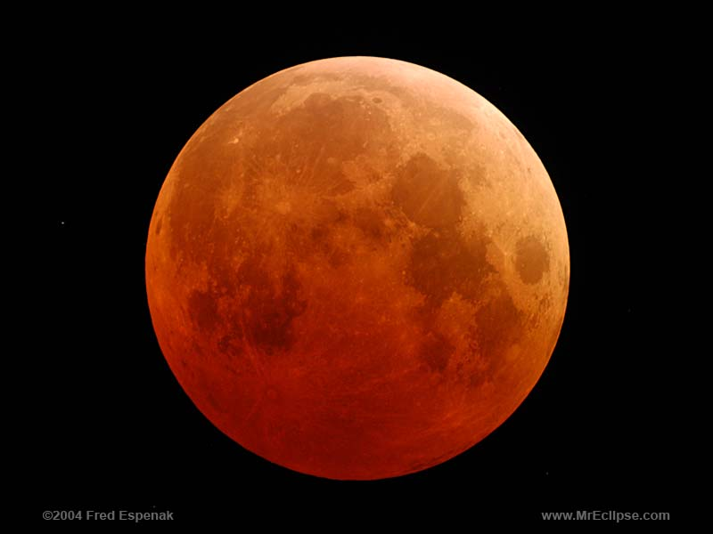
Total Lunar Eclipse
8 October 2014
Total: 23:25 - 0:25 NZDT
Partial: 22:15 - 1:40 NZDT
Moon rising from 25 - 38 degrees
Mag 7.3 star appears from behind fully eclipsed moon at 12:17am
Asteroid Fides (mag 9.8) disappears behind moon at 12:30am
Uranus 2 degrees from eclipsed moon

Slide 18
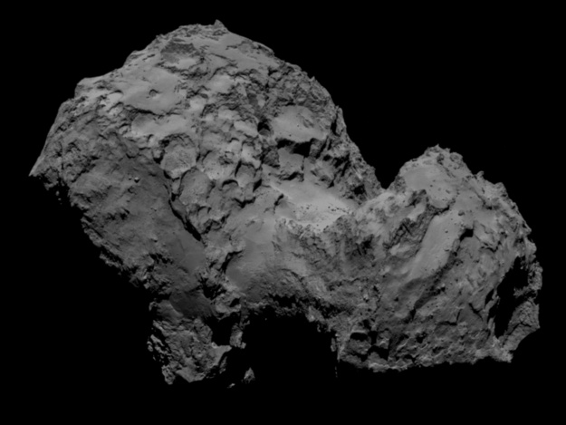
Exploration News
Rosetta at Comet 67P/ Churyumov-Gerasimenko
Landing near the big crater on the small end
Landing 11 November
Comet 67P mag 11 August 2015
Maven (NASA) & MOM (India) arrive at Mars next week

