Slide 1
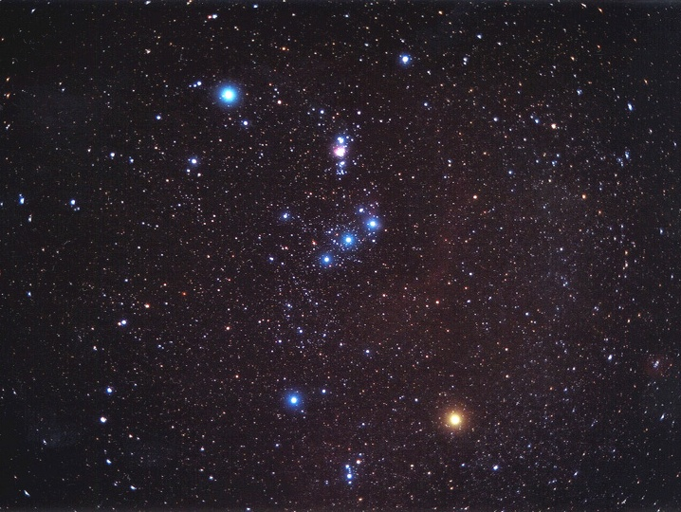
SUMMER NIGHTS
Easy observing for short summer nights
Matthew Spinelli APOD 7 Feb 2003

Slide 2
Summer Observing
Short nights
Warm evenings
Less dew
Orion and the Summer Milky Way
Big bright open clusters
Lots of easy double stars
Holiday observing!

Slide 3
Quick and Easy
Gets dark late, so not much time
Do several short sessions, start early
Save time & hassle with a minimal setup
Bright objects for the back yard or with the moon
Dark skies at holiday spots
Can take small scopes and binos on holiday
Have FUN!

Slide 4
Getting Dark
In Dec/January stars come out around 10pm
Many stars visible by 10:30pm
Truly dark after 11pm
Northern latitudes get dark an hour earlier!
Moon in evening sky Christmas - 8th January
Don’t wait! - set up before the stars come out
Identify stars and locations of objects early
Binoculars make more stars visible in twilight

Slide 5
Summer Observing Program
Focus on Summer Milky Way
Orion
Canis Major
Puppis
Monoceros
Split into four nights
Lists for Binos and Small scopes

Slide 6
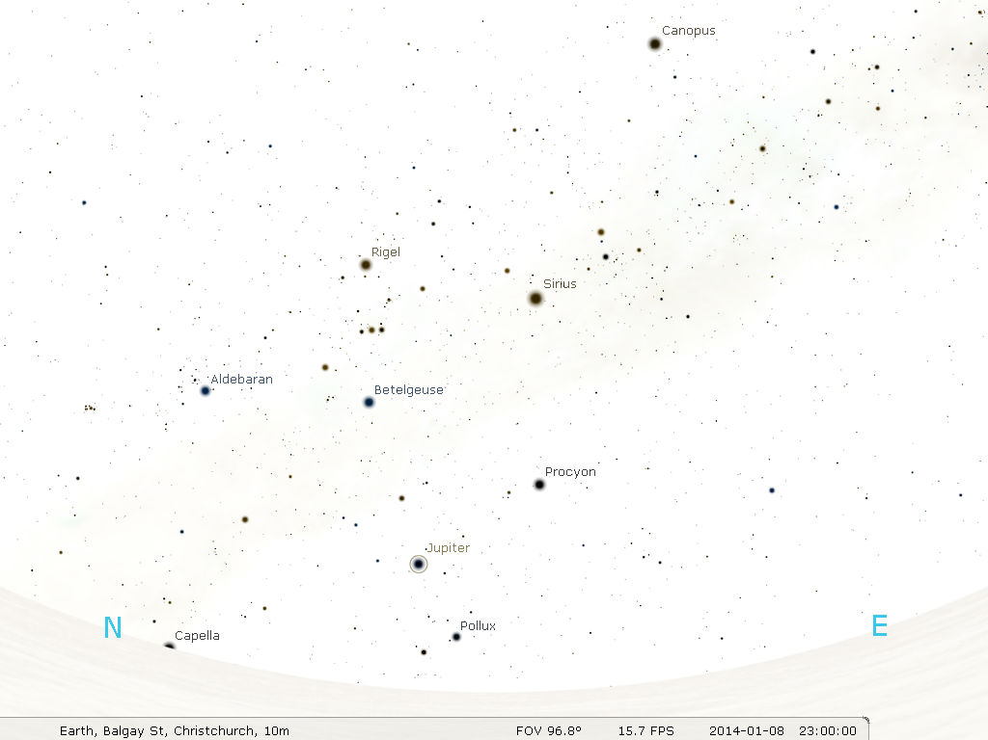
Summer Milky Way

Slide 7
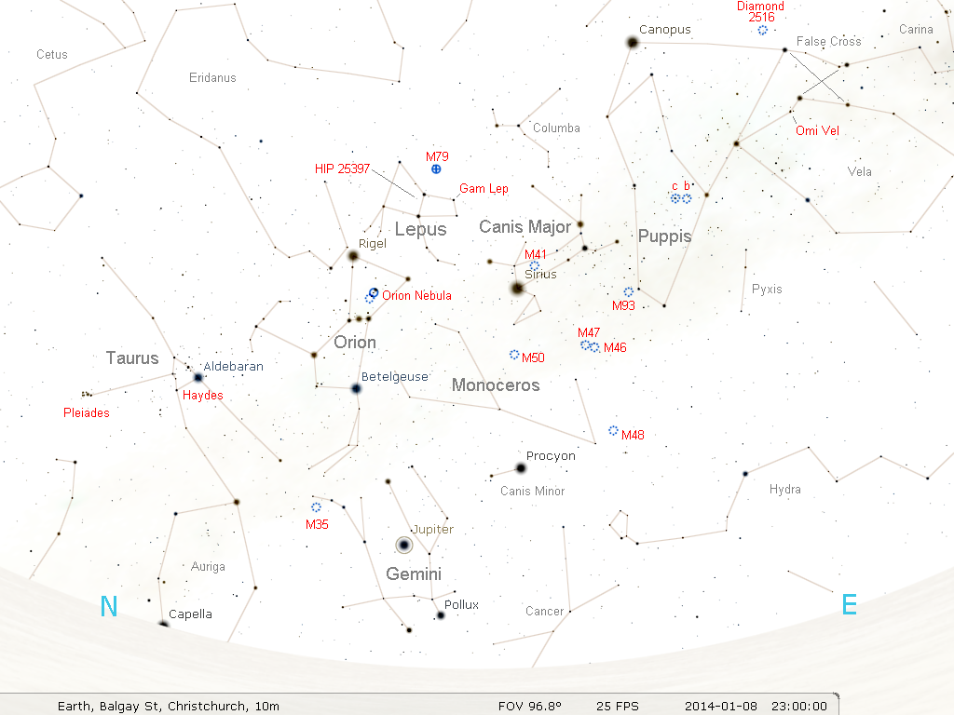

Slide 8
Night One
Orion and Milky Way - Binos
Don’t rush!
Take a night to enjoy wide field bino views
Become familiar with the sky
Scan the richness of the Milky Way
Binoculars show thousands of stars & clusters
Identify stars and objects listed
Dark skies are best

Slide 9
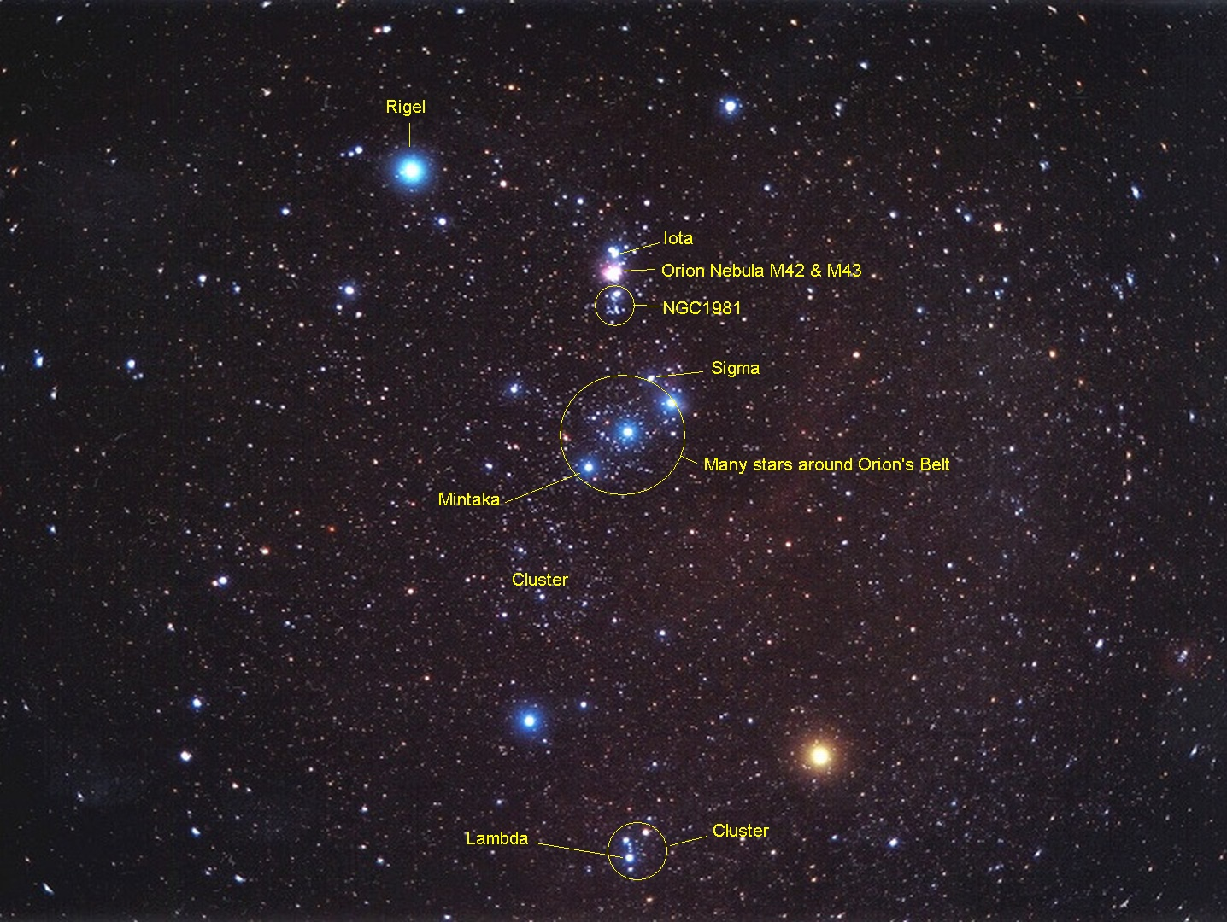
Matthew Spinelli APOD 7 Feb 2003

Slide 10
Night One
Observing List
Look at the richness of milky way, Haydes, Pleiades, M35
Orion nebular, NGC 1981 Open cluster & Belt cluster.
Identify double stars of Orion: Iota, Sigma, Mintaka, Rigel, Lambda
Loose star cluster around Lambda Orionis
Gamma Lepus: bino double 3.5/6.1-100”. Secondary much dimmer toward centre of Lepus - need steady binos!
Can you see globular cluster M79 in Lepus - dim, small and fuzzy!

Slide 11
Night Two
Around Orion with a Telescope
Revisit Pleiades & M35 with scope - rich areas of sky
Orion Nebula M42, bright centre, outlying nebula visible on dark night
M43 - part of same nebula divided off by dust lane
Trapezium - tight quadruple star in heart of M42 - box shape
Iota triple star - close double 2.7/7-11", dim secondary, very dim third star further way in arc, mag 9.7-49”
Same field, bright wide pair HIP 26197&99 4.8/5.6-32”
Sigma quadruple - easy triple in line 3.7/6.6/6.3-13"/41", dim fourth star close on opposite side 8.8-11”

Slide 12
Night Two
Observing List - Part 27
Mintaka 2.2/6.8-53" wide but dim secondary
Rigel 0.3/6.8-9.3" close, difficult, much dimmer secondary
Lambda 3.5/5.4-4.1” - very close, dimmer secondary, amongst large loose cluster of stars.
Very wide bino double Gamma Lepus - 3.5/6.1-100”, unrelated stars. Very easy in scope.
Wide double HIP 25397 in centre of Lepus, 5.8/7.5-26”
M79 globular cluster, dim and fuzzy in small scope, brighter concentrated centre.

Slide 13
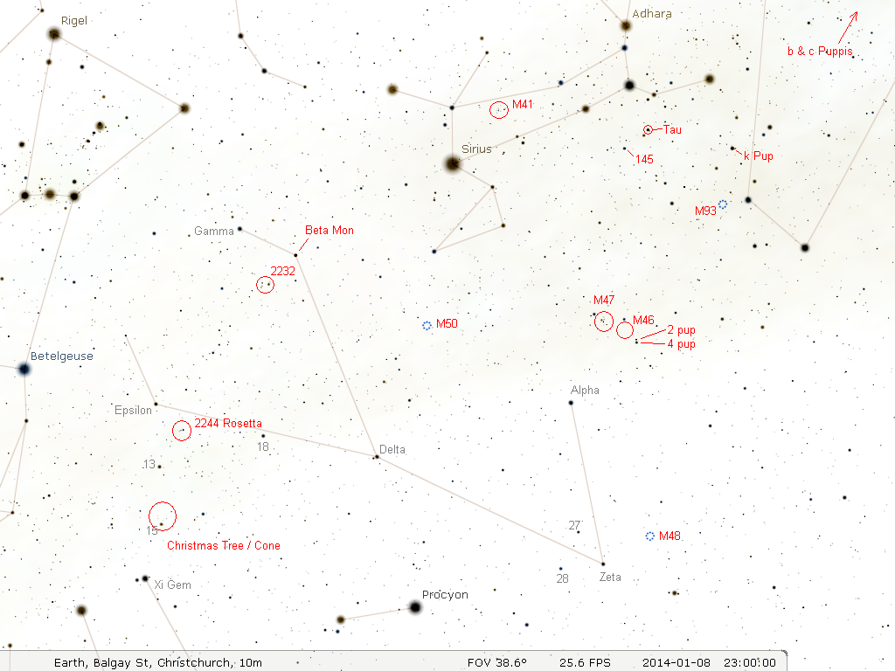

Slide 14
Night three
Monoceros to Puppis with binos
Rich part of the Milky Way - many stars and faint clusters from c-Puppis to M50
Become familiar with Canis Major - find M41 and M50
Identify Tau and 145 CMa double. Nice cluster around Tau CMa in telescope.
k-Puppis double and M93 are nearby.
c-Puppis is the bright red star in open cluster NGC2451
NGC2477 is near b-Puppis. 100’s of dim stars. Hazy patch.
M47 is big and bright. M46 is dim and hazy.
Note stars 2 and 4 Puppis. 2-Pup is an easy telescope double

Slide 15
Night three - part 2
Finding your way around Monoceros
Halfway between Orion’s belt and bright Sirius are Gamma and Beta Monoceros. Beta is a nice telescope triple.
Loose cluster NGC 2232, near Beta Mon, resolves in binos
Follow the line of dim stars from Betelgeuse to Epsilon, 18, and Delta Monoceros
Further on is the small triangle of Zeta, 27 and 28 Monoceros
Above is Alpha, and to the right is open cluster M48.
The Rosette nebula contains a small cluster. On a dark night the nebula itself might be visible in binos with averted vision
4 stars arc down from Epsilon Mon to Xi Gemini. The Christmas tree cluster is around 15 Monoceros, big.

Slide 16
Night Four
Monoceros to Puppis with a Telescope
M41 Open cluster - big, bright, many stars
Tau Canis Major cluster - Just a bright star at first glance, but averted vision makes many stars appear!
Colourful wide double 145 CMa 5/5.8-26" Orange/Blue
Evenly matched close but easy "cat eyes" pair k-Puppis 4.4/4.6-10", both white.
M93 rich small open cluster, many tiny stars and haze
c-Puppis - Bright red star in big bright cluster NGC2451
b-Puppis - near the dimmer cluster NGC2477 with hundreds of tiny stars and haze

Slide 17
Night Four
Part 2
M47 big and bright, scattered stars.
M46 hundreds of dimmer stars - nice on a dark night
2 Puppis double 6/6.8-17"
M50 & M48, good open clusters, many stars
Beta Monoceros triple - close double 4.6/5-7.2", secondary very close double 5.0/5.3-2.9" need highest power and very steady night. A fourth dimmer star is 250" away.
More stars of 2232 visible in telescope, need wide field
Rosette cluster shows more detail in telescope
Christmas tree cluster needs wide field but shows stars like lights on a Christmas tree.

Slide 18
Summary
Enjoy short and easy observing sessions
Doubles and bright open cluster still look good in the city
Dark sky holiday locations make binos and small scopes come alive!
If all else fails, there's the still the Moon and Jupiter!
Have fun - you're on holiday!

Slide 19
Notices
Lists & Charts will be put on CAS web site
Collimation Workshop - 1pm Saturday 22 Nov
BBQ - 6pm Saturday 22 November
No meeting Dec/Jan
Sat 24 Jan - New astronomer's BYO scope evening - "Summer nights" objects
Next Meeting 17 Feb - Open discussion + Q&A
Star Date SI Fri 20 - Mon 23 Feb

