Slide 1
Agenda for This Week (Mar 13/15)
-Logistics
-Github file updates
-Coding Exercises in Rstudio

Slide 2
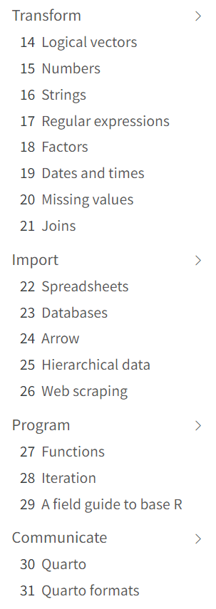
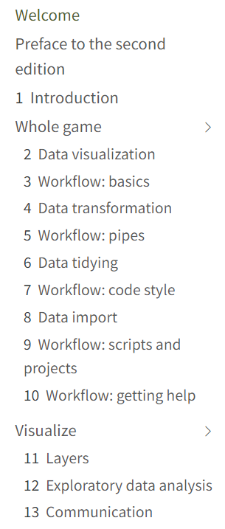
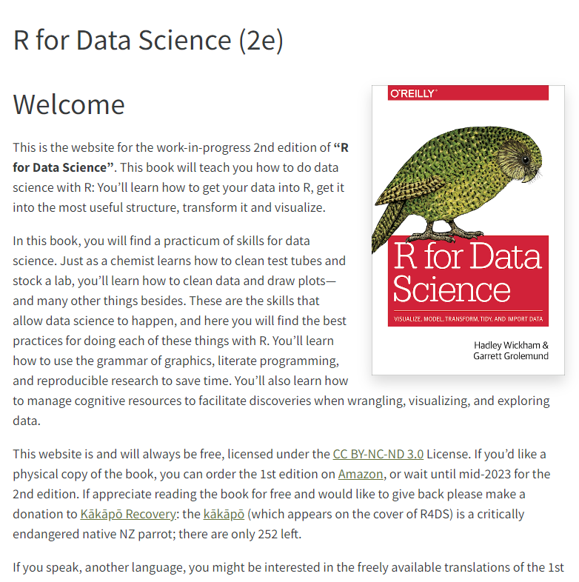
For next week of class
(after spring break)
Read Ch 4, 5, 8 of Wickham & Grolemund
4- Whole game- Data transformation
5- Whole game- Workflow: pipes
8- Whole game- Data import

Slide 3
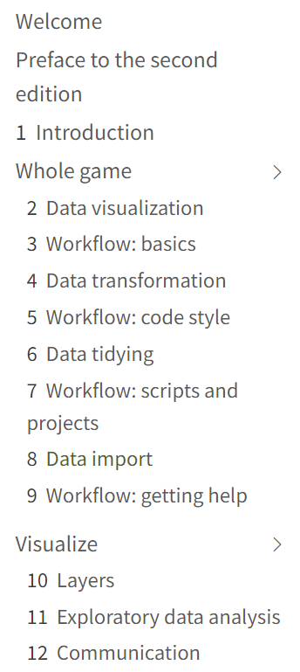
Before spring break
After spring break
The joy of working with an in-progress book

Slide 4
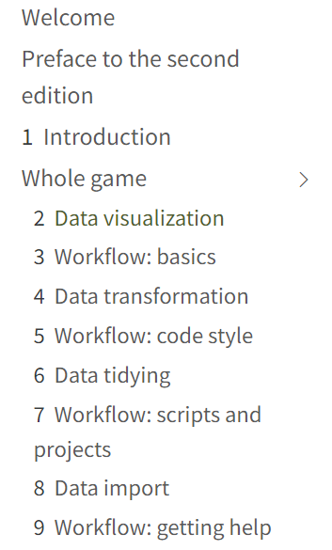
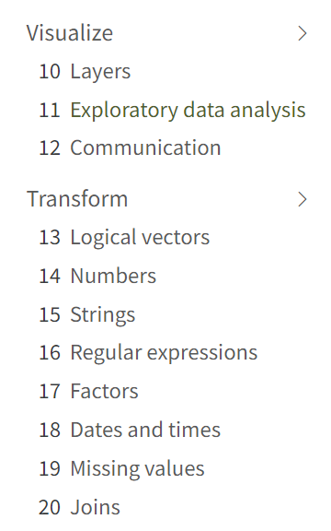
After spring break
For next week,
Ch 6- Data tidying
Ch 10- Layers
Also Ch 5 of Wilke

Slide 5


Slide 6
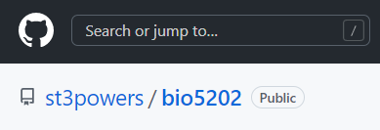
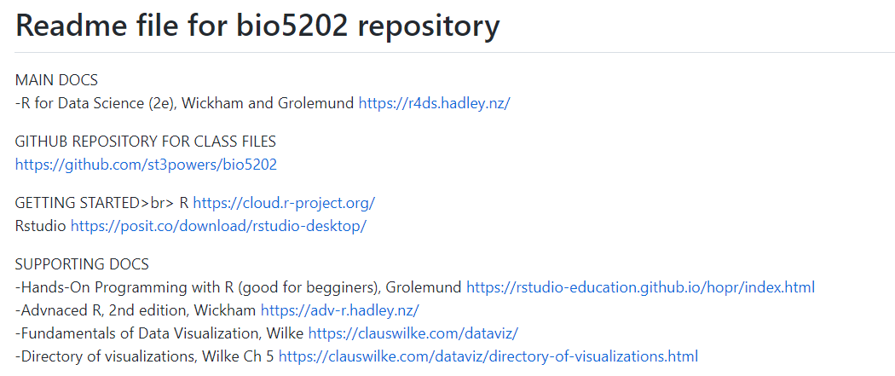
https://github.com/st3powers/bio5202

Slide 7
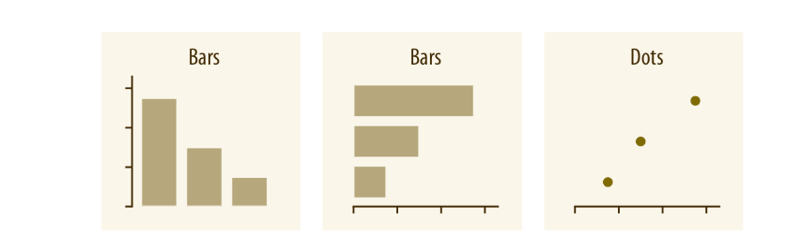
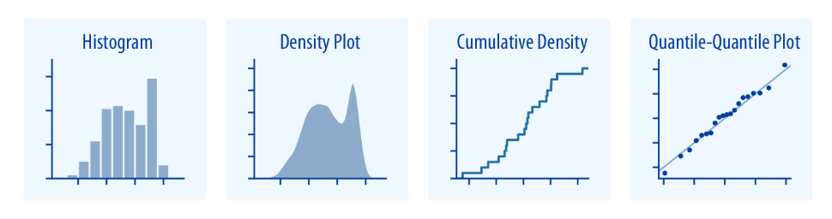
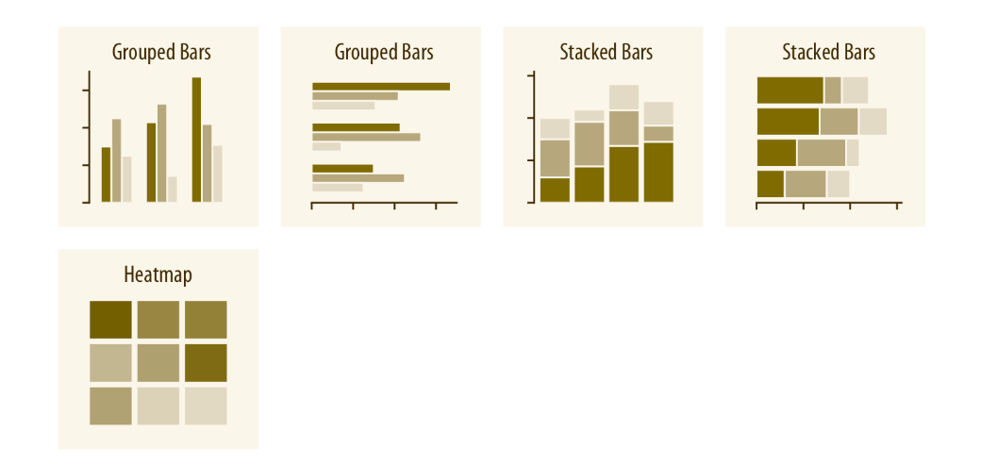
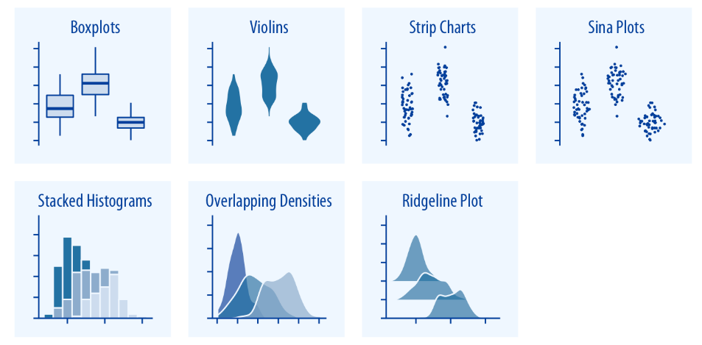
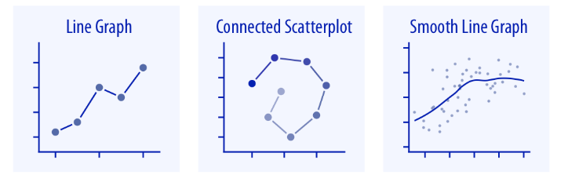
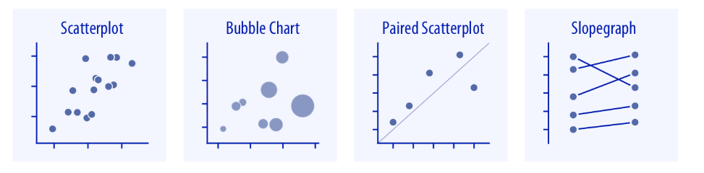
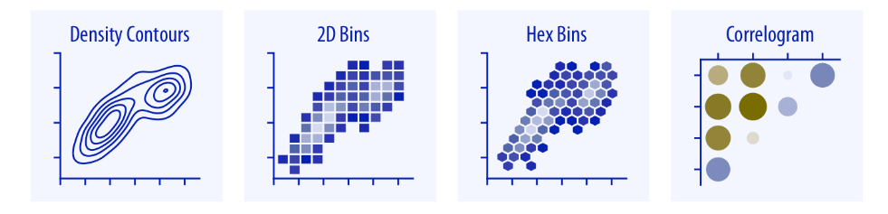
From Ch 5 of Wilke, Directory of Visualizations

Slide 8
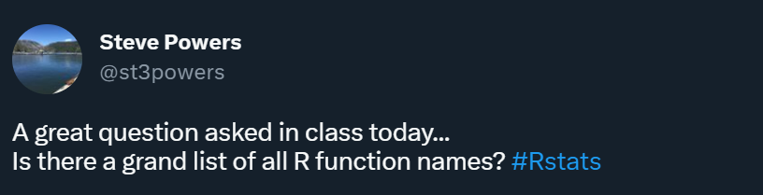

Slide 9
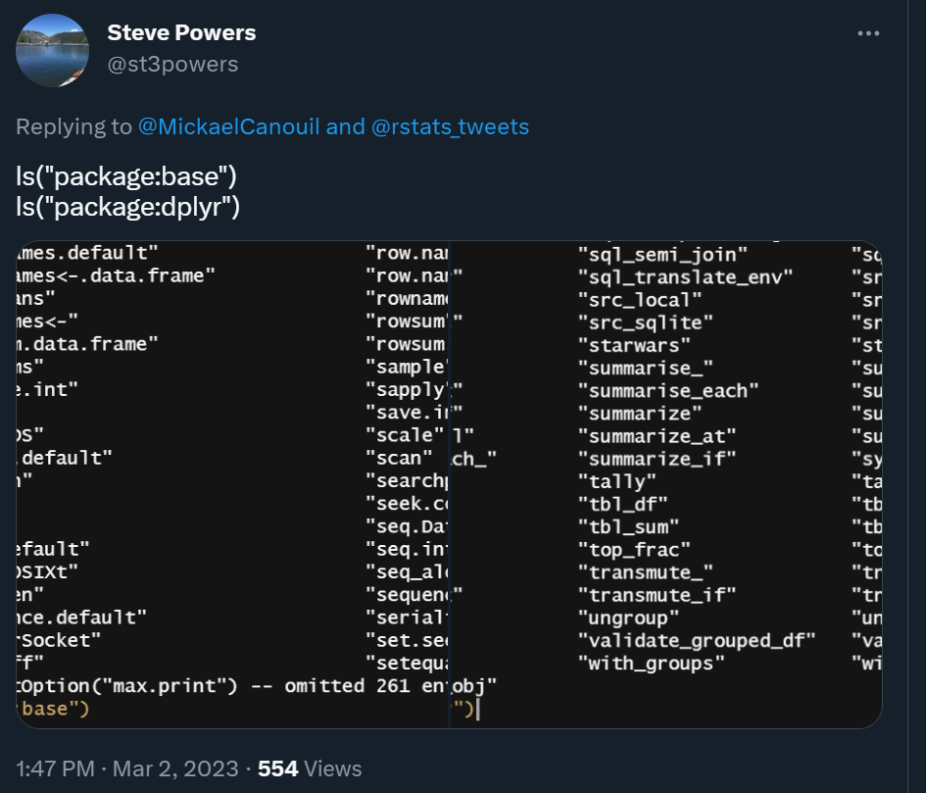

Slide 10
Ch 4 exercises (Data Transformation)

Slide 11
Data Import files
-requires downloading multiple files from github repo

Slide 13
For this week,
Ch 6- Data tidying
Ch 10- Layers
Also Ch 5 of Wilke

Slide 14
Why use open source programming software such as R/Rstudio? Why use scripted analyses?

Slide 15
-accelerate progress in research, document progress
-enable collaborative work in teams
-ensure robust methods, catch mistakes, reproducibility
-be able to work with big data
-get a job
-meet professional and societal standards of openness, transparency
-build on other people's work/allow others to build on your work
-decrease cultural barriers to science and education
-make powerful visualizations, apply models and stats

Slide 16
Loose ends from last week…

Slide 17

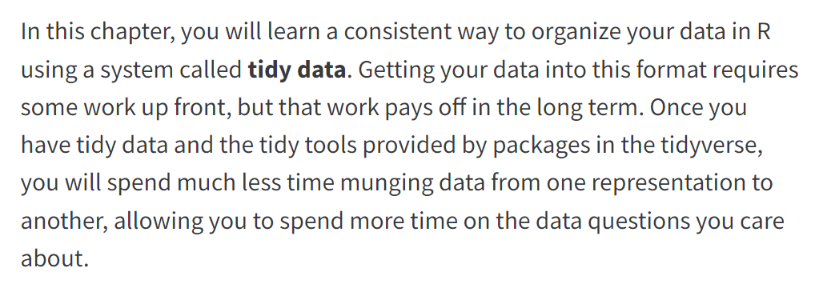

Slide 18
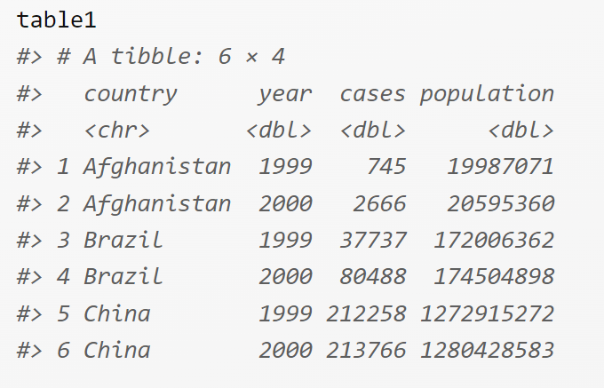
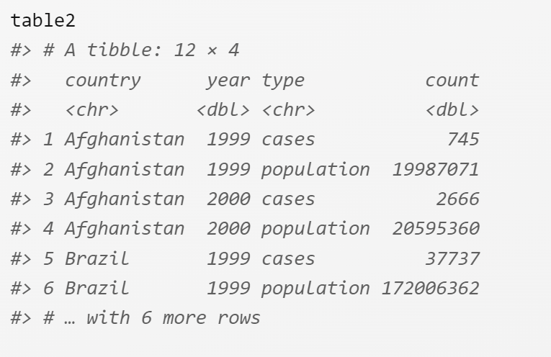
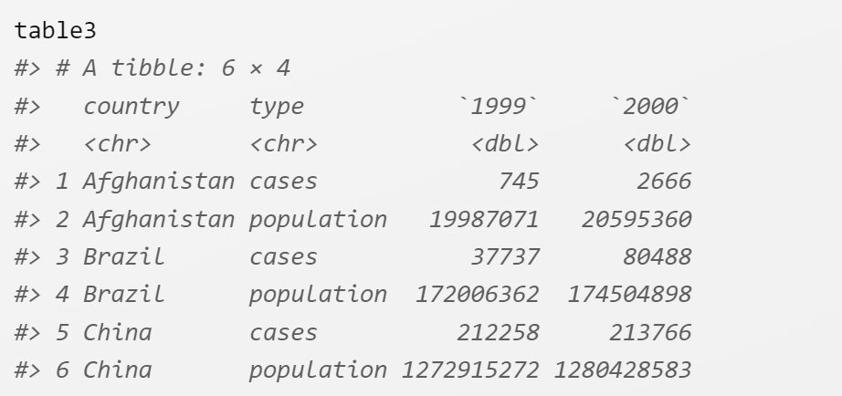

Slide 19
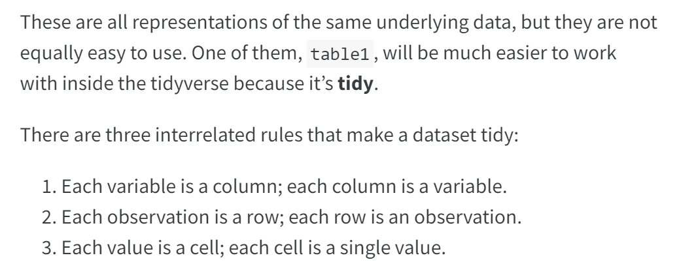

Slide 20

"This data is now tidy…" -Wickham and Grolemund

Slide 21
Tuberculosis cases
Compute the sum of cases per year across countries
Compute the sum of cases that occurred in either 1999 or 2000, by country
Compute the sum of cases that occurred in either Brazil or China in 2000 only

Slide 22
For next week (Mar 27)
Ch 11- Exploratory Data Analysis

