Slide 1
Agenda for This Week (Mar 27)
-Problem Set, will be distributed by email by 6pm today, due Fri Mar 31 by 8pm
-Ch 10 and 11
-Slides available on github
-Coding Exercises in Rstudio

Slide 2
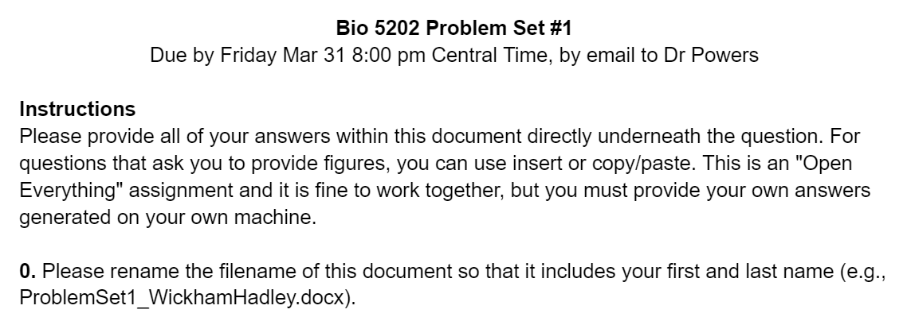

Slide 3
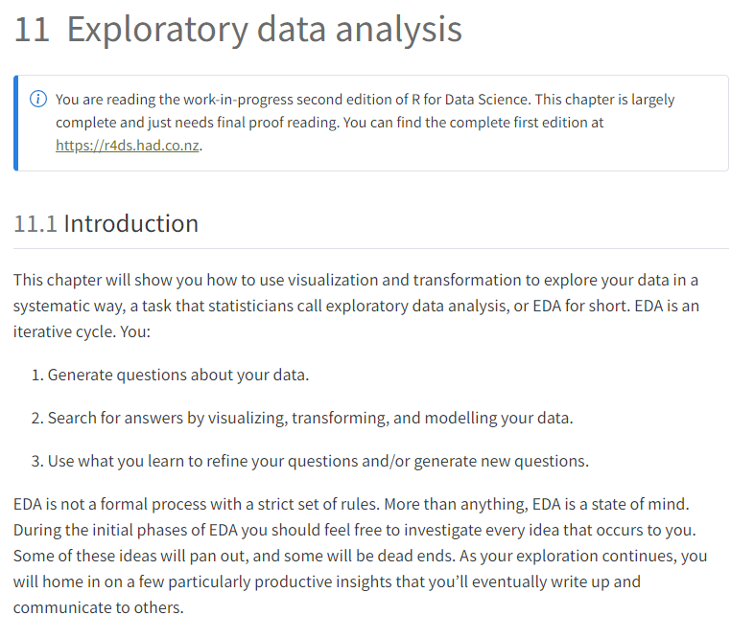

Slide 4
Bar charts in ggplot
geom_bar()
geom_bar is designed to make it easy to create bar charts that show counts of data
(not plot the data values)

Slide 5
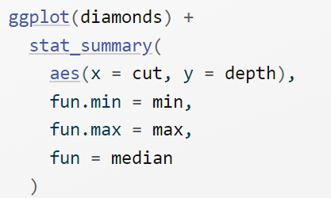
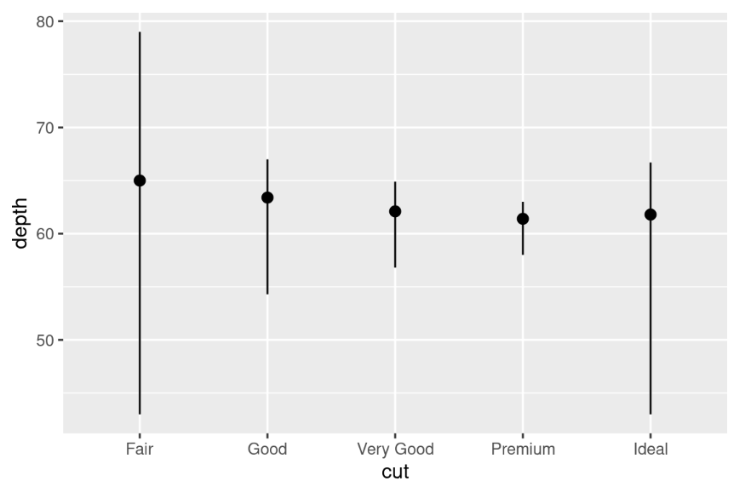
For categorical data
Check out
geom_pointrange()
geom_errorbar()

