Slide 1
Agile Overview
@malcolmbastien

Slide 2
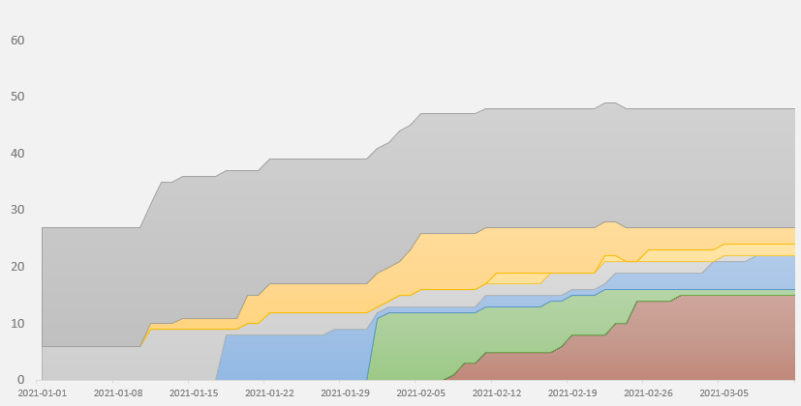
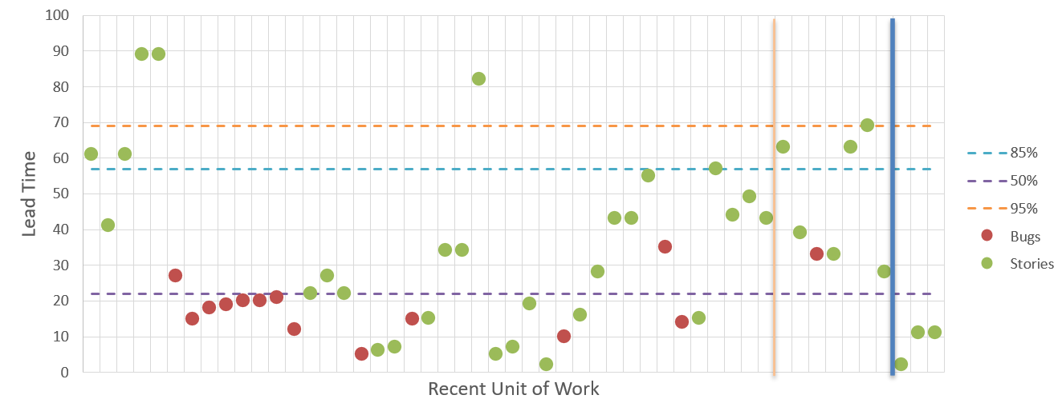
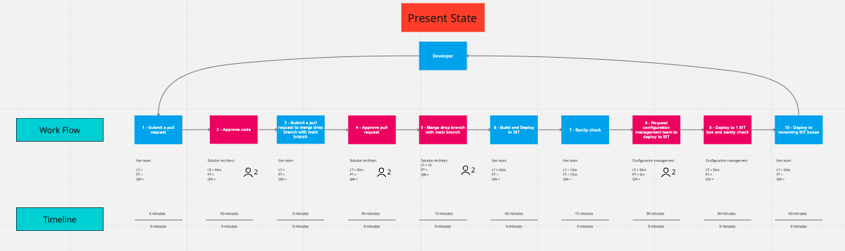
Intro
Malcolm Bastien
Senior Agile Coach @ Agile by Design
KCP - Kanban Coaching Professional

Slide 3
Contents
An Agile Project Management Story
When Agile or Waterfall is More Appropriate
Defining Agile
Keys to Getting the Benefits of Agile

Slide 4
Waterfall vs Agile
Context Specific Methods

Slide 5
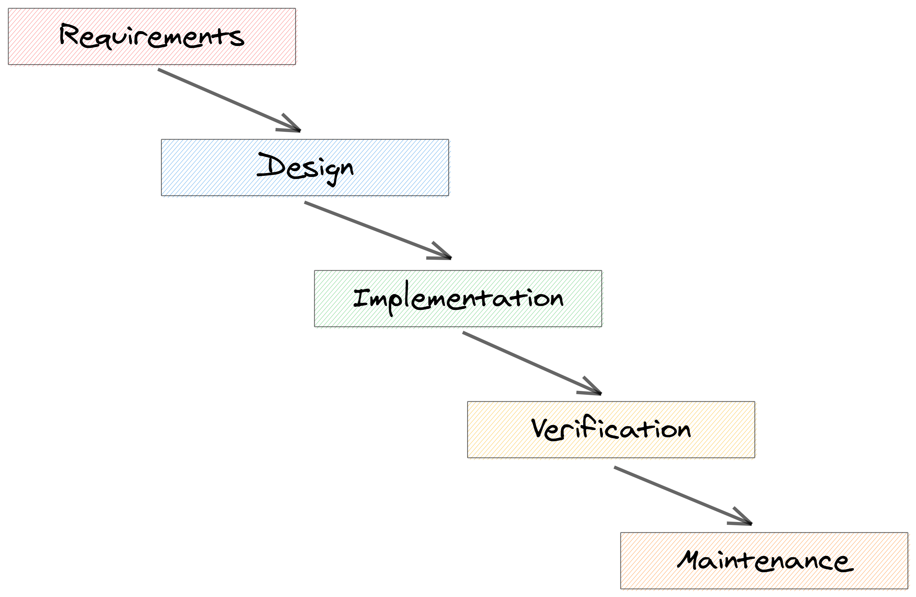
Conditions when Waterfall works
Structured, big batch planning
When deviation from plan is waste or risk
When locking in resources creates efficiencies
“Best” practices

Slide 6
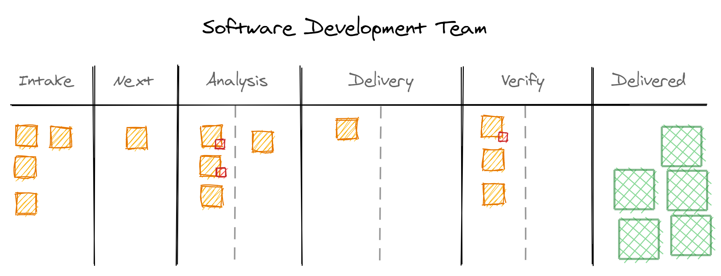
Conditions when Agile works
Path to outcomes is non-linear
Following a plan can lead to waste or risk
Pivoting based on learning goals (MVPs)
“Good” practices

Slide 7
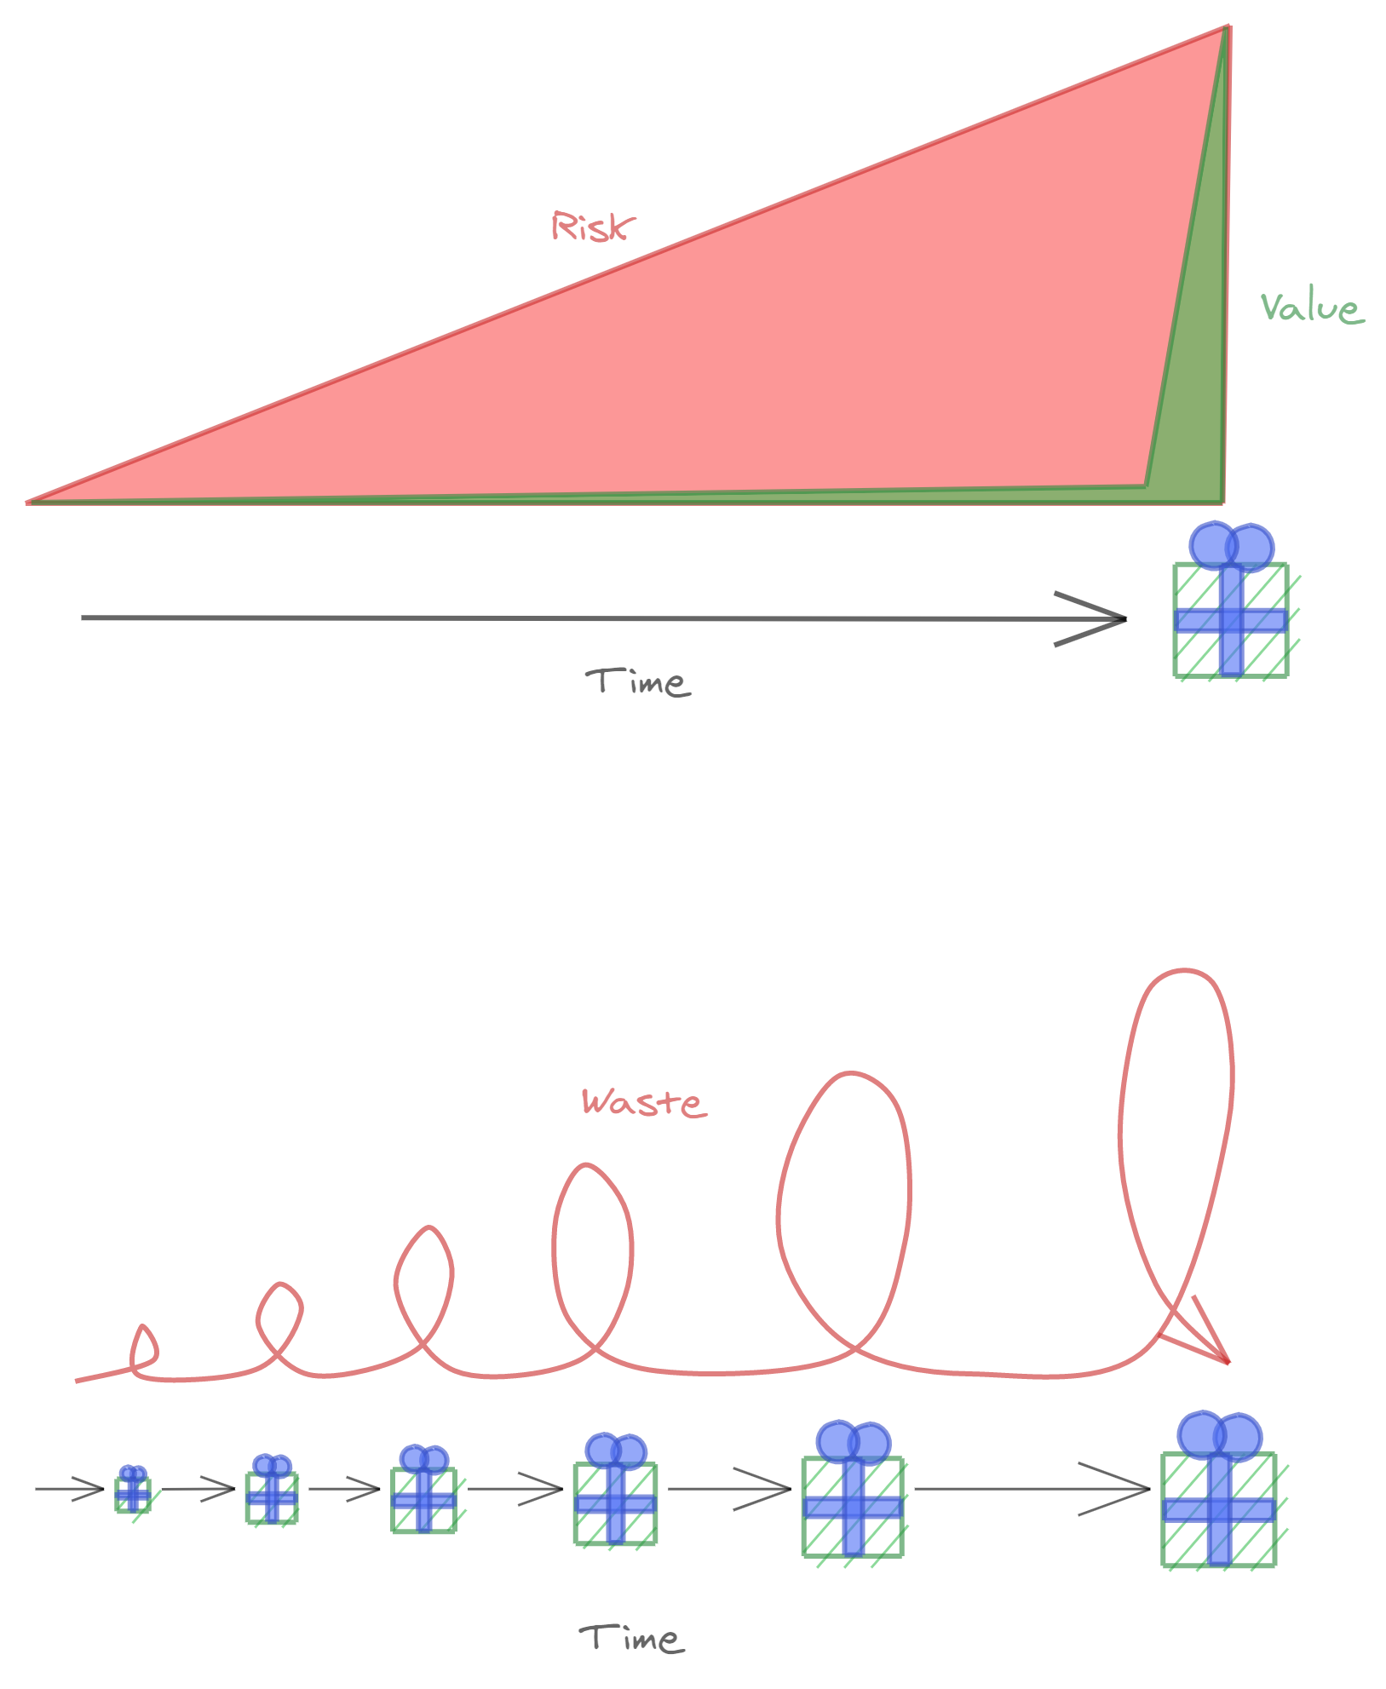
Don’t apply the wrong method in the wrong context
Waterfall
  Lock in all flexibility
  Efficiency becomes risk
Agile
  Extra learning processes become waste
  Iterative and frequent delivery not fit for purpose

Slide 8

What is Agile?

Slide 9
Many Definitions of Agile
“True agility means that teams are constantly working to evolve their processes”
“The true essence of Agile is the concept of moving forward with imperfect information”
“Agile means embracing manifesto values”
“Agile is about continuous improvement”

Slide 10
Agile as a Practice
Improve quality
Produce more
DevOps
Lean
Produce faster
Increase learning
2. Objects
Reduce costs
Scrum
Kanban
Reduce risk
Teams
Projects
1. Outcomes
Products
3. Methods
Businesses

Slide 11
How do we get the benefits?
Principles
Incremental & Iterative
Embracing Failure
Effective Teams
Leadership & Purpose

Slide 12
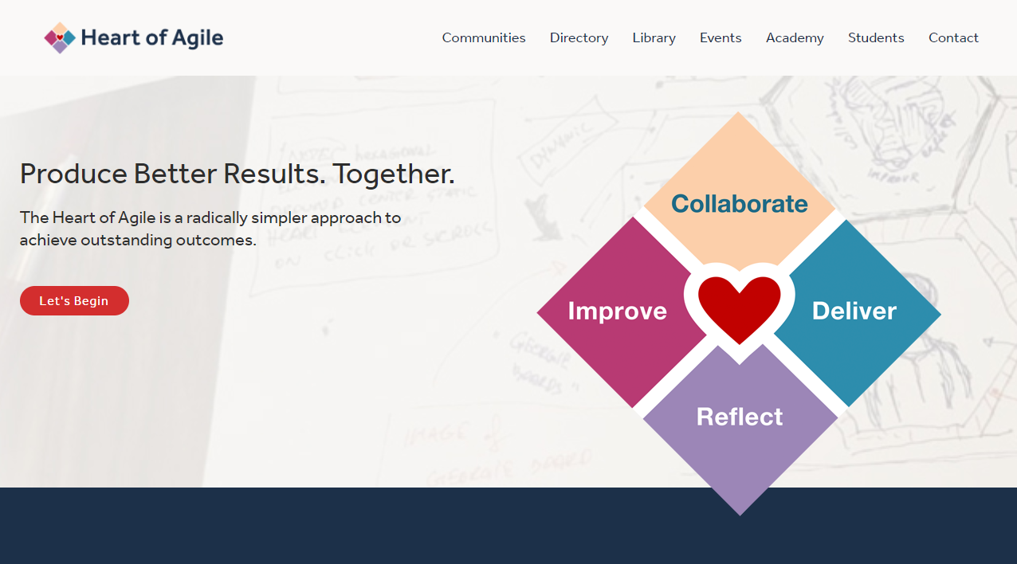
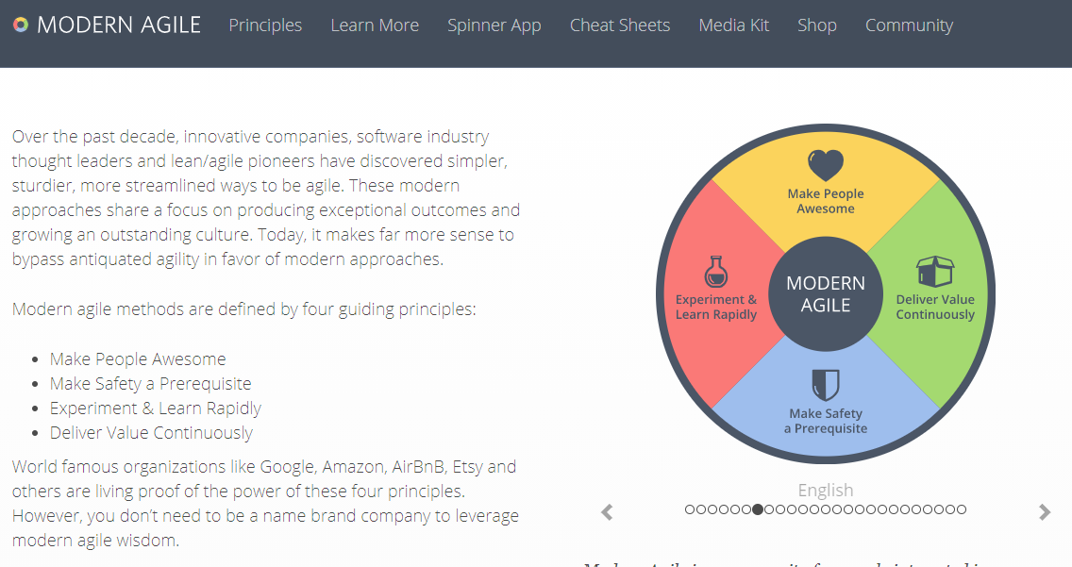
Principles
Guide your choices, decisions and actions
Generally applicable across many situations
Examples:
  “Effectiveness over efficiency”
  “Focus on user needs”
  “People over process”
https://heartofagile.com
https://modernagile.org

Slide 13
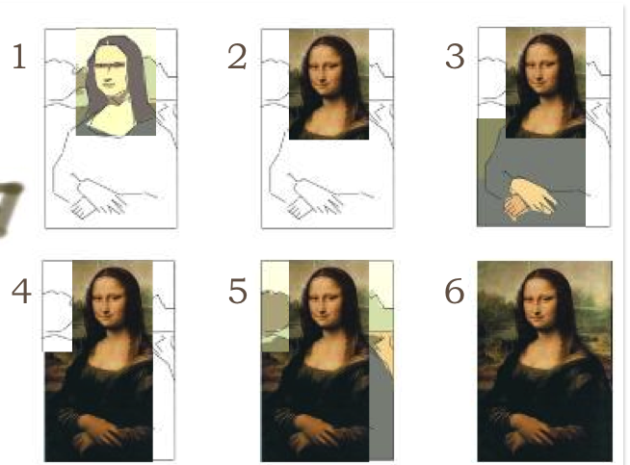
Work Incrementally and Iteratively
Incremental:
  “Don’t do it all at once”
Iterative:
  “Don’t try to get it right the first time”
Gives more options on what to work on next
https://itsadeliverything.com/revisiting-the-iterative-incremental-mona-lisa

Slide 14
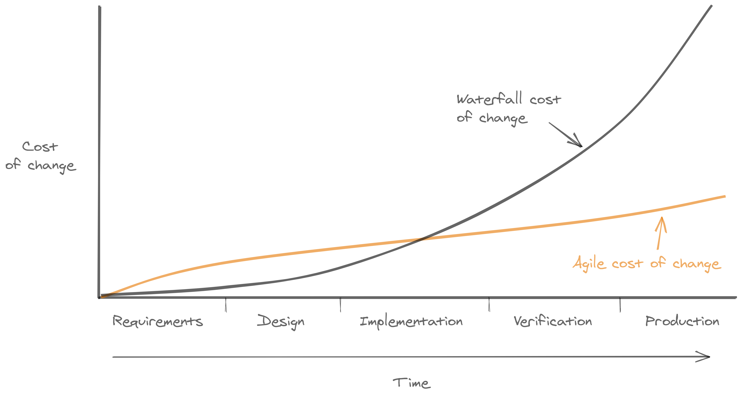
Learning comes from doing
The Agile Cost of Change Curve
Doing generates new information
We want to maximize learning
Treat work as hypotheses to be validated
Enablers:
  Small batches
  Small teams
http://www.agilemodeling.com/essays/costOfChange.htm

Slide 15
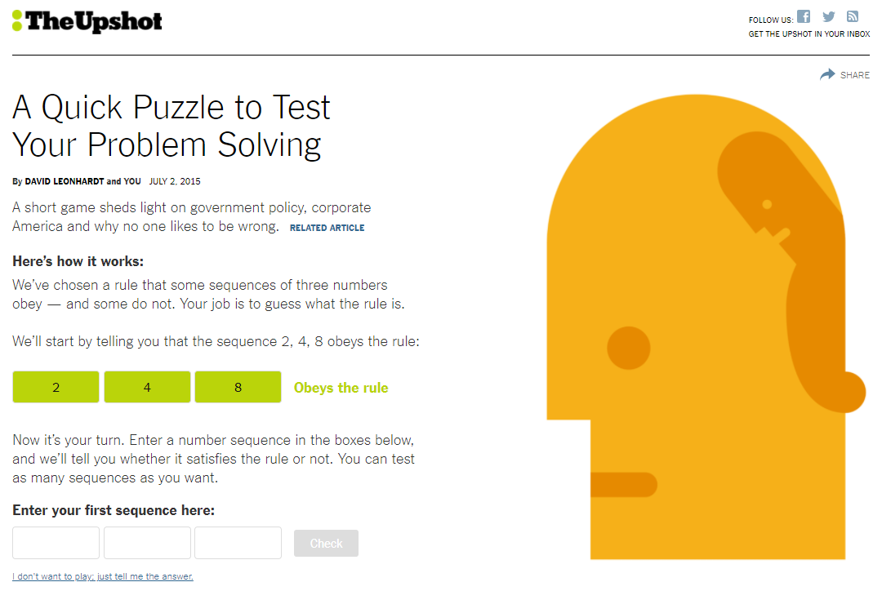
The Numbers Game
https://www.nytimes.com/interactive/2015/07/03/upshot/a-quick-puzzle-to-test-your-problem-solving.html

Slide 16

A Culture that Embraces Failure
“Only new failures generate information”¹
Accept small failures in order to avoid big ones
Requires the right environment
  Psychological safety
Fast feedback enables fast learning
1. The Principles of Product Development Flow

Slide 17
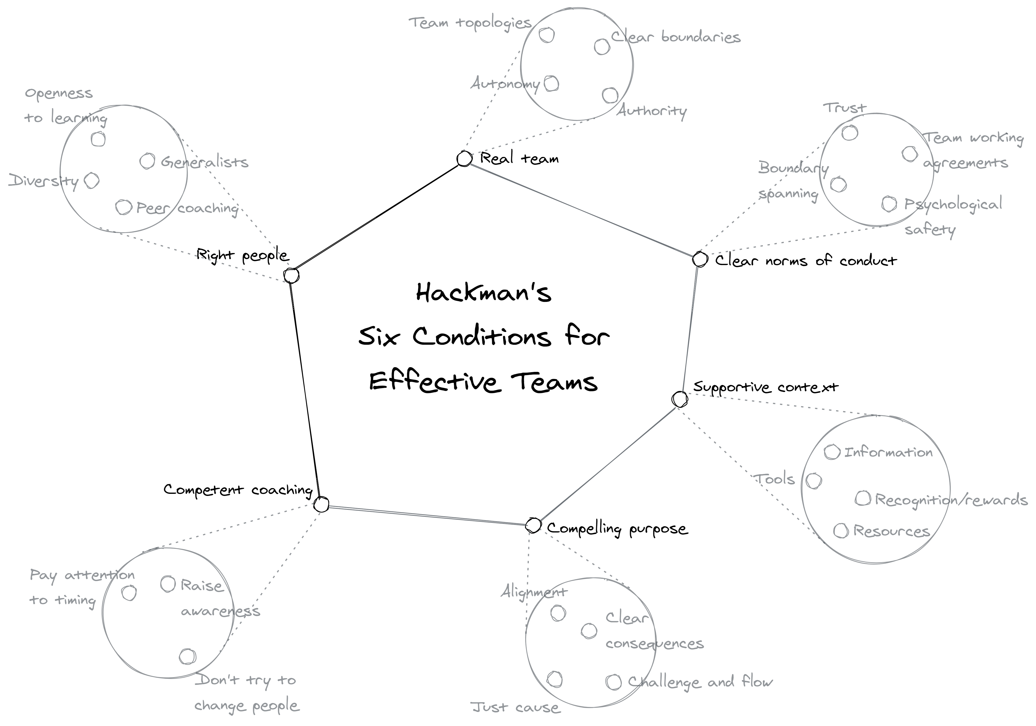
Effective Teams
Teams matter more than individuals
Think about conditions
A team is not just a group of people

Slide 18
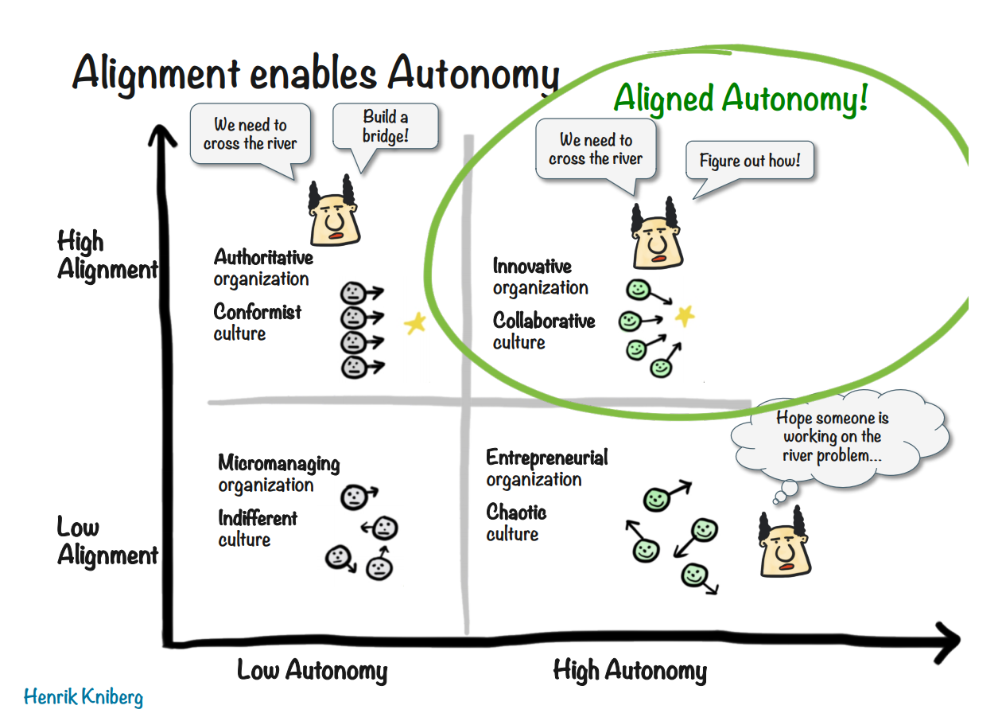
Leadership and Purpose
All change requires leadership
Establish direction
Create culture through your actions
Henrik Kniberg, Spotify - The unproject culture, https://blog.crisp.se/wp-content/uploads/2014/03/unproject.pdf

Slide 19
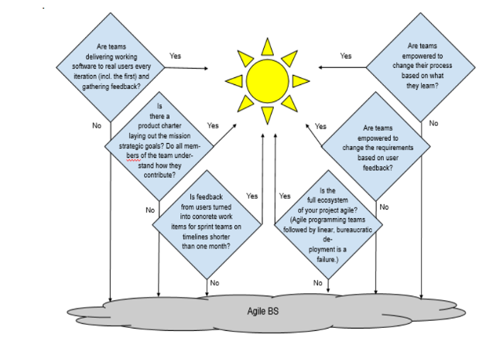
Agile BS
Emphasize the principles over methodologies
Avoid companies that want to do Agile, but not really change
DIB Guide: Detecting Agile BS - https://media.defense.gov/2018/Oct/09/2002049591/-1/-1/0/DIB_DETECTING_AGILE_BS_2018.10.05.PDF

Slide 20
Summary
Waterfall or Agile: Know the context
Defining Agile: Know the principles
Learn by doing: Make hypotheses the atomic unit of work
Teams: Teams are the fundamental means of delivery
Leadership: Nothing happens without leadership

