Slide 1
Room Controller Start Up Guide
Version: 1.0
Author: Malcolm Bugler
Date: 06/28/2017

Slide 2
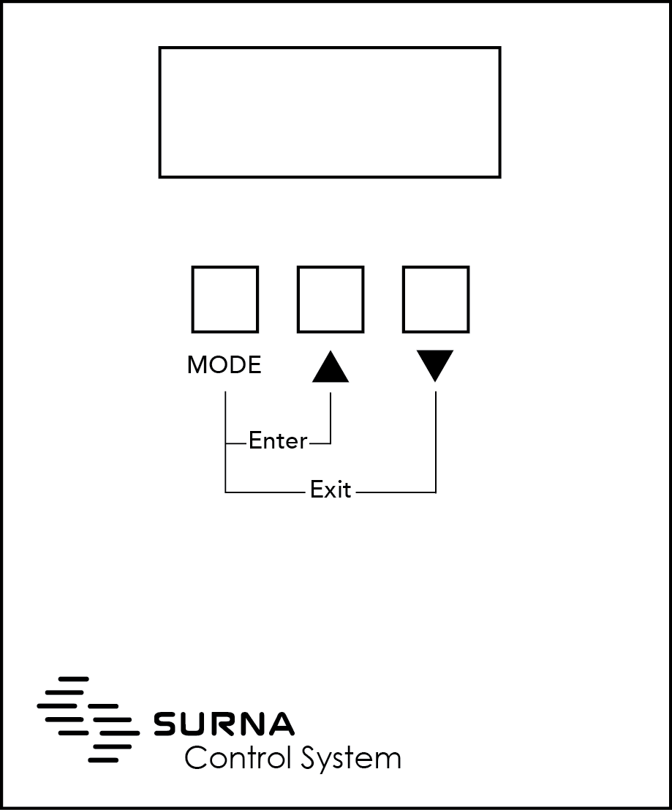
First Time Use - Power Up Display
This display will be shown for the first 5 seconds after the unit is powered on and on demand from the configuration menu.
The first line shows the type of the device.
The second line shows the firmware version and build.
If this display shows for longer than 5 seconds after power on, see the section on fault finding
TYPE=ROOMCNTL_M
V1.01 build 0010

Slide 3
First Time Use – Set Host Address
Allows the device Modbus address to be set.
The address can be between 1 and 216 but must be different to any other device on the same network. The Reflector Controller uses 37 bus addresses.
UP and DOWN adjust the address.
Press MODE once the desired address is set to advance to Set Number of Zones.
MODBUS ADDR=1
UP/DWN TO CHANGE

Slide 4
First Time Use – Set Number of Zones
This display allows the total number of Zones (Enviro Monitors) for this controller to be set.
The minimum number of Zones is 1, the maximum is 8.
UP and DOWN adjust the number of Zones.
Once the desired number of Zones has been set, press MODE to advance to Set Zone Address.
NUM ZONES=1
UP/DWN TO CHANGE

Slide 5
First Time Use – Set Zone Address
This allows the address of the Enviro Monitor for each zone to be programmed.
Press the “Magic” Button on each EnviroMonitor for 5 seconds to place it in Program Address Mode.
MISSING will be shown until the address is programmed. Once PRESENT, MODE will advance to the next Zone, then onto Adjust Zone Altitude.
ZONE=1 MISSING
SETTING ADDRESS

Slide 6
First Time Use – Set Zone Output 4 Option
Allows the output 4 option for zones in the system to be set.
Up / Down goes through the sequence of OFF, CO2 DOSING and LIGHT SCHEDULE.
MODE advances to the next enabled zone and then to Adjust Low Humidity.
ZONE=1 OUTPUT 4
CO2 DOSING

Slide 7
First Time Use – Adjust Zone Altitude
Allows the altitude for all zones in the system to be adjusted between 0 and 20000 feet.
Up / Down adjusts the altitude in 100FT increments
MODE advances to Adjust Low Humidity.
ZONE=1 ALTITUDE
1000FT

Slide 8
First Time Use – Adjust Zone Low Humidity
Allows the low humidity limit for all zones in the system to be adjusted between 35% and 50%.
Up / Down adjusts the humidity limit in 1% increments
MODE advances to Adjust Temperature Differential.
ZONE=1 LO HUMID
40%

Slide 9
First Time Use – Adjust Zone Temp Differential
Allows the temperature differential for all zones in the system to be adjusted between 2F and 5F.
Up / Down adjusts the temp differential in 1F increments
MODE advances to Adjust Low CO2 limit if CO2 dosing is enabled or to set number interfaces.
ZONE=1 TEMP DIFF
2F

Slide 10
First Time Use – Set Number of Interfaces
This display allows the total number of interfaces for this controller to be set.
The minimum number of interfaces is 0, the maximum is 32. UP and DOWN adjust the number of interfaces.
Once the desired number of interfaces has been set, press MODE to advance to Set Interface Address. Note: Advances to Set Year if Interfaces=0.
INTERFACES=1
UP/DWN TO CHANGE

Slide 11
First Time Use – Set Interface Address
This allows the address of the interface to be programmed.
Press the “Magic” Button on each Interface for 5 seconds to place it in Program Address Mode.
MISSING will be shown until the address is programmed. Once PRESENT, MODE will advance to the next Interface.
IFACE=1 MISSING
SETTING ADDRESS

Slide 12
First Time Use – Enable Interface Channel (1)
Allows an interface channel to be enabled or disabled.
Once enabled, the channel shows the internal reflector temperature or zero degrees if it cannot be read.
UP and DOWN toggle the channel on/off.
MODE advances to the next channel and then to Select Zone.
INTERFACE=1
CHAN1=OFF

Slide 13
First Time Use – Enable Interface Channel (2)
Shows an interface channel enabled.
UP and DOWN toggle the channel on/off.
MODE advances to the next channel and then to Select Zone.
INTERFACE=1
CHAN1=ON 75F

Slide 14
First Time Use – Set Interface Zone
Allows the Zone to be set for an interface.
UP and DOWN select the zone (1-8)
Zones are only selectable if enabled.
Pressing MODE advances to the next interface, then onto Set Year.
INTERFACE=1
SET ZONE=1

Slide 15
First Time Use – Set Year
Allows the Year to be set.
Value limited to 2000 to 2050
UP / DOWN changes the year.
MODE advances to Set Month
YEAR=2016
MODE=SET MONTH

Slide 16
First Time Use – Set Month
Allows the Month to be set.
UP / DOWN changes the month.
MODE moves to Set Day
MONTH=Jan
MODE=SET DAY

Slide 17
First Time Use – Set Day
Allows the Day to be set.
UP / DOWN changes the day.
MODE moves to Set Hour
DAY=22
MODE=SET HOUR

Slide 18
First Time Use – Set Hour
Allows the Hour to be set.
UP / DOWN changes the hour.
MODE moves to Set Minute
HOUR=3
MODE=SET MINUTE

Slide 19
First Time Use – Set Minute
Allows the Minute to be set.
UP / DOWN changes the minute
MODE completes first time set up set up and restarts the system.
MIN=03
ENTER TO SET

Slide 20
Idle Mode – Zone Status (1)
This display shows the current temperature, day/night mode, cool/heat (C/H), dehumidifying (D), relative humidity and CO2 ppm and dosing output state (O)
UP / DOWN selects the Zone - these keys repeat.
MODE key toggles between this and the current temperature, day / night mode, set points and current fan speed for the selected zone.
Hold MODE key for over a second to enter Adjust Set Point Mode.
ZN=1 72F DAY CD
RH=18% 1020ppm O

Slide 21
Idle Mode – Zone Status (2)
This is the display is shown after power up and shows the current temperature, day / night, set points and fan speed for the selected zone.
UP / DOWN selects the Zone - these keys repeat.
MODE key toggles between this and the temperature, day / night mode, RH and CO2 ppm for the selected zone.
Hold MODE key for over second to enter Adjust Set Point Mode.
ZN=1 72F DAY CD
SET=75F/55% F30

Slide 22
Idle Mode – Error Annunciation (1)
When detected, errors alternate with the idle screen.
If more than one error is active, they are shown in sequence until they clear.
MODE and Up (Enter) enters Error Selection mode which allows errors the be scrolled through.
Errors are removed from the list when they clear.
ZONE=1
T1 FAIL

Slide 23
Idle Mode – Error Annunciation (1)
These are a list of current errors:
Zone Sensor Failure
Zone Communications Failure
Interface Communications Failure
Fan Locked Rotor
Channel Reflector Missing
Channel Power Failure
INTERFACE=1
COMM FAIL

Slide 24
Idle Mode – Error Selection
Allows the current list of errors to be scrolled through while they persist.
UP / DOWN scroll through the current list of errors.
MODE and Down (Exit) exits back to the Idle Display.
The error output is cleared on entering this mode until another error occurs.
IFACE=1 CH=1
LOCKED ROTOR

Slide 25
User Mode – Change Day Temp Set Point
This display allows the day temperature set point to be adjusted.
Up and Down change the value between 65F and 90F.
MODE advances to Change Night Temperature Set point.
This display will time out after 3 seconds back to the idle screen.
Hold MODE for over a second to enter Configuration Mode
ZN=1 72F DAY C
DAY SET=75F

Slide 26
User Mode – Change Night Temp Set Point
This display allows the night temperature set point to be adjusted.
Up and Down change the value between 65F and 90F.
MODE advances to Change Day Humidity Set point.
This display will time out after 3 seconds back to the idle screen.
Hold MODE for over a second to enter Configuration Mode
ZN=1 72F DAY C
NIGHT SET=75F

Slide 27
User Mode – Change Day Humidity Set Point
This display allows the day humidity set point to be adjusted.
Up and Down change the value between 45% and 65%.
MODE advances to Change Night Humidity Set point.
This display will time out after 3 seconds back to the idle screen.
Hold MODE for over a second to enter Configuration Mode
ZN=1 72F DAY C
DAY SET=55%

Slide 28
User Mode - Change Night Humidity Set Point
This display allows the night humidity set point to be adjusted.
Up and Down change the value between 45% and 65%.
MODE advances to either Change Low CO2, Light On Schedule or Day Temperature Set point.
This display will time out after 3 seconds back to the idle screen.
Hold MODE for over a second to enter Configuration Mode
ZN=1 72F DAY C
NIGHT SET=45%

Slide 29
User Mode – Change Low CO2 Set Point
This screen is only displayed if the CO2 output option is enabled.
Up / Down change the low CO2 limit to OFF or 900ppm to 1100ppm in 100ppm steps.
MODE advances to Change High CO2 Limit.
This display will time out after 3 seconds back to the idle screen.
Hold MODE for over a second to enter Configuration Mode.
ZN=1 72F DAY H
LOW CO2=900ppm

Slide 30
User Mode – Change High CO2 Set Point
This screen is only displayed if the CO2 output option is enabled.
Up / Down change the high CO2 limit to OFF or 1200ppm to 1500ppm in 100ppm steps.
MODE advances to Day Temperature Set point.
This display will time out after 3 seconds back to the idle screen.
Hold MODE for over a second to enter Configuration Mode.
ZN=1 72F DAY CD
HIGH CO2=1300ppm

Slide 31
User Mode – Change Light On Time
This screen is only available if output 4 is set to Light Schedule.
Up / Down adjusts the time between OFF, 00:00am and 11:45pm in 15 minute increments.
MODE advances to Adjust Light Off Time.
This display will time out after 3 seconds back to the idle screen.
Hold MODE for over a second to enter Configuration Mode.
ZN=1 72F DAY CD
LIGHT ON=00:00a

Slide 32
User Mode – Change Light Off Time
This screen is only available if output 4 is set to Light Schedule.
Up / Down adjusts the time between OFF, 00:00am and 11:45pm in 15 minute increments.
MODE advances to Adjust Light Off Time.
This display will time out after 3 seconds back to the idle screen.
Hold MODE for over a second to enter Configuration Mode.
ZN=1 72F DAY CD
LIGHT OFF=12:00p

Slide 33
Configuration Mode – Select Zone
This display is shown on entry to configuration mode.
Up and Down select the zone to configure (1 - 8). If the zone is not assigned, the display will show as OFF and the second line will be ENTER=SET-ADDR
MODE advances to Select Interface.
MODE and Up together (Enter) enters Adjust Sensor Trim if the zone is assigned or goes to set address if not.
MODE and Down together (Exit) exits to Idle.
ZONE=1
ENTER=CONFIG

Slide 34
Configuration Mode – Zone Sensor Trim
Allows the temperature trim for a zone to be set between -3.0 and + 3.0 degrees.
Up / Down adjust the trim
MODE goes to Adjust Zone Altitude
MODE and Down (Exit) exits to Select Zone.
ZONE=1 SENSOR
TEMP TRIM=-1.2F

Slide 35
Configuration Mode – Adjust Zone Altitude
Allows the altitude for this zone to be adjusted between 0 and 20000 feet
Up / Down adjust the altitude in 100FT increments
MODE advances to Adjust Zone Low Humidity.
MODE and Down (Exit) exits to Select Zone.
ZONE=1 ALTITUDE
1000FT

Slide 36
Config Mode – Adjust Zone Low Humidity
Allows the low humidity limit for all zones in the system to be adjusted between 35% and 50%.
Up / Down adjusts the humidity limit in 1% increments
MODE advances to Adjust Temperature Differential.
MODE and Down (Exit) exits to Select Zone.
ZONE=1 LO HUMID
40%

Slide 37
Config Mode – Adjust Zone Temp Differential
Allows the temperature differential for all zones in the system to be adjusted between 2F and 5F.
Up / Down adjusts the temp differential in 1F increments
MODE advances to Adjust Low CO2 limit.
MODE and Down (Exit) exits to Select Zone.
ZONE=1 TEMP DIFF
2F

Slide 38
Configuration Mode – Zone Comms Stats
Displays the communications status for this zone
MODE advances to Adjust Zone Trim
MODE and Up (Enter) goes to Set Zone Address.
MODE and Down (Exit) exits to Select Zone.
ZONE=2 COMMS
OK=7001 ERR=0

Slide 39
Configuration Mode – Set Zone Address (1)
Displays this when setting the zone address.
Once the device address is set, PRESENT and the comms status is displayed (see next slide).
MODE returns to Zone Comms Stats
MODE and Down (Exit) exits to Zone Comms Stats.
ZONE=2 MISSING
SETTING ADDRESS

Slide 40
Configuration Mode – Set Zone Address (2)
Displays this when the address is set and the device is present.
ZONE=2 PRESENT
OK=1 ERR=3

Slide 41
Configuration Mode –Zone Firmware Version
This displays the current firmware version for a Zone.
MODE advances to Zone Sensor Trim.
MODE and Down (Exit) exits to the idle screen.
ZONE=2 VERSION
V1.40 build 2

Slide 42
Configuration Mode – Select Interface
This display is only available if one or more interfaces are enabled.
Up and Down select the interface to configure (1 - 32)
MODE advances to the Host Comms Display.
MODE and Up together (Enter) enters the Select Channel display.
MODE and Down together (Exit) exits to Idle.
INTERFACE=1
ZN=1 CH=1_______

Slide 43
Configuration Mode – Select Interface (2)
This shows the Select Interface display when channels are enabled.
INTERFACE=1
ZN=1 CH=12----78

Slide 44
Configuration Mode – Select Channel (1)
Allows an interface channel to be enabled or disabled.
MODE advances the channel (1-8) and then to Set Interface Zone.
Up and Down toggle the channel on/off.
MODE and Down (Exit) exits to Select Interface.
INTERFACE=1
CHAN1=OFF

Slide 45
Configuration Mode – Select Channel (2)
Shows an interface channel enabled.
When the channel is on the internal temperature of the reflector is shown.
If the temperature sensor cannot be read, the temperature shows zero degrees.
INTERFACE=1
CHAN1=ON 75F

Slide 46
Configuration Mode – Set Interface Zone
Allows the zone to be set for an interface.
MODE advances to the Interface Comms Stats display.
UP and DOWN select the zone (1-8)
Zones are only selectable if enabled.
MODE and Down (Exit) exits to Select Interface.
INTERFACE=1
SET ZONE=1

Slide 47
Configuration Mode – Interface Comms Stats
Displays the comms stats for an interface.
MODE advances to the Interface Version display.
MODE advances to Interface Version.
MODE and Up (Enter) enters Set Interface Address.
MODE and Down (Exit) exits to Select Interface.
IFACE=1 COMMS
OK=6694 ERR=0

Slide 48
Configuration Mode – Interface Address (1)
Displays this when setting the interface address.
Once the device address is set, PRESENT and the comms status is displayed (see next slide).
MODE returns to Interface Comms Status.
MODE and Down (Exit) exits to Comms Status.
IFACE=2 MISSING
SETTING ADDRESS

Slide 49
Configuration Mode – Interface Address (2)
Displays this when the interface address is set and the device is present.
IFACE=2 PRESENT
OK=1 ERR=3

Slide 50
Configuration Mode – Interface Version (1)
Displays the firmware version of the interface.
MODE advances to Select Interface Channels
MODE and Down (Exit) exits to Select Interface.
IFACE=2 VERSION
V1.09 build 1

Slide 51
Configuration Mode – Host Comms Stats
Shows the communication stats for the host bus.
MODE advances to Date and Time.
MODE and Up (Enter) enter Set Host Address.
MODE and Down (Exit) exit to Idle.
HOST COMMS
OK=0 ERR=0

Slide 52
Configuration Mode – Set Host Address
Allows the host Modbus address to be set.
This must be done prior to assigning any interface address.
Up and Down change the address.
MODE and Down (Exit) exit to Host Comms Stats.
MODBUS ADDR=1
UP/DWN TO CHANGE

Slide 53
Configuration Mode – Current Date and Time
Shows the current date and time.
MODE advances to Type and Version
MODE and Up (Enter) enters Set Year.
Mon 01/01/2016
12:12:30

Slide 54
Configuration Mode – Set Year
Allows the Year to be set.
Value limited to 2000 to 2050
MODE moves to Set Month
Up / Down changes the year.
MODE and Down (Exit) exits back to Current Date and Time without setting the time.
YEAR=2016
MODE=SET MONTH

Slide 55
Configuration Mode – Set Month
Allows the Month to be set.
MODE moves to Set Day
Up / Down changes the month.
MODE and Down (Exit) exits back to Current Date and Time without setting the time.
MONTH=Jan
MODE=SET DAY

Slide 56
Configuration Mode – Set Day
Allows the Day to be set.
MODE moves to Set Hour
Up / Down changes the day.
MODE and Down (Exit) exits back to Current Date and Time without setting the time.
DAY=22
MODE=SET HOUR

Slide 57
Configuration Mode – Set Hour
Allows the Hour to be set.
MODE moves to Set Minute
Up / Down changes the hour.
MODE and Down (Exit) exits back to Current Date and Time without setting the time.
HOUR=3
MODE=SET MINUTE

Slide 58
Configuration Mode – Set Minute
Allows the Minute to be set.
MODE moves back to Set Year
Up / Down changes the minute.
MODE and Down (Exit) exits back to Current Date and Time without setting the date and time.
MODE and Up (Enter) sets the date and time and returns to Set Year.
MIN=03
ENTER TO SET

Slide 59
Configuration Mode – Type and Version
Displays the device type and firmware version.
MODE advances to PID Display.
MODE and Up (Enter) enters Factory Reset Enable
MODE and Down (Exit) exit to Idle.
TYPE=REFCNTL1_M
V1.38 build 1309

Slide 60
Configuration Mode – Factory Reset Enable
Displays the device type and firmware version.
MODE and Up (Enter) execute the factory reset and enters first time setup.
MODE and Down (Exit) exit to Device Version.
*FACTORY RESET*
**ENTER=RESET**

Slide 61
Configuration Mode – PID Display
Displays the device Unique Product Identification.
MODE advances to Select Zone.
MODE and Down (Exit) exit to Idle.
PID=REFCNTL10002
35G6A02

