Slide 1
Employee Attrition Case Study
Malcolm Carlson
Notes:
Hello, I am Malcolm Carlson and I will be sharing some insights from a case study I did of employee data, in particular, about what factors contribute to attrition.

Slide 2
Top factors that lead to turnover
Multiple regression model was used to determine the top predictors of turnover. The factors were chosen by the lowest P-Values.
Attrition Factor | P-Value
YearsSinceLastPromotion | 0.000305
JobSatisfaction | 0.000150
EnvironmentSatisfaction | 0.000657
DistanceFromHome | 0.000232
NumCompaniesWorked | 0.000274
JobInvolvement | 2.47e-05
Notes:
I used a multi regression model to narrow down the top contributors to attrition. I narrowed this list of 19 factors down be removing the items with high p-value scores or anything over .05.
Years since last promotion is a good indicator for possible attrition.
Managers could keep track of this factor, particularly with their employee development plans.
Environmental satisfaction or having a comfortable work environment does play a roll in attrition. Many companies are changing their offices to be more comfortable as well as collaborative for this reason.
Number of companies worked is really a job hopping metric and could be taken into account during the hiring process.
Job involvement is another factor that can lead to attrition. A possible remedy for this issue could be increasing an employee’s responsibility or more challenging assignments.

Slide 3
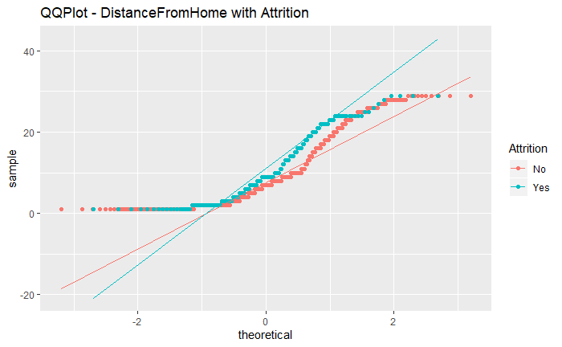
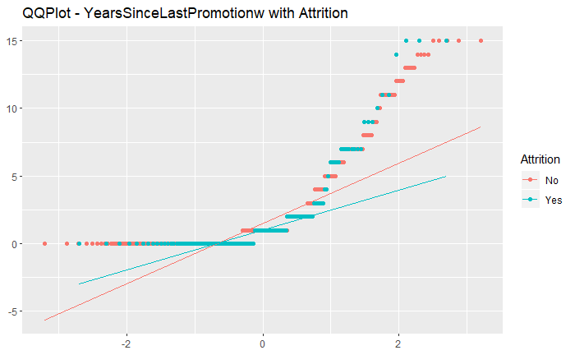
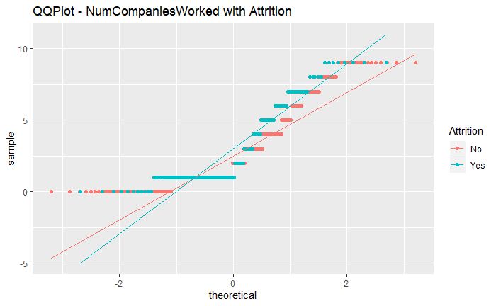
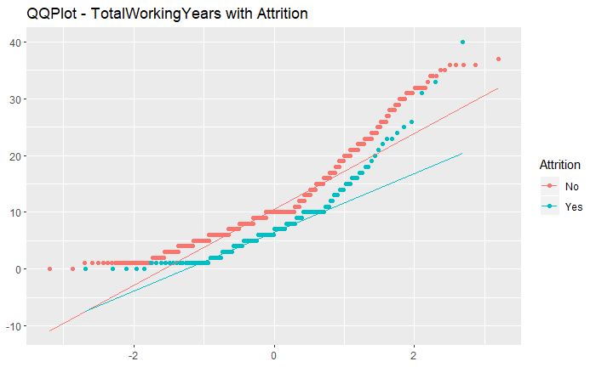
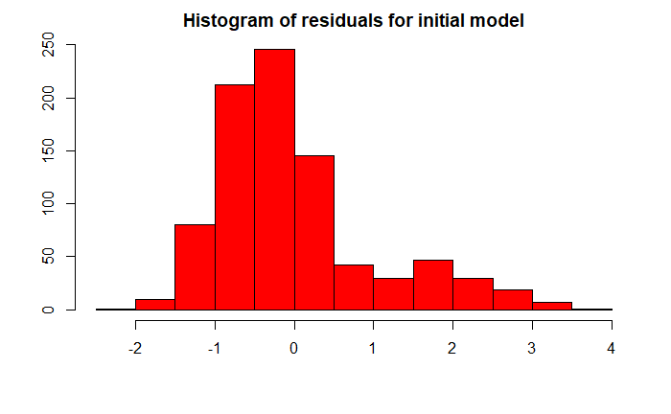
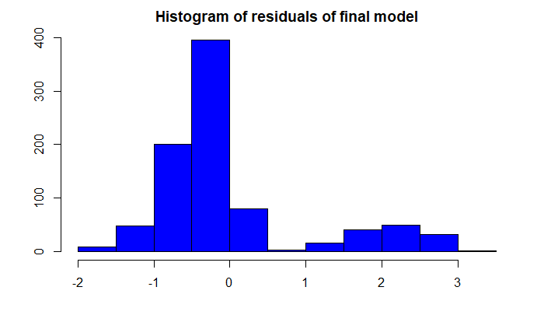
Assumptions
Initial Model
Reduced Model
Notes:
In order to ensure the model was valid, I wanted to address each assumption of linearity, constant variance, normal distribution of residuals and independence. I used QQ plots for linearity and normality as well as histograms for the residuals. I also checked for any collinearity by verifying low VIF or variance inflation factor scores(below 10) for each factor.

Slide 4
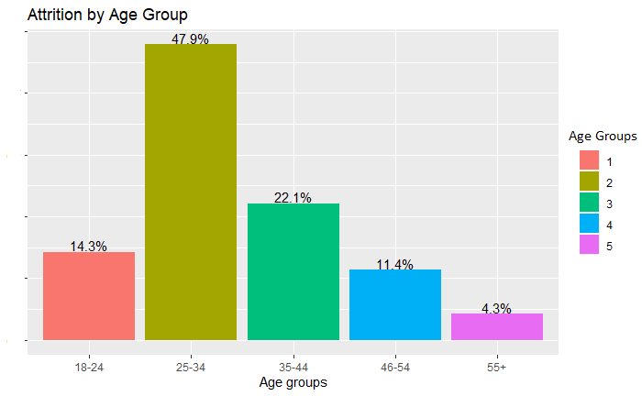
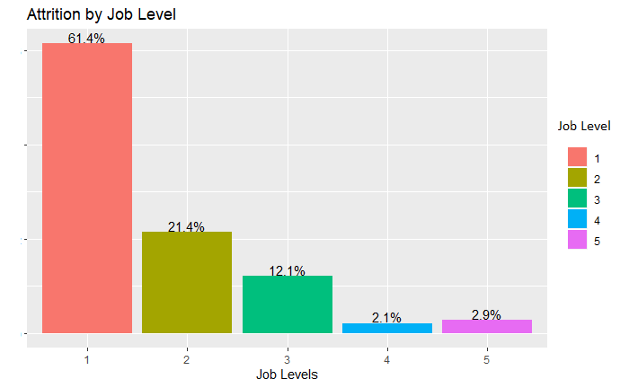
Other Observations about Attrition
Notes:
On this slide there are two bar charts to show attrition by Age groups on the left and Attrition by Job level on the right. The age group with the highest attrition is 25 to 34, accounting for almost half of the attrition.
From job level chart, we see that the lowest job level of 1 has the highest attrition. Some remedies for this could be focusing resources for younger employees to keep them engaged and also moving up into the later job levels faster.

Slide 5
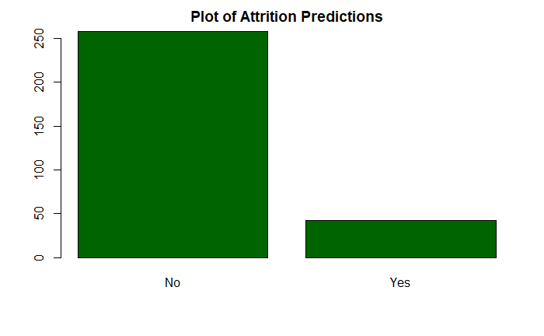
Classifying Attrition
Two models were assessed to determine the best classification for employees that may leave. KNN(K Nearest Neighbor) and Naïve Bayes. The Naïve Bayes model proved to be the most accurate along with highest Sensitivity and Specificity.
Accuracy | Sensitivity | Specificity
85% | 90% | 66%
Notes:
Two classifiers were assessed and the Bayes model performed the best, achieving 85% accuracy, 90% sensitivity and 66% Specificity or the model’s ability to predict each category and both categories. I charted the predictions on the right in green. 16 variables were used to classify attrition in this study and the table in the slide are the variables that resulted in the best results.

Slide 6
Employee Salary Prediction
A step-wise multi-regression model was used to predict employee salaries. The target was to have a Root Mean Square Error < $3000.00. An RMSE of 1033 was achieved.
R2 | RMSE | MAE
95% | 1033.25 | 751
Notes:
I used a step-wise multiple regression model for employee salary prediction. The model achieved root mean error of 1033. There are really only DailyRate, JobLevel, JobRole and TotalWorkingYears used for this model two of those variables had multiple levels beneath or where categorical.

Slide 7
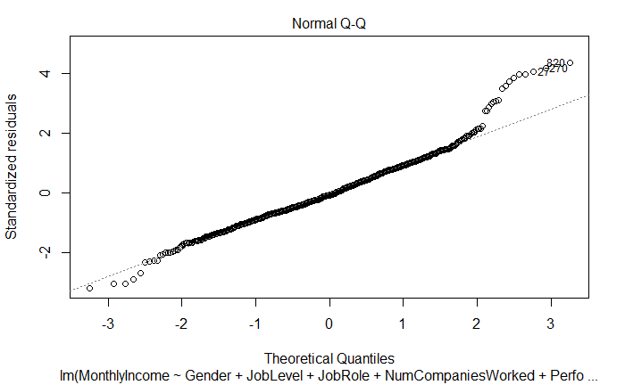
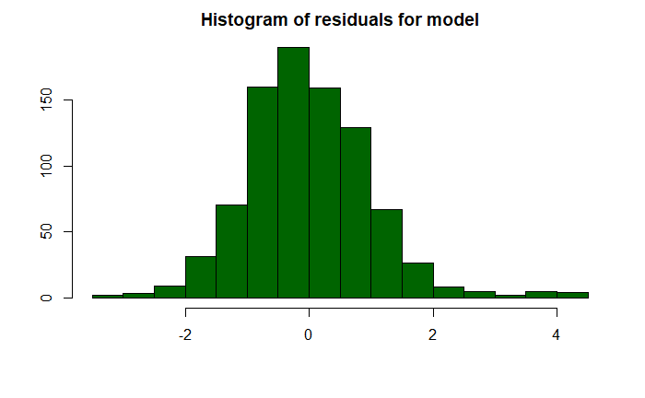
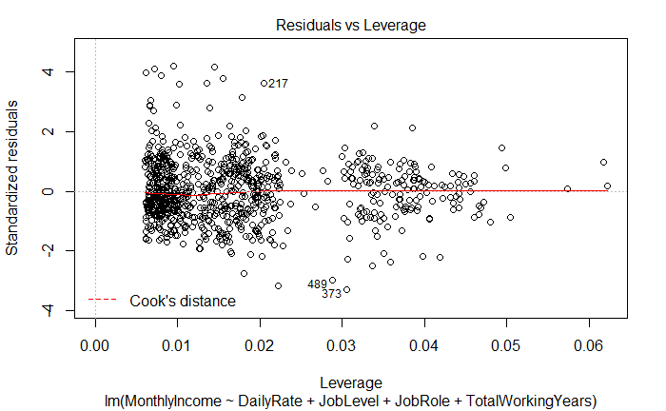
Assumptions for Prediction Regression
Notes:
I wanted to make sure the assumptions were met and to also keep track of the Variance Inflation to make sure no values were over 10. The VIF was well within acceptable limits. The residuals histogram also shows normality as well as a fairly straight QQ plot as well as a residuals scatter plot to check for randomness of the residuals.

Slide 8
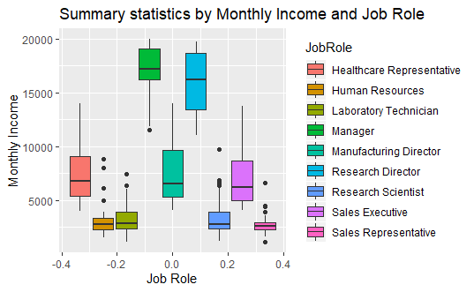
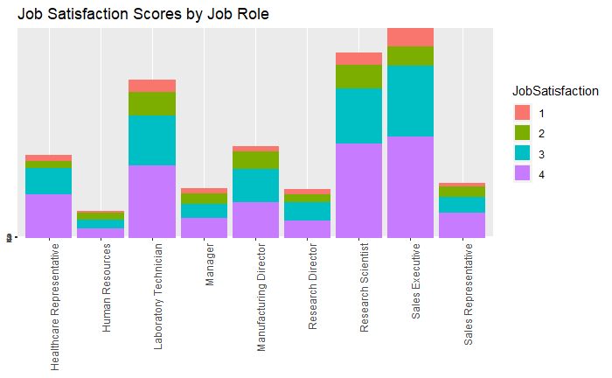
Job Roles
Notes:
Here, we have some information about Job Roles. I wanted to look at the summary statistics for each Job Role, the box plot on the left, and also look at the Job Satisfaction scores by job role, the stacked chart on the right. Scores for 3 and 4 which were highest ratings, tended to be the largest portion of the graph, which would indicate strong satisfaction by job role. Jobs with the highest satisfaction scores(3 and 4) are Research Scientist, Sales Executive and Laboratory technician. Human resources, managers had the highest levels of dis-satisfaction with (1,2).

Slide 9
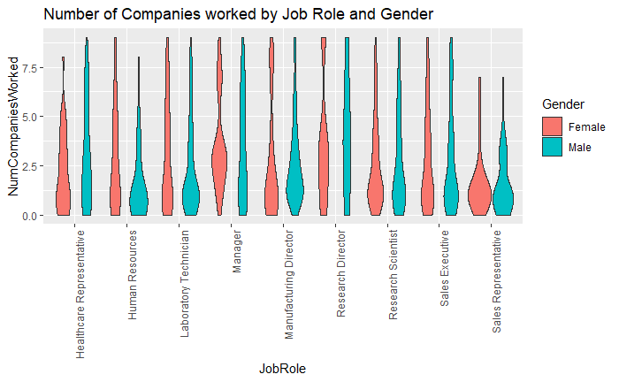
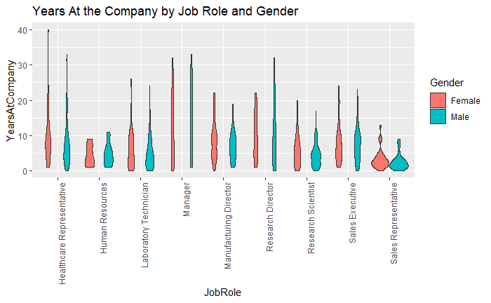
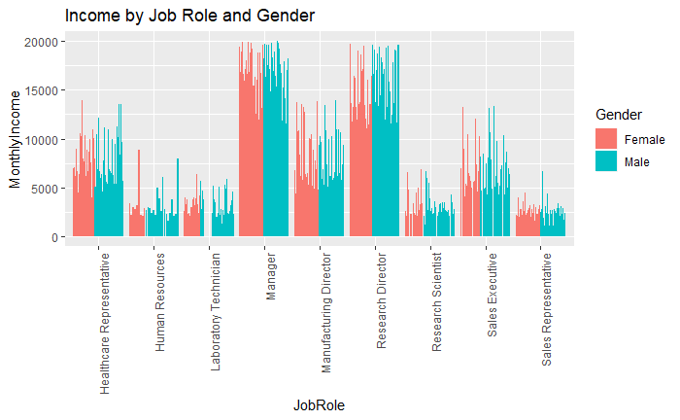
A look at differences in Gender
Notes:
The charts on this slide look at Number of Companies worked broken out by Job Role and Gender, the violin chart on the left, Years at the current company, the violin chart in the middle and finally Income by Job role and gender on the right.
Men look to work for more companies than women from this chart but not by wide margins.
Women tend to stay at their company for longer periods although not by much from the middle chart.
The income chart on the right shows a fairly equitable balance of income between men and women in the same roles although the are about 150 more men than women in total.

Slide 10
Conclusion
The factors that should be managed to reduce employee attrition are years since last promotion, ensuring a comfortable environment, monitoring job involvement and looking at number of companies worked during the hiring process to cut down on attrition.
Naïve Bayes model was used to classify employees by attrition
A step-wise multiple regression model was used to predict employee salary
The HR group and general managers tended to have higher dissatisfaction while sales executives, laboratory technicians and research scientists tend to have the highest satisfaction although general job satisfaction was high.
Income looked equitable between men and women but more diversity information would be helpful for further study.
Notes:
Move to Thank you slide

Slide 11
Thank You!

