Slide 1
Beer Data EDA

Slide 2
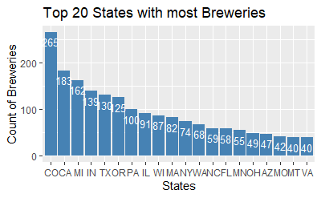
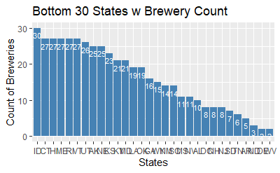
Breweries by State
Created data frame with ordered state brewery count:
stateSum=nona%>%group_by(State)%>%summarise(Brewery_count=n())
orderedstateSum<-stateSum[order(-stateSum$Brewery_count),]
head(orderedstateSum)
#Top 20 ordered bar chart
top20=head(orderedstateSum,20)
top20%>%ggplot(aes(x=reorder(State,-Brewery_count),y=Brewery_count))+
geom_bar(stat="identity",fill="steelblue")+
geom_text(aes(label=Brewery_count), vjust=1.6, color="white", size=3.5)+
ggtitle("Top 20 States with most Breweries")+xlab("States")+ylab("Count of Breweries")
#Bottom 30 ordered bar chart
bottom30=tail(orderedstateSum,30)
view(bottom30)
bottom30%>%ggplot(aes(x=reorder(State,-Brewery_count),y=Brewery_count))+
geom_bar(stat="identity",fill="steelblue")+geom_text(aes(label=Brewery_count), vjust=1.6, color="white", size=3)+
ggtitle("Bottom 30 States w Brewery Count")+xlab("States")+ylab("Count of Breweries")

Slide 3
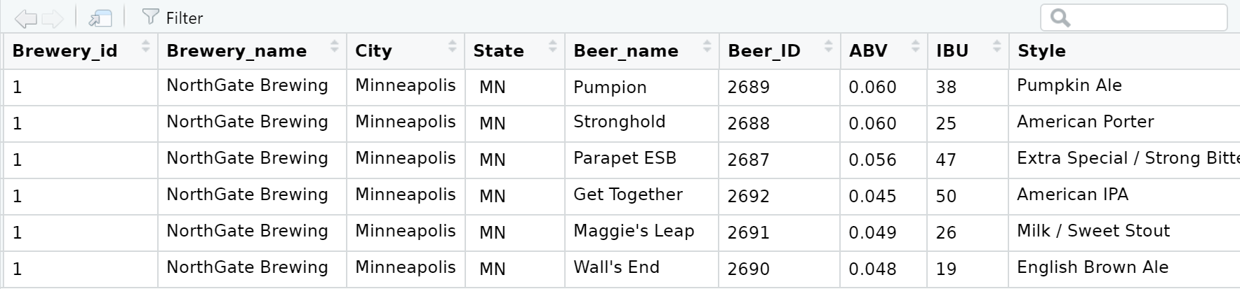
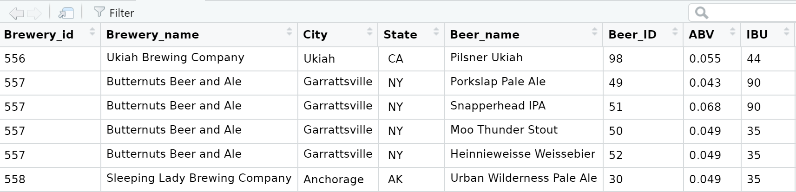
Merged Beer data
Code for merge:
#Cleanup to enable a key with same name
breweriesdf <- breweriesdf %>% rename(
Brewery_id = Brew_ID,
Brewery_name = Name
)
#Change name to be more unique
beerdf <- beerdf %>% rename(
Beer_name = Name
)
#Merge step
combineddf<-merge(breweriesdf,beerdf, by="Brewery_id",all = TRUE)
#Below is after imputation, fixing the missing data
top6merge<-head(nona)
bottom6merge<-tail(nona)
view(top6merge,title = "Top 6 head data for merged dataset")
view(bottom6merge,title = "Bottom 6 head data for merged dataset")

Slide 4
Data Imputation
The ABV and IBU were missing ABV(62) and IBU(1005) values which needed to be resolved to get more accurate data analysis. We chose the mice library package to accomplish the imputation.
init = mice(combineddf, maxit=0)
predM = init$predictorMatrix
predM[, c("Beer_name", "Beer_ID", "Ounces", "Brewery_name")]=0
imp<-mice(combineddf, m=5, predictorMatrix = predM)
nona <- complete(imp)
nona$State<-trimws(nona$State)
write.csv(nona,file="/Users/malco/Documents/MDS/MDS_6306_DDS/CaseStudy1/nona.csv",row.names=FALSE)

Slide 5
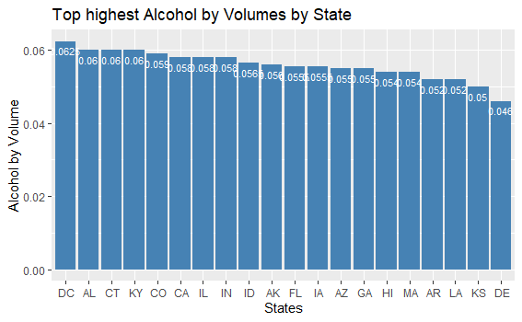
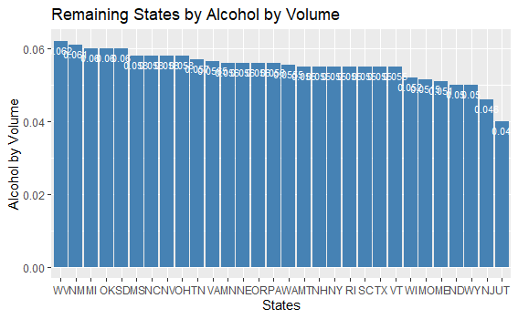
Median Alcohol by Volume
The median Alcohol by Volume data is ordered in ascending order by State.
#Dataframe of just State,ABV,IBU
medianABVIBU<-nona%>%group_by(State)%>%summarize(medianABV=median(ABV),medianIBU=median(IBU))
#Code for Top 20 highes ABV by State
top20medABV=head(medianABVIBU,20)
top20medABV<-top20medABV%>%select(State,medianABV)
head(top20medABV)
top20medABV%>%ggplot(aes(x=reorder(State,-medianABV),y=medianABV))+
geom_bar(stat="identity",fill="steelblue")+geom_text(aes(label=medianABV), vjust=1.6, color="white", size=3)+
ggtitle("Top highest Alcohol by Volumes by State")+xlab("States")+ylab("Alcohol by Volume")
#Code for ascending ordered ABV by State
remainingABV=tail(medianABVIBU,30)
remainingABV<-remainingABV%>%select(State,medianABV)
remainingABV%>%ggplot(aes(x=reorder(State,-medianABV),y=medianABV))+
geom_bar(stat="identity",fill="steelblue")+geom_text(aes(label=medianABV), vjust=1.6, color="white", size=3)+
ggtitle("Remaining States by Alcohol by Volume")+xlab("States")+ylab("Alcohol by Volume")

Slide 6
The most extreme Alcohol by Volume and International Bitterness Unit State
#Code to selct by ABV and IBU and find max value
maxABV<-nona%>%group_by(State)%>%select(State,ABV)
maxIBU<-nona%>%group_by(State)%>%select(State,IBU)
maxABV[which.max(maxABV$ABV), ]
maxIBU[which.max(maxIBU$IBU), ]
State | Alcohol by Volume
Colorado | .128
State | International Bitterness Units
Colorado | 138

Slide 7
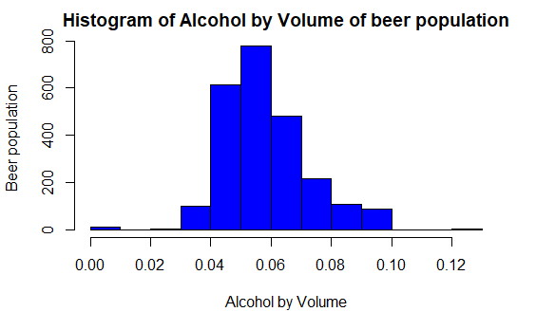
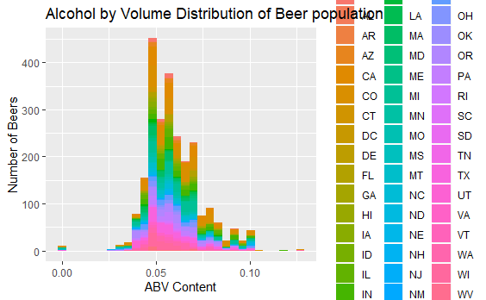
Alcohol by Volume Analysis
Summary Statistics
Min. :0.00100
1st Qu.:0.05000
Median :0.05600
Mean :0.05933
3rd Qu.:0.06700
Max. :0.12800
The sample distribution of Alcohol by Volume is large enough to ensure any departure from normality can be overcome by the Central Limit Theorem. The distribution does appear to be mostly normal but slightly right skewed.
justABV<-nona%>%select(ABV)
summary(justABV)
hist(justABV$ABV,
main="Histogram of Alcohol by Volume of beer population",
xlab="Alcohol by Volume",
ylab="Beer population",
col="blue",
border="black")
nona%>%ggplot(aes(x=ABV,fill=State))+geom_histogram(bins=30)+ggtitle("Alcohol by Volume Distribution of Beer population")+xlab("ABV Content")+ylab("Number of Beers")
#1 sample t-test of ABV data
logjustABV<-log(justABV)
t.test(x=justABV, conf.int = "TRUE", alternative = "two.sided")
One Sample t-test
data: justABV
t = 202.43, df = 2409, p-value < 2.2e-16
alternative hypothesis: true mean is not equal to 0
95 percent confidence interval:
0.05875595 0.05990546
sample estimates:
mean of x
0.05933071

Slide 8
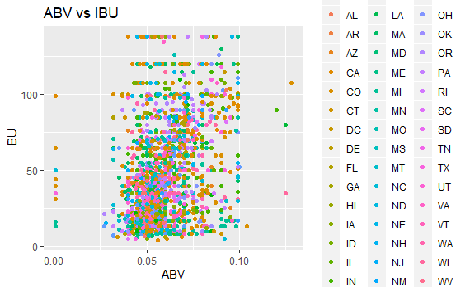
Question of Interest: A relationship exists between Alcohol by Volume and International Bitterness Units.
A scatter plot of Alcohol by Volume and International Bitterness Unit does not appear to have a relationship.
The scatter plots of ABV and IBU do not show much of a pattern.
A linear regression was used to test if there was a relationship between ABV and IBU.
#Code for linear regressionnona%>%ggplot(aes(x=ABV,y=IBU))+geom_point()+geom_smooth(method="lm")
#+ ABV*Style
fit = lm(IBU~ABV, data = nona)
summary(fit)

Slide 9
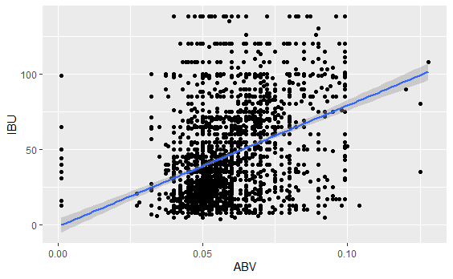
Linear Regression to test for Relationship
Call:
lm(formula = IBU ~ ABV, data = nona)
Residuals:
Min 1Q Median 3Q Max
-69.361 -20.887 -5.503 16.270 106.920
Coefficients:
Estimate Std. Error t value Pr(>|t|)
(Intercept) -0.9706 2.4945 -0.389 0.697
ABV 801.2621 40.8601 19.610 <2e-16 ***
---
Signif. codes: 0 ‘***’ 0.001 ‘**’ 0.01 ‘*’ 0.05 ‘.’ 0.1 ‘ ’ 1
Residual standard error: 28.86 on 2408 degrees of freedom
Multiple R-squared: 0.1377, Adjusted R-squared: 0.1373
F-statistic: 384.5 on 1 and 2408 DF, p-value: < 2.2e-16

Slide 10
Other Questions of Interest
What is the most popular beer style per geographic region?
Is there a relationship between style of beer an regional population?

Slide 11
Thank You for your Time!

