Slide 1
Craft Beer Study
DDS 6306
Jason Burk
Malcolm Carlson

Slide 2
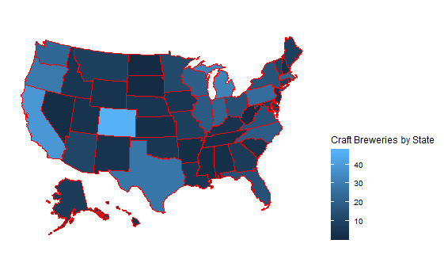
Breweries by State

Slide 3
Data Imputation
Using a function called “MICE” or Multivariate Imputation by Chained Equations we were able to infer values for Alcohol by Volume (ABV-62 NA) and International Bitterness Units (IBU-1005) where missing.
The MICE algorithm imputes an incomplete column (the target column) by generating 'plausible' synthetic values given other columns in the data.

Slide 4
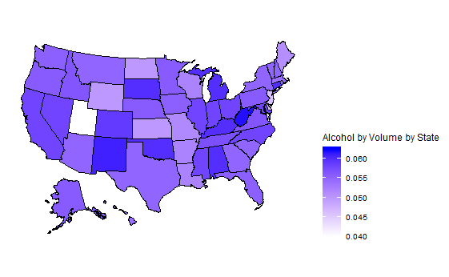
Median Alcohol by Volume (ABV) by State
Bud ABV:5%

Slide 5
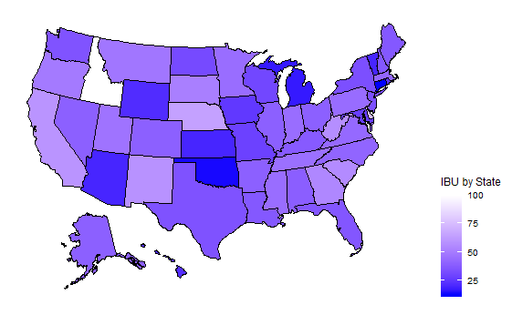
Median International Bitterness Units (IBU) by State

Slide 6
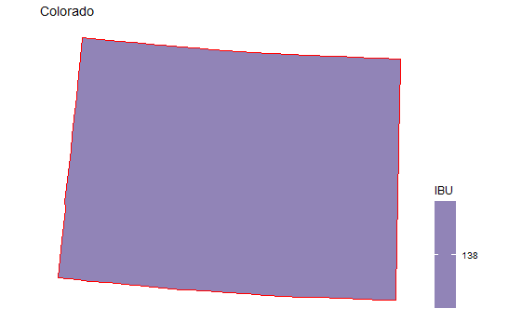

The most extreme Alcohol by Volume and International Bitterness Unit State

Slide 7
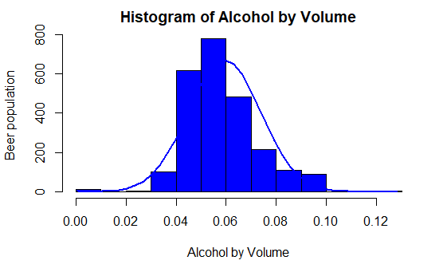
Histogram of Alcohol by Volumes

Slide 8
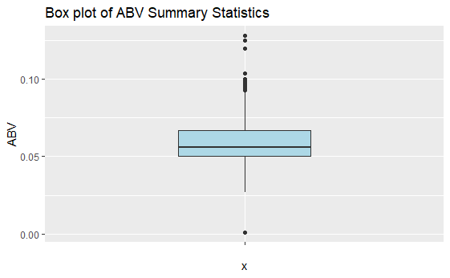
ABV Summary Statistics
Summary Statistics
Min | .001
1st Quartile | .050
Median | .056
Mean | .059
3rd Quartile | .067
Max | .128

Slide 9
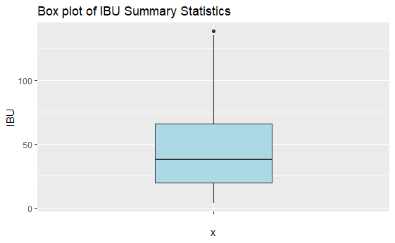
IBU Analysis
Summary Statistics
Min | 4
1st Quartile | 20
Median | 38
Mean | 47
3rd Quartile | 66
Max | 138

Slide 10
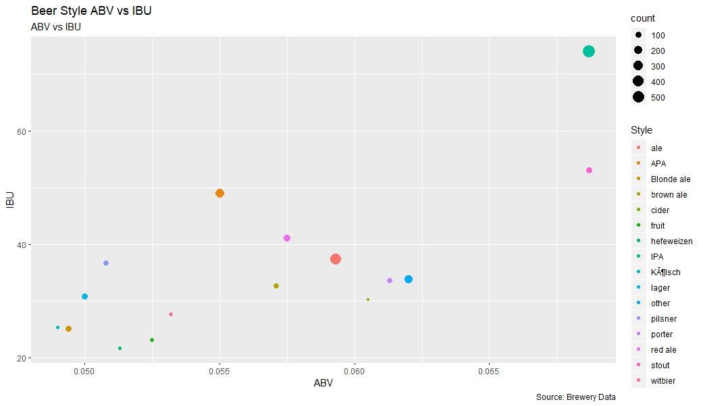
Alcohol by Volume and International Bitterness Units by Style

Slide 11
KNN Investigation between IPAs and other ALEs

Slide 12
Regional Study: Beer Styles, ABV and IBU
The beer data was broken up into five regions: Northeast, North Central, Midwest, South and West.
Key metrics
Northeast
Most popular beer style(as measured by number of offerings)
Leas popular

Slide 13
Thank You for your Time!

Slide 14
Backup

Slide 15
Other Questions of Interest
What is the most popular beer style per geographic region?
Is there a relationship between style of beer an regional population?
Is there an opportunity for investing in high IBU beer supplier in the West?

Slide 16
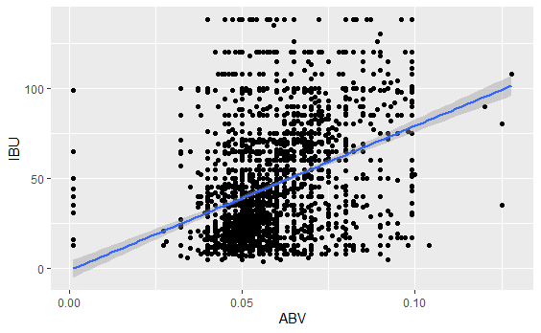
Linear Regression to test for Relationship
Results form Linear Regression Test
Reject the Null hypothesis that there is a relationship between Alcohol by Volume and International Bitterness Units with a P-value significantly less than an alpha of .05.

Slide 17
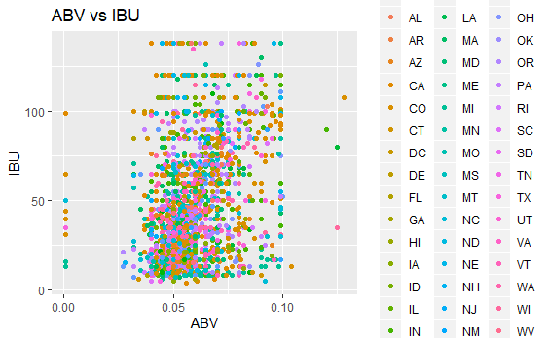
Question of Interest: A relationship exists between Alcohol by Volume and International Bitterness Units.
A scatter plot of Alcohol by Volume and International Bitterness Unit does not appear to have a relationship.
The scatter plots of ABV and IBU do not show much of a pattern.
A linear regression was used to test if there was a relationship between ABV and IBU.

Slide 18
Feedback
Box plot for summary data

