Slide 1
Case Study 1 US Craft Beer
DDS 6306
Malcolm Carlson

Slide 2
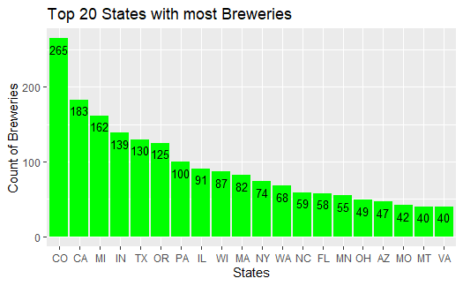
Breweries by State
Brewries by State - Ascending Order
CO | 265 | NY | 74 | IA | 30 | KS | 23 | NV | 11
CA | 183 | WA | 68 | ID | 30 | KY | 21 | AL | 10
MI | 162 | NC | 59 | CT | 27 | MD | 21 | NH | 8
IN | 139 | FL | 58 | HI | 27 | LA | 19 | NJ | 8
TX | 130 | MN | 55 | ME | 27 | OK | 19 | SD | 7
OR | 125 | OH | 49 | RI | 27 | GA | 16 | TN | 6
PA | 100 | AZ | 47 | VT | 27 | WY | 15 | AR | 5
IL | 91 | MO | 42 | UT | 26 | NM | 14 | ND | 3
WI | 87 | MT | 40 | AK | 25 | SC | 14 | DE | 2
MA | 82 | VA | 40 | NE | 25 | MS | 11 | WV | 2
 |  |  |  |  |  |  |  | DC | 8

Slide 3
Data Imputation
The ABV and IBU were missing ABV(62) and IBU(1005) values which needed to be resolved to get more accurate data analysis.
The mice library(Multivariate Imputation by Chained Equations) was chosen to address the missing values.
MICE uses chosen columns to simulate plausible values for the missing data.

Slide 4
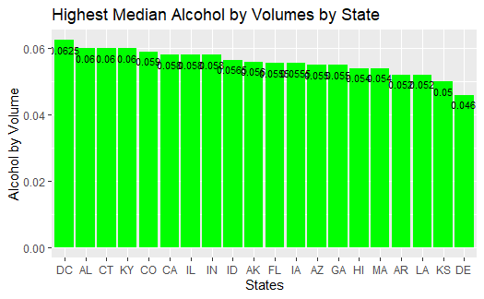
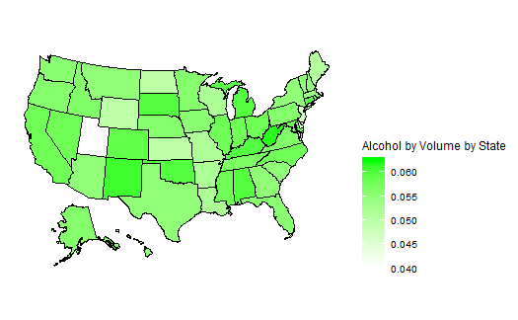
Median Alcohol by Volume

Slide 5
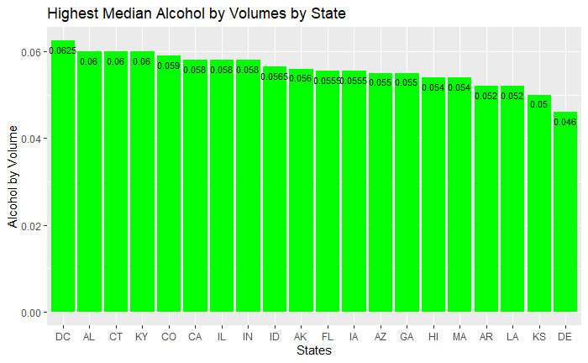
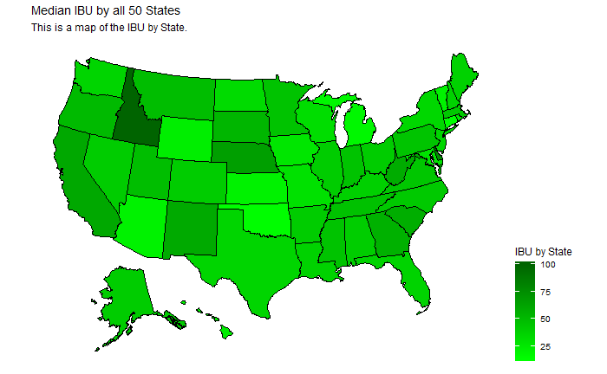
Median IBU by State

Slide 6
The most extreme Alcohol by Volume and International Bitterness Unit State
State | Alcohol by Volume
Colorado | 13%
State | International Bitterness Units
Colorado | 138

Slide 7
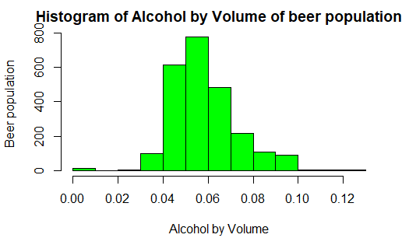
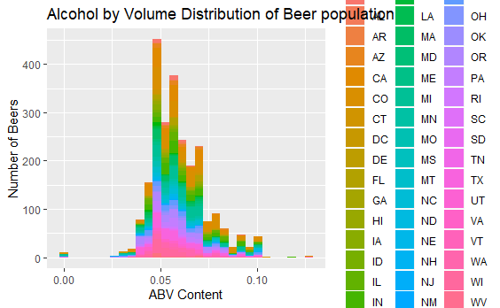
Alcohol by Volume Analysis
Summary Statistics
Min | .00100
1st Quartile | .05600
Median | .05600
Mean | .05933
3rd Quartile | .06700
Max | .12800
The sample distribution of Alcohol by Volume is large enough to ensure any departure from normality can be overcome by the Central Limit Theorem. The distribution does appear to be mostly normal but slightly right skewed.

Slide 8
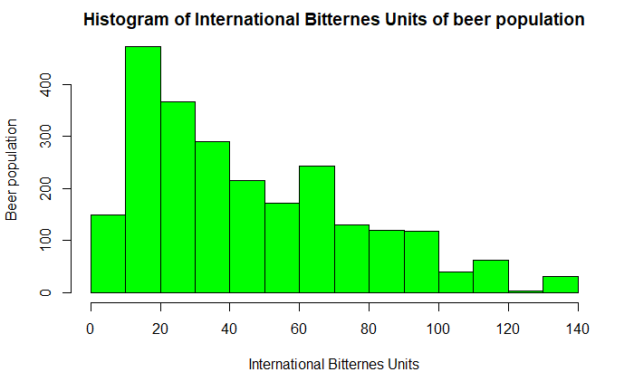
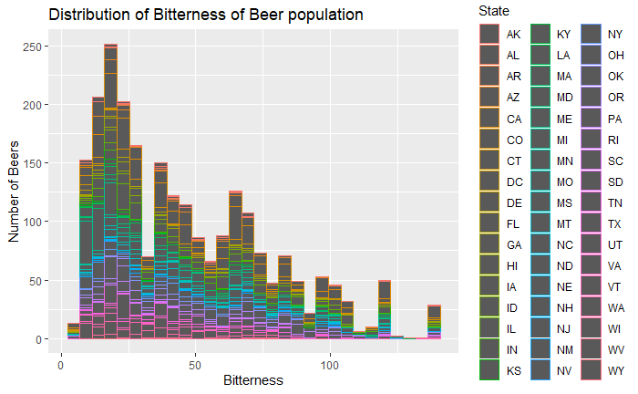
IBU Analysis
The distribution for IBU is very right skewed but could also be cleaned up by CLT.
Summary Statistics
Min | 4
1st Quartile | 20
Median | 38
Mean | 47
3rd Quartile | 66
Max | 138

Slide 9
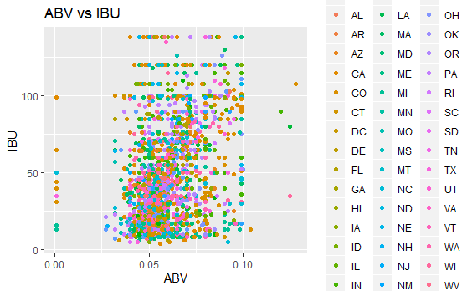
Question of Interest: A relationship exists between Alcohol by Volume and International Bitterness Units.
A scatter plot of Alcohol by Volume and International Bitterness Unit does not appear to have a relationship.
The scatter plots of ABV and IBU do not show much of a pattern.
A linear regression was used to test if there was a relationship between ABV and IBU.

Slide 10
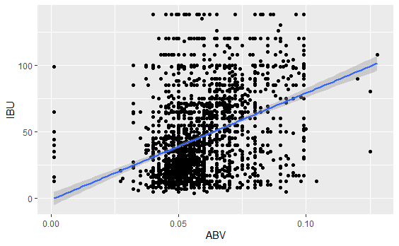
Linear Regression to test for Relationship
Results form Linear Regression Test
Reject the Null hypothesis that there is a relationship between Alcohol by Volume and International Bitterness Units with a P-value significantly less than an alpha of .05.

Slide 11
Other Questions of Interest
What is the most popular beer style per geographic region?
Is there a relationship between style of beer an regional population?
Is there an opportunity for investing in high IBU beer supplier in the West?

Slide 12
Thank You for your Time!

Slide 13
Feedback

