Slide 1
Craft Beer Study
DDS 6306
Jason Burk
Malcolm Carlson
Notes:
Hello,
I’m Malcolm Carlson and I will be presenting a case study that Jason Burk and I worked on about Craft Beer in the United States.

Slide 2
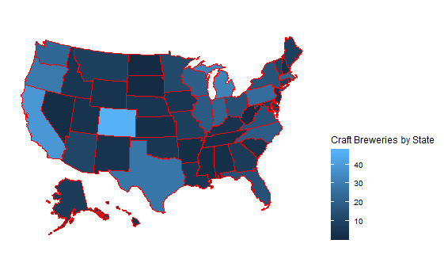
Breweries by State
Notes:
On the left we are showing a sorted list in ascending order of craft breweries by state.
On the right we have a map of all the states color shaded by number of breweries. The lighter the color, the more breweries the state has.
My home state of Texas is in the Top 5 with 28 and Jason’s home state of Colorado has the highest number of craft breweries.

Slide 3
Addressing Missing Data
Using a function called “MICE” or Multivariate Imputation by Chained Equations we were able to infer values for Alcohol by Volume (ABV-62 NA) and International Bitterness Units (IBU-1005) where missing.
The MICE algorithm imputes an incomplete column (the target column) by generating 'plausible' synthetic values given other columns in the data.
Notes:
For this study we had to properly address missing data. There were missing values in the Alcohol By Volume and IBU columns which were important to our study so we used the mice library(or Multivariate Imputation by Chained Equations) to synthesize missing values using other columns in the data. This was important because the IBU data was missing over a thousand values which would have impacted the accuracy of our results.

Slide 4
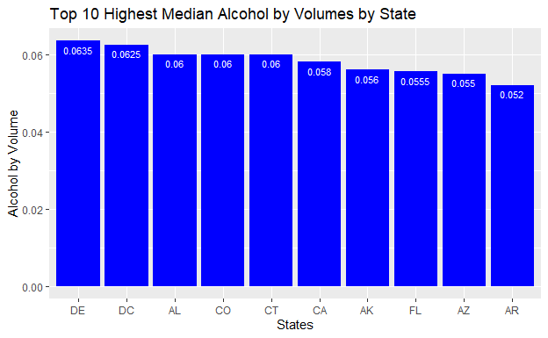
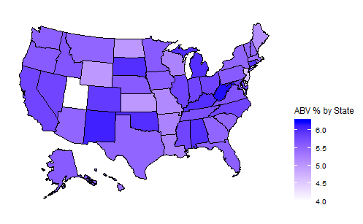
Median Alcohol by Volume (ABV) by State
Bud ABV: .05
Notes:
This slide shows the median alcohol by volume across all the states where we have the top 10 states on the left and on the right, we have map of all the states shaded by median ABV. The bluest states have craft beers with the highest ABV. Budweizer has an ABV of .05 or 5%
DE %6.35,CA %6 ,AR %5,AK %5.6,AL %6

Slide 5
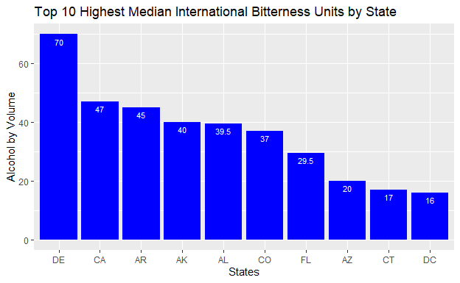
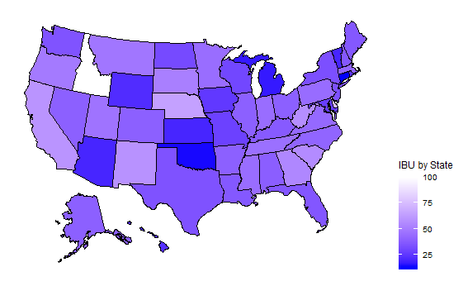

Median International Bitterness Units (IBU) by State
Notes:
This slide shows the median international bitterness units across all the states with a top 10 bar chart on the left and a map of all the states by IBU on the right.. The lightest blue states have craft beers with the highest IBU. Budweizer has an IBU of 7.
DE 70, CA 47, AR 45, AK 40, AL 39.5, CO 37, FL 29.5, AZ 20, CT 17, DC 16

Slide 6
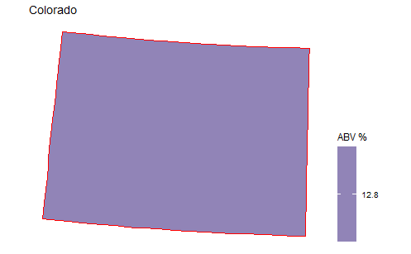
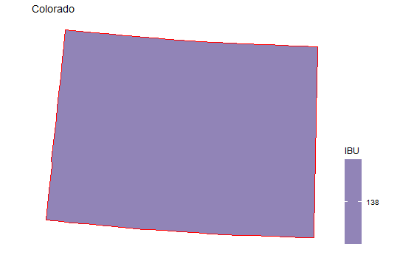
The most extreme Alcohol by Volume and International Bitterness Unit State
Notes:
CO ABV Max =~13%, CO IBU=138

Slide 7
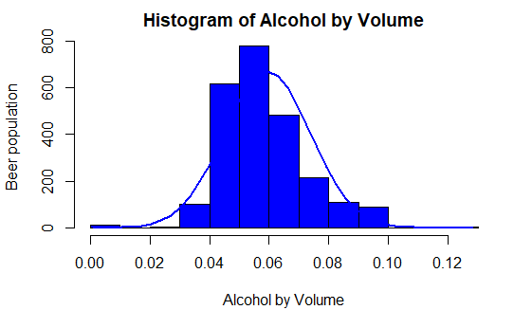
Histogram of Alcohol by Volumes

Slide 8
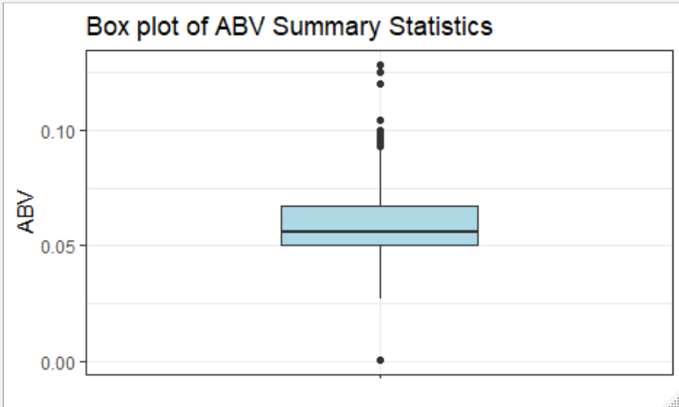
ABV Summary Statistics
Summary Statistics
Min | .001
1st Quartile | .050
Median | .056
Mean | .059
3rd Quartile | .067
Max | .128

Slide 9
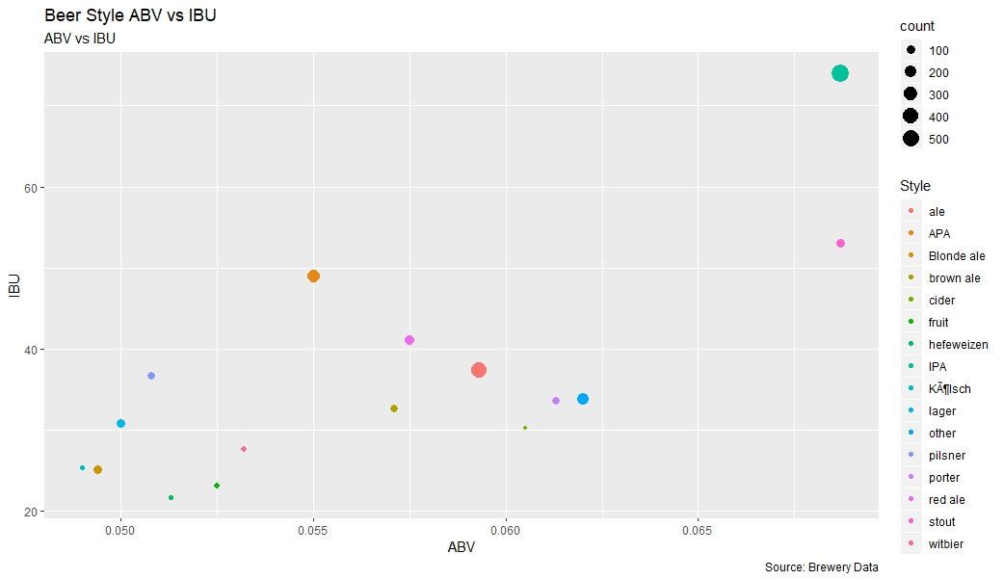
Alcohol by Volume and International Bitterness Units by Style
Notes:
This plot shows Alcohol by volume on the x axis with the bitterness units on the y axis. The styles of beers are listed in the legend on the right with counts of beer styles represented by the size of dot on this plot. What this tells us is what beers have the most representation and what their IBU and ABV levels are.
Highest bitterness and alcohol by volume are the IPAs in the upper right hand corner of the plot. The IPAs have the largest circle, meaning there are more IPAs than the other beers. Stout beers, the orange dot on the right below IPAs are high in ABV and IBU but not as many offerings as their circle is smaller.
Regular Ales are the second most popular in terms of count and are in the mid range in ABV and lower than the middle in bitterness.
Lowest ABV and IBU beers seem to be the least popular with the craft brew producers (Lagers, Blonde Ale, Pilsner, hefeweizen)

Slide 10
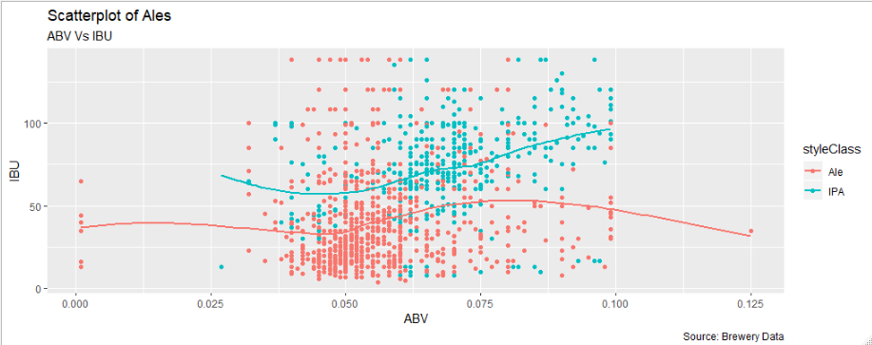
Scatter Plot of ABV and IBU for all Ales
Notes:
This plot has ABV across the x axis and IBU on the y axis and is plotting division between IPAs colored in the blue green color and regular Ales, colored in orange.

Slide 11
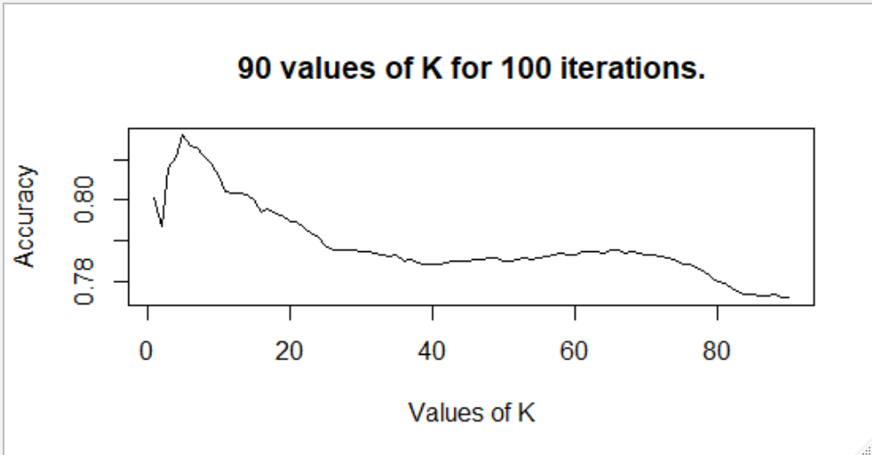
KNN results classifying IPAs or ALEs, using ABV and IBU
Best K | Specificity | Sensitivity | Accuracy
5 | 72% | 90% | 83%
Notes:
This plot and table of the K Nearest Neighbor classifier describes how the Ales vs IPAs were classified using ABV and IBU. The best K value is the value the generates the most accurate classifications. We were able to classify our subset of all Ales as either IPA or other Ales.

Slide 12
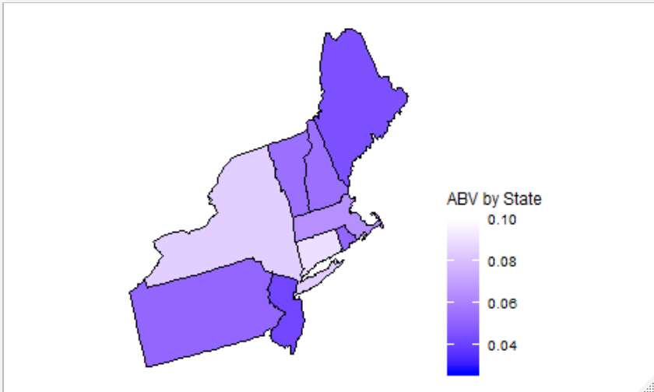
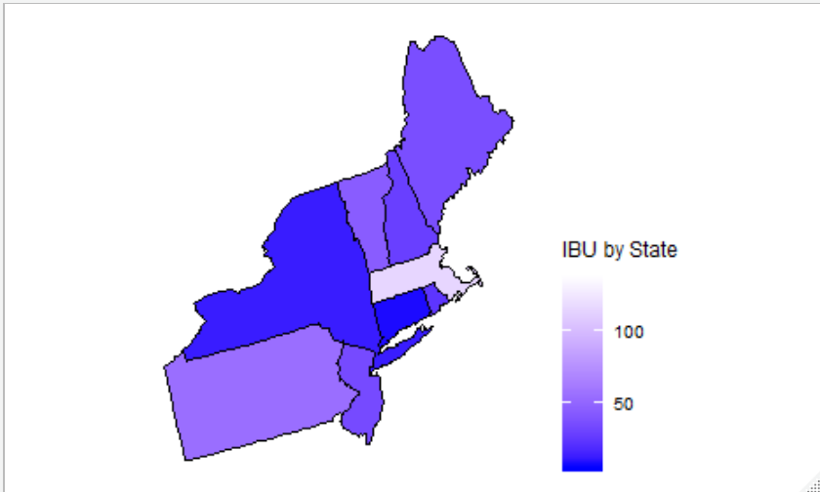
North Eastern Region – Top Ten Beer Styles
Notes:
This table has the top 10 most popular beer styles by region. We are looking at the North Eastern states here. We have a map of the North East regions by both ABV and IBU.

Slide 13
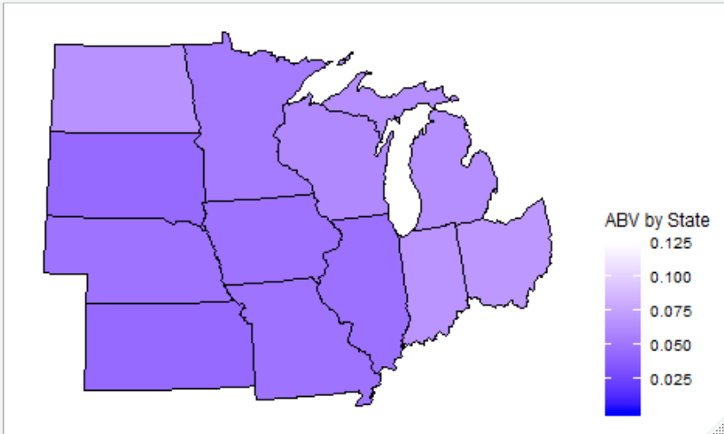
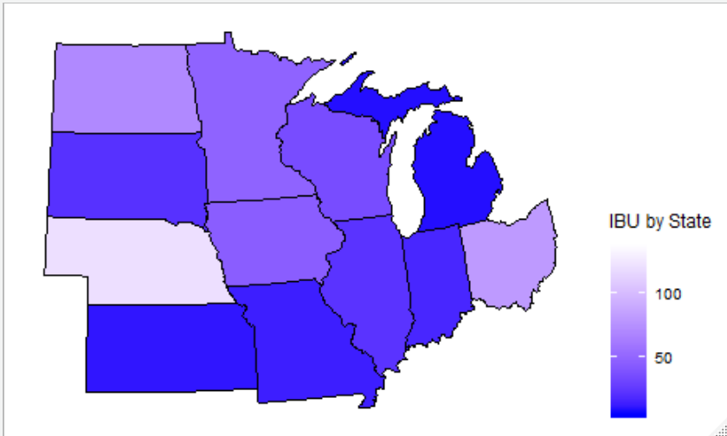
Midwest Region: Top 10 Beer Styles
Notes:
In the Midwest part of the country, the same trend holds true in that craft beer drinkers prefer IPAs and most other Ales.

Slide 14
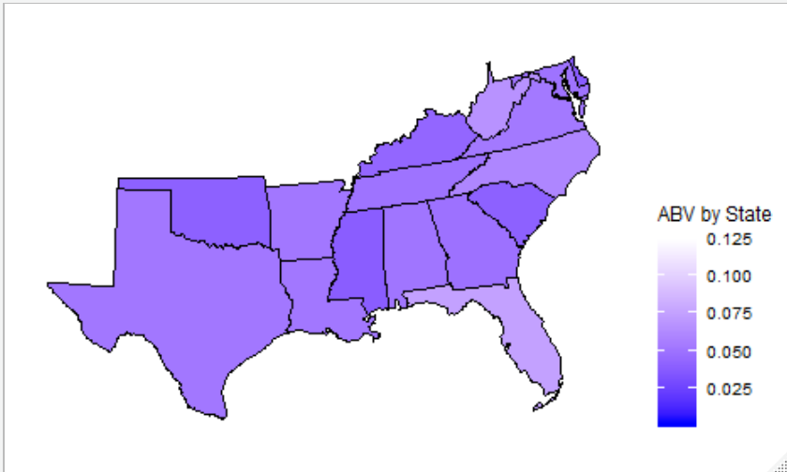
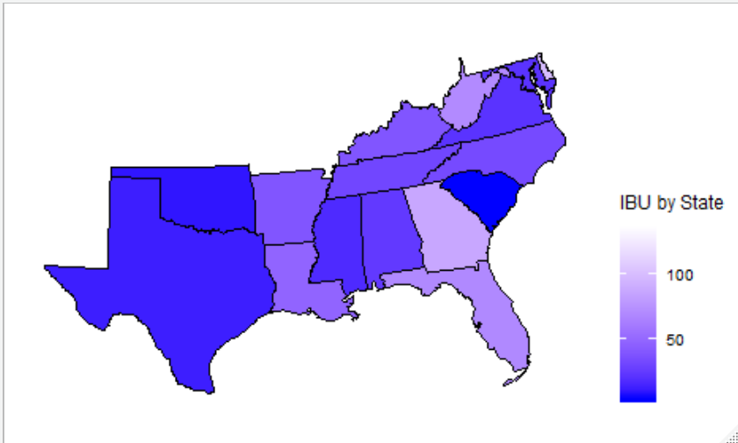
South Region: Top Ten Beer Styles
Notes:
Here in the South, we also prefer IPAs and Ales but do not have as many choices as the Midwest and the Western states.

Slide 15
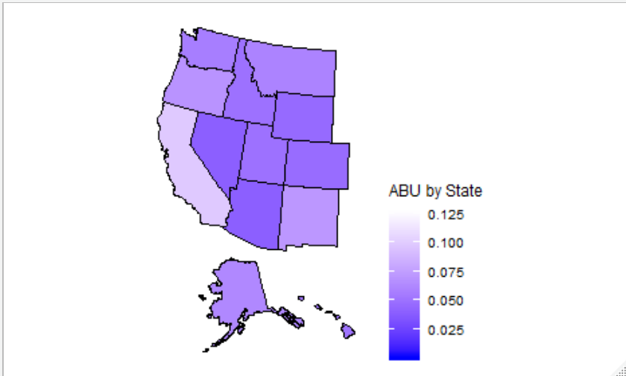
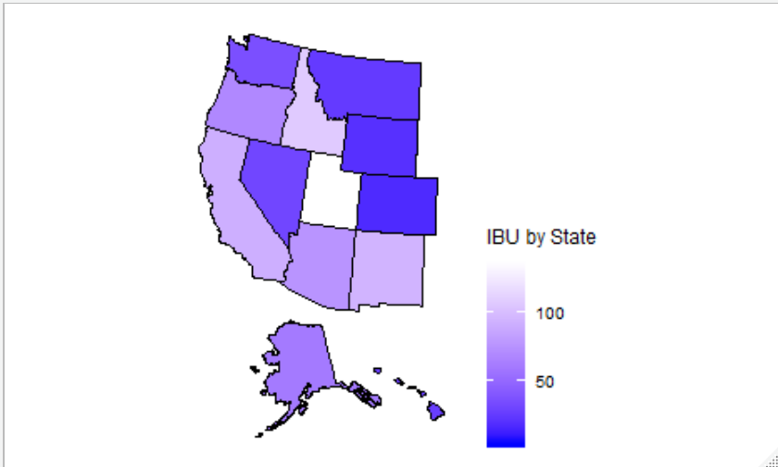
Western Region – Top 10 Beer Styles
Notes:
The Wester part of the country really loves IPA’s and Ales in general and they have the most option when it comes to those beers. California and Colorado, both very popular craft brew hubs, account for a large part of these result.

Slide 16
Thank You for your Time!
Notes:
From this study, Budwiezer may want to consider investing in beer offerings that have higher bitterness and ABV levels, particularly in IPAs and Ales to reach more of the craft beer market. There is definitely opportunities for growth in those segments.
Thank you for your time and let me know if you have any questions.

Slide 17
Backup

Slide 18
Other Questions of Interest
What is the most popular beer style per geographic region?
Is there a relationship between style of beer an regional population?
Is there an opportunity for investing in high IBU beer supplier in the West?

Slide 19
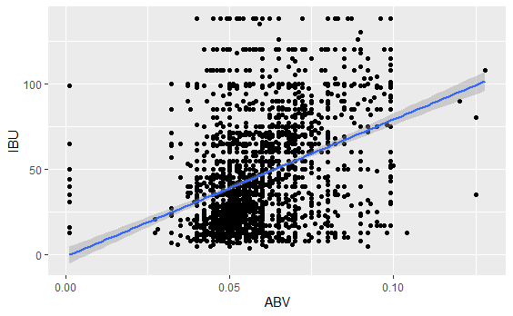
Linear Regression to test for Relationship
Results form Linear Regression Test
Reject the Null hypothesis that there is a relationship between Alcohol by Volume and International Bitterness Units with a P-value significantly less than an alpha of .05.

Slide 20
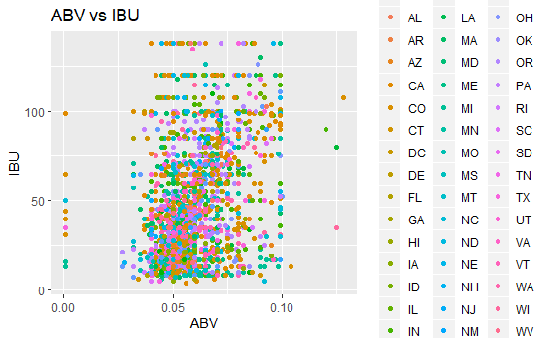
Question of Interest: A relationship exists between Alcohol by Volume and International Bitterness Units.
A scatter plot of Alcohol by Volume and International Bitterness Unit does not appear to have a relationship.
The scatter plots of ABV and IBU do not show much of a pattern.
A linear regression was used to test if there was a relationship between ABV and IBU.

Slide 21
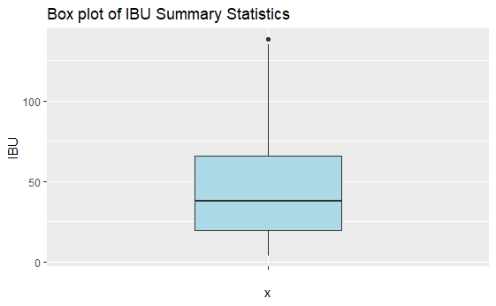
IBU Analysis
Summary Statistics
Min | 4
1st Quartile | 20
Median | 38
Mean | 47
3rd Quartile | 66
Max | 138

Slide 22
Feedback
Box plot for summary data

