Slide 1
Craft Beer Study
DDS 6306
Jason Burk
Malcolm Carlson

Slide 2
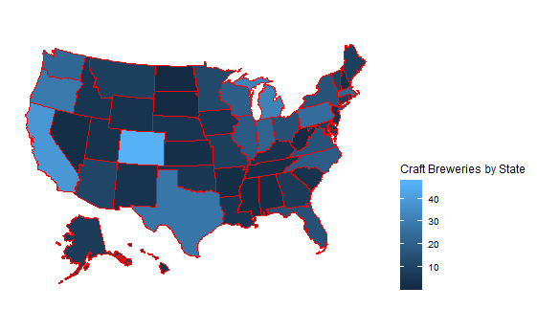
Breweries by State

Slide 3
Data Imputation
Using a function called “MICE” or Multivariate Imputation by Chained Equations we were able to infer values for Alcohol by Volume (ABV-62 NA) and International Bitterness Units (IBU-1005) where missing.
The MICE algorithm imputes an incomplete column (the target column) by generating 'plausible' synthetic values given other columns in the data.

Slide 4
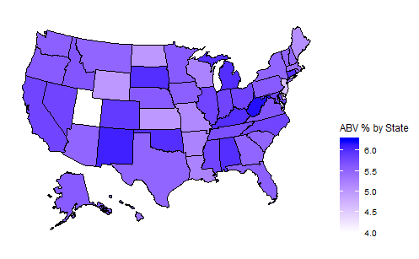
Median Alcohol by Volume (ABV) by State
Bud ABV:5%

Slide 5
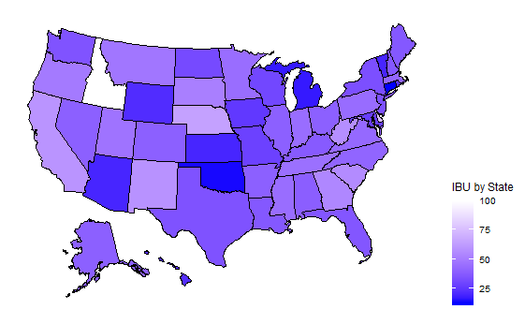

Median International Bitterness Units (IBU) by State

Slide 6
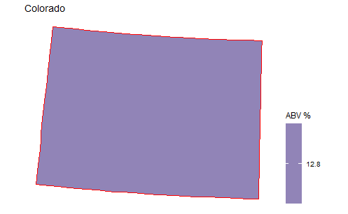
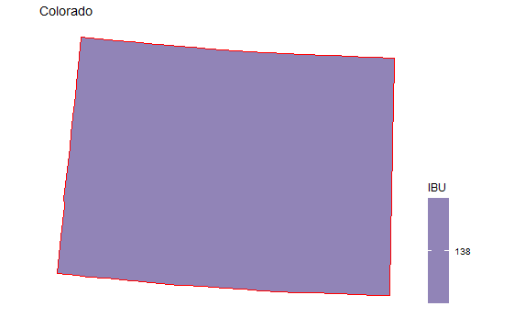
The most extreme Alcohol by Volume and International Bitterness Unit State

Slide 7
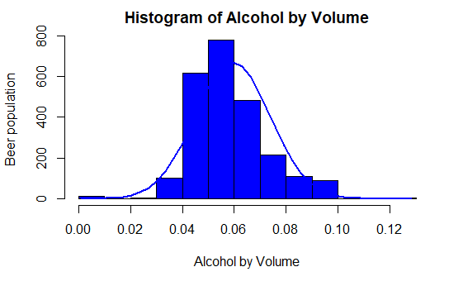
Histogram of Alcohol by Volumes

Slide 8
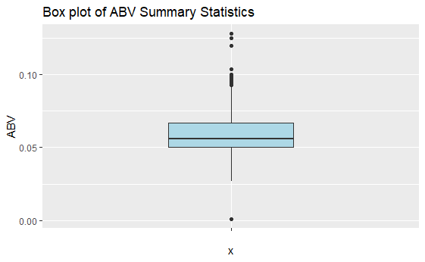
ABV Summary Statistics
Summary Statistics
Min | .001
1st Quartile | .050
Median | .056
Mean | .059
3rd Quartile | .067
Max | .128

Slide 9
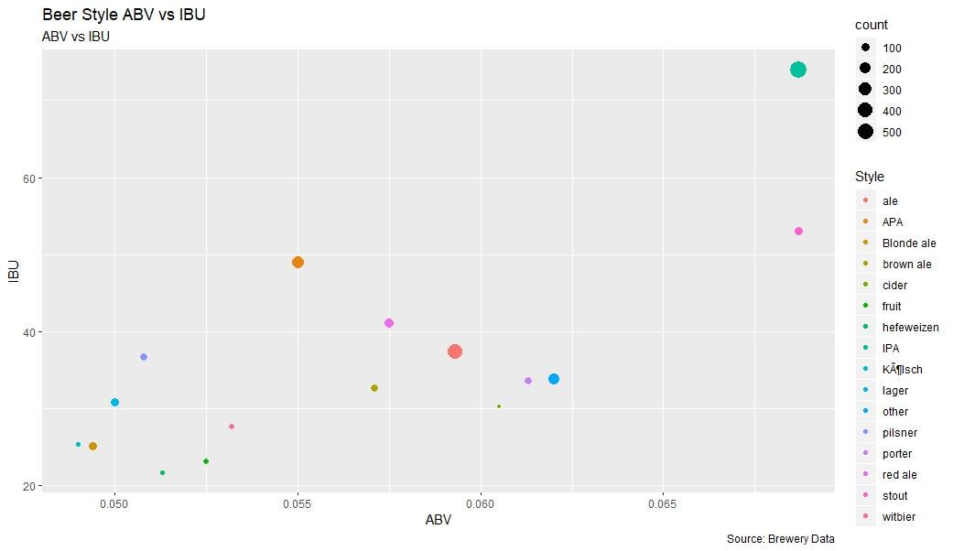
Alcohol by Volume and International Bitterness Units by Style

Slide 10
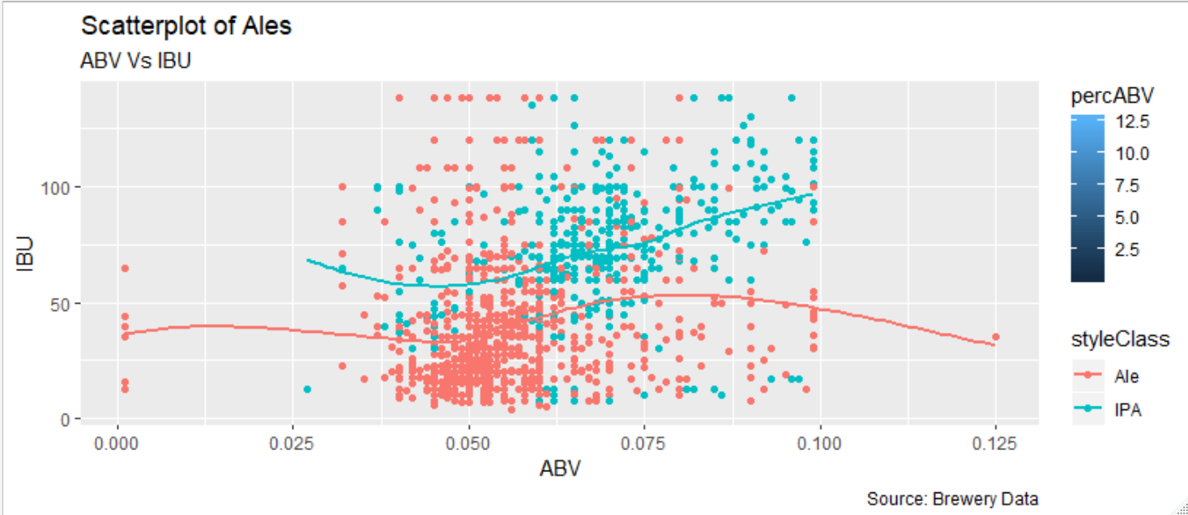
Scatter Plot of ABV and IBU for all Ales

Slide 11
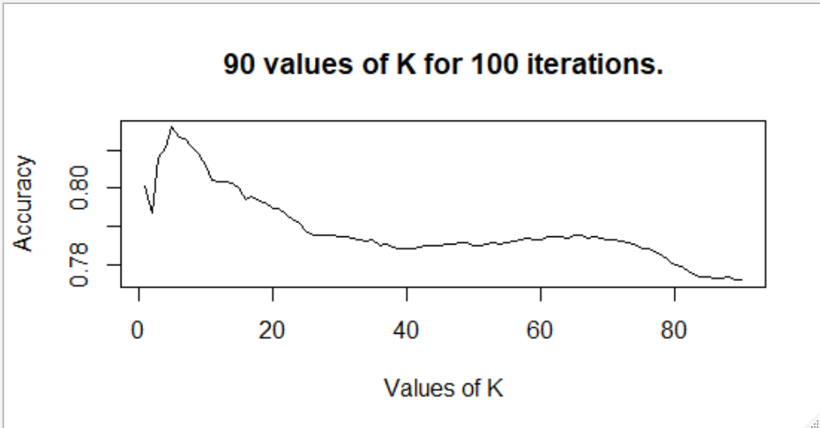
KNN results classifying IPAs or ALEs, using ABV and IBU
Best K | Specificity | Sensitivity | Accuracy
5 | 72% | 90% | 83%

Slide 12
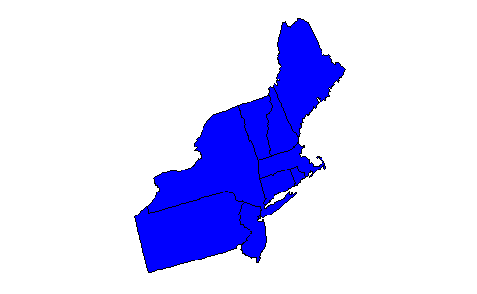
North Eastern Region – Top Ten Beer Styles
Budweizer and Bud Light or Lagers

Slide 13
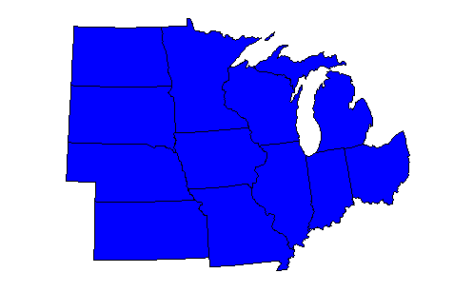
Midwest Region: Top 10 Beer Styles

Slide 14
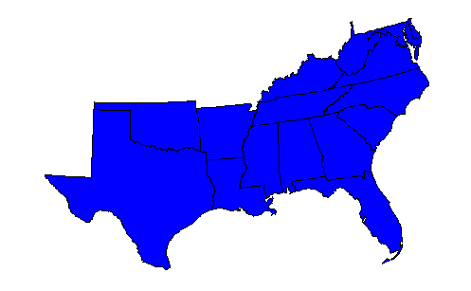
South Region: Top Ten Beer Styles

Slide 15
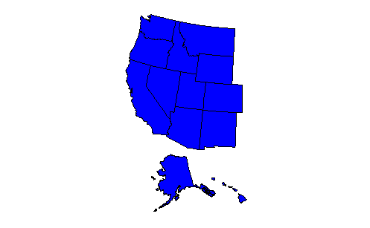
Western Region – Top 10 Beer Styles

Slide 16
Thank You for your Time!

Slide 17
Backup

Slide 18
Other Questions of Interest
What is the most popular beer style per geographic region?
Is there a relationship between style of beer an regional population?
Is there an opportunity for investing in high IBU beer supplier in the West?

Slide 19
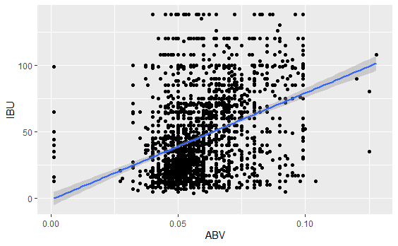
Linear Regression to test for Relationship
Results form Linear Regression Test
Reject the Null hypothesis that there is a relationship between Alcohol by Volume and International Bitterness Units with a P-value significantly less than an alpha of .05.

Slide 20
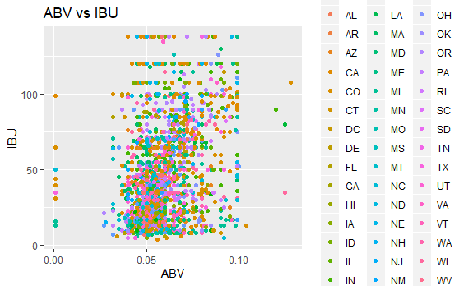
Question of Interest: A relationship exists between Alcohol by Volume and International Bitterness Units.
A scatter plot of Alcohol by Volume and International Bitterness Unit does not appear to have a relationship.
The scatter plots of ABV and IBU do not show much of a pattern.
A linear regression was used to test if there was a relationship between ABV and IBU.

Slide 21
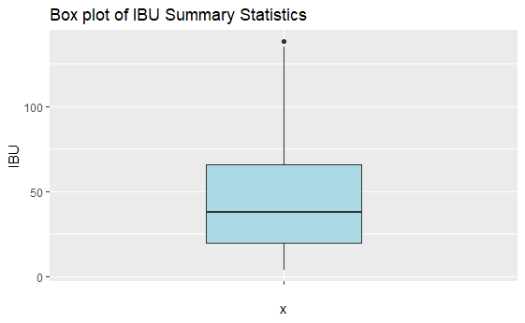
IBU Analysis
Summary Statistics
Min | 4
1st Quartile | 20
Median | 38
Mean | 47
3rd Quartile | 66
Max | 138

Slide 22
Feedback
Box plot for summary data

