Slide 1

With whom does Brazil most resemble in its global relations?
Using imporst and exports numbers
Notes:
Good morning.
My name is Malcolm and I am a Student of bacherlors in Statistc and I am in my third year in Unicamp.
I bring this case today cause I think its a good aplication of statistic and clustering methods in the Society (identity the geopolitical position of our country)
In this case we will see With whom does Brazil most resemble in its global relations considering the numbers of imports and exports of goods and services per capita.

Slide 2
With whom does Brazil most resemble in its global relations?
The importance of international trade for brazil
The Diversity of Brazil's Trade Partners
Analysis Objective: Identifying Patterns in Commercial Relationships
Notes:
We will start this case talking about the The Importance of International Trade for Brazil .
Explore the relevance of international trade to the Brazilian economy, highlighting the importance of exports and imports for economic growth, job creation, and the country's development.
- Brazil, due to its natural resources advantage, is a big exporter of raw materials such as soybeans, oil, iron, and beef. According to the Ministry of Development, Brazil's trade balance was positive at the first trimestry of 2024.
The Diversity of Brazil's Trade Partners Present the diversity of Brazil's trade partners worldwide, emphasizing the geographical scope of the country's trade relations and the variety of sectors and products involved in trade.
- Among the countries with the most trade with Brazil are the United States, China, and Argentina, among others. This illustrates the diversity of trade partners, as these three countries have different political orientations, with Argentina being somewhat closer politically to China.
Analysis Objective: Identifying Patterns in Commercial Relationships Describe the main objective of your analysis, which is to identify patterns in Brazil's import and export numbers and compare them with other countries to understand with whom Brazil most resembles in terms of international trade relationships.
- With these considerations, the purpose of this study is to identify Brazil's position and its relationship with other countries using its foreign trade numbers.

Slide 3
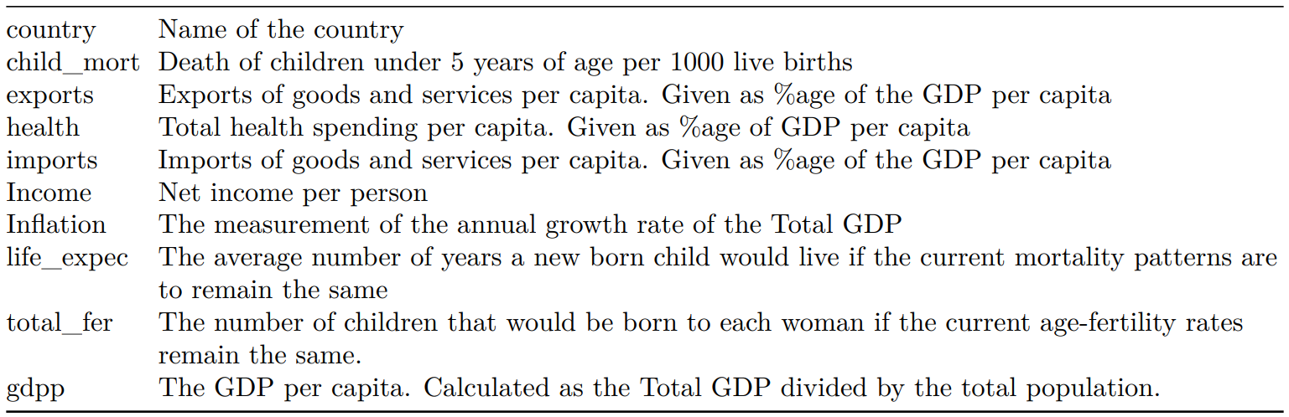
Dataset
Made available on Kaggle, sourced by HELP International
Notes:
Temos esses índices de 167 países do ano de 2020
Our dataset was extract by the Kaggle and its was sorced by HELP International, HELP International is an international humanitarian that is committed to fighting poverty and providing the people of backward countries with basic amenities and relief during the time of disasters and natural calamities.
In this database we have all of these variables (talk about them), but in this case we will use for clustering all the countries is just the imports and exports of goods and services per capita.

Slide 4
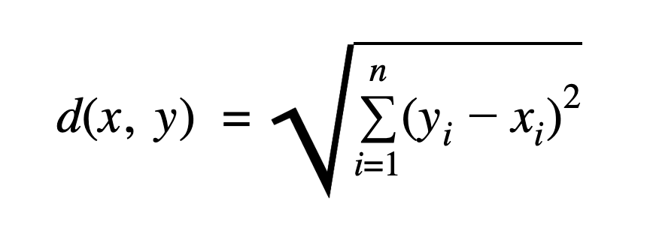
methods
Aggregation Index: Import and Export Numbers
Clustering performed using hierarchical clustering
Decision on number of clusters made using the Elbow method
Analysis
Notes:
Hierarchical clustering is a method that groups observations based on their distances from each other. Using the Euclidian distance represented by this formula, In other words, they create groups by joining observations that are closest to each other.
The elbow method verifies the stability of the variance of the groups at each number of considered groups. point of inflection
The elbow method determine the optimal number of clusters. It involves plotting the variance explained by the clusters against the number of clusters and identifying the point where the rate of decrease in variance slows down, resembling an elbow in the plot. This point indicates the optimal number of clusters for the dataset.

Slide 5
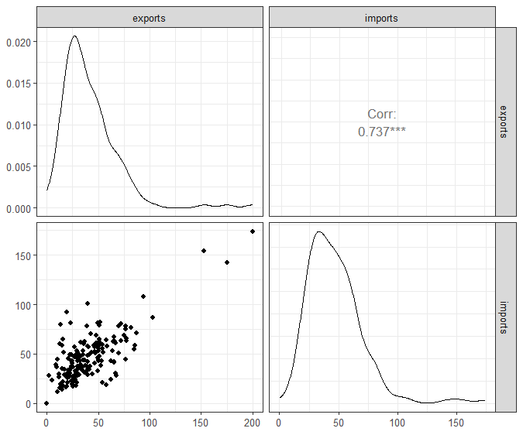
Imports and exports
Strongly correlated
Positive and linear association
Right asymmetric distribuition
Notes:
Here we have a pairs Graphic with the two interet variables: the number of imports and the number of exports of each country on our database.
We can see here that the two variables are linearly and strongly correlated (this we can see Looking at the points Graphic below), and the both distributions seems like a Right asymmetric distribution (in my perspective, not normal)

Slide 6
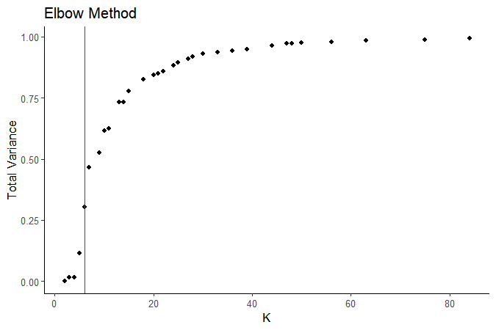
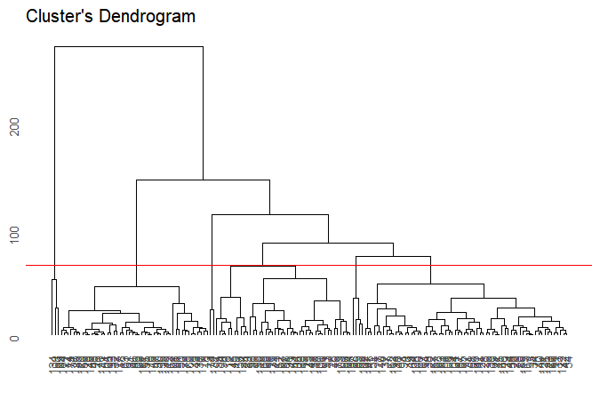
Hierarchical clustering
Defining the number of clusters
Clustering with complete linkage
Notes:
Like i said, for decide the number of clusters we will use the Elbow Method. Here in the red line I considered a good candidate for a point of inflexion, deciding the our number of clusters is six.
The red line in clusters dendrograma indicates the heigh witch K equals 6, its something like 64

Slide 7
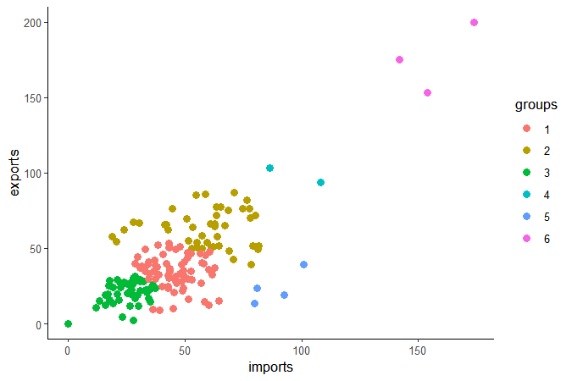
Clusters
Six clusters
Brazil included in Group 3 with Argentina, Australia, Canada, China, Colombia, France, all BRICS countries, and 39 other countries.
Notes:
Grupo 1: Afghanistan, Austria, Bolivia, Chila, Germany, Portugal
Grupo 2: Angola, Maldives, Paraguay, Vietnam
Grupo 4: Ireland and Seychelles (an island), Ireland is one of the world's largest exporters of pharmaceutical and software products according to the Brazilian government
Grupo 5: Liberia and Lesotho (southern Africa)
Grupo 6: Luxembourg and Singapore

Slide 8
Case discussion
Clusterization can be used to identify similar profiles, optimizing various processes, such as:
Identifying potential customers, better directing the marketing team
Identifying a better fit profile for a job vacancy, optimizing the hiring process
In our case, identifying a country similar to ours in order to establish commercial partnerships with them
Organizing something that is not properly separated
Notes:
So, like i said, considered important to show this case because its a method with a lot of importants applications: like suposing that you are a sales company like that, with the clusterization we can identify potentials customser, better directing the market team, saving time and Money in this contact this customers process, suposing you are hirign a person with a especifical phisical condition, you can identify a potencials candidates, saving time in this process to.
In our case, we list the countries that is closest to Brazil and with this information, we can identify potencials countries that we can establish a comercial partnership

Slide 9
references
Gov Agency
Industry Portal
Brazilian Governament
Codes

Slide 10

Thank you
Malcolm dos Reis A. Pereira

