Slide 1
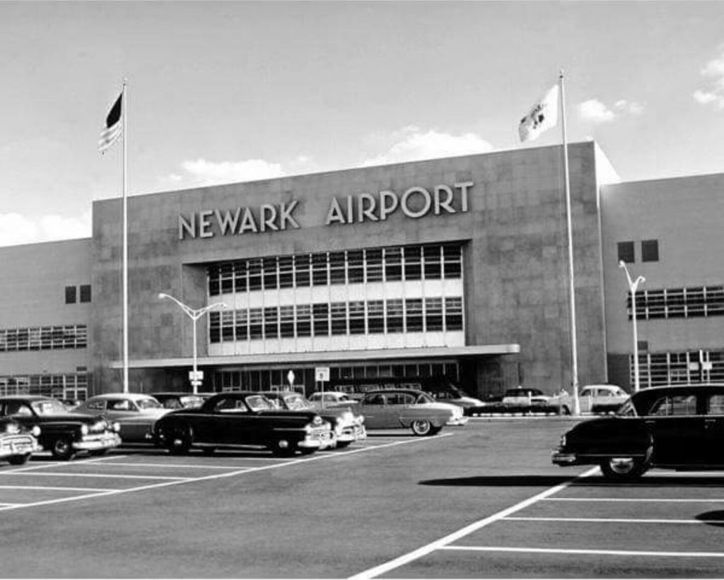
Flight delays at Newark Airport

Slide 2
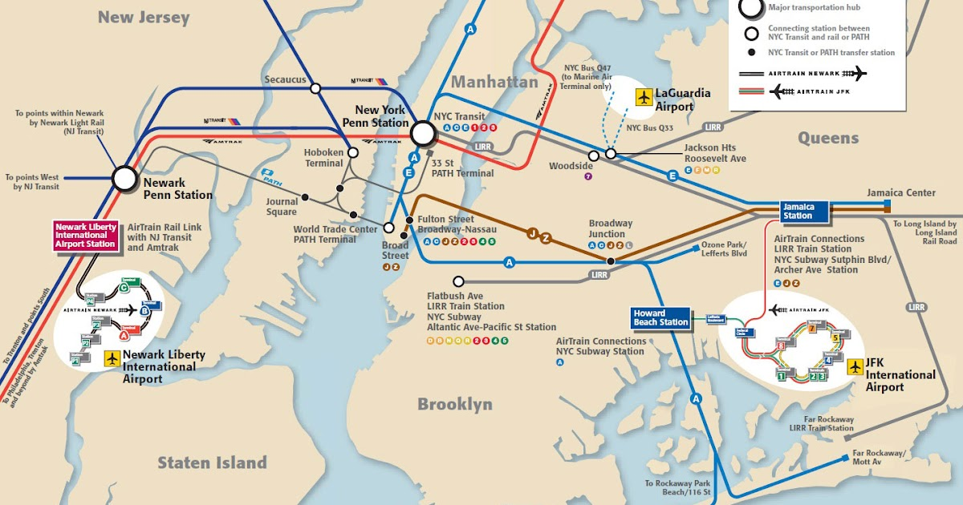
Newark Airport

Slide 3

Business concerns

Slide 4
Business questions
Q1 - Is weather to blame for delays?
Q2 – What type of weather is of most concern?
Q3 – What other factors impact departure delays at the airport?
Q4 – How do delays at Newark Airport compare to JFK and LGA?

Slide 5
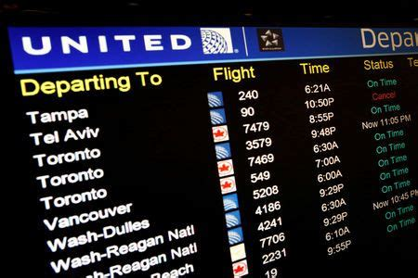
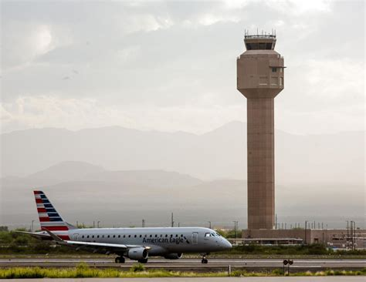

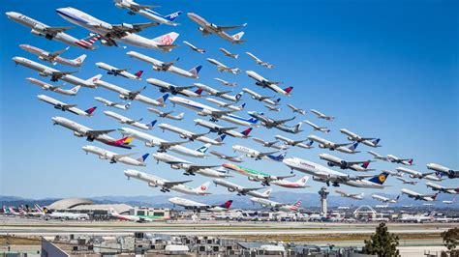
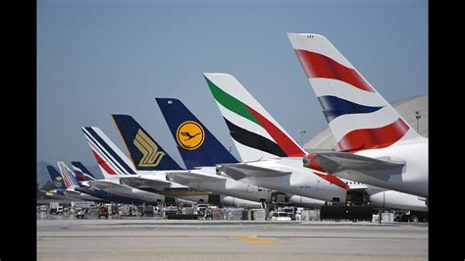
Data

Slide 6
Approach
Can the data predict delays?
We’re quite comfortable with predictions
It’s going to be 30C tomorrow
Scotland have a 60% chance of beating France in the 6 Nations rugby
Best to categorise the prediction as “DELAY” or “NO DELAY”
Logistic regression uses many inputs to predict a category of outcome rather than a value
It’s going to be hot tomorrow
Scotland will win in Paris
2 basic steps to this process
Use most of the data to train the regression model as to when a delay occurs due to weather
Use the remains of the data to test the regression model and its powers of prediction

Slide 7
Weather and delays
8,735 observations, 9 types of weather
5 of these had almost no records
I was left with:
Wind direction
Wind speed
Wind gust
Visibility
Could not find any (free) weather data for Newark Airport to supplement the data set provided
Delay > 0 mins = TRUE, otherwise FALSE
Combined Delay and Weather Data
Built model using training data
Then test it on unseen data.

Slide 8
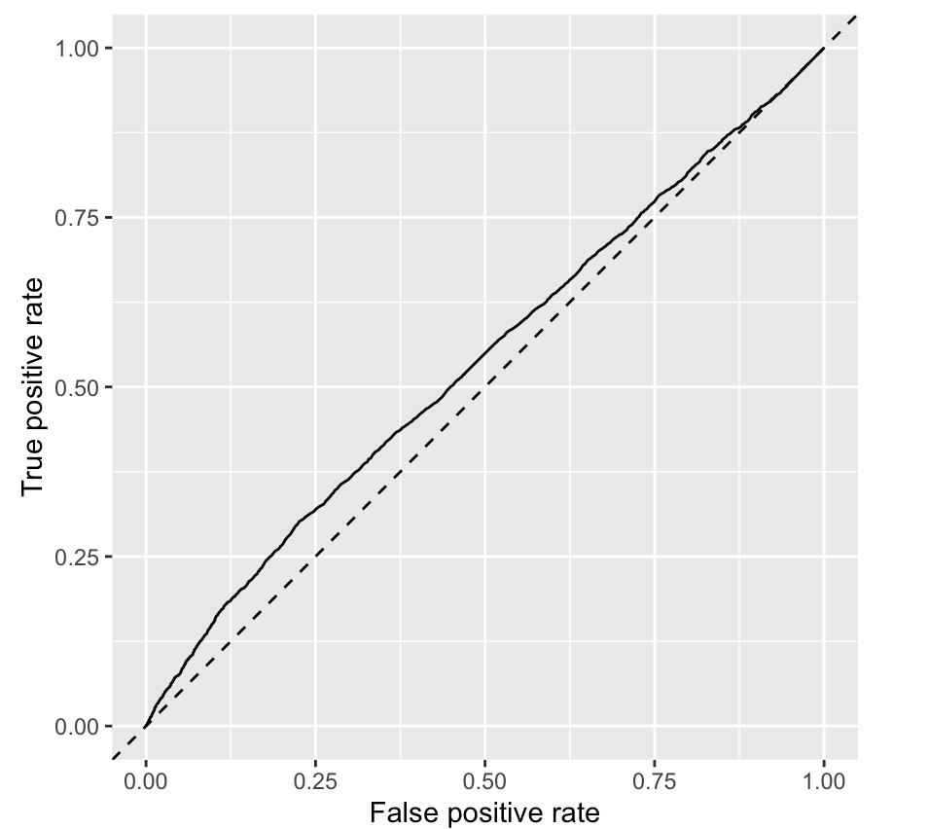
Weather results
The predictive results were poor
Weather not a major factor in departure delays
Weather model AUC = 0.54
Only visibility was significant

Slide 9
Other factors and delays
Looked at the data points within the flights and planes datasets to explain departure delays
flight metrics included: date & time of departure, the airline, the distance to travel
plane metrics included: age of plane, capacity, no of engines
Also enriched dataset by calculating busy-ness metrics:
how many planes were departing that hour or day

Slide 10
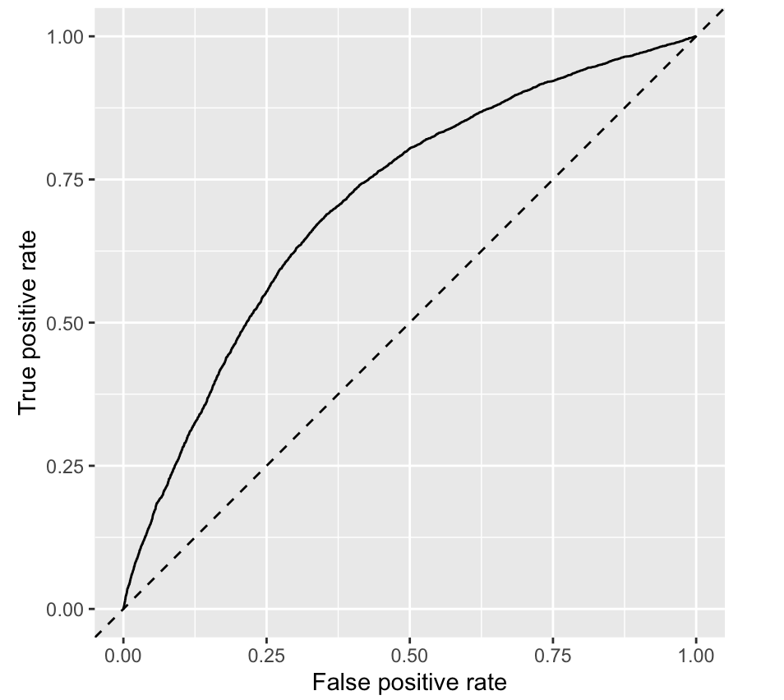
Other factors and delays
The predictive results were much improved – AUC of 0.7125
Significant variables were:
Hour
Day
Departures in day
Departures in hour
Seats on plane

Slide 11
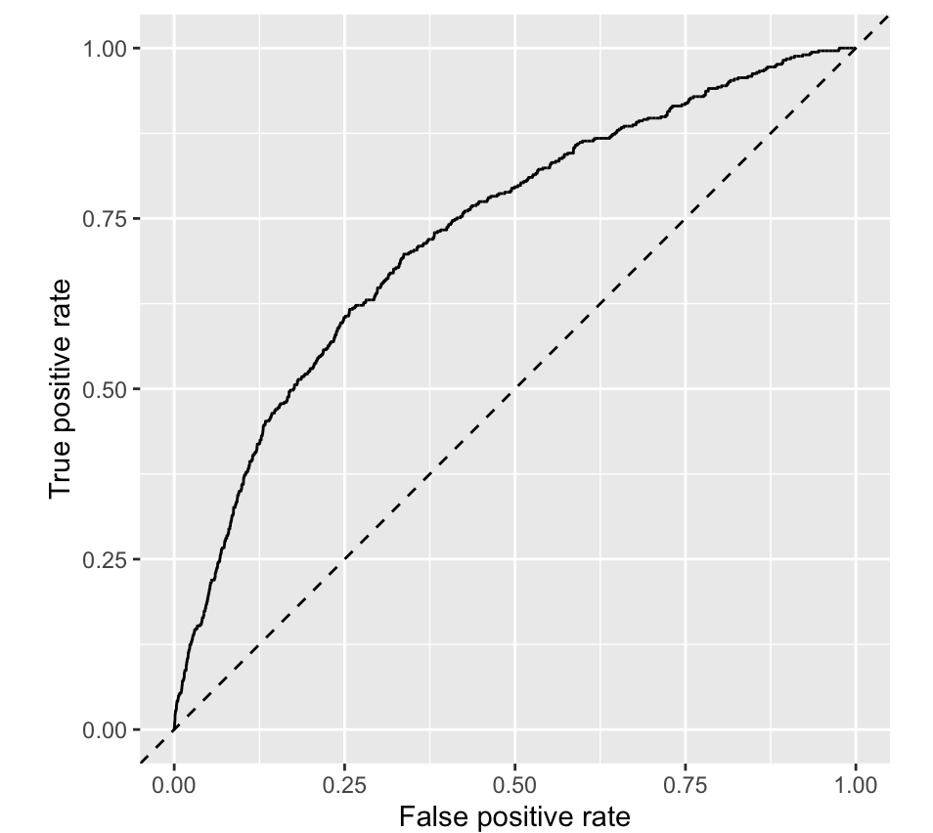
Cancelled flights
Within flights data, air_time variable had no value for over 3,000 flights
Indications of a cancelled flight.
Cancelled flights model – AUC of 0.7125

Slide 12
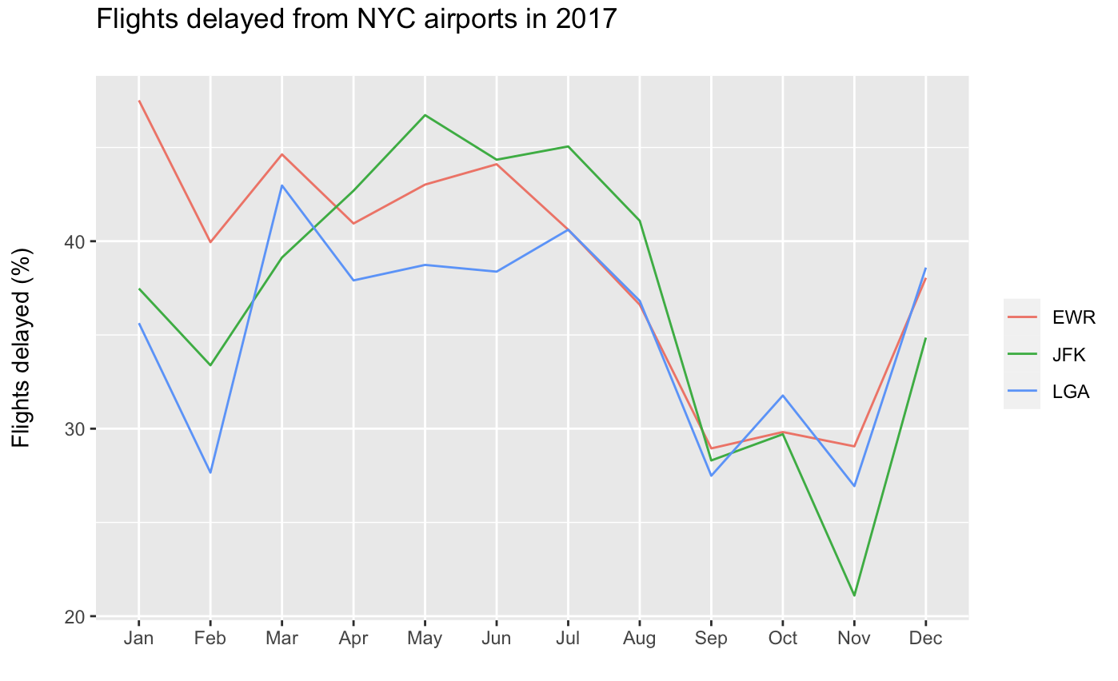
Flights delayed - NYC airports

Slide 13
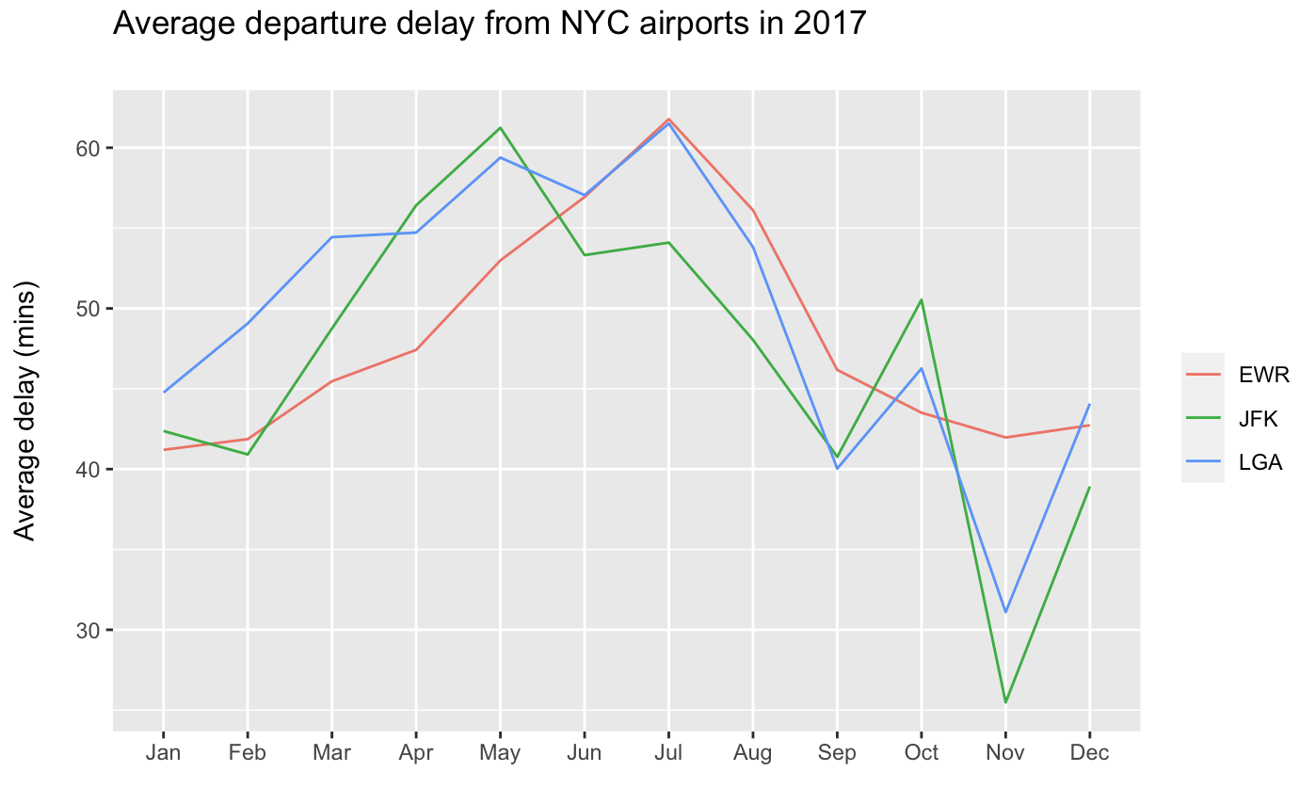
Average delay - NYC airports

Slide 14
Conclusions
Weather does not have a significant impact on flight delays
Other variables do have a significant impact on departure delays
Newark delay statistics trend in line with the other NYC airports

