Slide 1
Splash page

Slide 2
Newark Airport
Newark Liberty International Airport (airport code EWR)
10 miles south west of NYC
1 of 3 international airports serving NYC
JFK airport (JFK) and La Guardia (LGA)
2017 passenger numbers – JFK (55 million), EWR (43 million), LGA (30 million)

Slide 3
Business concerns
Management are concerned about delays to flights departing their airport
Delays have a business implications
Delays may result in passengers (and cargo planes) choosing to fly from other airports
Risk of reputational damage is high - passengers can broadcast their grievances through social media to the world
Endemic delays may see a permanent shift of business to other airports
Principally they fear that poor weather is causing too many delays
If weather is to blame they are willing to invest in facilities to limit the effects of bad weather

Slide 4
Business questions
Q1 - Is weather to blame for delays?
Q2 – What type of weather is of most concern?
Q3 – What other factors impact departure delays at the airport?
Q4 – How do delays at Newark Airport compare to JFK and LGA?

Slide 5
Data
Airport management have provided 5 sets of data for my analysis
All of the data relates to 2017
1 – flights: lots of data points to describe departing flights (from EWR, JFK and LGA) including delay time
2 – airports: data relating to many airports in the USA
3 – airlines: the names and short-codes for 12 US airlines
4 – planes: lots of data relating to the types of planes flying in to and out of US airports
5 – weather: lots of data for the 3 NYC airports recorded at the weather station at each airport

Slide 6
Approach
Can the data predict delays?
We’re quite comfortable with predictions
It’s going to be 30C tomorrow
Scotland have a 60% chance of beating France in the 6 Nations
Instead of predicting the length of delay
Best to categorise the prediction as “DELAY” or “NO DELAY”
Such an approach is suited to modelling technique of logistic regression
Logistic regression uses many inputs to predict a category of outcome rather than a value
It’s going to be hot tomorrow
Scotland will win in Paris
2 basic steps to this process
Use most of the data to train the regression model as to when a delay occurs due to weather
Use the remains of the data to test the regression model and its powers of prediction

Slide 7
Weather and delays
There were 8,735 weather observations
9 different types of weather
5 of these had almost no records
I was left with:
Wind direction
Wind speed
Wind gust
Visibility
Could not find any (free) weather data for Newark Airport
Departure Delay > 0 mins = TRUE, otherwise FALSE
Combined Delay Data and Weather Data – split in to training set and test set.
Build model using training data
Then test it on unseen data.

Slide 8
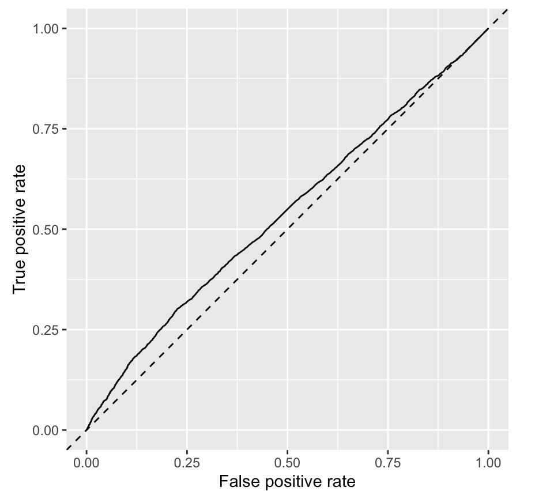
Weather results
The predictive results were poor – indicating that weather is not a major factor in departure delays.
The diagonal line represents a model with no predictive ability – the AUC for this line is 0.5
The solid line is the weather_delay model – the AUC is just 0.54
The only weather variable that was significant in the model was visibility

Slide 9
Other factors and delays
Looked at the data points within the flights and planes datasets to explain departure delays
flight metrics included: date & time of departure, the airline, the distance to travel
plane metrics included: age of plane, capacity, no of engines
Also enriched dataset by calculating busy-ness metrics:
how many planes were departing that hour or day
Trained the model on the majority of the data
Tested the model on the remainder

Slide 10
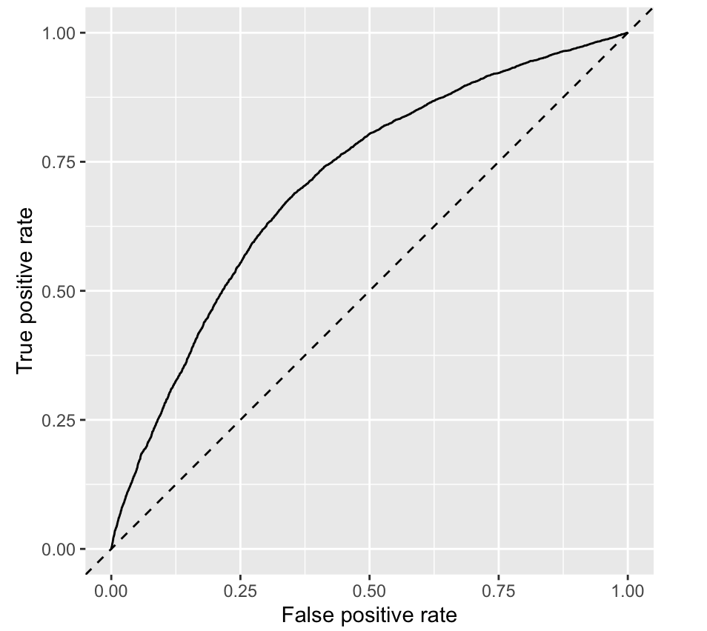
Other factors and delays
Predictive results were much better – AUC of 0.7125
Significant variables were:
Hour Day Departures in day Departures in hour No of seats in plane

Slide 11
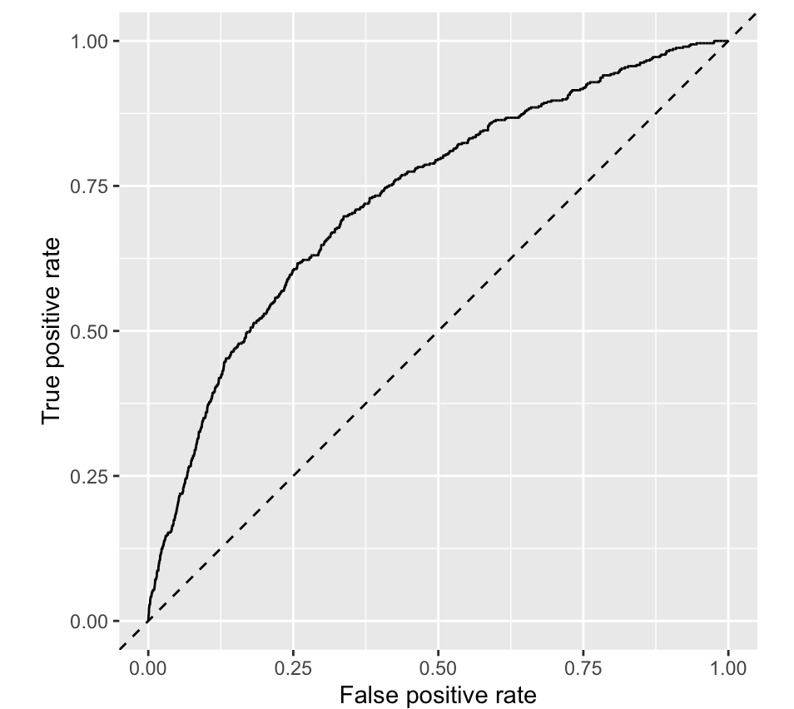
Cancelled flights
Within the flights data, the air_time variable has no value for over 3000 flights
These are indications of cancelled flights
Built a 3rd model to predict cancelled flights using flights, plane and weather variables
The AUC of “cancelled flights” model (0.7177) similar to “other factors” model
But has poorer diagnostic results – more details in the report

Slide 12
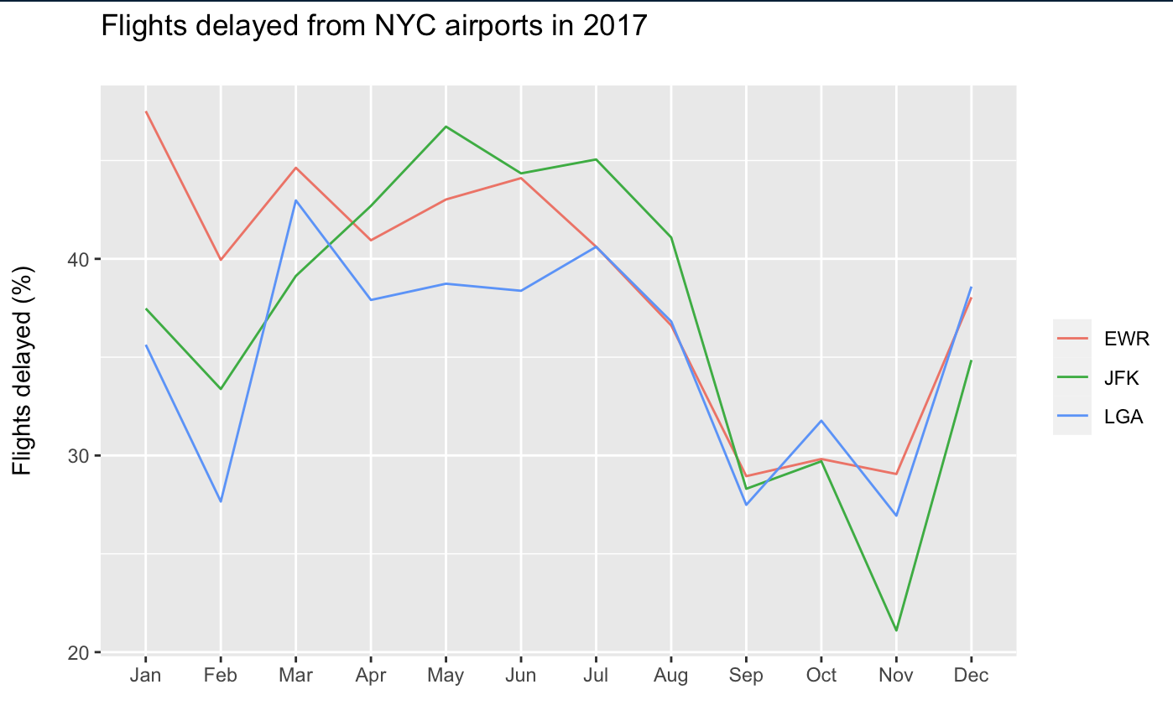
Flights delayed - NYC airports
same trend for delays is mirrored across all three airports delays highest in the summer months peak again in Dec and Jan in other words, the delays are highest during the main holiday periods.
whilst JFK has higher passenger numbers, Newark still has more delays in % terms

Slide 13
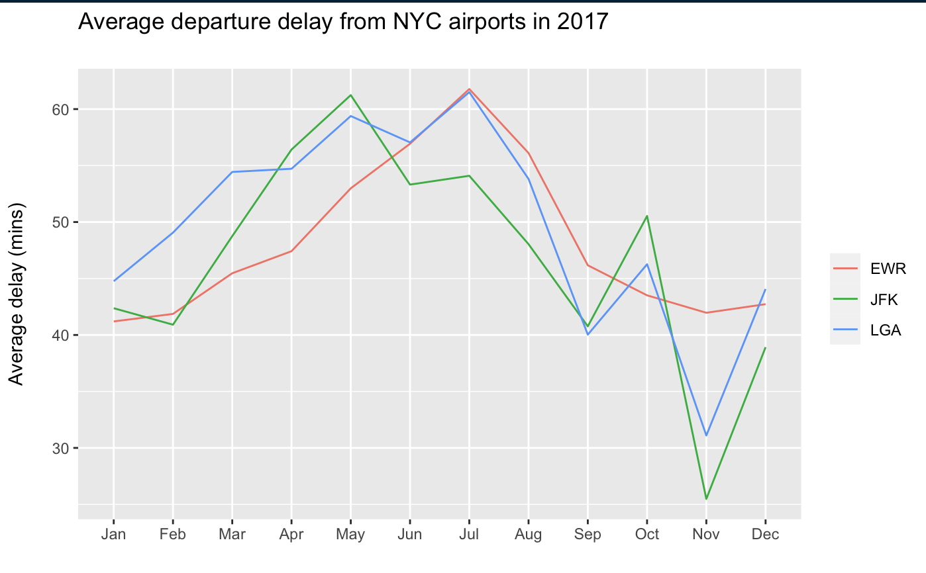
Average delay - NYC airports
again, average departure delays were highest in the summer months fall during the Autumn period rise again during the Christmas break.
average delays rose in the first half of 2017 at Newark Airport as they did at the other NYC airports
in the latter half of 2017, Newark unfortunately saw their average departure delay exceed that of JFK and La Guardia even though the percentage of flights they saw delayed trended in line with the other NYC airports (see first graph).

Slide 14
Conclusions
Weather does not have a significant impact on flight delays
Other variables do have a significant impact on departure delays
Newark delay statistics do not compare favourably with JFK
Larger sample size and greater access to data for further models to be developed.

