Slide 1
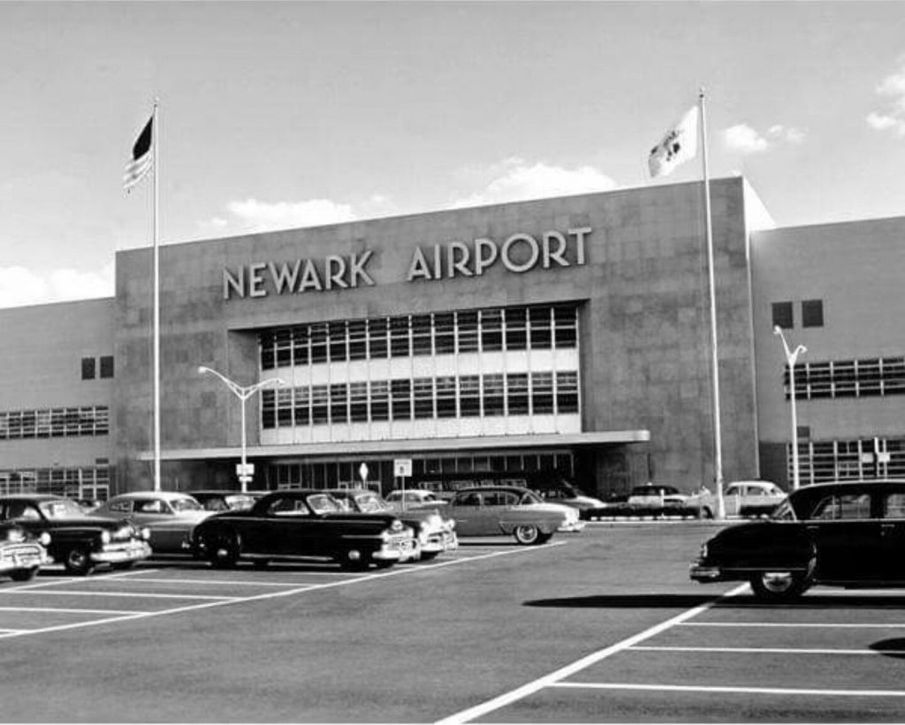
Flight delays at Newark Airport

Slide 2
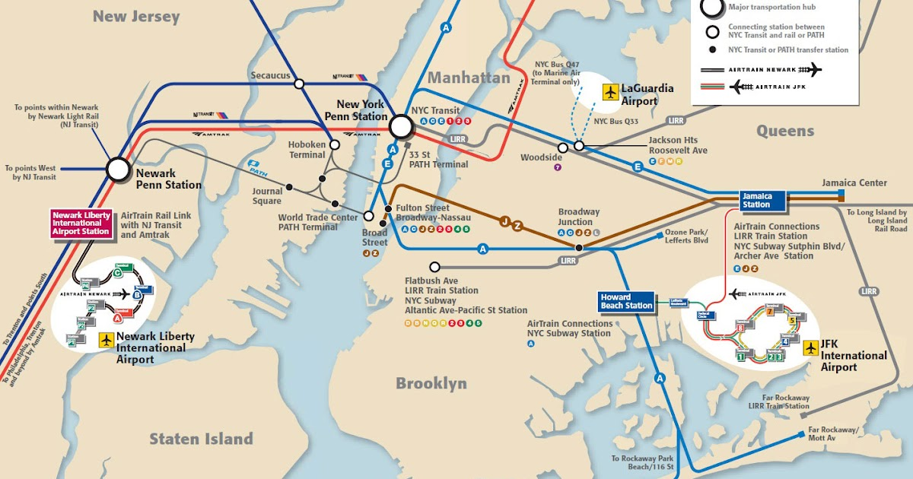
Newark Airport

Slide 3

Business concerns

Slide 4
Business questions
Q1 - Is weather to blame for delays?
Q2 – What type of weather is of most concern?
Q3 – What other factors impact departure delays at the airport?
Q4 – How do delays at Newark Airport compare to JFK and LGA?

Slide 5

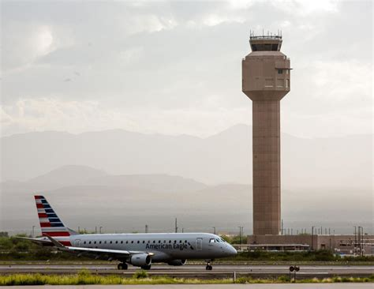

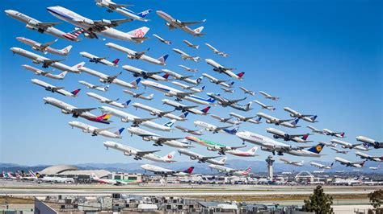
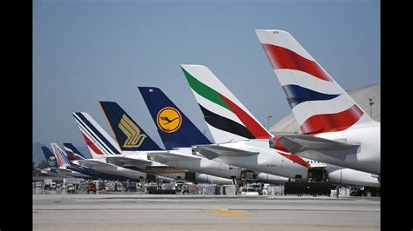
Data

Slide 6
Approach
Can the data predict delays?
We’re quite comfortable with predictions
It’s going to be 30C tomorrow
Scotland have a 60% chance of beating France in the 6 Nations rugby
Best to categorise the prediction as “DELAY” or “NO DELAY”
Logistic regression uses many inputs to predict a category of outcome rather than a value
It’s going to be hot tomorrow
Scotland will win in Paris
2 basic steps to this process
Use most of the data to train the regression model as to when a delay occurs due to weather
Use the remains of the data to test the regression model and its powers of prediction

Slide 7
Weather and delays
8,735 observations, 9 types of weather
5 of these had almost no records
I was left with:
Wind direction
Wind speed
Wind gust
Visibility
Could not find any (free) weather data for Newark Airport to supplement the data set provided
Delay > 0 mins = TRUE, otherwise FALSE
Combined Delay and Weather Data
Built model using training data
Then test it on unseen data.

Slide 8
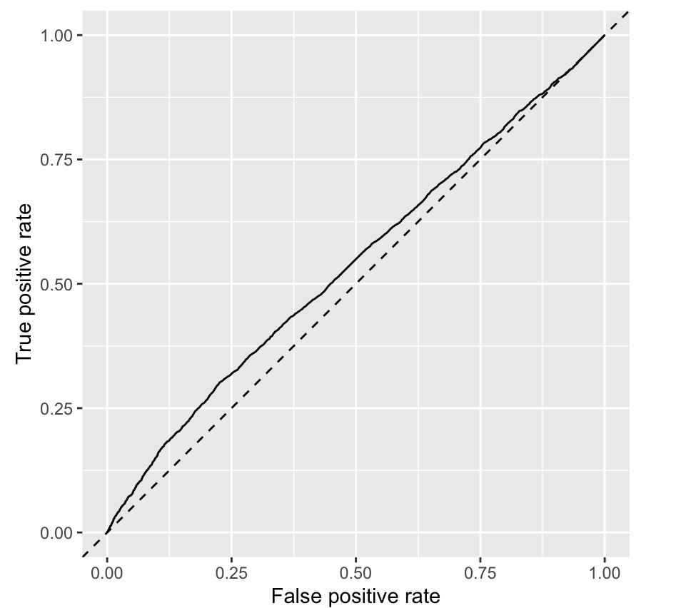
Weather results
The predictive results were poor
Weather not a major factor in departure delays
Weather model AUC = 0.54
Only visibility was significant

Slide 9
Other factors and delays
Looked at the data points within the flights and planes datasets to explain departure delays
flight metrics included: date & time of departure, the airline, the distance to travel
plane metrics included: age of plane, capacity, no of engines
Also enriched dataset by calculating busy-ness metrics:
how many planes were departing that hour or day
Trained the model on the majority of the data
Tested the model on the remainder

Slide 10
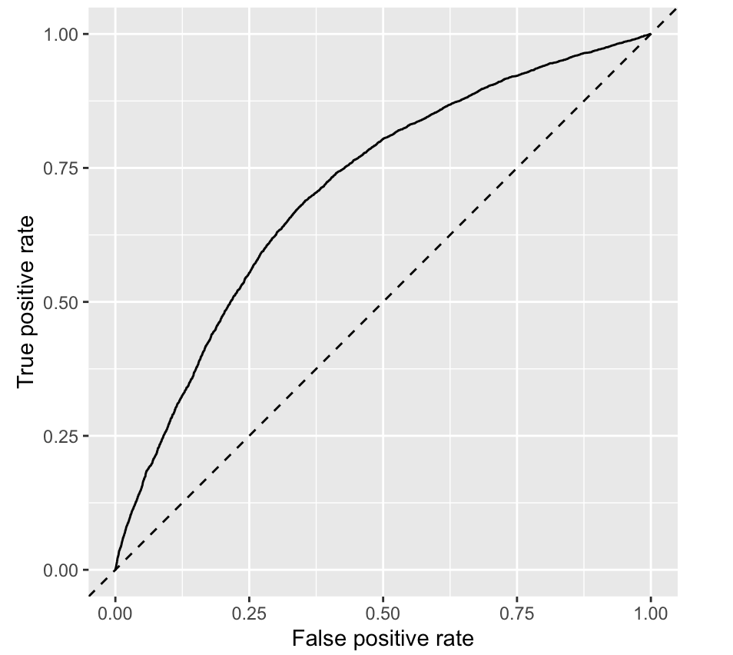
Other factors and delays
The predictive results were much improved – AUC of 0.7125
Significant variables were:
Hour
Day
Departures in day
Departures in hour
Seats on plane

Slide 11
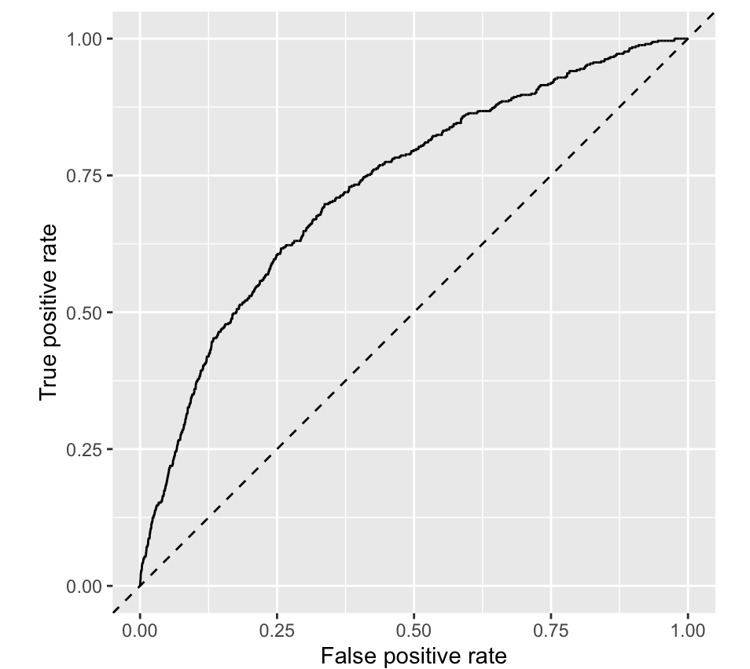
Cancelled flights
Within flights data, air_time variable had no value for over 3,000 flights
Indications of a cancelled flight.
Cancelled flights model – AUC of 0.7125

Slide 12
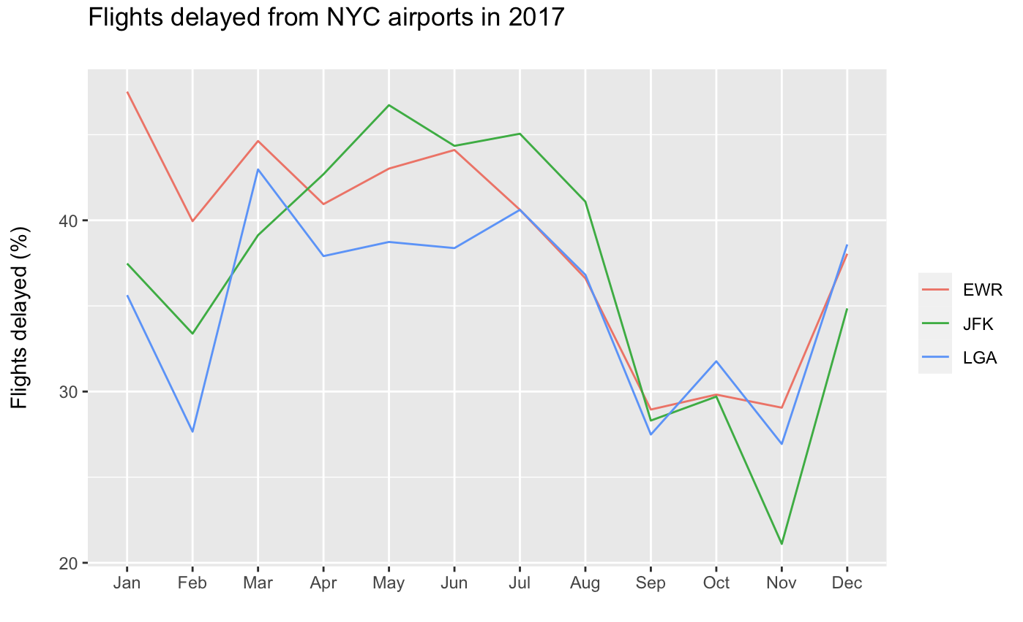
Flights delayed - NYC airports

Slide 13
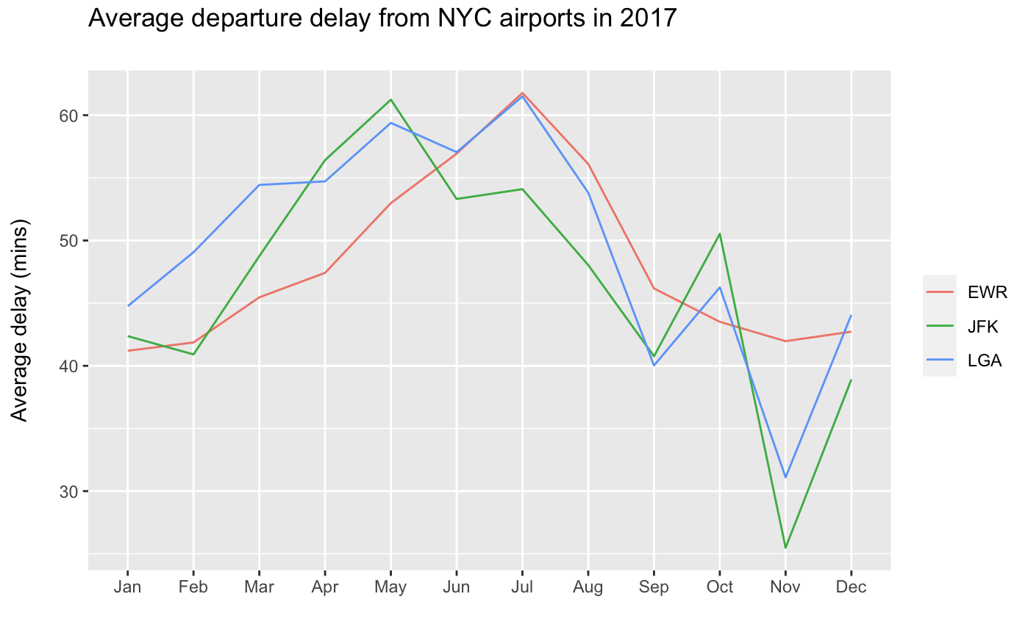
Average delay - NYC airports

Slide 14
Conclusions
Weather does not have a significant impact on flight delays
Other variables do have a significant impact on departure delays
Newark delay statistics trend in line with the other NYC airports
Larger sample size and greater access to data for further models to be developed.

