Slide 1
Maps of Imaginary Lands
Malcolm Tredinnick
@malcolmt

Slide 2
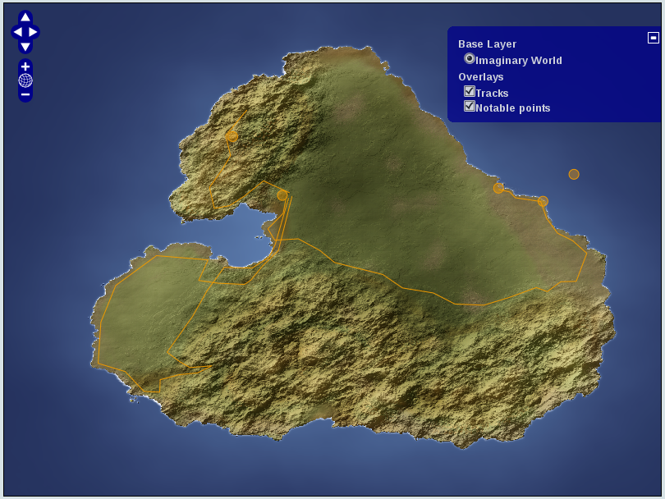
The goal

Slide 3
The problem
Some preparation required.
May be new
  This should not be a problem, but... :)

Slide 4
The solution
I have provided running code.
Github URL at end of slides.
[Cheat: search for malcolmt on github and follow your nose]

Slide 5
What is success?
Look at Django and GeoDjango module.
Do the GeoDjango tutorial
Run (and read) my code
Do something better!

Slide 6
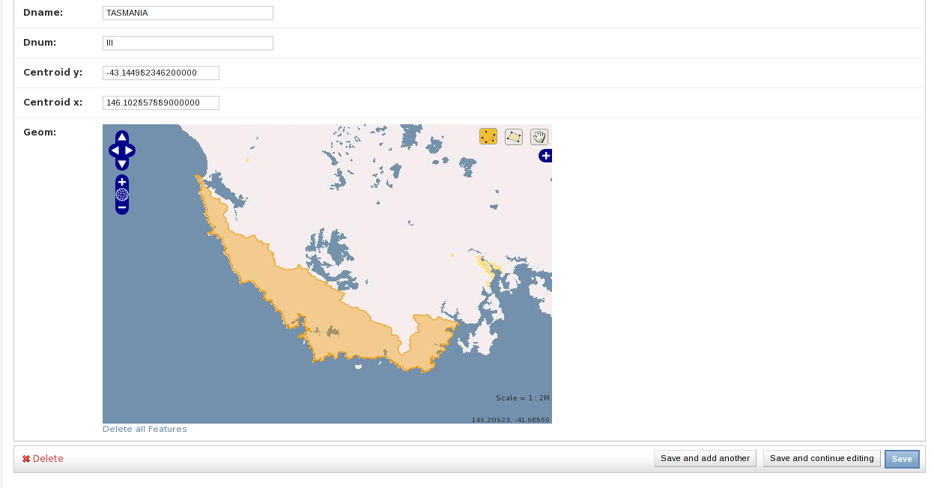
GeoDjango Admin
Nice experience out of the box

Slide 7
GeoDjango admin?!
How does it work?
What can I do next?
Is this all there is?

Slide 8
The secret tip
All maps are mashups.

Slide 9
Mashups
Combine multiple data sources
For example
  Google maps + Twitter locations

Slide 10
The Stack
OpenLayers.js
Tile cache
django.contrib.gis
Mapnik
postgis

Slide 11
OpenLayers
Client side, Javascript framework
Combines data from multiple data feeds
Provides neat looking UI around it
Day to learn, lifetime to customise

Slide 12
Mapnik
Server side way to combine data sources
Different details and different zoom levels
Input from raster or vector formats

Slide 13
Tilecache
... or mod_tile or tilestache or other
Avoid recomputing common data

Slide 14
GeoDjango
Use views to provide subset of data
Easy default output in formats understood by OpenLayers.

Slide 15
The Stack
OpenLayers.js
Tile cache
django.contrib.gis
Mapnik
postgis

Slide 16
Imaginary Maps
Need to replace base image
GeoAdmin very customisable; easy to do
Mapnik WMS server running locally

Slide 17
Code Samples

Slide 18
class Track(models.Model):
name = models.CharField(unique=True,
max_length=50)
path = models.LineStringField(
geography=True)
objects = models.GeoManager()
def __unicode__(self):
return self.name

Slide 19
class AdminBase(admin.GeoModelAdmin):
openlayers_url = "/..../OpenLayers.js"
wms_url = "http://localhost:8001"
wms_layer = "base"
wms_name = "Imaginary island"
default_lat = -0.0434097180624
default_lon = 150.057492178

Slide 20
import adventure
from django.contrib.gis import shortcuts
def tracks(request):
geom = _get_request_box(request)
result = adventure.models.Track.objects.filter(
path__intersects=geom).kml()
return shortcuts.render_to_kml(KML_TEMPLATE,
{"geomdata": result, "places": result})

Slide 21
github.com/malcolmt/imaginary-maps-in-django

