Slide 1
Maps of Imaginary Lands
Malcolm Tredinnick

Slide 2
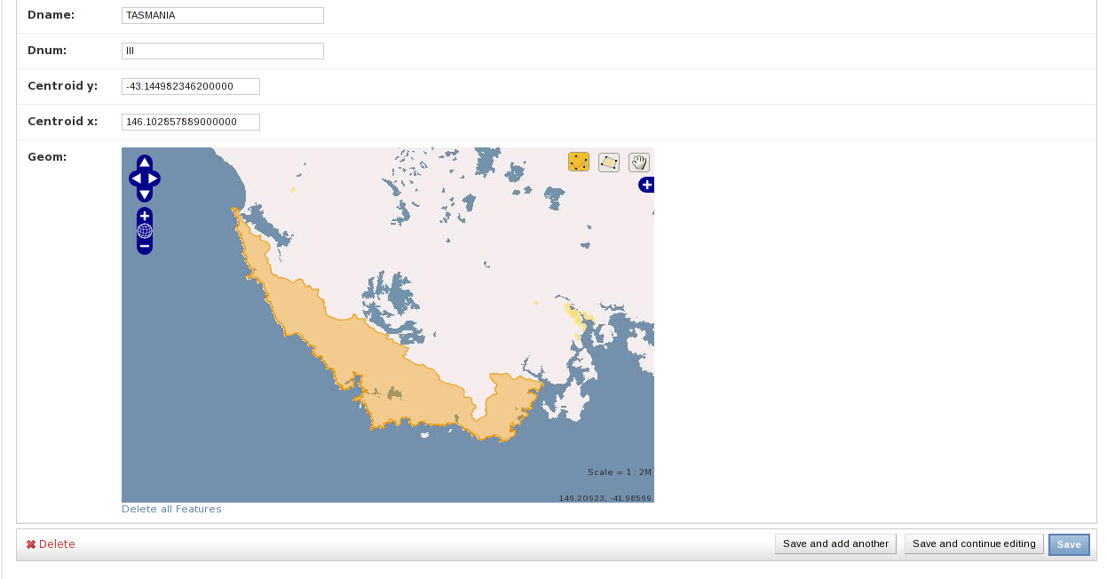
GeoDjango Admin
Nice experience out of the box

Slide 3
GeoDjango admin?!
How does it work?
What can I do next?
Is this all there is?

Slide 4
OpenLayers
Client side, Javascript framework
Combines data from multiple data feeds
Provides neat looking UI around it
Day to learn, lifetime to customise

Slide 5
Mapnik
Server side way to combine data sources
Different details and different zoom levels
Input from raster or vector formats

Slide 6
Tilecache
... or mod_tile or tilestache or other
Avoid recomputing common data

Slide 7
GeoDjango
Use views to provide subset of data
Easy default output in formats understood by OpenLayers.

Slide 8
The Stack
OpenLayers.js
Tile cache
django.contrib.gis
Mapnik
postgis

Slide 9
Imaginary Maps
Need to replace base image
GeoAdmin very customisable; easy to do
Mapnik WMS server running locally

