Slide 1
Maps of Imaginary Lands
Malcolm Tredinnick

Slide 2
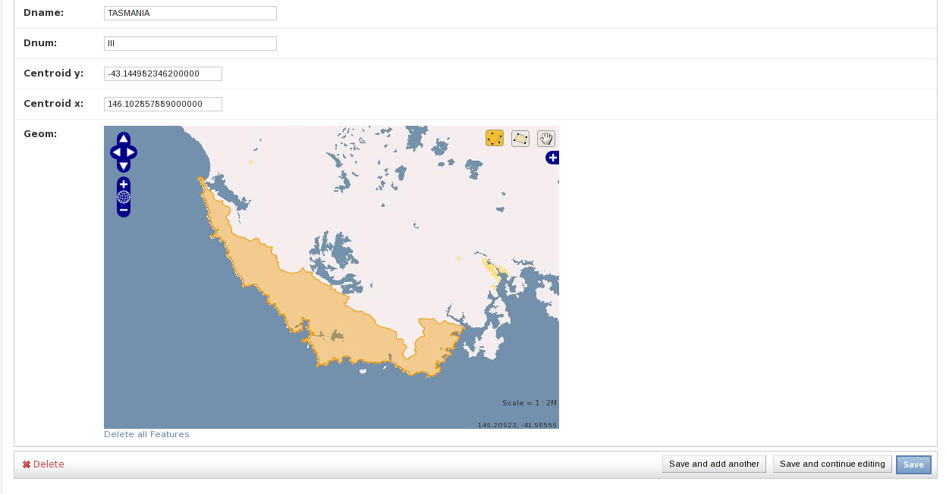
GeoDjango Admin
Nice experience out of the box

Slide 3
GeoDjango admin?!
How does it work?
What can I do next?
Is this all there is?

Slide 4
OpenLayers
Client side, Javascript framework
Combines data from multiple data feeds
Provides neat looking UI around it
Day to learn, lifetime to customise

Slide 5
Mapnik
Server side way to combine data sources
Different details and different zoom levels
Input from raster or vector formats

Slide 6
Tilecache
... or mod_tile or tilestache or other
Avoid recomputing common data

Slide 7
GeoDjango
Use views to provide subset of data
Easy default output in formats understood by OpenLayers.

Slide 8
The Stack
OpenLayers.js
Tile cache
django.contrib.gis
Mapnik
postgis

Slide 9
Imaginary Maps
Need to replace base image
GeoAdmin very customisable; easy to do
Mapnik WMS server running locally

Slide 10
Code Samples

Slide 11
class Track(models.Model):
name = models.CharField(unique=True,
max_length=50)
path = models.LineStringField(
geography=True)
objects = models.GeoManager()
def __unicode__(self):
return self.name

Slide 12
class AdminBase(admin.GeoModelAdmin):
openlayers_url = \
"/static_data/openlayers/OpenLayers.js"
wms_url = "http://localhost:8001"
wms_layer = "base"
wms_name = "Imaginary island"
default_lat = -0.0434097180624
default_lon = 150.057492178

Slide 13
def _get_request_box(request):
bbox = request.GET.get("BBOX",
request.GET.get("bbox"))
minx, miny, maxx, maxy = [float(elt) for
elt in bbox.split(",")]
return geos.Polygon.from_bbox((minx, miny,
maxx, maxy))

