Slide 1
Australian datasets and Django
Malcolm Tredinnick
June, 2010

Slide 2
Importing data is a puzzle to solve

Slide 3
Motivation...

Slide 4
“The dataset creator hates you!”

Slide 5
General Principles
Allow restarting
Assert for all assumptions
Use brain and eyes before computer
Use all available tools, not just Python
  grep
  cut
  head / tail
  ...

Slide 6
Case study #1

Slide 7
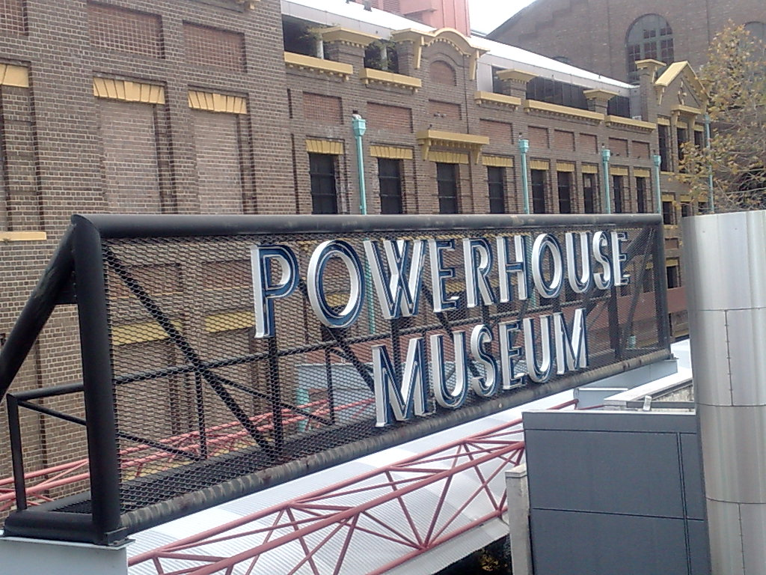
“Powerhouse Museum” by Beth Kanter, CC Attribution 2.0 licensed.

Slide 8
Collection Data
75,814 items in a text file
Creative Commons license
Appears “mostly sane”

Slide 9
Worked examples...

Slide 10
Case study #2

Slide 11
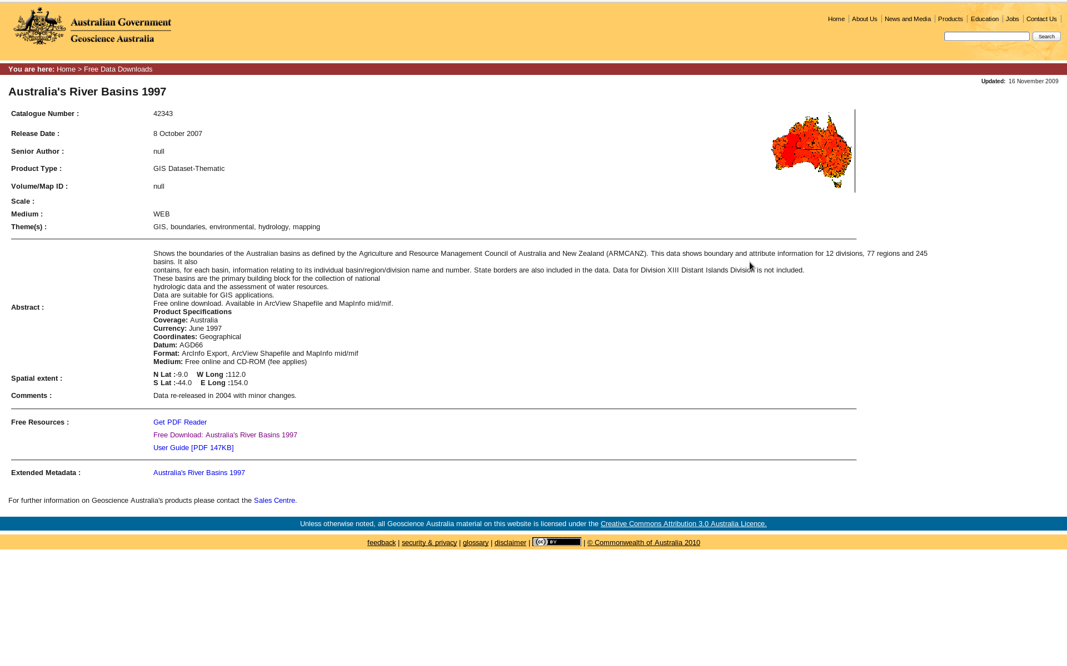
Australian River Basins

Slide 12
GIS Dataset
Creative Commons Attribution license
Polygons, lines, points (labels)
Well documented
Not entirely trivial on the surface

Slide 13
GeoDjango overview

Slide 14
Worked examples...

Slide 15
http://github.com/malcolmt/pycon-au-2010

