Slide 1
Graph-based Mining of In-the-Wild, Fine-grained, Semantic Code Change Patterns

Slide 2
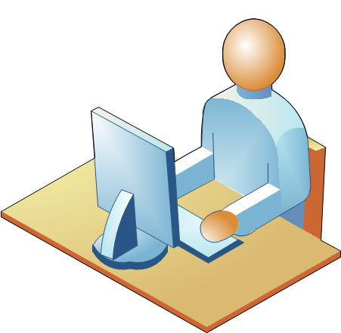
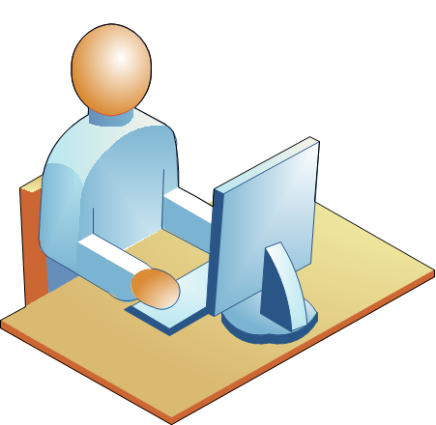
Repetitiveness of Software
Source code is repetitive
Repetitive Code
Parsing Java source file
Parsing Java source file
JDT
java.util
JDT
java.util
Tree traversal
Tree traversal
Smith
Nguyen

Slide 3
Repetitiveness of Changes
Source code is repetitive
Code changes are repetitive
Repetitive Change
Parsing Java source file
Parsing Java source file
JDT
java.util
JDT
java.util
Tree traversal
Tree traversal
Smith
Nguyen

Slide 4
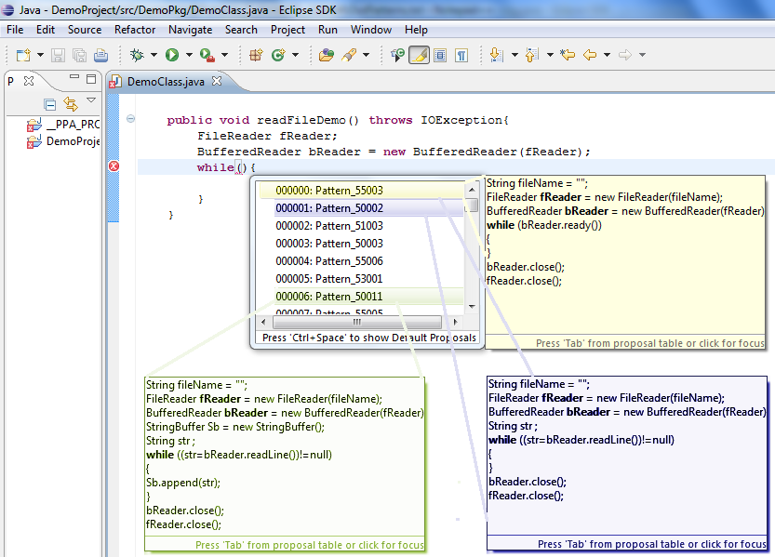
Repetitiveness of Changes
Source code is repetitive
Code changes are repetitive
Applications of change pattern:
Change/fix recommendation
Code auto-completion

Slide 5


Repetitiveness of Changes
Source code is repetitive
Code changes are repetitive
Applications of change pattern:
Change/fix recommendation
Code auto-completion
Programming patterns and code examples
Scanner.<init>
Scanner.hasNext
while
Scanner.next
Scanner.close

Slide 6
Repetitiveness of Changes
Source code is repetitive
Code changes are repetitive
Applications of change pattern:
Change/fix recommendation
Code auto-completion
Programming patterns and code examples
Language migration
Refactoring support
...
-------
-------
--------
...
extract
method
...
-------
-------
--------
...
-------
-------
--------
...
-------
-------
--------
...

Slide 7
Example of Repeated Code Changes
Adapting a new language feature JDK1.4 → JDK1.5
Before
After
1– for (Iterator<Element> it = o.getElements().iterator(); it.hasNext();)
2– myElms.add (it.next());____________________________
1+ for (Element elm : o.getElements())________________
2+ myElms.add(elm);_______________________
Code refactoring
Before
After
1– List <HighlightInfo> list = new ArrayList <>();________________
2– for ( HighlightInfo info : highlights1 )_______________________
3– list.add (info);__________________________________
1+ List <HighlightInfo> result = new ArrayList <>();______
2+ result.addAll (highlights1);_______________________

Slide 8
Challenges of Semantic Change Pattern Detection
Syntactically un-changed program elements could carry the semantic context of change
Before
After
1
2
3 File f = new File ("Output.txt"); _______________________
4 FileOutputStream s = new FileOutputStream (f); _________
5 i = str.indexOf ("pattern",start); ______________________
1+ if (start <= 0) ____________________________________
2+ return; __________________________________
3 File of = new File ("Output.txt");______________________
4 FileOutputStream outStream = new FileOutputStream (of);
5 i = str.indexOf ("pattern",start);____

Slide 9
Challenges of Semantic Change Pattern Detection
Syntactically un-changed program elements could carry the semantic context of change
Elements of a semantic change could be non-contiguous in source code
Before
After
1
2
3 File f = new File ("Output.txt"); _______________________
4 FileOutputStream s = new FileOutputStream (f); _________
5 i = str.indexOf ("pattern",start); ______________________
1+ if (start <= 0) ____________________________________
2+ return; __________________________________
3 File of = new File ("Output.txt");______________________
4 FileOutputStream outStream = new FileOutputStream (of);
5 i = str.indexOf ("pattern",start);____

Slide 10
Challenges of Semantic Change Pattern Detection
Syntactically un-changed program elements could carry the semantic context of change
Elements of a semantic change could be non-contiguous in source code
Before
After
1
2
3 File f = new File ("Output.txt"); _______________________
4 FileOutputStream s = new FileOutputStream (f); _________
5 i = str.indexOf ("pattern",start); ______________________
1+ if (start <= 0) ____________________________________
2+ return; __________________________________
3 File of = new File ("Output.txt");______________________
4 FileOutputStream outStream =new FileOutputStream (of);
5 i = str.indexOf ("pattern",start);____

Slide 11
Challenges of Semantic Change Pattern Detection
Different semantic changes could have the same syntactic change representation
Before
After
1
2
3 File f = new File ("Output.txt"); _______________________
4 FileOutputStream s = new FileOutputStream (f); _________
5 i = str.indexOf ("pattern",start); ______________________
1+ if (start <= 0) _______________________________
2+ return; ______________________________
3 File of = new File ("Output.txt");______________________
4 FileOutputStream outStream = new FileOutputStream (of);
5 i = str.indexOf ("pattern",start);____
1 i = str.indexOf ("pattern", start);
2
3 3
4 sub = str .substring( i ) ; ______________________
1 i = str.indexOf ("pattern", start);
2+ if (start <= 0) _______________________________
3+ return; ______________________________
4 sub = str .substring( i ) ;

Slide 12
Challenges of Semantic Change Pattern Detection
Different semantic changes could have the same syntactic change representation
Before
After
1
2
3 File f = new File ("Output.txt"); _______________________
4 FileOutputStream s = new FileOutputStream (f); _________
5 i = str.indexOf ("pattern",start); ______________________
1+ if (start <= 0) _______________________________
2+ return; ____________________________________
3 File of = new File ("Output.txt");______________________
4 FileOutputStream outStream = new FileOutputStream (of);
5 i = str.indexOf ("pattern",start);____
1
2
3 3i = str.indexOf ("pattern", start); ______________________
1+ if (mode <= 0) _______________________________
2+ return; ____________________________________
3 i = str.indexOf ("pattern", start);
Notes:
Un-related semantic changes could not be sufficiently distinguished by syntactic representation

Slide 13
Challenges of Semantic Change Pattern Detection
Syntactically un-changed program elements could carry the semantic context of change
Elements of a semantic change could be non-contiguous in source code
Different semantic changes could have the same syntactic change representation

Slide 14
Challenges of Semantic Change Pattern Detection
Syntactically un-changed program elements could carry the semantic context of change
Elements of a semantic change could be non-contiguous in source code
Different semantic changes could have the same syntactic change representation
Before
After
1
2
3 File f = new File ("Output.txt"); _______________________
4 FileOutputStream s = new FileOutputStream (f); _________
5 i = str.indexOf ("pattern",start); ______________________
1+ if(start <= 0) _______________________________
2+ return; ____________________________________
3 File f = new File ("Output.txt");__________________
4 FileOutputStream s = new FileOutputStream (f);____
5 i = str.indexOf ("pattern",start);____

Slide 15
Challenges of Semantic Change Pattern Detection
Syntactically un-changed program elements could carry the semantic context of change
Elements of a semantic change could be non-contiguous in source code
Different semantic changes could have the same syntactic change representation

Slide 16
Challenges of Semantic Change Pattern Detection
Syntactically un-changed program elements could carry the semantic context of change
Elements of a semantic change could be non-contiguous in source code
Different semantic changes could have the same syntactic change representation

Slide 17
Challenges of Semantic Change Pattern Detection
Syntactically un-changed program elements could carry the semantic context of change
Elements of a semantic change could be non-contiguous in source code
Different semantic changes could have the same syntactic change representation

Slide 18
Challenges of Semantic Change Pattern Detection
Syntactically un-changed program elements could carry the semantic context of change
Elements of a semantic change could be non-contiguous in source code
Different semantic changes could have the same syntactic change representation

Slide 19
Syntactically un-changed program elements could carry the semantic context of change

Slide 20
Elements of a semantic change could be non-contiguous in source code

Slide 21
Different semantic changes could have the same syntactic change representation
Un-related semantic changes could not be sufficiently distinguished by syntactic representation

Slide 22
CPatMiner
Use program dependence graph to capture data/control dependencies between atomic changes
Use frequent sub-graph mining to infer semantic change patterns

Slide 23
Fine-grained Code Representation

Slide 24
Fine-grained Change Representation

Slide 25
Change Pattern Mining Algorithm

Slide 26
StaMiner Approach Overview
Corresponding methods in client code
Java
C#
API Sequence Pairs
API Usage Mappings
Usage Sequencing
Statistical Alignment
Using large-scale data
Based on frequencies
Iteratively computing mappings using EM
Notes:
- In our approach, we first build sequence pairs of API elements from Java and C# corresponding client code.
We then use statistical alignment to derive API Usage mappings from sequence pairs.
The statistical alignment mined mappings from a large corpus of corresponding sequence pair by iteratively computing mappings with EM algorithm.
By that way, it does not need heuristics based on name similarity
Mapping corresponding client code in two languages
Aligning (sub)sequences of API elements using statistical alignment
Optimum alignments with consideration of order and length
Extracting sequences of API elements from a graph-based representation

Slide 27
Usage Sequencing
Scanner bookSc = new Scanner(new File(”books.txt”));
BookMetaData metaData = getMetaData(”..”);
while (bookSc.hasNextLine()) {
String bookInfo = bookSc.nextLine();
…
}
bookSc.close();
Directly extracting
Graph-based representation
Scanner.new getMetaData
WHILE
Scanner.hasNextLine Scanner.nextLine
…
Scanner.Close
Scanner.new
getMetaData
Scanner.hasNextLine
WHILE
Scanner.nextLine
…
Scanner.close
Notes:
For example, with the code to read information of books and use book metadata to parse the information fields.
The directly extracting method can give a sequence which includes of a project specific getMetaData call.
Otherwise, the graph-based representation, with dependency annotation, can help extracting sequence without that getMetaData call.

Slide 28
API Usage Representation [Nguyen et al. ESEC/FSE 2009]
Java code
HashMap.new
Action node
HashMap<String, Integer> myVocabIdxDict = new
HashMap<String, Integer>();
myVocabIdxDict.put(”alphabet”, 1);
FileWriter writer = new FileWriter(”VocabIdx.txt”) ;
for ( String vocab: myVocabIdxDict.keySet()){
writer.append(vocab + ” ” +
myVocabIdxDict.get(vocab)+” \r\n”);
}
writer . close () ;
HashMap.put
FileWriter.new
HashMap.keySet
FOR
Control node
HashMap.get
FileWriter.append
FileWriter.close
Data and
control flow
dependencies
Notes:
We apply our previous work to build the graph-based representation of API Usage.
The node in the graph represents API elements or control. For example, the initialization of HashMap is represented by node HashMap.new. Method call of HashMap put is represented by node HashMap.put.
The edge represents control or data dependencies between API elements in code.
The usage graph is a simplified version of PDG which focuses on API elements
Highlight constructing process of Groum
A Simplified version of PDG for API
Advantages:
Higher abstraction level
Discard noisy information like “;”
Show (direct) connection between elements having dependencies (Objective: learning API mapping using that API usage representation)

Slide 29
API Usage Representation [Nguyen et al. ESEC/FSE 2009]
Java code
HashMap<String, Integer> myVocabIdxDict = new
HashMap<String, Integer>();
myVocabIdxDict.put(”alphabet”, 1);
FileWriter writer = new FileWriter(”VocabIdx.txt”) ;
for ( String vocab: myVocabIdxDict.keySet()){
writer.append(vocab + ” ” +
myVocabIdxDict.get(vocab)+” \r\n”);
}
writer . close () ;
Notes:
We apply our previous work to build the graph-based representation of API Usage.

Slide 30



Empirical Evaluation
1
Meaningful Patterns
2
Comparison with syntax-based approach
3
Activities
4
Commonality of Patterns
5
Temporal Distribution

Slide 31
Data Collection

Slide 32
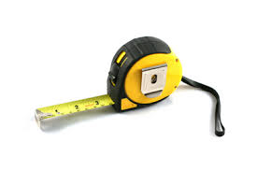
Experimental Settings and Metrics

Slide 33
Survey Results (RQ1)

Slide 34
Comparative Study (RQ2)

Slide 35
Examples

Slide 36
Diversity of Change Patterns (RQ3)

Slide 37
Commonality of Patterns (RQ4)

Slide 38
Temporal Distribution of Patterns (RQ5)

Slide 45
Subject Systems
Open-source projects developed
in Java and ported to C#
Pairs of corresponding client code methods
Project | Java |  |  | C# |  |  | Mapped Methods
 | Ver | File | Method | Ver | File | Method
Antlr | 3.5.0 | 226 | 3,303 | 3.5.0 | 223 | 2,718 | 1,380
db4o | 7.2 | 1,771 | 11,379 | 7.2 | 1,302 | 10,930 | 8,377
fpml | 1.7 | 138 | 1,347 | 1.7 | 140 | 1,342 | 506
Itext | 5.3.5 | 500 | 6,185 | 5.3.5 | 462 | 3,592 | 2,979
JGit | 2.3 | 1,008 | 9,411 | 2.3 | 1,078 | 9,494 | 6,010
JTS | 1.13 | 449 | 3,673 | 1.13 | 422 | 2,812 | 2,010
Lucene | 2.4.0 | 526 | 5,007 | 2.4.0 | 540 | 6,331 | 4,515
Neodatis | 1.9.6 | 950 | 6,516 | 1.9b-6 | 946 | 7,438 | 4,399
POI | 3.8.0 | 880 | 8,646 | 1.2.5 | 962 | 5,912 | 4,452
Total |  |  |  |  |  |  | 34,628
Notes:
To evaluate our tool, we learned API mappings from a collect of open-source projects which is written in both Java and C#. Finally, we found 9 projects.
To build the corpus of pairs of corresponding client code, we find corresponding mapped methods based on their signatures.
Overall, we can identify about thirty five thousand mapped methods.
The mapped methods are used for mining API usage mappings.

Slide 46
Mining API Usage Mappings
Project | Total | Distribution over Number of Java APIs (%) |  |  |  | Distribution over Number of Java Variables (%)
 |  | 1 | 2-3 | 4-7 | 8+ | 1 | 2 | 3 | 4+
Antlr | 1,202 | 52% | 36% | 10% | 2% | 90% | 6% | 2% | 2%
db4o | 19,562 | 10% | 44% | 30% | 16% | 48% | 30% | 18% | 4%
fpml | 913 | 64% | 28% | 4% | 4% | 88% | 12% | 0% | 0%
Itext | 9,918 | 72% | 24% | 4% | 0% | 90% | 6% | 2% | 2%
JGit | 32,621 | 64% | 26% | 8% | 2% | 82% | 12% | 2% | 4%
JTS | 1,139 | 48% | 34% | 18% | 0% | 80% | 12% | 8% | 0%
Lucene | 16,206 | 44% | 38% | 16% | 2% | 82% | 12% | 4% | 2%
Neodatis | 11,864 | 44% | 26% | 24% | 6% | 68% | 6% | 10% | 16%
POI | 7,400 | 62% | 28% | 10% | 0% | 88% | 10% | 0% | 2%
All | 100,825 | 51% | 31% | 14% | 4% | 81% | 11% | 5% | 3%
Many mappings involve multiple API
classes/methods (49%) and multiple variables (19%)
Notes:
We then inspect the API Usage mappings.
We found that:
- Half of mappings involve 1 API,
- One third of mappings involve 2-3 APIs,
Only a few percentage involve more than 3 APIs.
For variables,
About eighty percent of mappings involve 1 variable,
Ten percent involve 2 variables,
The remaining small percentage of mappings involve more than 2 variables.
All of those mappings will then be used for our evaluation goals.

Slide 47
Mining API Usage Mappings
Project | Total | Distribution over Number of Java APIs (%) |  |  |  | Distribution over Number of Java Variables (%)
 |  | 1 | 2-3 | 4-7 | 8+ | 1 | 2 | 3 | 4+
Antlr | 1,202 | 52% | 36% | 10% | 2% | 90% | 6% | 2% | 2%
db4o | 19,562 | 10% | 44% | 30% | 16% | 48% | 30% | 18% | 4%
fpml | 913 | 64% | 28% | 4% | 4% | 88% | 12% | 0% | 0%
Itext | 9,918 | 72% | 24% | 4% | 0% | 90% | 6% | 2% | 2%
JGit | 32,621 | 64% | 26% | 8% | 2% | 82% | 12% | 2% | 4%
JTS | 1,139 | 48% | 34% | 18% | 0% | 80% | 12% | 8% | 0%
Lucene | 16,206 | 44% | 38% | 16% | 2% | 82% | 12% | 4% | 2%
Neodatis | 11,864 | 44% | 26% | 24% | 6% | 68% | 6% | 10% | 16%
POI | 7,400 | 62% | 28% | 10% | 0% | 88% | 10% | 0% | 2%
All | 100,825 | 51% | 31% | 14% | 4% | 81% | 11% | 5% | 3%
Many mappings involve multiple API
classes/methods (49%) and multiple variables (19%)
Notes:
We then inspect the API Usage mappings
We found that
- Half of mappings involve 1 API
- One third of mappings involve 2-3 APIs
Only a few percentage involve more than 3 APIs
For variables,
About eighty percent of mappings involve 1 variable
Ten percent involve 2 variables
The remaining small percentage of mappings involve more than 2 variables

Slide 48
Empirical Evaluation
1
API mapping quality
2
Comparison with the state-of-the-art approach
(Mining API Mapping for Language Migration, Zhong et al. ICSE 2010)
3
Usefulness in Code Migration
Notes:
In the first step, we evaluate the accuracy of our API mapping tool

Slide 49
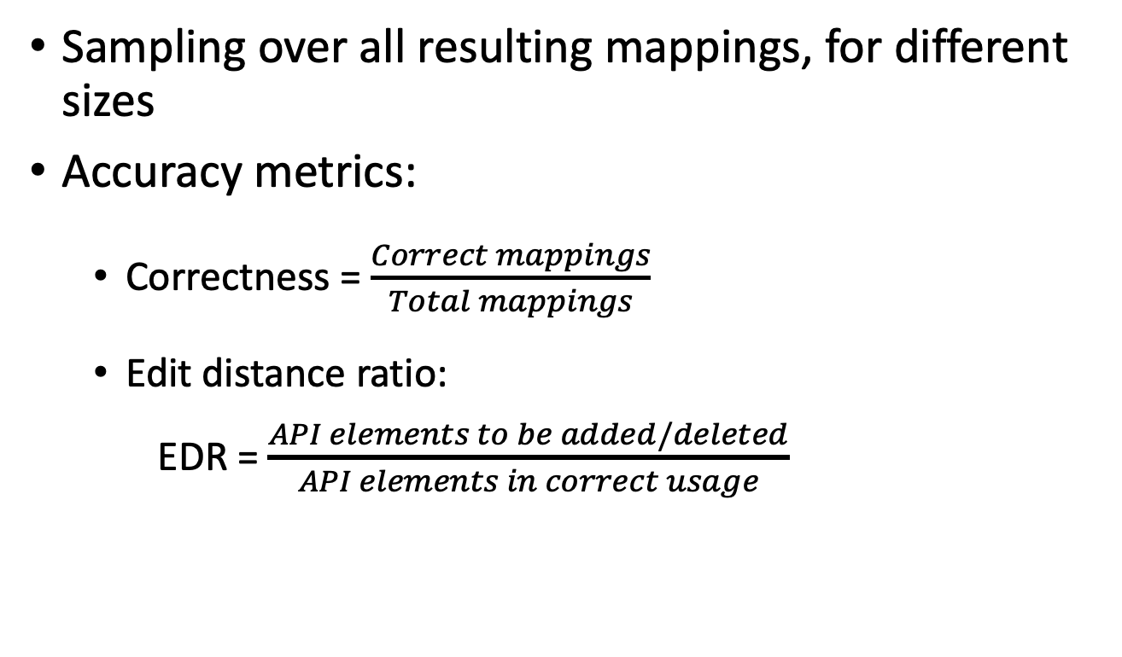
Settings and Metrics
Sampling over all resulting mappings, for different sizes
Accuracy metrics:
Correctness = $\frac{Correct mappings}{Total mappings}$
Edit distance ratio: EDR = $\frac{API elements to be added/deleted}{API elements in correct usage}$
Notes:
To check accuracy of mappings, we used the same sampling and manual checking strategy as in MAM paper.
We evaluate the accuracy using metrics of correctness.
We also measure the edit distance between the correct mappings and mined mappings. The higher the distance the more effort that developer need to fix mappings
To check accuracy of mappings, we used used the same sampling
…
We also measure the edit distance between the correct mappings and mined mappings. The higher the distance the more

Slide 50
Accuracy in Mining API Usage Mappings
Project | Correctness | EDR
Antlr | 86.0% | 7.7%
db4o | 92.0% | 4.1%
fpml | 90.0% | 6.2%
Itext | 90.0% | 9.2%
JGit | 86.0% | 7.9%
JTS | 86.0% | 7.8%
Lucene | 86.0% | 6.5%
Neodatis | 94.0% | 2.4%
POI | 78.0% | 10.6%
All | 87.1% | 7.3%
Correctness can be as high as 94%. On average, it is 87.1%.
EDR can be as low as 2.4%. On average, it is 7.3%.
Notes:
The correctness of learned mappings is high. It can achieve the correctness of 94 percent for Neodatis project and 87 percent for all projects.
The EDR value is also small. On average, developer need to modify less than one tenth to get the correct mappings.

Slide 51
Different Numbers of Variables in API Usage Mappings
 |  | Number of Variables in C# Usages
 |  | 1 | 2 | 3 | 4+
Number of Variables in Java Usages | 1 | 297 | 5 | 0 | 0
 | 2 | 12 | 37 | 1 | 0
 | 3 | 2 | 5 | 11 | 0
 | 4+ | 0 | 0 | 3 | 6
1
1
Many usage mappings involve a single object in both languages (297/379 = 78.4%)
2
351 out of 379 (92.6%) mappings have the same numbers of variables
3
28/379 (7.4%) have different numbers of variables
Notes:
We also find out that 80 percent of mappings involve only a single object in both languages.
Although in many cases, mappings involve the same number of variables at each side, there exists mappings with different number of variables.

Slide 52
Different Numbers of Variables in API Usage Mappings
 |  | Number of Variables in C# Usages
 |  | 1 | 2 | 3 | 4+
Number of Variables in Java Usages | 1 | 297 | 5 | 0 | 0
 | 2 | 12 | 37 | 1 | 0
 | 3 | 2 | 5 | 11 | 0
 | 4+ | 0 | 0 | 3 | 6
1
1
Many usage mappings involve a single object in both languages (297/379 = 78.4%)
2
351 out of 379 (92.6%) mappings have the same numbers of variables
28/379 (7.4%) have different numbers of variables
Notes:
We also find out that 80 percent of mappings involve only a single object in both languages.
Although in many cases, mappings involve different numbers of variable, there exists mappings with different number of variables

Slide 53
Empirical Evaluation
1
API mapping quality
2
Comparison with the state-of-the-art approach
(Mining API Mapping for Language Migration, Zhong et al. ICSE 2010)
3
Usefulness in Code Migration
Notes:
We also compare our approach with the state-of-the-art approach MAM by Zhong and colleagues.

Slide 54
Settings and Metrics
Evaluating class and method mappings
Oracle: manually written API mappings provided by Java2CSharp tool
Metrics:
Precision
Recall
F-score
Notes:
In this experiment, we want to compare the state of the art (MAM).
Since MAM mines class and method mappings hence we compare the class and method mappings with MAMs.
For comparison, we used the oracle that was built as part of J2CS tool.
We use 3 metrics in IR for comparison.
We manually checked
false positive mappings. If they are true mappings, we consider them
as newly found ones and removed them from the false positive set.

Slide 55
Comparison with MAM: API classes
Package | API Class Mappings
 | Precision |  | Recall |  | F-score
 | MAM | StaMiner | MAM | StaMiner | MAM | StaMiner
java.io | 66.9% | 70.0% | 54.5% | 63.6% | 60.1% | 66.6%
java.lang | 63.4% | 82.5% | 60.5% | 76.7% | 61.9% | 79.5%
java.math | 50.0% | 50.0% | 50.0% | 50.0% | 50.0% | 50.0%
java.net | 100.0% | 100.0% | 50.0% | 50.0% | 66.7% | 66.7%
java.sql | 100.0% | 100.0% | 50.0% | 50.0% | 66.7% | 66.7%
java.util | 61.5% | 64.7% | 51.6% | 71.0% | 56.1% | 67.7%
jUnit | 100.0% | 100.0% | 100.0% | 100.0% | 100.0% | 100.0%
orw.w3c | 60.0% | 80.0% | 75.0% | 100.0% | 66.7% | 88.9%
All | 64.7% | 74.4% | 56.7% | 72.9% | 60.4% | 73.6%
9.7% higher precision
16.2% higher recall
13.2% higher F-score
Notes:
Overall, in comparison in API class mappings of 8 library, our tool can achieve 10 percent higher about precision, 16 percent higher about recall and in total 13 percent higher about F-score.

Slide 56
Comparison with MAM: API methods
Package | API Method Mappings
 | Precision |  | Recall |  | F-score
 | MAM | StaMiner | MAM | StaMiner | MAM | StaMiner
java.io | 60.0% | 70.0% | 54.5% | 64.0% | 57.1% | 66.9%
java.lang | 71.7% | 86.7% | 69.6% | 76.5% | 70.6% | 81.3%
java.math | 66.7% | 66.7% | 66.7% | 66.7% | 66.7% | 66.7%
java.net | 100.0% | 100.0% | 33.3% | 33.3% | 50.0% | 50.0%
java.sql | 100.0% | 100.0% | 50.0% | 50.0% | 66.7% | 66.7%
java.util | 54.4% | 63.0% | 53.1% | 54.8% | 53.7% | 58.6%
jUnit | 100.0% | 100.0% | 100.0% | 100.0% | 100.0% | 100.0%
orw.w3c | 76.9% | 84.6% | 41.6% | 45.8% | 54.0% | 59.4%
All | 66.2% | 77.5% | 60.3% | 65.6% | 63.1% | 71.1%
11.3% higher precision
5.3% higher recall
8.0% higher F-score
Notes:
Similarly for method mappings, our tool can achieve 11 percent higher about precision, 5 percent higher about recall and in total 8 percent higher about F-score.

Slide 57
Newly Found Mappings
 | API in Java | API in C#
1 | java.util.Locale.getDefault() | System.Globalization.CultureInfo.CurrentCulture
2 | java.lang.Class.getSuperclass() | System.Type.BaseType
3 | java.nio.charset.Charset.forName(String) | Sharpen.Extensions.GetEncoding(string)
4 | java.util.Collections.unmodifiableList(ArrayList) | System.Collections.ReadOnly(ArrayList)
5 | java.lang.Math.random() | System.Random.NextDouble()
6 | java.lang.Number.floatValue() | System.IConvertible.ToSingle(...)
120 new API mappings of API classes and methods
not manually written in Java2CSharp
Notes:
During experiment, we also found mappings that do not exist in J2CS data file.
The table shows 6 newly found where method calls in Java are mapped with field access in C#, or with method calls with totally different names.

Slide 58
Usefulness in Code Migration
Procedure:
Adding the mined mappings to Java2CSharp
Using Java2CSharp to translate 5 subject projects
Metrics:
Number of compilation errors
Number of defects: semantic errors after compiling
Notes:
In the experiment, we added newly found mappings to already existed mapped in Java2CSharp.
Then we use Java2CSharp to translate 5 subject projects studied in MAM paper.
We evaluate the usefulness based on the number of compilation errors exists when using Java2CSharp translation tool.
We then fixed those errors and determine the number of semantic errors after compiling.
Manually inspect the migrated code for the new five subject projects to count the API-related defects.
For each project, inspect the top five largest files in C#.

Slide 59
Code Migration Improvement with J2CSharp
Project | Compilation Errors |  |  |  | Defects
 | MF | MAM | StaMiner | Improve | MF | MAM | StaMiner | Improve
rasp | 191 | 176 | 166 | 13.10% | 123 | 101 | 88 | 28.50%
llrp | 238 | 235 | 235 | 1.30% | 114 | 114 | 114 | 0.00%
SimMetrics | 13 | 9 | 9 | 30.70% | 0 | 0 | 0 | 0
aligner | 25 | 25 | 25 | 0.00% | 0 | 0 | 0 | 0
fit | 99 | 97 | 84 | 15.20% | 0 | 0 | 0 | 0
All | 566 | 542 | 519 | 8.30% | 237 | 215 | 202 | 14.80%
StaMiner helped Java2CSharp reduce 47 compilation errors and 35 defects
StaMiner helped Java2CSharp reduce 47 compilation errors
That’s 23 compilation errors and 13 defects improvement over MAM
Notes:
For evaluation, we migrate code from Java to C# with three mappings set:
-The provided mappings for J2CSharp,
The mappings with additional of those learned by MAM
The mappings with additional of those learned by our tool
Overall, newly found mappings help reduce about one tenth of compilation error and one sixth of defects.
StaMiner is also able to improve over MAM by further reducing 23 compilation errors and 13 defects

Slide 60
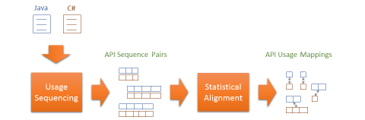


Conclusion
StaMiner
StaMiner: Mining API (usage) mappings with a statistical approach
Accuracy improvement over the state-of-the-art approach
Useful in code migration
Manual
Automated

