Slide 1
Graph-based Mining of In-the-Wild, Fine-grained, Semantic Code Change Patterns

Slide 2


Repetitiveness of Software
Repetitive Code
Parsing Java source file
Parsing Java source file
JDT
java.util
JDT
java.util
Tree traversal
Tree traversal
Smith
Nguyen

Slide 3
Repetitiveness of Changes
Repetitive Change
Parsing Java source file
Parsing Java source file
JDT
java.util
JDT
java.util
Tree traversal
Tree traversal
Smith
Nguyen

Slide 4
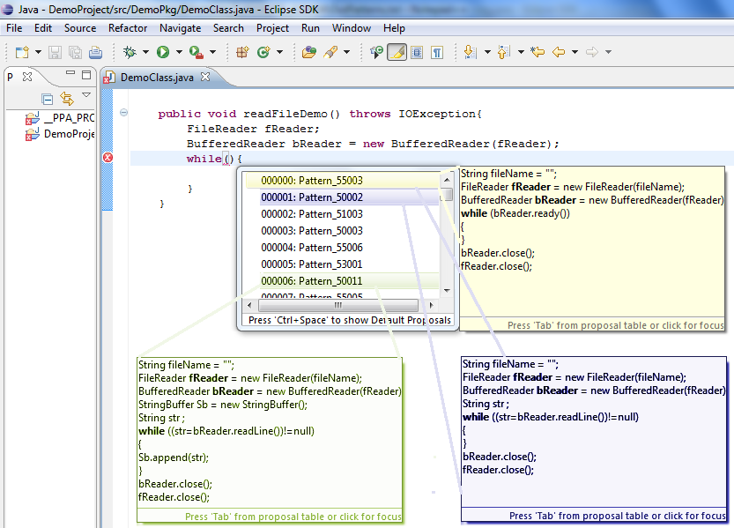
Change Pattern and Applications
Source code is repetitive
Code changes are repetitive
Applications of change pattern:
Change/fix recommendation
Code auto-completion

Slide 5


Change Pattern and Applications
Source code is repetitive
Code changes are repetitive
Applications of change pattern:
Change/fix recommendation
Code auto-completion
Programming patterns and code examples
Scanner.<init>
Scanner.hasNext
while
Scanner.next
Scanner.close

Slide 6
Change Pattern and Applications
Source code is repetitive
Code changes are repetitive
Applications of change pattern:
Change/fix recommendation
Code auto-completion
Programming patterns and code examples
Language migration
Refactoring support
...
-------
-------
--------
...
extract
method
...
-------
-------
--------
...
-------
-------
--------
...
-------
-------
--------
...

Slide 7
Example of Repeated Code Changes
Adapting a new language feature JDK1.4 → JDK1.5
Before
After
1– for (Iterator<Element> it = o.getElements().iterator(); it.hasNext();)
2– myElms.add (it.next());____________________________
1+ for (Element elm : o.getElements())________________
2+ myElms.add(elm);_______________________
Code refactoring
Before
After
1– List <HighlightInfo> list = new ArrayList <>();________________
2– for ( HighlightInfo info : highlights1 )_______________________
3– list.add (info);__________________________________
1+ List <HighlightInfo> result = new ArrayList <>();______
2+ result.addAll (highlights1);_______________________

Slide 8
Challenges of Semantic Change Pattern Detection
Syntactically un-changed program elements could carry the semantic context of change
Before
After
1
2
3 File f = new File ("Output.txt"); _______________________
4 FileOutputStream s = new FileOutputStream (f); _________
5 i = str.indexOf ("pattern",start); ______________________
1+ if (start <= 0) ____________________________________
2+ return; __________________________________
3 File of = new File ("Output.txt");______________________
4 FileOutputStream outStream = new FileOutputStream (of);
5 i = str.indexOf ("pattern",start);____

Slide 9
Challenges of Semantic Change Pattern Detection
Syntactically un-changed program elements could carry the semantic context of change
Elements of a semantic change could be non-contiguous in source code
Before
After
1
2
3 File f = new File ("Output.txt"); _______________________
4 FileOutputStream s = new FileOutputStream (f); _________
5 i = str.indexOf ("pattern",start); ______________________
1+ if (start <= 0) ____________________________________
2+ return; __________________________________
3 File of = new File ("Output.txt");______________________
4 FileOutputStream outStream = new FileOutputStream (of);
5 i = str.indexOf ("pattern",start);____

Slide 10
Challenges of Semantic Change Pattern Detection
Syntactically un-changed program elements could carry the semantic context of change
Elements of a semantic change could be non-contiguous in source code
Before
After
1
2
3 File f = new File ("Output.txt"); _______________________
4 FileOutputStream s = new FileOutputStream (f); _________
5 i = str.indexOf ("pattern",start); ______________________
1+ if (start <= 0) ____________________________________
2+ return; __________________________________
3 File of = new File ("Output.txt");______________________
4 FileOutputStream outStream =new FileOutputStream (of);
5 i = str.indexOf ("pattern",start);____

Slide 11
Challenges of Semantic Change Pattern Detection
Different semantic changes could have the same syntactic change representation
Before
After
1
2
...
5 i = str.indexOf ("pattern",start); ______________________
1+ if (start <= 0) _______________________________
2+ return; ______________________________
…
5 i = str.indexOf ("pattern",start);____
1 i = str.indexOf ("pattern", start);
2
3 3
4 sub = str .substring( i ) ; ______________________
1 i = str.indexOf ("pattern", start);
2+ if (start <= 0) _______________________________
3+ return; ______________________________
4 sub = str .substring( i ) ;

Slide 12
Challenges of Semantic Change Pattern Detection
Different semantic changes could have the same syntactic change representation
Before
After
1
2
…
5 i = str.indexOf ("pattern",start); ______________________
1+ if (start <= 0)________________________________
2+ return; ______________________________
…
5 i = str.indexOf ("pattern",start);____
1
2
3 3i = str.indexOf ("pattern", start); ______________________
1+ if (mode <= 0) ______________________________
2+ return; ______________________________
3 i = str.indexOf ("pattern", start);
Notes:
Un-related semantic changes could not be sufficiently distinguished by syntactic representation

Slide 13
Challenges of Semantic Change Pattern Detection
Syntactically un-changed program elements could carry the semantic context of change
Elements of a semantic change could be non-contiguous in source code
Different semantic changes could have the same syntactic change representation

Slide 14
Challenges of Semantic Change Pattern Detection
Syntactically un-changed program elements could carry the semantic context of change
Elements of a semantic change could be non-contiguous in source code
Different semantic changes could have the same syntactic change representation
Before
After
1
2
3 File f = new File ("Output.txt"); _______________________
4 FileOutputStream s = new FileOutputStream (f); _________
5 i = str.indexOf ("pattern",start); ______________________
1+ if(start <= 0) _______________________________
2+ return; ____________________________________
3 File f = new File ("Output.txt");__________________
4 FileOutputStream s = new FileOutputStream (f);____
5 i = str.indexOf ("pattern",start);____

Slide 15
Challenges of Semantic Change Pattern Detection
Syntactically un-changed program elements could carry the semantic context of change
Elements of a semantic change could be non-contiguous in source code
Different semantic changes could have the same syntactic change representation

Slide 16
Syntactically un-changed program elements could carry the semantic context of change

Slide 17
Elements of a semantic change could be non-contiguous in source code

Slide 18
Different semantic changes could have the same syntactic change representation
Un-related semantic changes could not be sufficiently distinguished by syntactic representation

Slide 19
CPatMiner
Use program dependence graph to capture data/control dependencies between atomic changes
Use frequent sub-graph mining to infer semantic change patterns

Slide 20
Fine-grained Code Representation

Slide 21
Fine-grained Change Representation

Slide 22
Change Pattern Mining Algorithm

Slide 23
Usage Sequencing
Scanner bookSc = new Scanner(new File(”books.txt”));
BookMetaData metaData = getMetaData(”..”);
while (bookSc.hasNextLine()) {
String bookInfo = bookSc.nextLine();
…
}
bookSc.close();
Directly extracting
Graph-based representation
Scanner.new getMetaData
WHILE
Scanner.hasNextLine Scanner.nextLine
…
Scanner.Close
Scanner.new
getMetaData
Scanner.hasNextLine
WHILE
Scanner.nextLine
…
Scanner.close
Notes:
For example, with the code to read information of books and use book metadata to parse the information fields.
The directly extracting method can give a sequence which includes of a project specific getMetaData call.
Otherwise, the graph-based representation, with dependency annotation, can help extracting sequence without that getMetaData call.

Slide 24



Empirical Evaluation
1
Meaningful Patterns
2
Comparison with syntax-based approach
3
Activities
4
Commonality of Patterns
5
Temporal Distribution

Slide 25
Data Collection

Slide 26

Experimental Settings and Metrics

Slide 27
Survey Results (RQ1)

Slide 28
Comparative Study (RQ2)

Slide 29
Examples

Slide 30
Diversity of Change Patterns (RQ3)

Slide 31
Commonality of Patterns (RQ4)

Slide 32
Temporal Distribution of Patterns (RQ5)

Slide 34
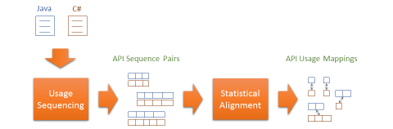


Conclusion
StaMiner
StaMiner: Mining API (usage) mappings with a statistical approach
Accuracy improvement over the state-of-the-art approach
Useful in code migration
Manual
Automated

