Slide 1
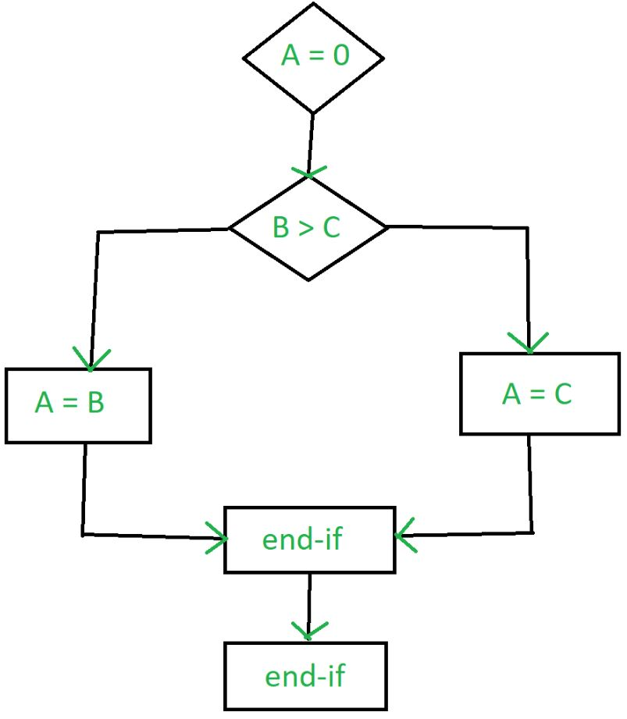
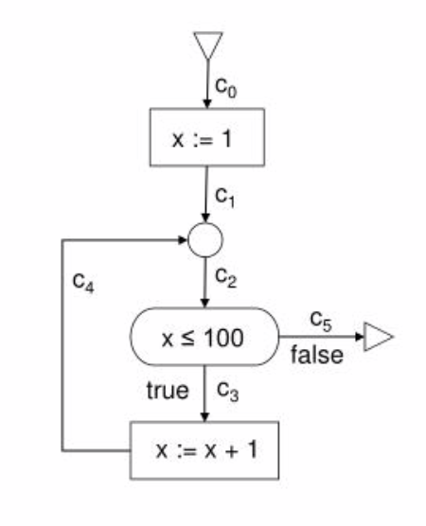
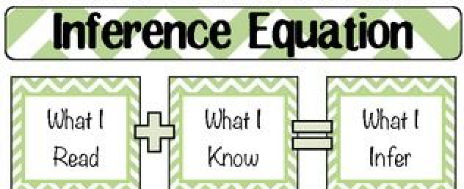
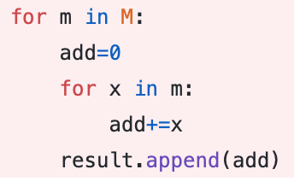
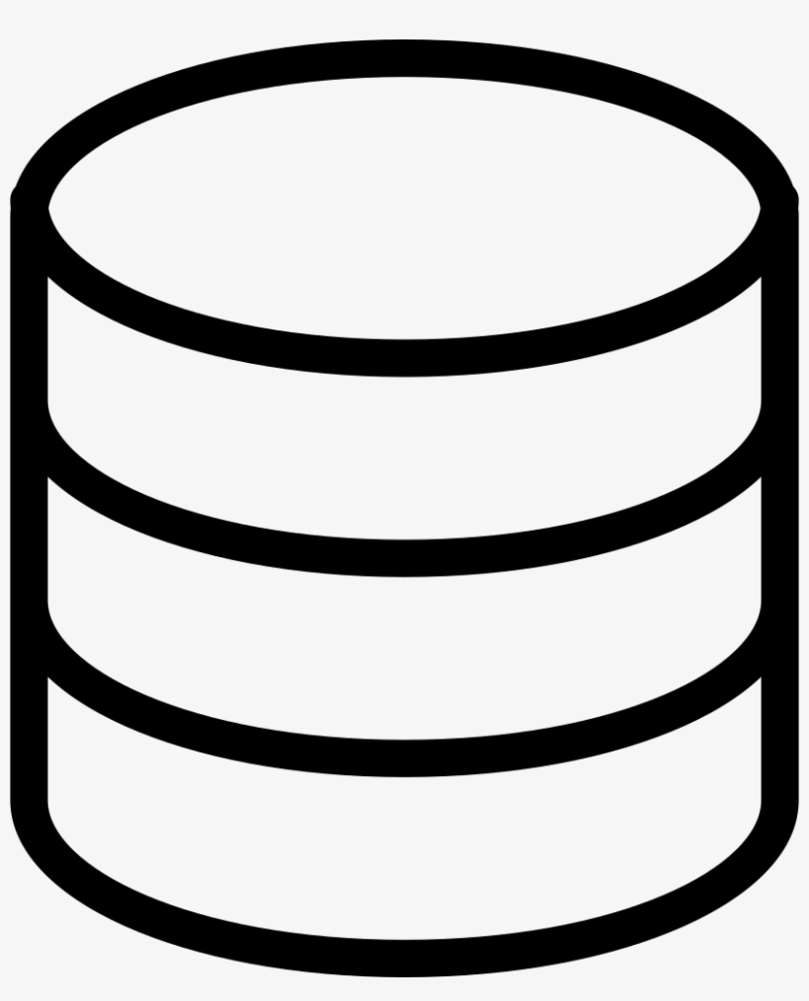
1
4
Evaluation
Problem and Industrial Relevance
Changing ML-based software (e.g., to improve performance, fix bugs, adapt libraries) is currently done by hand (tedious, error prone).
Current tool support for code changes is very limited in scope and expensive to implement.
How can we gather changes? How can we learn from code changes and feed the rules to refactoring tools?
Mining frequent code changes in Dynamically-Typed languages (Python) is hard : unavailable Type information.
We plan to mine 3000+ Python open-source ML code bases.
We evaluate the effectiveness of our approach :
Submit our mined patterns to developers and check whether they recognize the pattern.
Catalog and analyze properties of mined patterns.
Frequent Code Change Pattern Mining
in ML Code Bases
Malinda Dilhara, Ameya Ketkar, and Danny Dig
Oregon State University and University of Colorado Boulder
5
What Follows
2
Contributions
A search engine for Python source code transformations.
A data driven, automated approach to perform code refactoring.
A tool suite based on control graphs and type inference to collect frequent code changes.
Curated repository of frequent code changes for ML codes.
6
Executive Summary
Python is the lingua franca for ML source codes.
Automating frequently repeated code refactoring reduces developer burden.
We introduce: An approach to mine frequently repeated source code patterns.
4. This will open the path to introduce data-driven source code refactoring.
3
Approach
fine-grained program dependence graph (Hoan et al.)
Type Inference
fine-grained type augmented program dependence graph (fgtaPDG).
Source code segments that implement given example
fgtaPDG
Code repository

