Slide 1
CRYPTOGRAPHY · PYTHON 3 · CLI APPLICATION · EDUCATIONAL
Cryptographic Cipher Analyzer
Caesar & Vigenère Cryptanalysis Tool
Encrypt · Decrypt · Analyze · Break
Frequency analysis · Index of Coincidence · Kasiski examination
163
9
100%
unit tests
CLI commands
passing
Project viva presentation · 2026
Notes:
[~35s] Good morning everyone. My name is ___ (introduce yourself). Today I am presenting my project, the Cryptographic Cipher Analyzer — a command-line application written in Python 3. In one sentence: it can encrypt and decrypt messages with the Caesar and Vigenère ciphers, and then turn around and break those same ciphers automatically using classical cryptanalysis. The three numbers on this slide summarise the project: 163 automated unit tests, nine command-line commands, and a strict educational-only scope. Over the next eight to ten minutes I will show the system design, walk through every feature with real screenshots, and finish with the test results and conclusions.

Slide 2
ROADMAP
Agenda
02
01 Introduction & Objectives
What the tool is, why it exists, technology stack
02 System Design
Layered architecture and the request data flow
03 Ciphers in Action
Caesar & Vigenère: CLI demos + interactive menu
04 Cryptanalysis Engine
Frequency · IC · Kasiski · full key recovery
05 Files & Reports
Whole-file encryption and timestamped reports
06 Security & Testing
Honest security verdicts and 163 unit tests
07 Conclusion
Results, limitations and future work
Target talk time: 8–12 minutes across 20 slides
Notes:
[~25s] Here is the plan for the talk. First, the objectives — what problem the tool solves and for whom. Second, the system design: the technology stack, the layered architecture and how a request flows from input to report. Third, the two ciphers in action, including the interactive menu. Fourth — the heart of the project — four cryptanalysis attacks, ending with the full recovery of a Vigenère key. Then file operations and report generation, the security analysis module, and the automated test suite. I will close with results, limitations and future work.

Slide 3
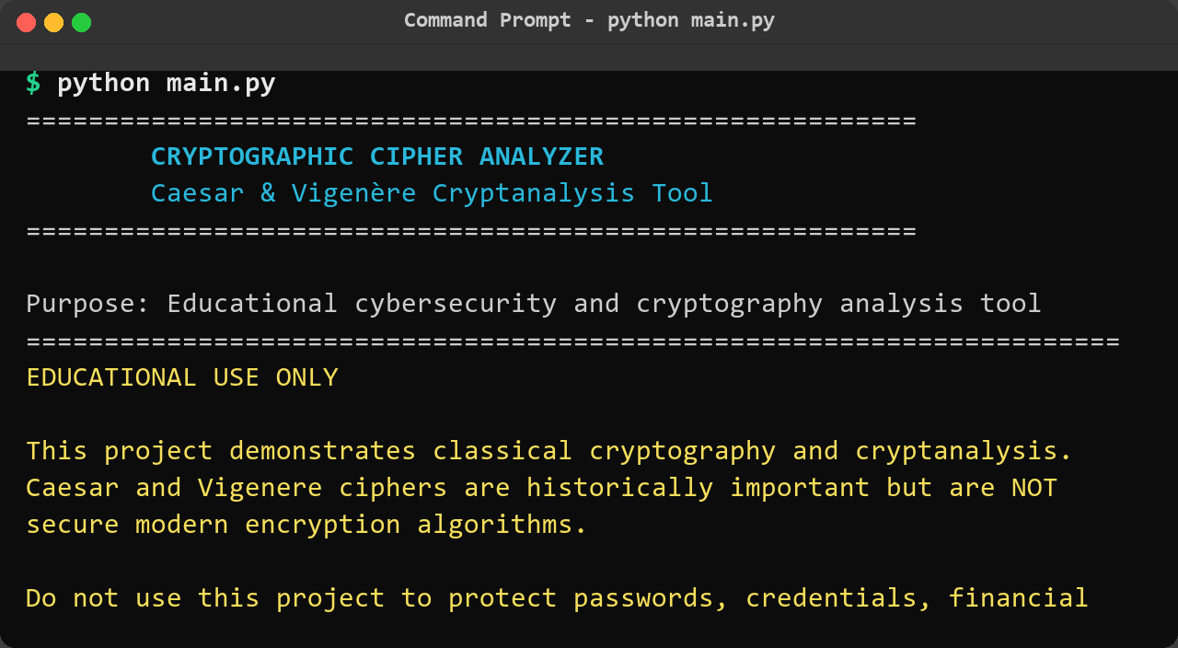
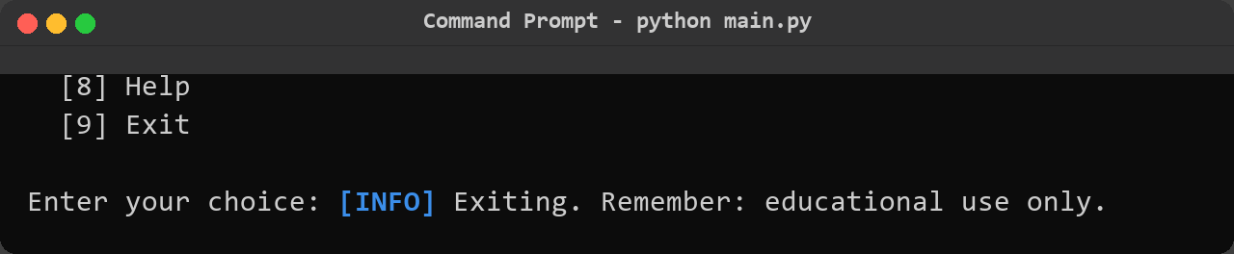
01 · INTRODUCTION
Project Overview & Objectives
03
• Command-line cryptanalysis laboratory. A Python 3 CLI that encrypts, decrypts and breaks classical ciphers — Caesar and Vigenère.
• Every attack stage is automated. Brute-force Caesar cracking, statistical key-length estimation, per-column Vigenère key recovery.
• Two complete interfaces. Menu-driven interactive mode plus nine scriptable CLI subcommands.
• Evidence trail built in. Every analysis can be saved as a timestamped text report under reports/.
• Honest security messaging. Every run prints an educational disclaimer — classical ciphers are not secure.
Screenshots: tool launch — banner, main menu and command reference
Notes:
[~40s] So what exactly is this project? It is a cryptanalysis laboratory in the terminal. You can feed it plaintext and get ciphertext back, or feed it ciphertext and recover the plaintext without ever knowing the key. Four things make it more than a toy. First, every stage of the attack is automated — brute force for Caesar, statistics for Vigenère. Second, it has two complete interfaces: a guided menu for beginners and nine scriptable CLI commands. Third, every analysis can be saved as a timestamped report, which is what the screenshot shows. And fourth, it is honest: it never pretends these ciphers are secure — every run prints an educational disclaimer. The second screenshot shows the built-in command reference.

Slide 4
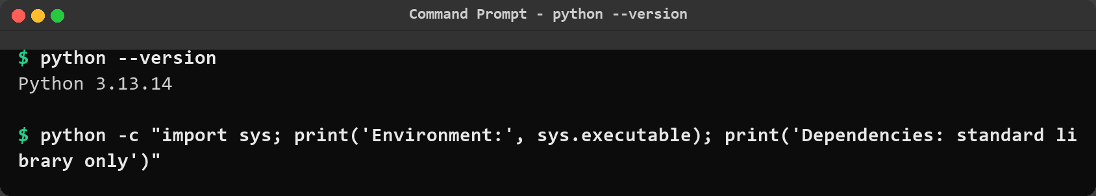
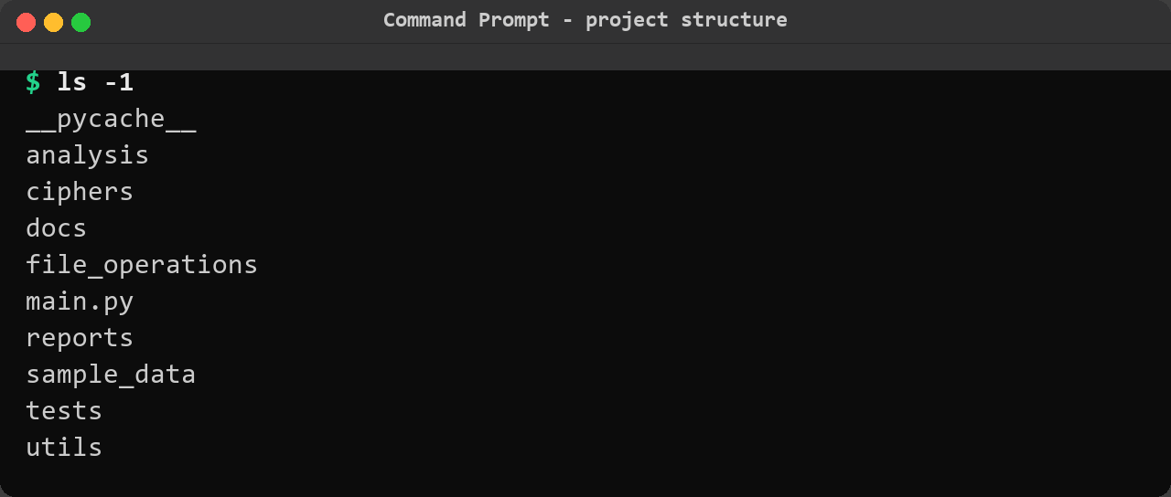
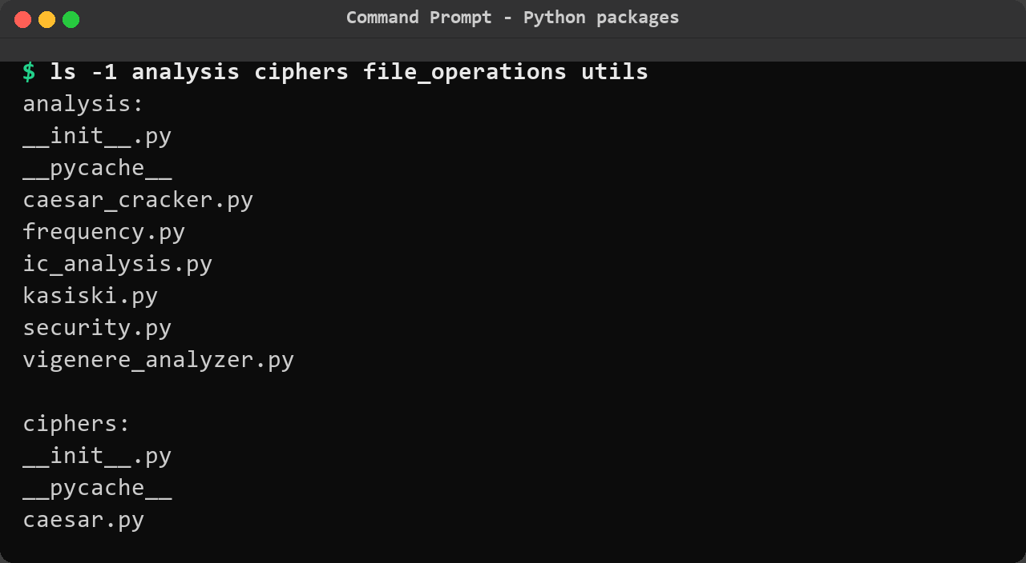
01 · ENVIRONMENT
Technology Stack & Project Structure
04
• Python 3.13 — pure standard library, zero third-party runtime dependencies
• Modular packages — ciphers, analysis, file_operations, utils, tests
• Two interfaces — interactive menu + 9 CLI subcommands
• Sample data & reports — ready-made ciphertexts, timestamped output folder
• Verified quality — 163 unit tests run in ~0.6 s, all passing
Screenshots: python --version, folder structure and Python packages
Notes:
[~35s] The technology choices were deliberately simple. The whole tool is Python 3, standard library only — no third-party runtime dependencies — so it runs on any machine with Python installed. The code is organised into five packages: ciphers holds the two encryption algorithms, analysis holds the four cryptanalysis engines, file_operations handles disk I/O, utils provides validation, text handling and reporting, and tests contains the 163 unit tests. The screenshots show the verified Python version, the top-level folder structure and the package contents. This structure was a conscious decision: it keeps presentation, logic and testing in separate layers, as the next slide shows.

Slide 5
02 · SYSTEM DESIGN
Layered Architecture
05
USER INTERACTION
WHY LAYERS?
Interactive menu (banner.py) · argparse CLI (main.py)
• main.py only presents results — no cryptography lives there
• Each analysis module is independently testable
• Validators stop bad input before the engines run
• One ReportBuilder is shared by every command
• The 163 tests map directly to module boundaries
▼
OPERATIONS
Caesar / Vigenère encrypt · decrypt · Frequency · IC · Kasiski · Security · Files · Reports
▼
CORE ENGINES
ciphers/caesar.py · vigenere.py · analysis/caesar_cracker.py · vigenere_analyzer.py
▼
SHARED SERVICES
validators · text_utils · report_generator — standard library only
Design principle: presentation strictly separated from cryptanalysis logic
Notes:
[~45s] Here is the architecture in four layers. At the top, user interaction: main.py with argparse for the CLI, and banner.py driving the interactive menu. Below that, the operations layer: encryption, the four analyses, file operations and reports. The core engines live in their own modules — caesar.py, vigenere.py, caesar_cracker.py and vigenere_analyzer.py. At the bottom, shared services: validators, text utilities and the report generator. Why does this matter? main.py only presents results — no cryptography lives there. Each analysis module can be tested in isolation, and the 163 tests map directly onto these module boundaries. Bad input can never reach the engines because validators run first.

Slide 6
02 · SYSTEM DESIGN
Request Flow: From Input to Report
06
1
2
3
4
5
INPUT
▶
VALIDATE
▶
PROCESS
▶
PRESENT
▶
REPORT
Typed text, file input, or CLI flags
validators.py — shift, key and text rules
Cipher engines / analysis engines
banner tables and ranked candidates
Optional timestamped text report
ENGINEERING HIGHLIGHTS
• Never crashes on bad input: invalid shifts, empty text and missing files produce friendly messages, not tracebacks
• Idempotent files: the source file is never modified without explicit --overwrite confirmation
• Graceful EOF handling: piped input or Ctrl+Z exits the menu cleanly
One pipeline serves both the interactive menu and the CLI commands
Notes:
[~35s] This slide shows what happens on every single command, in five steps. Input arrives typed, from a file, or as CLI flags. Validation normalises it — shifts must be integers, keys must be letters, text must not be empty. Then processing: a cipher engine or an analysis engine runs. Presentation formats the result as tables and ranked candidates. Finally, optionally, a timestamped report is written. The highlights at the bottom are the engineering guarantees: invalid input never crashes the program, source files are never modified without explicit overwrite confirmation, and end-of-input exits the menu cleanly. The same pipeline serves both the menu and the CLI.

Slide 7
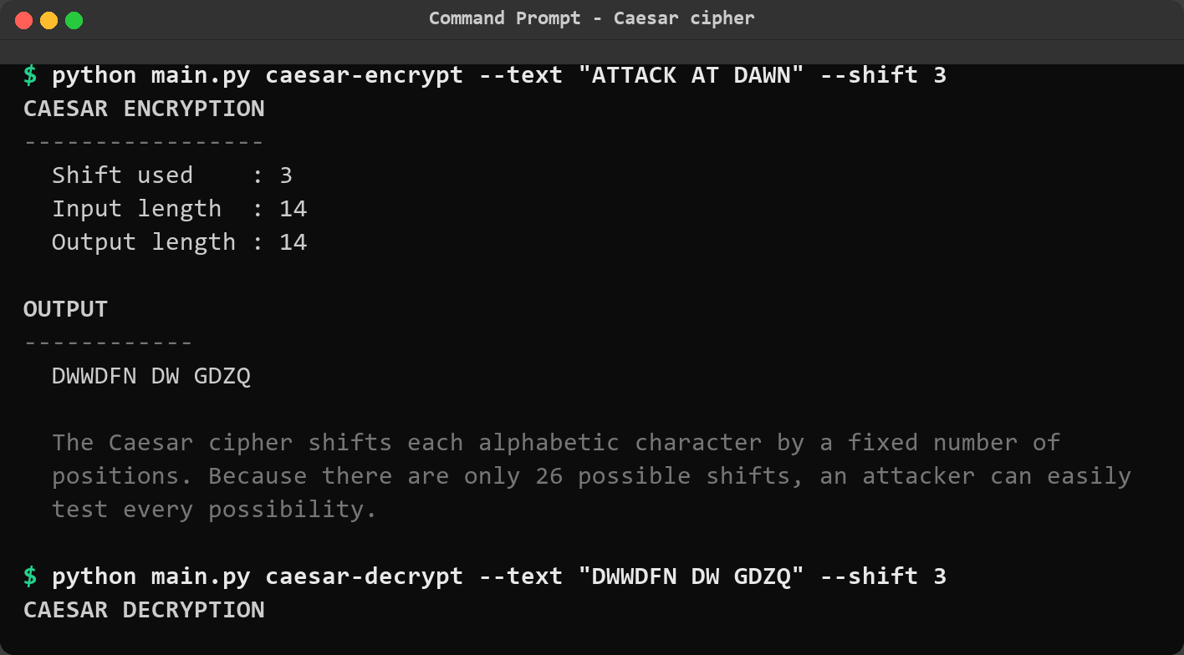
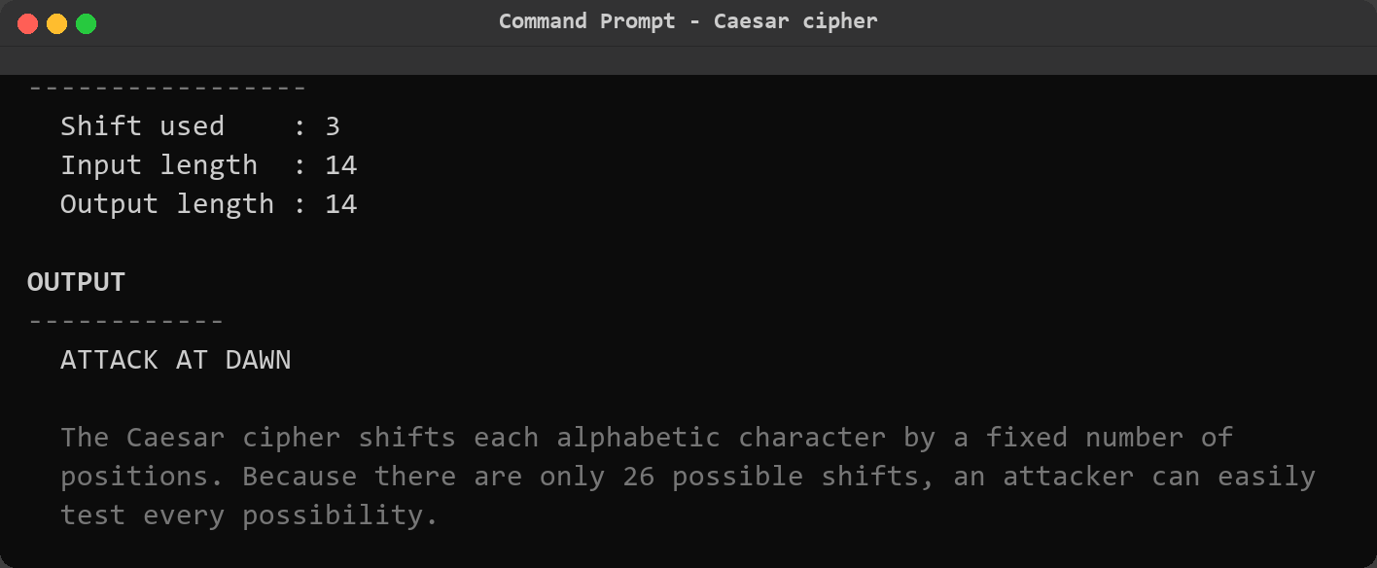
03 · CIPHERS IN ACTION
Caesar Cipher — Encryption & Decryption
07
• Mechanics: every letter shifts by a fixed amount (mod 26); case, digits and punctuation are preserved
• Example: “HELLO WORLD” + shift 3 → “KHOOR ZRUOG”
• CLI: python main.py caesar-encrypt --text "HELLO WORLD" --shift 3
• Extras: menu option 1, negative shifts, input from file, --report output
• Keyspace: only 25 effective keys — the fatal weakness exploited on slide 11
Screenshots: Caesar encryption and decryption from the command line
Notes:
[~40s] Starting with the simplest cipher. The Caesar cipher shifts every letter by a fixed amount modulo 26 — HELLO WORLD becomes KHOOR ZRUOG with shift three. The right screenshots show the real CLI run: the command, the shift used and the output. Decryption is simply the inverse shift. Note the design details: case is preserved, digits and punctuation pass through untouched, and negative or oversized shifts are normalised. The crucial number is the keyspace: only 25 effective keys, because shift zero changes nothing. That is exactly the weakness the cracking demo will exploit a few slides from now. This cipher takes seconds to implement — and seconds to break.

Slide 8
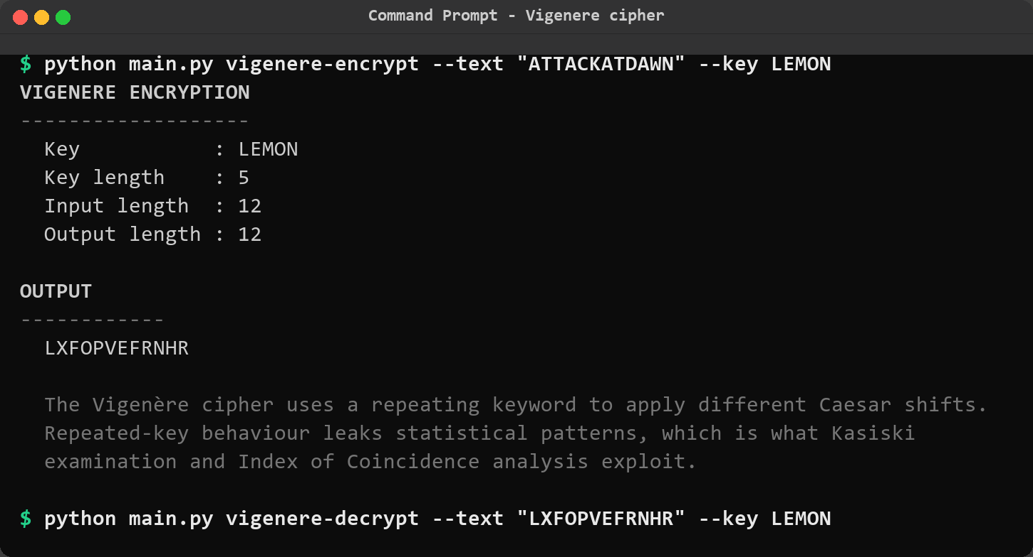
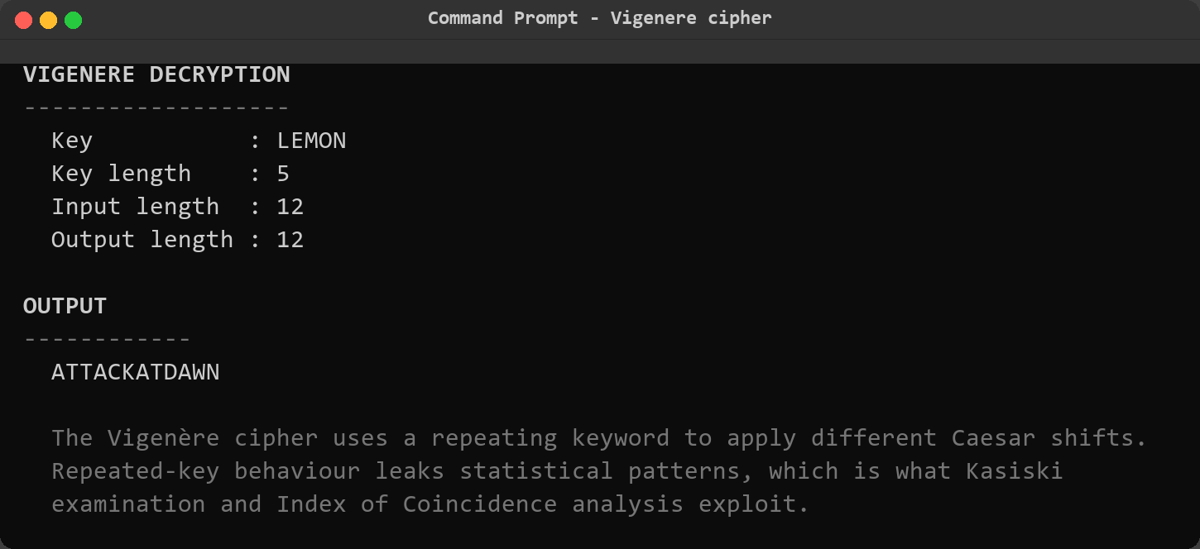
03 · CIPHERS IN ACTION
Vigenère Cipher — Polyalphabetic Layer
08
• Mechanics: a repeating keyword picks a different Caesar shift for every letter
• Example: ATTACKATDAWN + key LEMON → LXFOPVEFRNHR (classic reference example)
• CLI: python main.py vigenere-encrypt --text ... --key LEMON
• Strength over Caesar: flattens single-letter frequencies — naive frequency analysis fails
• Hidden flaw: the key repeats, and that repetition leaks structure (slide 13)
Screenshots: Vigenère encryption with key LEMON and the matching decryption
Notes:
[~40s] The Vigenère cipher fixes Caesar's obvious flaw. Instead of one shift, a repeating keyword applies a different shift to every letter — here the classic textbook example: ATTACKATDAWN with key LEMON produces LXFOPVEFRNHR. The key letter at each position selects which Caesar alphabet is used. This flattens the letter frequencies that make Caesar trivial to break — which is why it was called the indecipherable cipher for three centuries. But it introduces a new weakness: the keyword repeats, and whenever it realigns with the text, patterns appear in the ciphertext. That repetition is exactly what the Kasiski examination will detect later. The screenshots show encryption and decryption through the CLI.

Slide 9
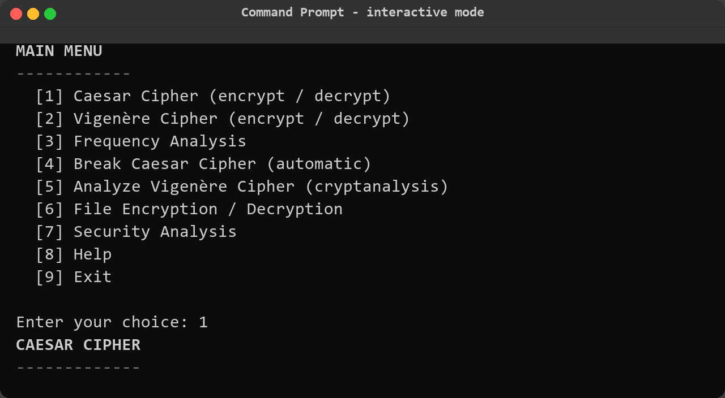
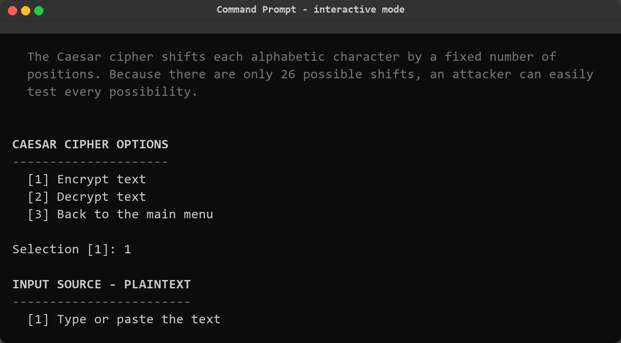
03 · CIPHERS IN ACTION
Interactive Menu Mode
09
• Nine options covering ciphers, analyses, files, security and help
• Guided prompts validate every input and re-ask on mistakes — cannot be crashed
• Submenus choose the source: type text or read from a file
• Report prompts offer to save every analysis as a text file
• Crash-proof loop invalid choices and end-of-input are handled without tracebacks
Screenshots: banner, main menu and a guided Caesar session
Notes:
[~30s] For demonstrations and users who prefer guidance, there is a full interactive mode. Running python main.py with no arguments opens this menu with nine options. Every prompt validates its input and re-asks on mistakes, so the program cannot be crashed by typing something wrong. Submenus let you choose between typing text or reading it from a file, and after every analysis the tool offers to save a report. The screenshot shows the banner, the main menu, and a guided Caesar session. This is also the mode I would use for a live demo — everything the CLI does is reachable from the menu.

Slide 10
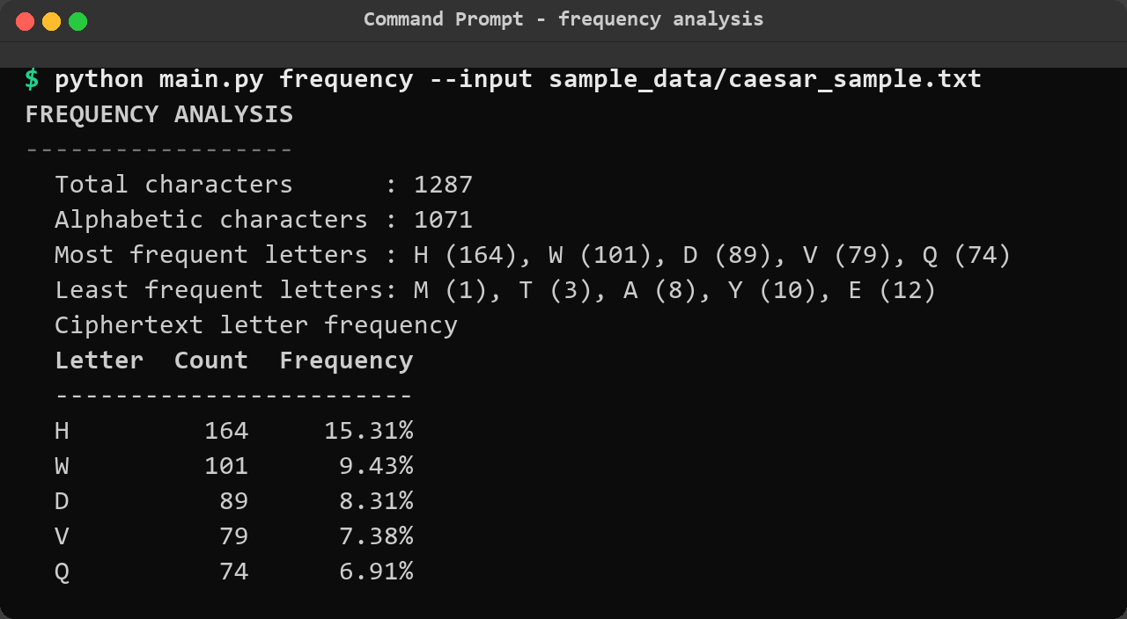
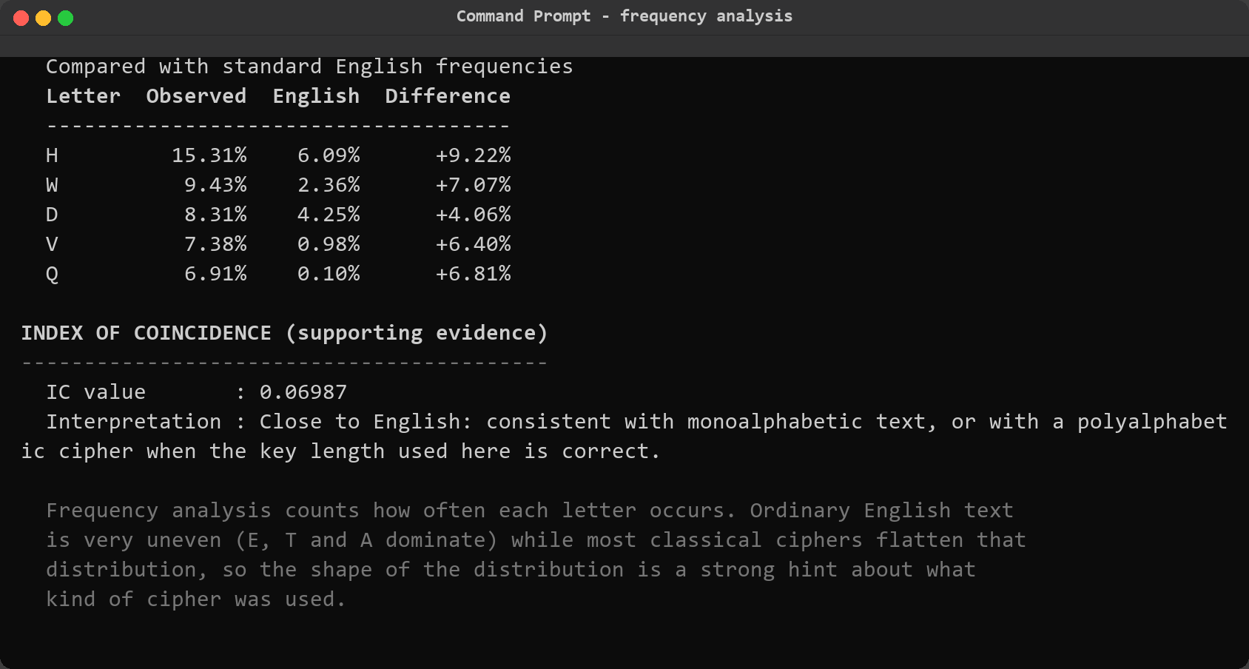
04 · CRYPTANALYSIS
Attack 1 — Letter Frequency Analysis
10
• Idea: English is uneven — E, T and A dominate; counting letters exposes structure
• Output: per-letter counts, percentages, and a ranked comparison vs standard English
• Reading it: peaks at H, K, O, R are shifted E, T, A, O — an instant Caesar diagnosis
• Reuse: the same counting powers the chi-square fitness score that ranks candidates
Foundation attack:
frequency counting feeds every later stage of the engine.
Screenshots: frequency summary and comparison with standard English
Notes:
[~40s] Now the cryptanalysis. Attack one: frequency analysis. The idea is that natural language is statistically uneven — in English, E, T and A dominate. The tool counts every letter, shows percentages, and — the useful part — compares the observed frequencies against the standard English table, sorted by difference. In the screenshot, the ciphertext peaks on H, K, O and R — exactly E, T, A and O shifted by three. One glance reveals the shift. Beyond diagnosis, the same counting logic powers a chi-square fitness score that later ranks candidate plaintexts, plus a digram scorer for common letter pairs. Frequency analysis is the foundation everything else builds on.

Slide 11
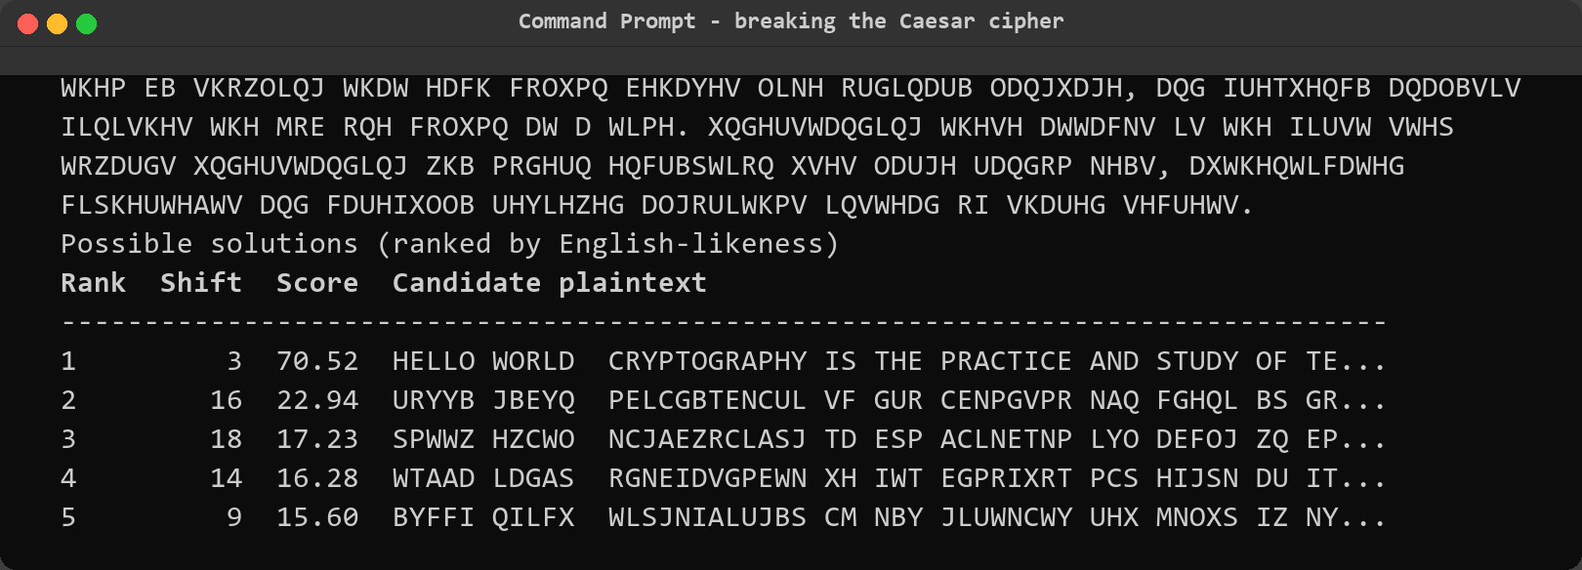
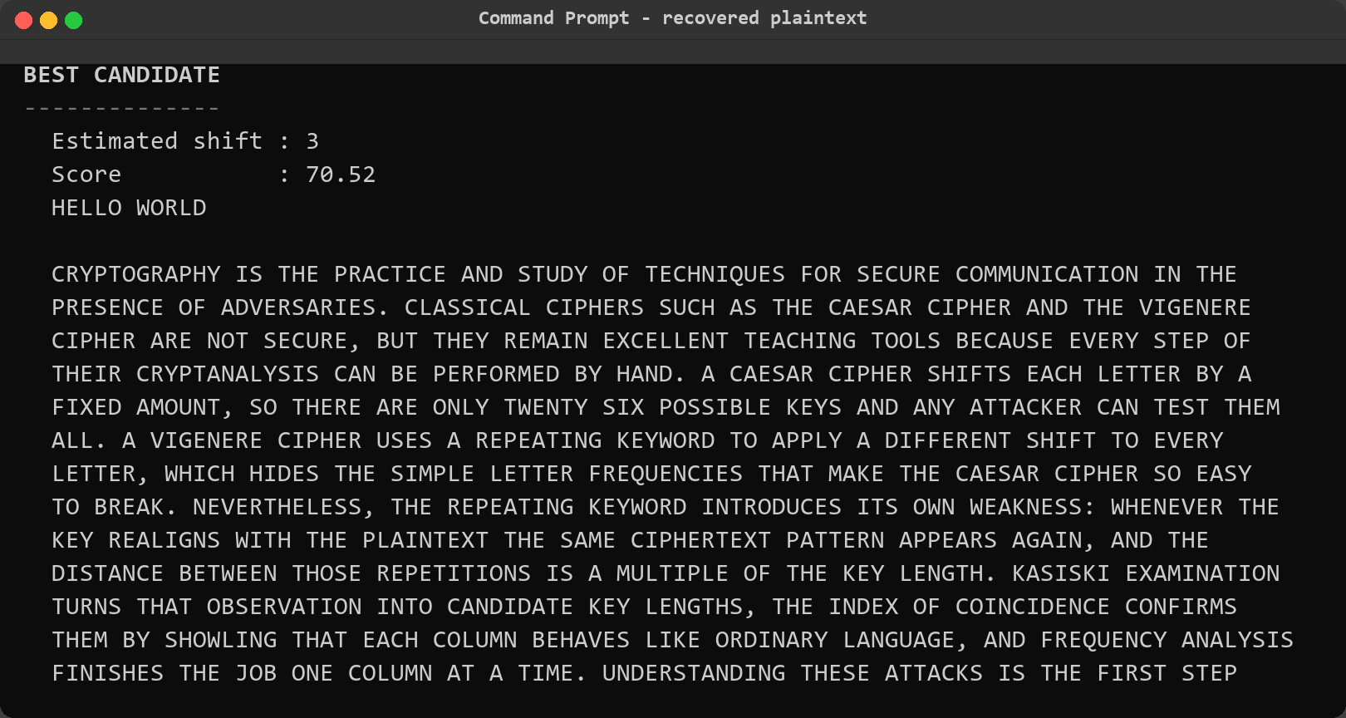
04 · CRYPTANALYSIS
Attack 2 — Automatic Caesar Cracking
11
• Method: try all 26 shifts; score each with chi-square + digram fitness vs English
• Demo input: 1,287-character ciphertext from sample_data/caesar_sample.txt
• Result: shift 3 ranked #1 with score 70.52 — runner-up only 22.94
• Output: top-5 ranked candidate plaintexts + the best full decryption
• Statistical honesty: an on-screen note warns that short or odd texts can mislead the ranking
Screenshots: ranked candidate table and BEST CANDIDATE block
Notes:
[~45s] Attack two is where it gets satisfying: automatic Caesar cracking. The command takes ciphertext only — no key. The tool tries all 26 shifts and scores each result with a chi-square statistic against English letter frequencies, combined with a digram score. In the demo, the input is a 1,287-character ciphertext from the sample data folder. The ranked table shows the result: shift three scored 70.52 while the runner-up scored only 22.94 — a decisive margin. Below the table, the BEST CANDIDATE panel prints the fully recovered plaintext. Notice the honesty note at the bottom of the terminal output: the ranking is statistical, and short or unusual texts can mislead it. The tool tells you that on screen.

Slide 12
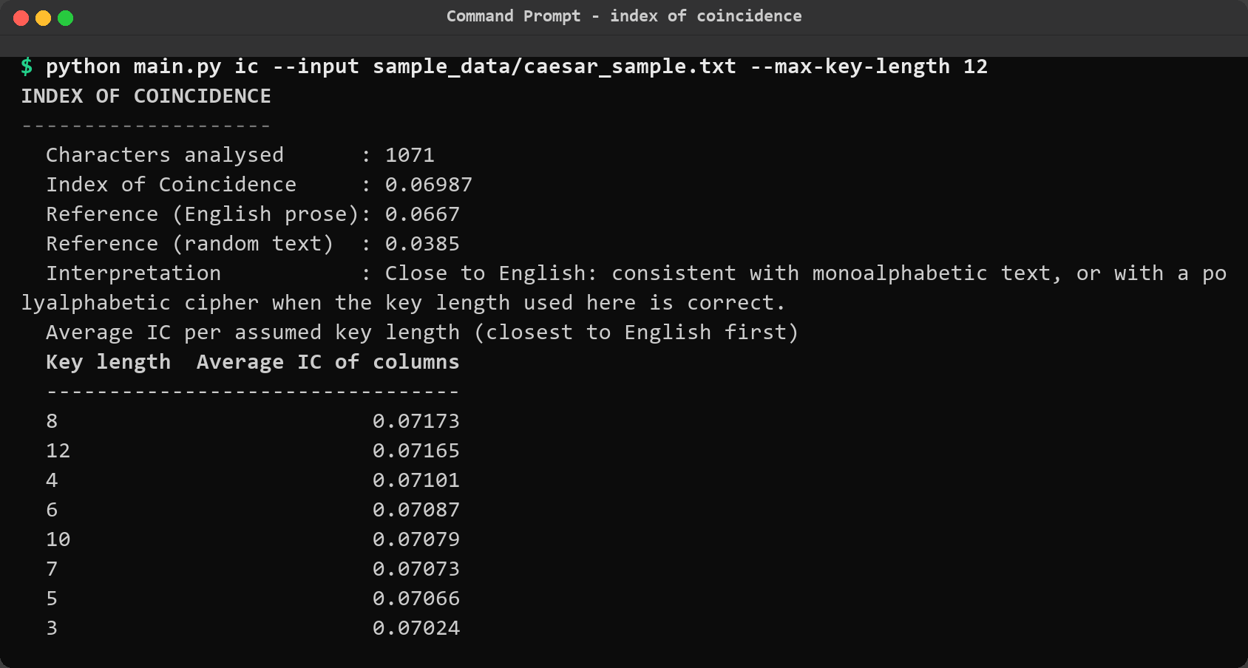
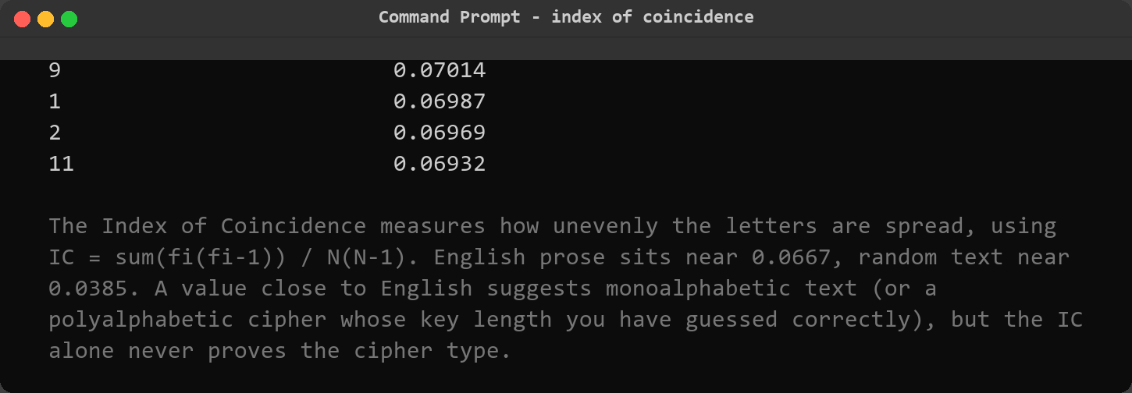
04 · CRYPTANALYSIS
Attack 3 — Index of Coincidence
12
• Definition: IC = Σ fᵢ(fᵢ−1) / N(N−1) — how unevenly letters are spread
• Benchmarks: English ≈ 0.0667 · random ≈ 0.0385
• Demo: Vigenère sample scores 0.0435 — low IC exposes polyalphabetic text
• Key-length probe: average IC per assumed length spikes at the true length (here 5, 10, 15)
• Caution: IC suggests, never proves — always corroborate with Kasiski evidence
Screenshots: IC summary and average IC per assumed key length
Notes:
[~40s] Attack three: the Index of Coincidence. It is a single number measuring how unevenly letters are distributed — the probability that two random letters from the text are identical. English prose sits around 0.0667; random text around 0.0385. The demo screenshot shows a Vigenère ciphertext scoring 0.0435 — clearly in the polyalphabetic range, confirming that naive frequency analysis will not work directly. The real power is the second table: the average IC computed per assumed key length. When the assumed length matches the true key length, every column behaves like English and the IC spikes — here it peaks at 5, 10 and 15, immediately suggesting a key length of five.

Slide 13
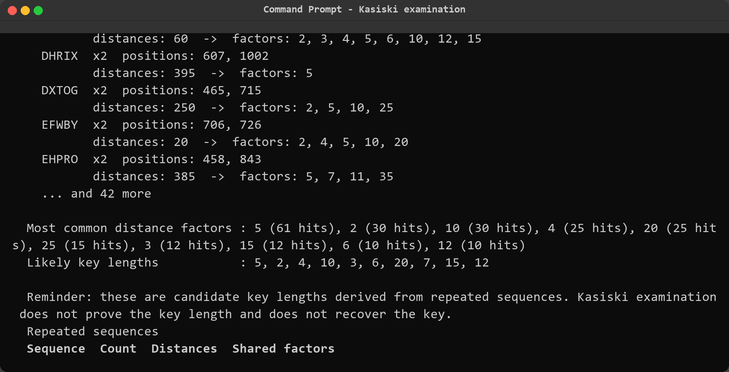
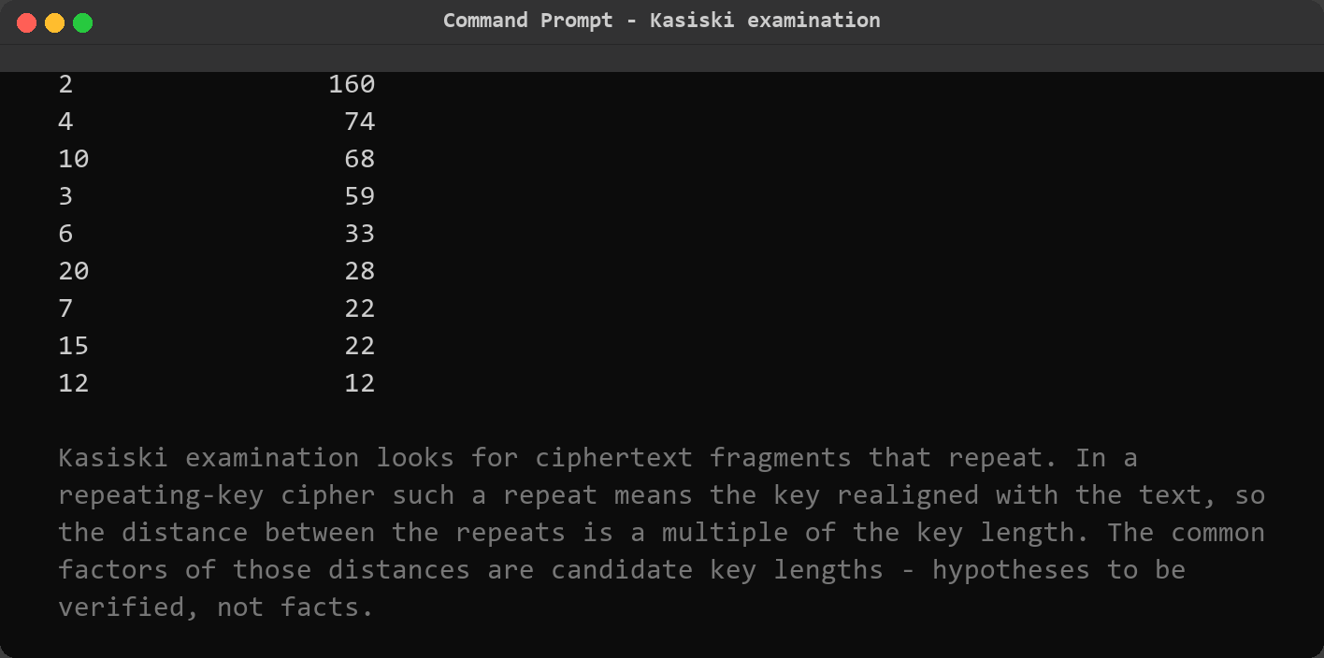
04 · CRYPTANALYSIS
Attack 4 — Kasiski Examination
13
• Idea: repeated ciphertext fragments appear where the key realigns with the text
• Maths: distances between repeats are multiples of the key length; common factors are candidates
• Demo: repeats at distances 500 and 395 → shared factors {5, 10, 20, 25}
• Ranking: evidence-weighted key-length table — length 5 leads the list
• Honesty: candidates are hypotheses to verify, not proven facts
Screenshots: repeated-sequence table and ranked key-length evidence
Notes:
[~40s] Attack four confirms that guess independently: Kasiski examination, published in 1863. The observation: in a repeating-key cipher, a repeated ciphertext fragment means the key realigned with the plaintext at that point — so the distance between the two repeats must be a multiple of the key length. The tool finds all repeated sequences of length three to five, computes their distances and factorises them. In the demo, fragments repeat at distances 500 and 395, whose common factors are 5, 10, 20 and 25. The evidence table ranks key lengths by accumulated factor hits — length five leads. Important nuance: Kasiski produces candidates, not proof. That is why the tool always pairs it with the IC evidence.

Slide 14
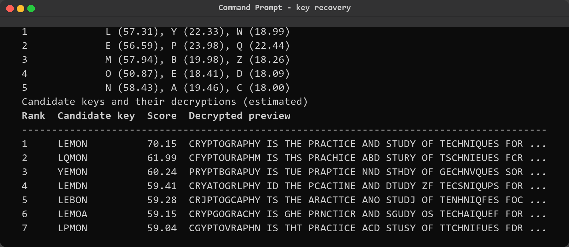
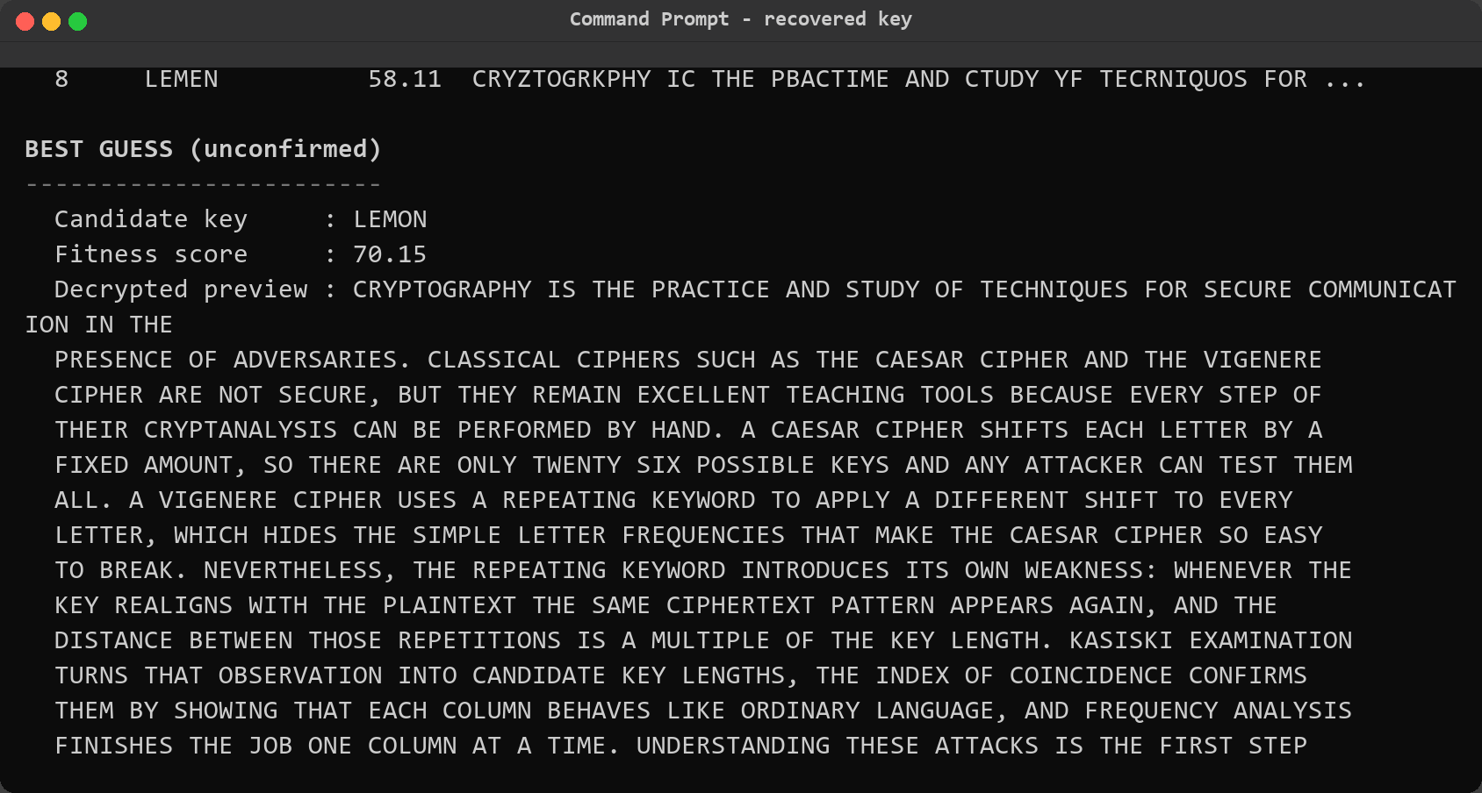
04 · CRYPTANALYSIS
Full Vigenère Cryptanalysis Pipeline
14
• Step 1 — Estimate: Kasiski + IC agree on key length 5 (combined score 0.948)
• Step 2 — Columns: split ciphertext into 5 columns; each behaves like Caesar-shifted English
• Step 3 — Solve: per-column frequency analysis suggests L, E, M, O, N (scores 50–58)
• Step 4 — Verify: candidate keys ranked by English-likeness; LEMON decrypts to real prose
Recovered key: LEMON — matches the original 100%
Screenshots: per-column key letter candidates and the ranked candidate keys
Notes:
[~45s] Now the full pipeline, combining all three techniques. Step one, estimation: Kasiski evidence and the per-length IC agree on key length five, with a combined score of 0.948. Step two: split the ciphertext into five columns — each column is now a monoalphabetic Caesar shift, so column IC rises to English levels. Step three: per-column frequency analysis suggests the most likely letter for each key position — L, E, M, O, N, each with a fitness score around 50 to 58, far above the runners-up. Step four: the tool assembles candidate keys, decrypts with each, and ranks them by English-likeness. LEMON comes first — highlighted in green — and the best-guess panel shows the recovered plaintext.

Slide 15
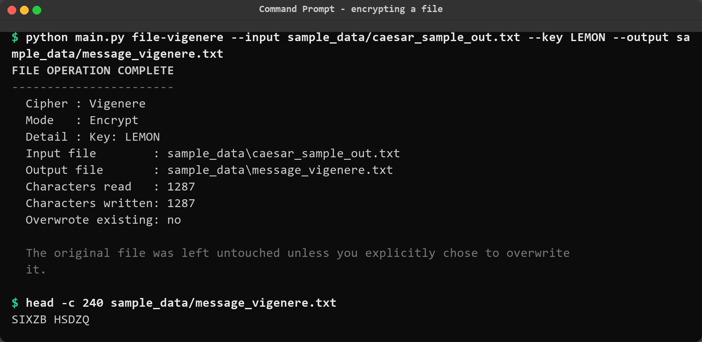
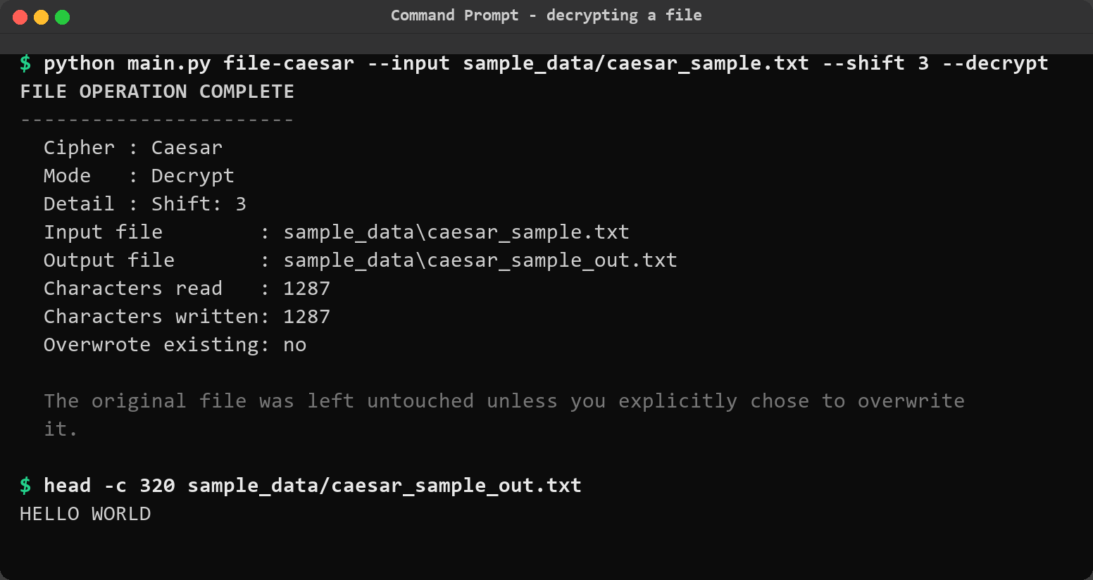
05 · FILES & REPORTS
File Encryption / Decryption
15
• Whole-file ciphers: file-caesar and file-vigenere transform entire text files
• Safe by default: output goes to <input>_out.<ext>; original untouched without --overwrite
• Round-trip proven: decrypt(encrypt(file)) reproduces the exact original — unit tested
• Statistics shown: file sizes, letter counts and character classes after every run
$ python main.py file-vigenere \
--input sample_data/message.txt --key LEMON
→ writes message_out.txt; original file preserved
Screenshots: encrypting and decrypting files from the CLI
Notes:
[~35s] Beyond single strings, the tool operates on whole files. The file-caesar and file-vigenere commands encrypt or decrypt an entire text file. Safety was the priority: the output defaults to a new file with an underscore-out suffix, and the original is never modified unless you explicitly pass the overwrite flag — interactively, the tool asks for confirmation first. The screenshots show a real encryption run with file statistics, and the decryption round trip, which reproduces the original exactly. This is also covered by dedicated unit tests: the round trip for both ciphers, and proof that an invalid key leaves the output file untouched.

Slide 16
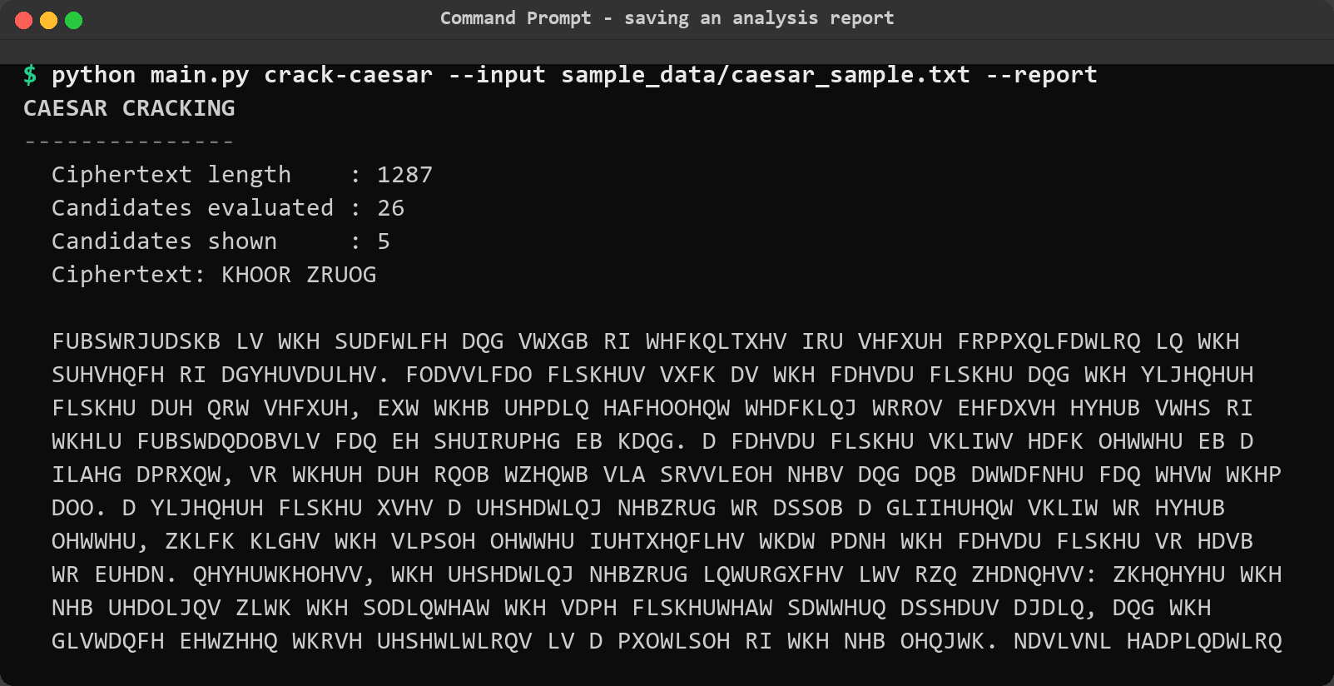
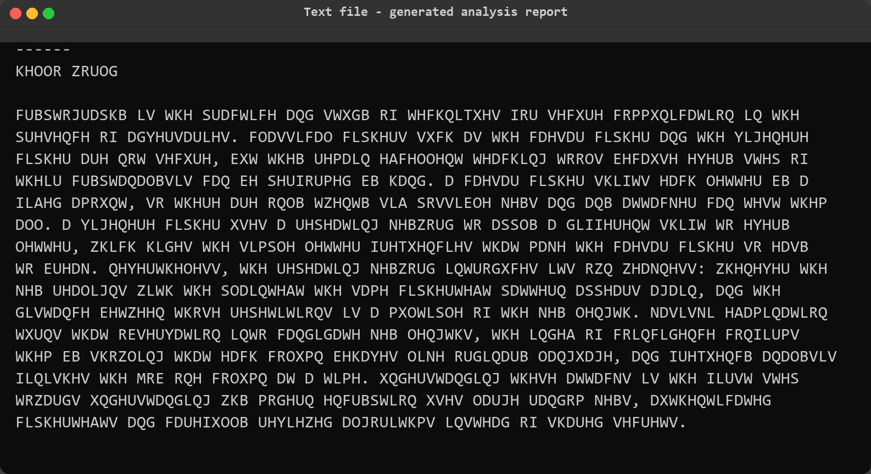
05 · FILES & REPORTS
Timestamped Analysis Reports
16
• One flag: append --report to any command to persist the analysis
• Interactive too: menus ask “Save this analysis as a report? [y/n]”
• Contents: inputs, statistics, tables, method notes, security assessment, disclaimer
• Organised: written under reports/ with timestamped filenames
• Viva-ready: reports double as evidence for the demonstration logbook
Screenshots: saving a report and the generated report contents
Notes:
[~30s] Every analysis can be persisted. Adding the report flag — or answering yes in the interactive mode — writes a timestamped text file under the reports folder. The report is complete: input statistics, all result tables, the cryptanalysis method notes, the security assessment and the educational disclaimer. The screenshots show the save confirmation and the actual contents of a generated report. This turned out to be genuinely useful during development: reports from test runs became the evidence log for the project documentation, and they give the examiner a reproducible record of every demo shown today.

Slide 17
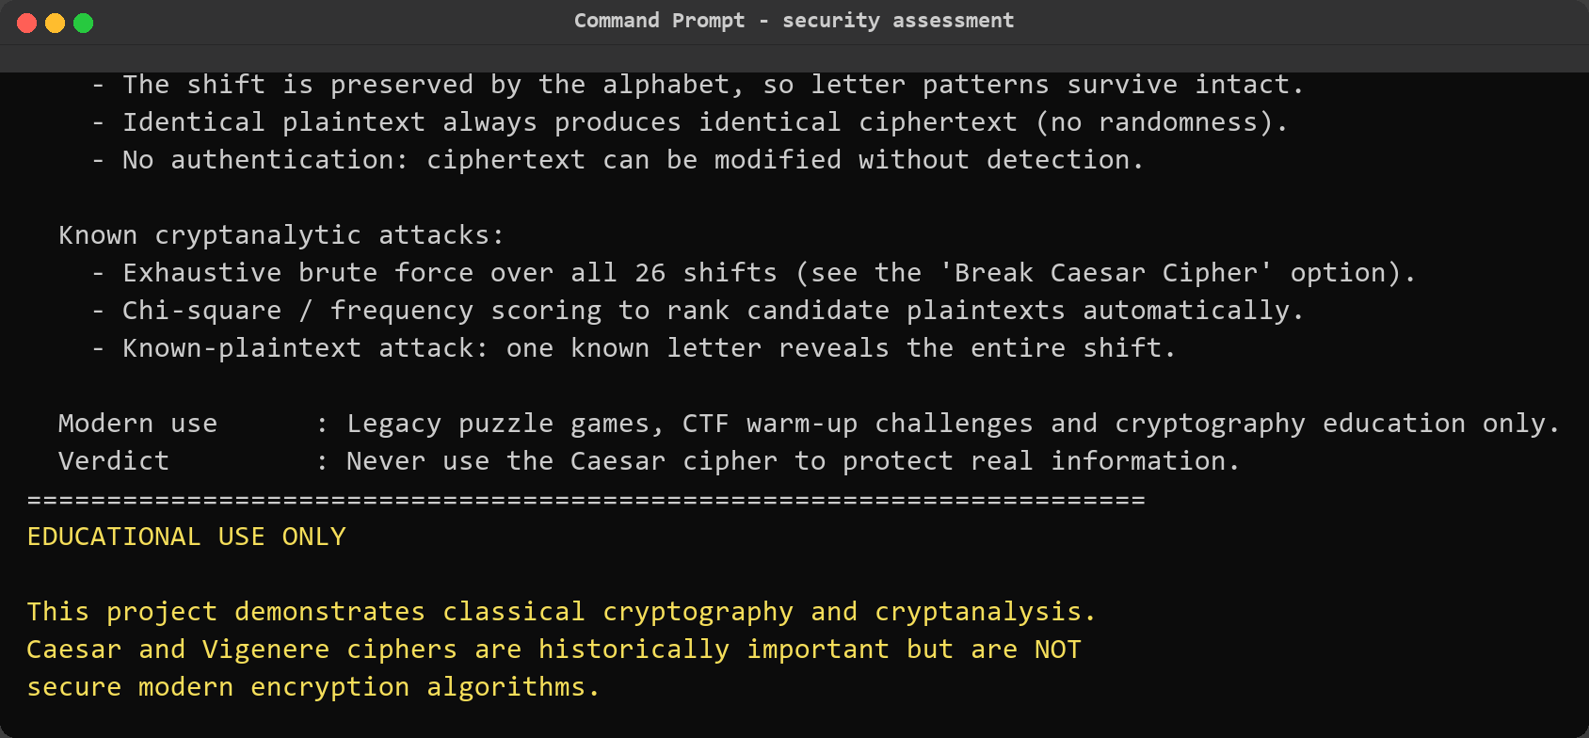
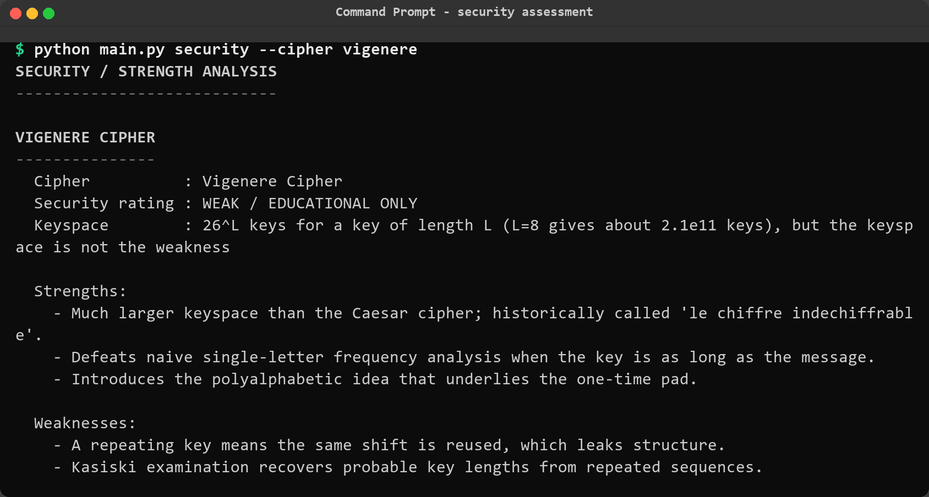
06 · SECURITY & TESTING
Security Analysis Module
17
• Profiles: keyspace size, strengths, weaknesses and known attacks per cipher
• Caesar verdict: VERY WEAK — 25 effective keys, broken in milliseconds
• Vigenère verdict: WEAK — resisted attack for 3 centuries until Kasiski (1863)
• Built-in disclaimer: educational use only — printed on every run
Why teach broken ciphers?
They are the only ciphers whose every attack step can be performed and understood by hand — the clearest motivation for modern cryptography.
Screenshots: Caesar profile (VERY WEAK) and Vigenère profile (WEAK)
Notes:
[~40s] The security module turns the tool's knowledge into explicit teaching content. For each cipher it profiles the keyspace, strengths, weaknesses and known attacks. Caesar: rated very weak — 25 effective keys, broken in milliseconds by brute force, destroyed by frequency analysis. Vigenère: rated weak — it resisted cryptanalysis for three centuries, but Kasiski's 1863 examination broke it. The module closes with the disclaimer printed on every run: educational use only, never protect real data. I want to stress the panel at the bottom left: broken ciphers are worth teaching precisely because every attack step can be performed and understood by hand — that understanding is what motivates modern cryptography.

Slide 18
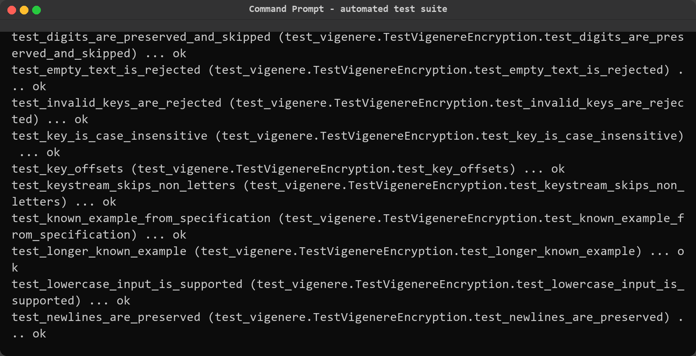
06 · SECURITY & TESTING
Automated Testing — 163 Tests, All Green
18
$ python -m unittest discover -s tests -v → Ran 163 tests in 0.606s — OK
Ciphers
Cryptanalysis
CLI
Files & Reports
round-trips, wrap-around, invalid input
IC values, Kasiski maths, key recovery
all commands, errors, interactive flows
round-trips, overwrite protection
Quality practice: tests written alongside every feature module
Notes:
[~35s] Quality was verified, not assumed. The project has 163 unit tests, all passing in about six tenths of a second — fast enough to run on every change. The screenshot shows the verbose unittest run. Coverage spans four areas, summarised in the chips below: the cipher engines — round trips for every shift and multiple keys, case and punctuation preservation, alphabet wrap-around; the cryptanalysis engines — known IC values, Kasiski distances and factorisation, and crucially a test that the analyser recovers a real key; the CLI — every subcommand, the report flag, error handling and interactive flows; and file operations — round trips, overwrite protection and report structure. Tests were written alongside each module, not retrofitted.

Slide 19
07 · CONCLUSION
Results, Limitations & Future Work
19
ACHIEVED
LIMITATIONS
FUTURE WORK
• Working encrypt/decrypt for 2 ciphers
• 4 cryptanalysis attacks automated
• Key LEMON recovered from ciphertext
• 163/163 tests passing in 0.6 s
• Reports, sample data, docs & PDF guide
• Classical ciphers are inherently insecure
• Statistical attacks need enough text
• Scoring heuristics are English-only
• CLI only — no GUI
• GUI or web front-end
• More ciphers: substitution, transposition, XOR
• Multilingual frequency tables
• Simulated known-plaintext attack demos
Understanding why classical ciphers fail is the first step towards understanding why modern encryption works.
Educational use only — never protect real data with classical ciphers
Notes:
[~40s] To conclude. The project achieves what it set out to do: a complete, tested, documented cryptanalysis tool with two ciphers and four automated attacks — demonstrated today by recovering the key LEMON from real ciphertext and cracking a Caesar cipher with a decisive statistical margin. The limitations are honestly stated: these ciphers are inherently insecure, statistical attacks need sufficient text, and the scoring is English-only. Future work includes a graphical interface, more cipher families such as substitution and transposition, multilingual frequency tables, and simulated known-plaintext attacks. The closing message is the point of the whole project: understanding why classical ciphers fail is the first step towards understanding why modern encryption works.

Slide 20
Thank You
Questions & Live Demo
python main.py # interactive menu
python main.py crack-caesar --input sample_data/caesar_sample.txt
python main.py analyze-vigenere --input sample_data/vigenere_sample.txt
163 tests · 9 commands · 2 ciphers · 4 attacks · 100% passing
Notes:
[~15s] Thank you for listening. If there is time, I would be glad to run a live demo — cracking a Caesar cipher or recovering a Vigenère key takes only seconds. I am happy to take your questions.

