Slide 1
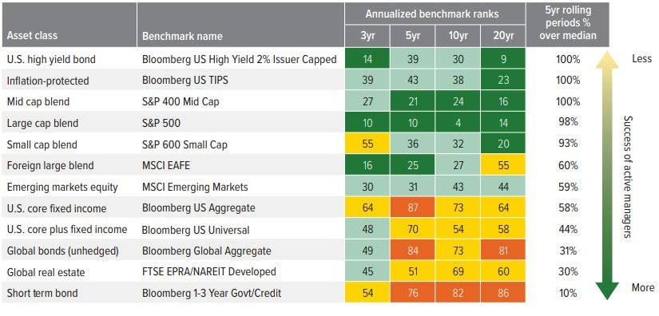
Active and passive funds differ in their approach to security selection and risk management. Active strategies seek to outperform a benchmark through manager decisions, while passive strategies aim to closely track an index with lower turnover and typically lower costs. Reviewing the balance between active and passive exposures can help clarify how much performance is driven by market returns versus manager selection, and whether the cost and risk trade-offs remain aligned with the investor’s objectives.
Active Passive Management

