Slide 1

Investment Proposal
Advisor:
Prepared by:
Date:

Slide 2
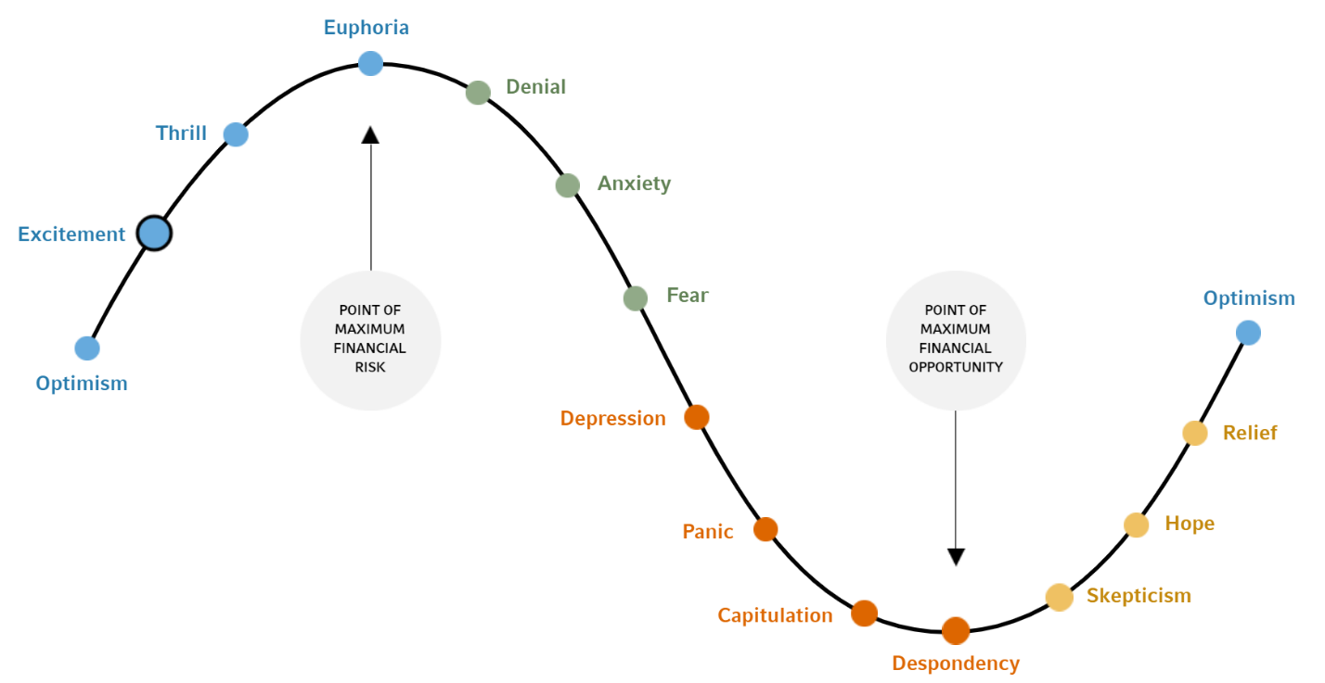
Emotions In Investing

Slide 3
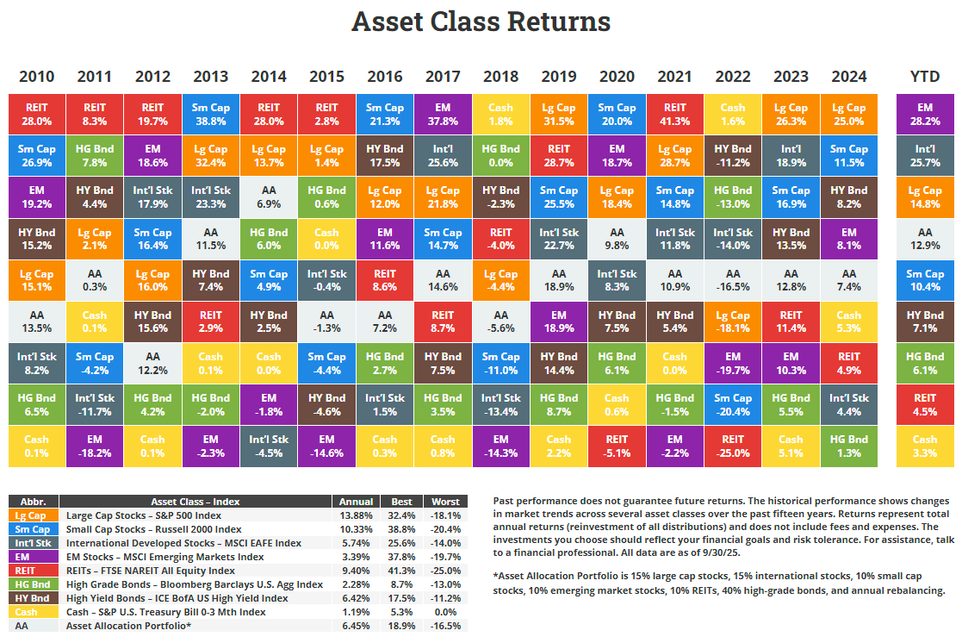
Shifting Market Leadership

Slide 4
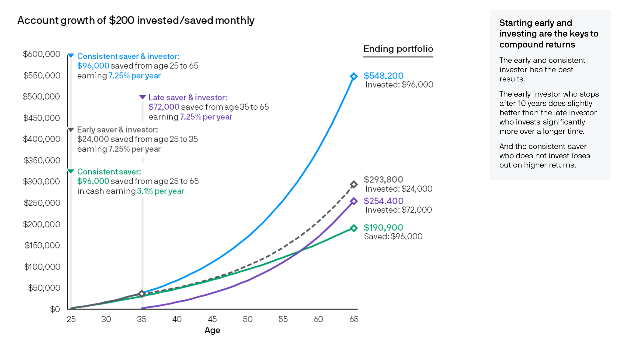
The Importance Of Investing Early

Slide 5
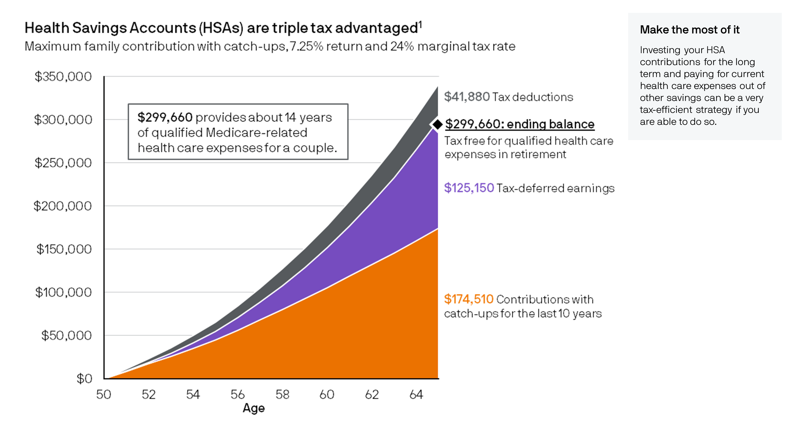
The Benefits of HSA Accounts

