Slide 1
Investment Proposal
Advisor:
Prepared by:
Date:

Slide 2
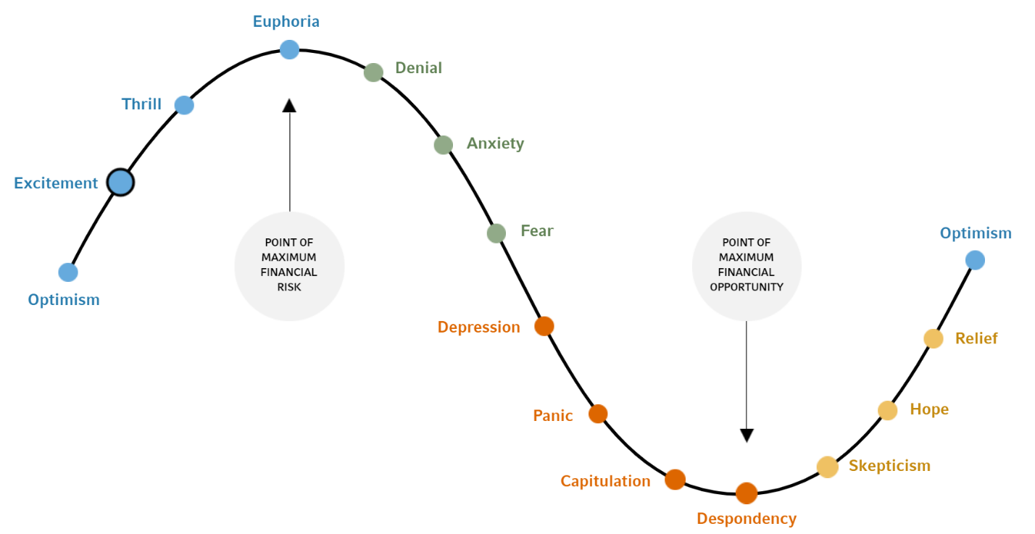
Emotions In Investing

Slide 3
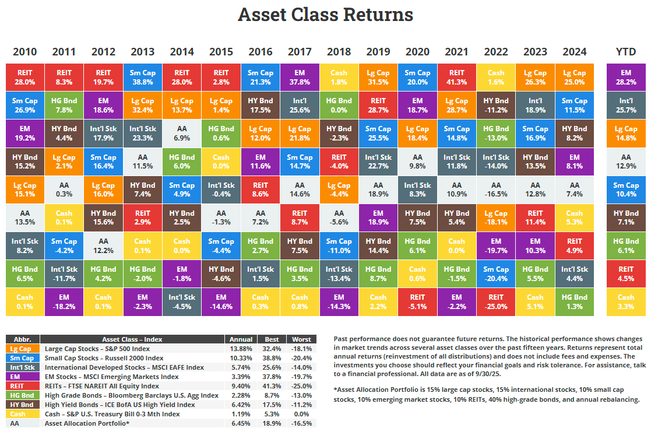
Shifting Market Leadership

Slide 4
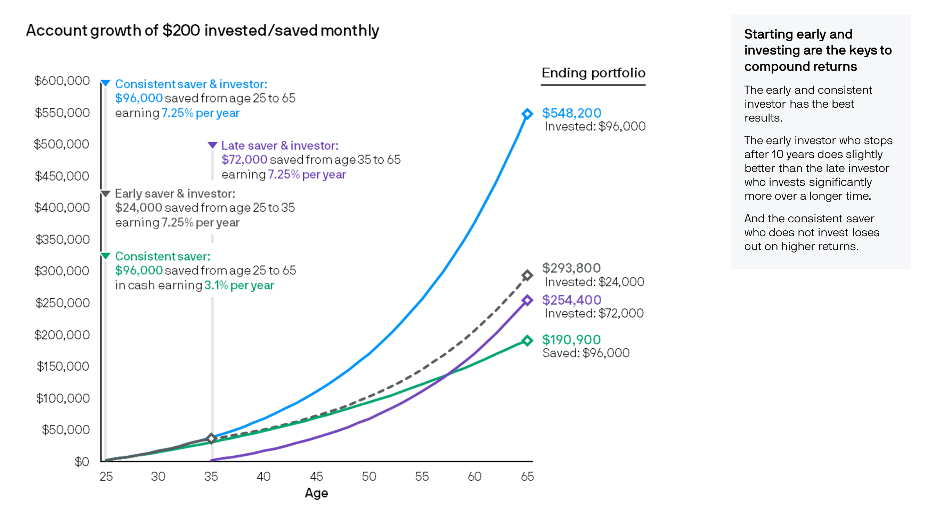
The Importance Of Investing Early

Slide 5
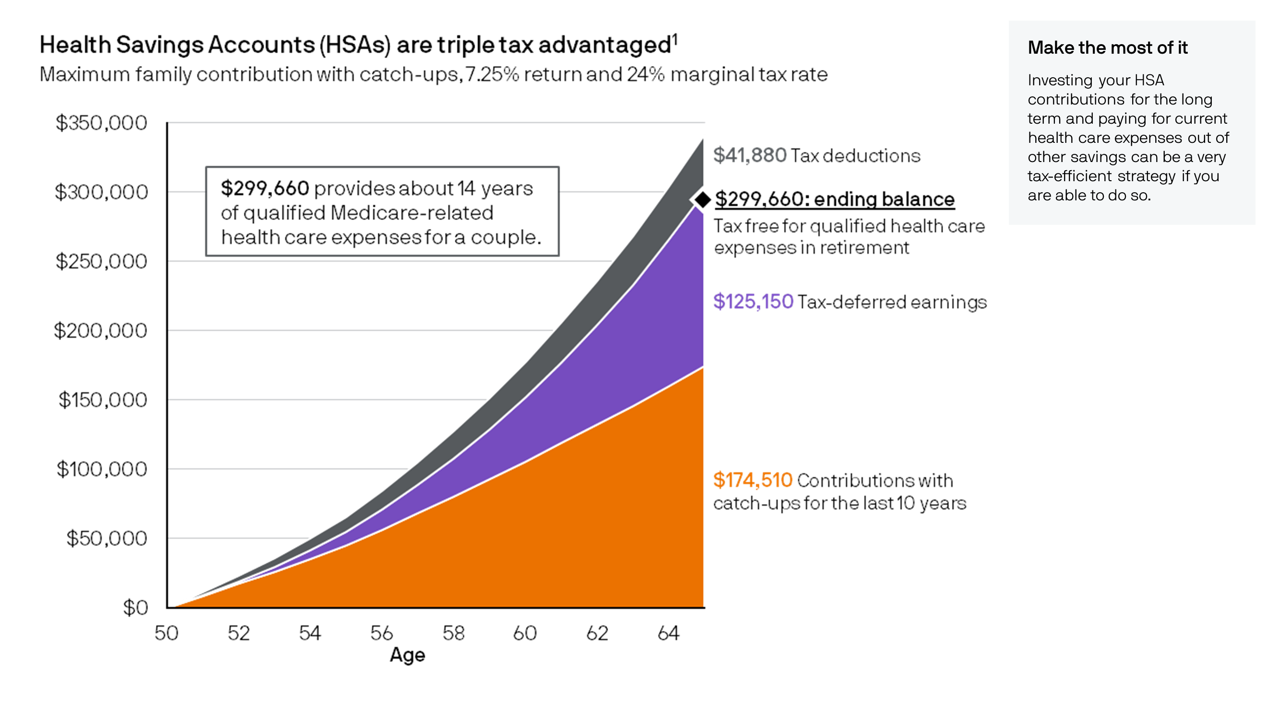
The Benefits of HSA Accounts

Slide 6
Global Asset Allocation

Slide 7
Qualified Accounts:
Global Asset Allocation
Non-Qualified Accounts:

Slide 8
Portfolio Overview

Slide 9
Tracking error measures how closely an investment follows its stated benchmark, and elevated tracking error can indicate meaningful deviations in performance relative to the index. These differences may arise from active management decisions, portfolio construction, or implementation costs. Reviewing tracking error alongside performance can provide additional context on how consistently a strategy behaves versus expectations. This helps clarify whether returns are being driven by intentional active risk or by unintended divergence from the benchmark.
Tracking Error

Slide 10
The expense ratio represents the annual cost a mutual fund or ETF charges to operate and manage the portfolio. This fee is deducted directly from the fund’s performance each year, and therefore reduces the return realized by the investor. Higher expense ratios create a persistent performance drag. Over time, even small differences can materially impact long-term results due to compounding. Importantly, higher fees do not necessarily lead to better performance; many higher-cost funds have difficulty outperforming comparable, lower-cost strategies on a net-of-fee basis
Expense Ratio

Slide 11
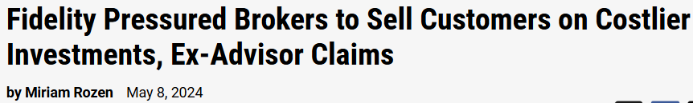
In some cases, advisors or broker-dealers may have business relationships with certain investment providers or offer proprietary products. While this is not inherently inappropriate, it can create situations where there may be an incentive to favor specific fund families or in-house products over other available options. Because of this, it is important for investors to understand how investment recommendations are made and whether compensation structures, revenue sharing, or firm affiliations may influence product selection. Evaluating investments based on cost, performance, fit within the portfolio, and alignment with the client’s goals helps promote more objective decision-making and stronger long-term outcomes.
Potential Conflict Of Interest

Slide 12
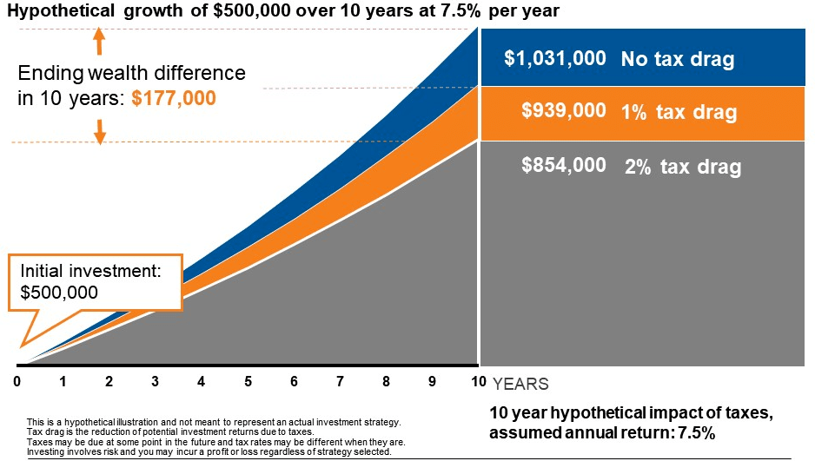
The Tax Cost Ratio measures how much a fund’s annual return is reduced by taxes. It shows the percentage of a fund’s performance that is lost due to taxable distributions—such as interest, dividends, and capital gains—each year. If a fund earns 6% before tax, and the investor keeps 4.8% after tax, the tax cost ratio is 1.2% (20% of the return lost in taxes). A high tax cost ratio means the investment is creating large taxable distributions each year, reducing how much of the return the investor actually keeps.
Tax Cost Ratio

Slide 13
Municipal bonds are generally not well-suited for tax-advantaged (qualified) accounts, such as IRAs or retirement plans. The primary benefit of municipal bonds is their tax-free interest, but that advantage is largely lost inside a qualified account where income is already tax-deferred or tax-free. As a result, investors may accept a lower yield without receiving any additional tax benefit. This can reduce overall income potential and lead to a lower long-term return compared to holding higher-yielding taxable bonds in the same account. For this reason, municipal bonds are typically more effective in non-qualified accounts, while taxable bonds are better positioned inside qualified accounts to maximize after-tax portfolio efficiency.
Muni Bonds in Qualified Accounts

Slide 14
Taxable bonds generate interest taxed as ordinary income when held in a non-qualified account. This annual taxation reduces the amount of income you retain and lowers the investment’s net return. A more tax-efficient approach in a non-qualified account is municipal bonds. Municipal bonds generally provide federally tax-free interest, and in many cases state tax-free interest as well. For investors in higher tax brackets, this can result in a significantly higher after-tax income stream compared to taxable bonds held in the same account.
Taxable Bonds in Non-Qualified Accounts

Slide 15
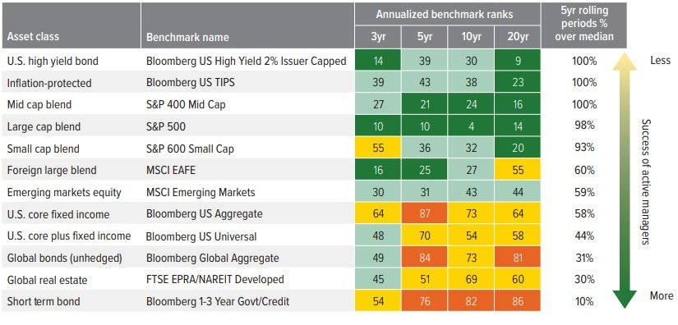
Active and passive funds differ in their approach to security selection and risk management. Active strategies seek to outperform a benchmark through manager decisions, while passive strategies aim to closely track an index with lower turnover and typically lower costs. Reviewing the balance between active and passive exposures can help clarify how much performance is driven by market returns versus manager selection, and whether the cost and risk trade-offs remain aligned with the investor’s objectives.
Active Passive Management

Slide 16
Allocations to individual country and sector-specific funds can lead to more concentrated exposures compared to broader, diversified funds. While this approach may provide targeted access to specific markets or themes, it can also increase sensitivity to country- or sector-specific economic, regulatory, or geopolitical developments. Reviewing these positions in the context of the overall portfolio can help ensure that concentration levels remain intentional and aligned with the investor’s risk tolerance and diversification objectives.
Specific Exposure

Slide 17
Some funds have underperformed their stated benchmarks over the observed period. Comparing fund returns to their relative indexes helps provide context on whether results have aligned with expectations, particularly after accounting for fees, tracking differences, and market conditions. Reviewing these outcomes can support an informed discussion around performance consistency and ongoing portfolio positioning.
Underperforming Funds

Slide 18
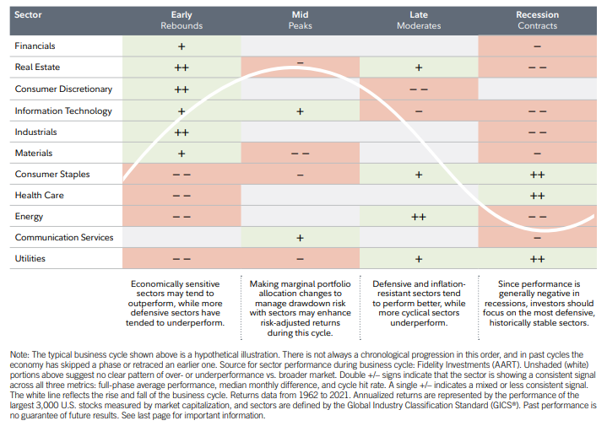
Current Allocation By Sector

Slide 19
Leveraged and inverse funds are designed to deliver amplified or opposite daily returns relative to a stated benchmark. Because these strategies reset daily, their long-term performance may differ materially from the benchmark’s cumulative return, particularly during periods of volatility. Reviewing the role, holding period, and sizing of these positions within the broader portfolio can help confirm that their behavior remains consistent with the investor’s objectives and risk profile.
Inverse/ Leveraged Funds

Slide 20
Target date funds offer a simplified, all-in-one investment approach, automatically adjusting asset allocation over time based on a stated retirement date. While this structure can provide convenience, it may not fully reflect an investor’s unique risk tolerance, tax situation, or holdings outside the fund. Reviewing how a target date fund fits within the broader portfolio can help confirm that its underlying exposures and glide path remain appropriate relative to the investor’s overall financial picture.
Target Date Funds

Slide 21
A high concentration in digital assets, such as Bitcoin, can materially influence overall portfolio behavior, given their historically higher volatility and return variability compared to traditional asset classes. As a result, portfolio performance may become more sensitive to short-term market movements and sentiment shifts specific to the digital asset market. Reviewing the size of this allocation in the context of overall risk tolerance, time horizon, and liquidity needs can help ensure the exposure remains aligned with broader portfolio objectives.
Digital Assets

Slide 22
Retail share classes often carry higher expense ratios or embedded distribution costs compared to institutional alternatives. These additional costs can reduce net returns over time, particularly in long-term holdings. Periodically reviewing available share class options can help determine whether lower-cost or more tax-efficient alternatives are accessible, given the account type, investment size, and platform.
Retail Share Class

Slide 23
The tables below summarize the portfolio’s fixed income exposure across several key dimensions, including yield, duration, issuer concentration, and credit quality. Yield reflects the level of income generated by the fixed income holdings. Duration measures how sensitive bond prices may be to changes in interest rates, with higher duration generally implying greater price movement when rates change. Issuer exposure highlights how concentrated the portfolio is among individual borrowers, while credit quality shows the mix between higher-quality and lower-quality bonds within the allocation. These factors are typically reviewed together to better understand the role fixed income plays within the overall portfolio.
Fixed Income Exposure

Slide 24
Many portfolios include individual stocks, which can offer growth potential but also introduce risks that differ from diversified investments. The performance of a single company can be impacted by factors unrelated to the broader market, such as business challenges, management changes, competitive pressures, or regulatory developments. As a result, portfolios with meaningful individual stock exposure may experience greater volatility and less consistency over time. Larger positions in a small number of stocks can increase concentration risk, while holdings clustered in one sector can reduce diversification benefits. For this reason, individual stock exposure is typically evaluated within the broader context of diversification, asset allocation, and long-term portfolio structure.
Individual Stocks

Slide 25
Disclosures
The information presented is for educational and illustrative purposes only and does not constitute an offer to buy or sell any security, nor should it be interpreted as personalized investment advice. Investment decisions should be made based on an investor’s individual objectives, risk tolerance, time horizon, tax situation, and financial circumstances. All investments involve risk, including possible loss of principal. Past performance is not indicative of future results. Forecasts, projections, and forward-looking statements are based on assumptions and are not guarantees. Actual results may differ materially. Market conditions, interest rates, regulations, and tax laws may change at any time and could impact investment outcomes. Clients should consult with their tax advisor, accountant, and legal counsel before implementing any strategy discussed.

Slide 26
Disclosures
Fixed income securities are subject to various risks, including credit risk, interest rate risk, reinvestment risk, liquidity risk, inflation risk, and market risk. Bond values generally decline as interest rates rise, and bonds sold prior to maturity may result in a gain or loss. Lower-rated bonds, including high-yield or non-investment-grade securities, involve greater volatility, higher credit risk, and increased possibility of default. Yield and income levels may fluctuate based on market conditions and are not guaranteed. Callable bonds may be redeemed by the issuer prior to maturity, which may affect cash flows and reinvestment opportunities. Fixed income diversification does not ensure a profit or protect against losses. Taxable bond yields referenced may not reflect fees, expenses, or the impact of taxes on returns.

Slide 27
Disclosures
Municipal bonds are subject to credit, interest rate, market, and inflation risks. Although municipal bond interest is generally exempt from federal income tax, it may be subject to state and local taxes, the Alternative Minimum Tax (AMT), and changes in tax law. Tax treatment may vary by issuer, state of residence, and individual tax circumstances. Capital gains, if realized, are taxable. Municipal securities carry varying levels of credit quality, and defaults—while historically low—are possible. Tax-equivalent yield comparisons are illustrative and assume specific tax brackets, which may not reflect a client’s actual situation. Investors should consult with a qualified tax professional before relying on any tax-related projections or assumptions.

Slide 28
Disclosures
Asset allocation and diversification are strategies designed to help manage risk; neither guarantees a profit nor eliminates the possibility of loss. Portfolio recommendations are based on current market conditions, which may change without notice. Modeling and hypothetical scenarios represent estimates and are not guarantees of future performance. Rebalancing may result in additional fees or tax consequences. The placement of assets across qualified and non-qualified accounts should be evaluated based on individual financial plans, tax considerations, and retirement objectives. Comparisons between taxable and tax-advantaged accounts are presented to illustrate potential differences and should not be interpreted as universal or definitive for all investors.

Slide 29
Disclosures
Benchmarks are presented for comparison purposes only and may not reflect the composition, risk profile, or investment approach of the referenced portfolio. Indexes are unmanaged, cannot be invested in directly, and do not include fees or expenses. Performance figures, yields, or return estimates are illustrative and should not be viewed as guarantees. Third-party data sources believed to be reliable are used, but accuracy and completeness cannot be assured. Charts, tables, and calculations may be simplified for presentation purposes. The client is responsible for reviewing full prospectuses, offering documents, and financial statements prior to making investment decisions. All opinions expressed are subject to change based on market conditions and new information.

