Slide 1
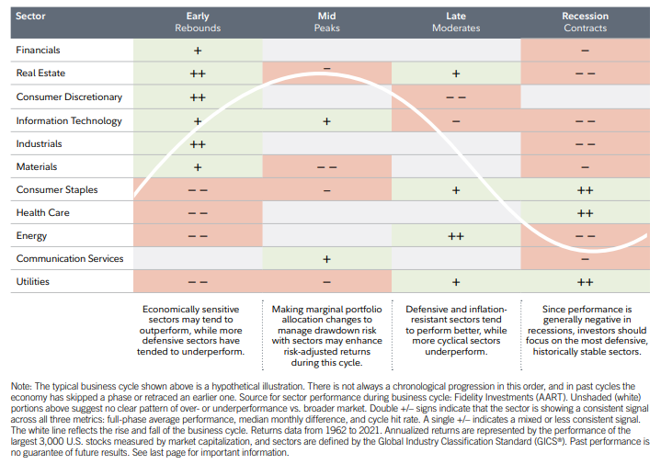

Current Allocation By Sector

