Slide 1
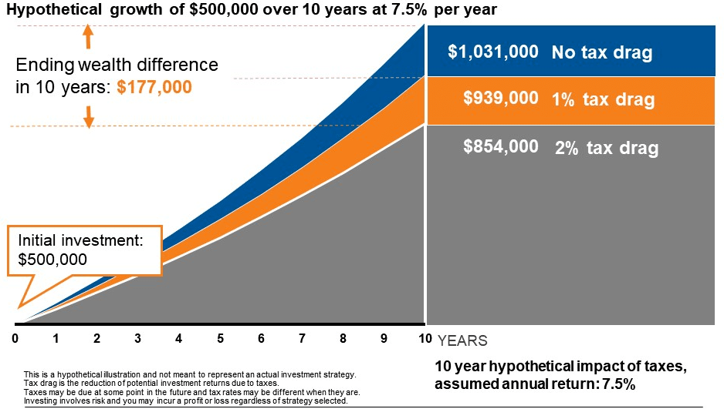

The Tax Cost Ratio measures how much a fund’s annual return is reduced by taxes. It shows the percentage of a fund’s performance that is lost due to taxable distributions—such as interest, dividends, and capital gains—each year. If a fund earns 6% before tax, and the investor keeps 4.8% after tax, the tax cost ratio is 1.2% (20% of the return lost in taxes). A high tax cost ratio means the investment is creating large taxable distributions each year, reducing how much of the return the investor actually keeps.
Tax Cost Ratio

