Slide 1

Amir Malekijoo
prospective Ph.D. student

Slide 2
About me
Artificial Intelligent Engineer
Specialized in Machine Learning / DL/ RL
3 years Research Experience

Slide 3
1
Research Experiences
Four Projects

Slide 4
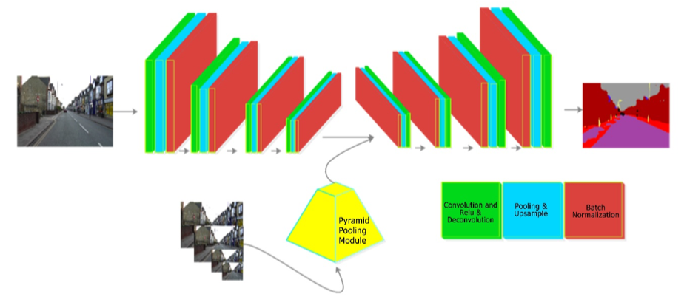
P-DecovNet [1]
Semantic Segmentation for Autonomous Cars
2017
Goal: Improve Semantic Segmentation
Problem: Inference with a Small Dataset,
Bordering Error.

Slide 5
P-DecovNet [1]
Metrics: Accuracy and mIoU
Convolution-Deconvolution (Auto Encoder)
Symmetric 4-Layer AutoEncoder
Pyramid Pooling Module
Add multi-scaled information to feature map to compensate the bordering segmentation error and emphasizing on local fine features

Slide 6
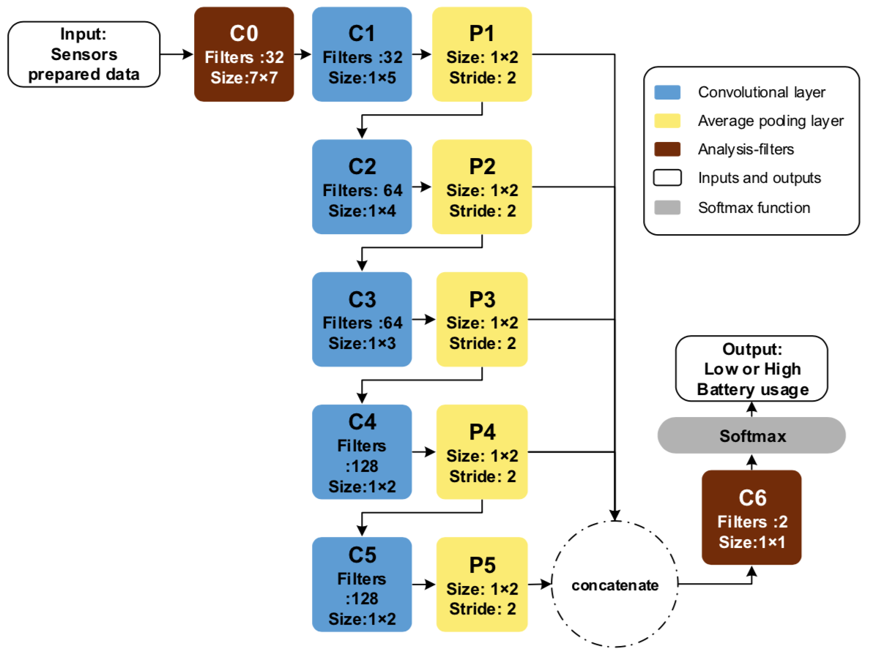
Battery Consumption Behavior [2]
Detecting Battery Consumption Behavior of users to improve the QoS
Goal: Detecting Battery Utilization Patterns
Devices: Smartwatches’ users
Problem: Detecting the Charging and Discharging Pattern, Predicting Battery Drain

Slide 7
Battery Consumption Behavior [2]
Metrics: Accuracy
Clustering with k-mean
identify general smartwatches battery discharge patterns
FCNN
identify the impact of multimodal and sensor-driven data

Slide 8
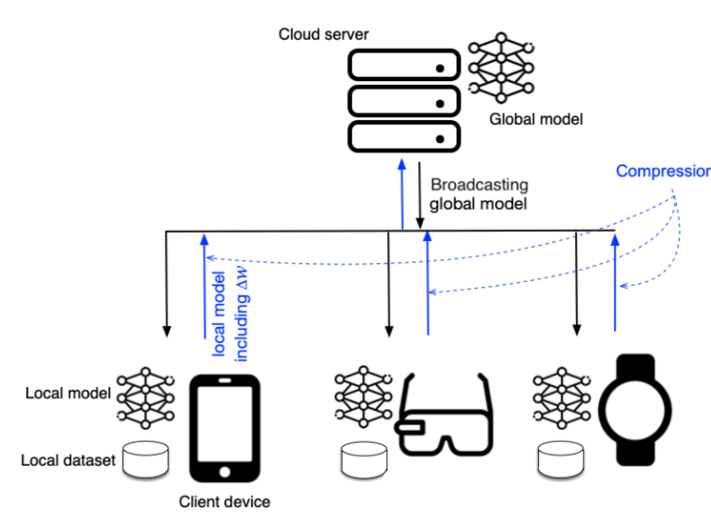
FedZip [3]
Compressed Federated Learning
Goal: Facilitate the communication of DL model
Modality: DL models with diverse Inputs
Problem: Limited Bandwidth, Heavy DL models.

Slide 9
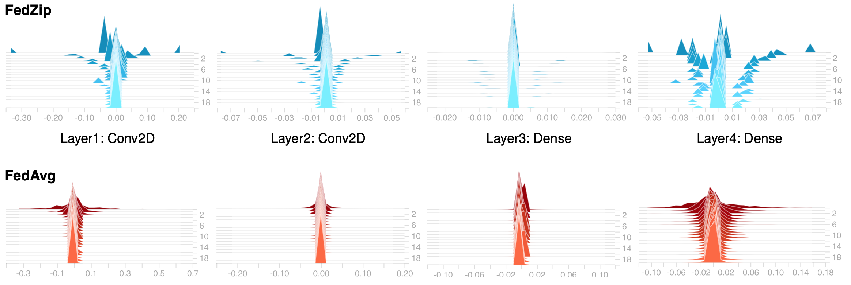
FedZip [3]
Metrics: Accuracy, Compression Rate.
Our Contributions:
Sparsification
Top-k
Quantization
K-mean
Encoding
Huffman and two other approaches

Slide 10
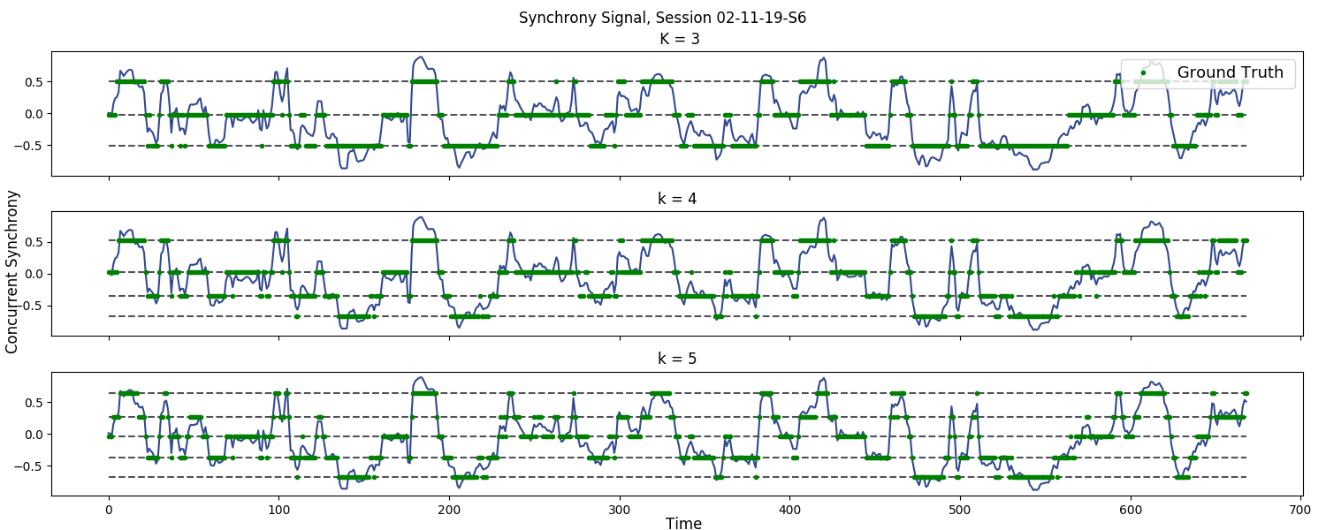
Physiological Synchrony (ongoing)
Detecting Physiological Synchrony in the wild
Goal: Detecting the Physiological Synchrony between Paramedic Trainees during Emergency Medical Service
Modality: EDA signals
Problem: Finding meaningful relationship between two people physiological Responses and interpret them.
Small Dataset
Metrics: Accuracy and subjective evaluation.
Convolution Neural Network
CNN + Voting System.

Slide 11
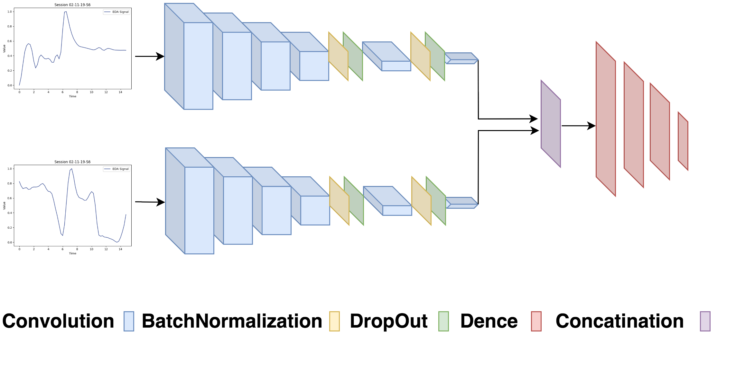
Physiological Synchrony (ongoing)
Metrics: Accuracy and subjective evaluation.
Our Contribution:
Convolution Neural Network
Ensemble Methods with Voting Systems
Qualitative analyses

Slide 12
2
Current Research Branches

Slide 13
VIDEO SEMANTIC SEGMENTATION

Slide 14
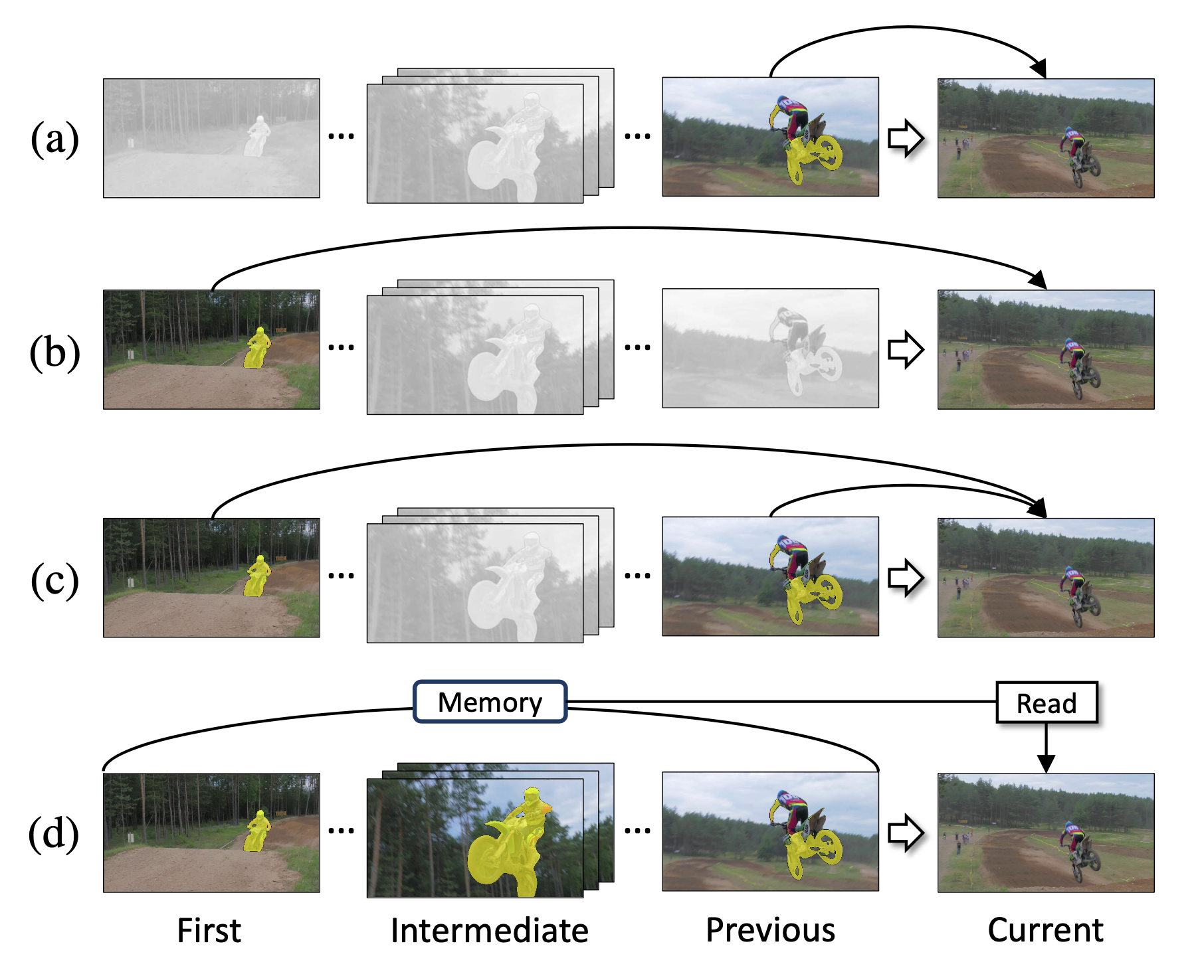
Video Semantic Segmentation
Supervised, Semi Supervised, Unsupervised
Types of Using frames
Current Frames
Previous Frames
Reference Frames
Memory-Frames
The image credit goes to [6]

Slide 15
Research Questions
Is there a possible approach to achieve better results in terms of famous metrics in this area such as ACC, IOU,..?
Is there a possible way to reduce the inference time and computation for LIVE STRIME and preserve the quality of approach?
How much are 5-TOP SOTAs reliable in different situation?

Slide 16
Dynamic Resource Management (DRM)

Slide 17
Dynamic Resource Management (DRM)
Self-Adaptivity (changing goals at run time),
Self-Optimization (changing dynamics of a modeled system)
Self-Awareness (through Reflections)

Slide 18
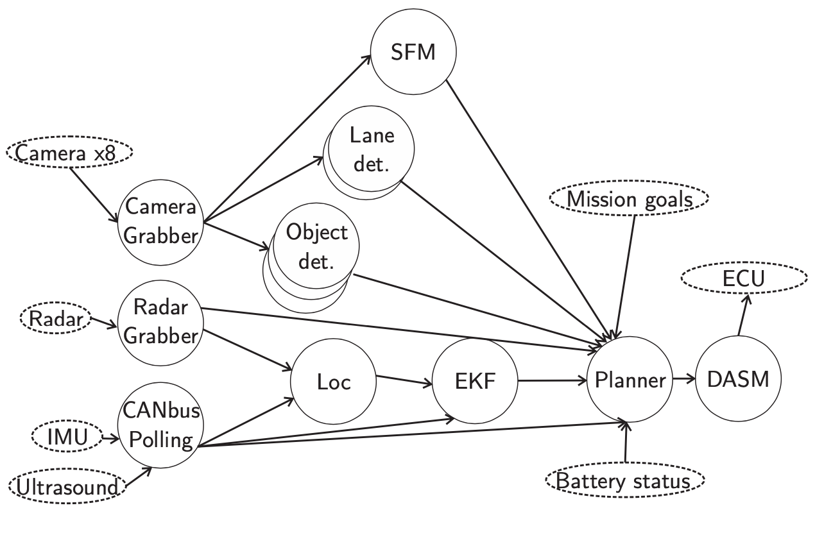
Chauffeur [9]
A Dataset which provides an interactive environment

Slide 19
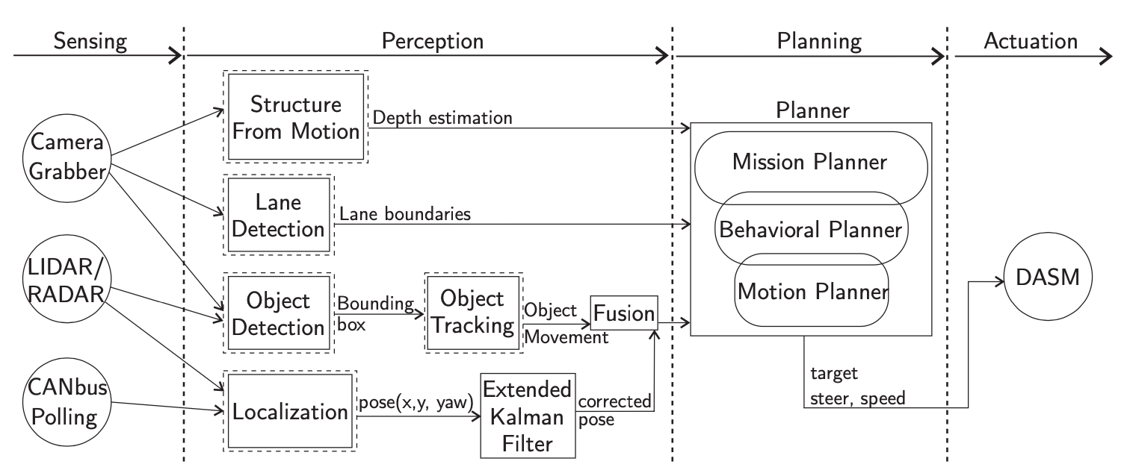
Chauffeur [9]
A Dataset which provides an interactive environment

Slide 20
Possible Research Questions
Is there a way that Proximal Policy Optimization (PPO) achieve better results (accuracy, convergence time, corresponding time)?
How much are Cyber-Physical scheduling systems are safe? Especially the SOTAs. (aviation industries)
Is that true that Reinforcement Learning gives us better outcome with higher throughput? Why? And How Come?

Slide 21
Topics
AI/ML applications
The relationship with Self-awareness and quality assurance
Open for new topics

Slide 22
References
[1] A. Malekijoo, M. Fadaeieslam, “Convolution-Deconvolution Architecture with Pyramid Pooling Module for semantic segmentation,” Multimedia Tools and Application, Multimed Tools Appl 78, 3237932392, 2019.
Link: https://rdcu.be/bMTCy
[2] M. Homayounfar, A. Malekijoo, A. Visuri, C. Dobbins, E. Peltonen, E. Pinksy, K. Teymourian, and R. Rawassizadeh. “Understanding Smartwatch Battery Utilization in the Wild”, In Sensors 2020. Link: https://doi.org/10.3390/s20133784
[3] A. Malekijoo, M.Fadaeieslam, H. Malekijou, M. Homayounfar, L.T. Chitkushev, and R. Rawassizadeh. “FedZip: A Compression Framework for Communication Efficient Federated Learning.” In SenSys 2020: ACM Conference on Embedded Networked Sensor Systems, Nov 2020, Yokohama, Japan. (Submitted, june 2020)
[4] Luiten, J.; Voigtlaender, P.; and Leibe, B. 2018. Premvos: Proposal-generation, refinement and merging for video object segmentation. In Asian Conference on Computer Vision, 565–580. Springer.
[5] Voigtlaender, P.; Chai, Y.; Schroff, F.; Adam, H.; Leibe, B.; and Chen, L.-C. 2019. Feelvos: Fast end-to-end embedding learning for video object segmentation. In Proceedings of the IEEE/CVF Conference on Computer Vision and Pattern Recognition, 9481–9490.
[6] Oh, S. W.; Lee, J.-Y.; Xu, N.; and Kim, S. J. 2019. Video object segmentation using space-time memory networks. In Proceedings of the IEEE/CVF International Conference on Computer Vision, 9226–9235.
[7] S. Cho, H. Lee, M. Kim, S. Jang and S. Lee, "Pixel-Level Bijective Matching for Video Object Segmentation," 2022 IEEE/CVF Winter Conference on Applications of Computer Vision (WACV), 2022, pp. 1453-1462, doi: 10.1109/WACV51458.2022.00152.
[8] Xiaohao Xu, Jinglu Wang, Xiao Li, Yan Lu, "Reliable Propagation-Correction Modulation for Video Object Segmentation,” arXiv:2112.02853v1 , 2021.
[9] Biswadip Maity, Saehanseul Yi, Dongjoo Seo, Leming Cheng, Sung-Soo Lim, Jong-Chan Kim, Bryan Donyanavard, and Nikil Dutt. 2021. Chauffeur: Benchmark Suite for Design and End-to-End Analysis of Self-Driving Vehicles on Embedded Systems. ACM Trans. Embed. Comput. Syst. 20, 5s, Article 74 (September 2021), 22 pages, DOI: https://doi.org/10.1145/3477005.
[10] W. Ali and H. Yun. 2019. RT-Gang: Real-Time Gang Scheduling Framework for Safety-Critical Systems. In Proc. IEEE RTAS. 143–155.
[11] Sina Shahhosseini and Tianyi Hu and Dongjoo Seo and Anil Kanduri and Bryan Donyanavard and Amir M. Rahmani and Nikil Dutt, "Hybrid Learning for Orchestrating Deep Learning Inference in Multi-user Edge-cloud Networks,” arXiv:2202.11098v1 [cs.LG] 21 Feb 2022

